Slide 1
Using eForms APIs & the TED Developer Portal
2nd eForms Technical Workshop – 29 September 2022
Karl Ferrand – TED unit - Publications Office of the EU

Slide 2
Agenda
Points for eSenders to consider
Preview environment
Using eForms APIs in Preview
TED Developer Portal

Slide 3
Points for eSenders to consider
Applications
eNotices2 replaces eSentool and eNotices by 25 October 2023
Schemas
24 October 2023 last day of existing XSLT, XSD and XML files
TEDXDC
TED XML to eForms Converter available as an XSLT project to be used locally
New eForms schema based on UBL
TED CVS for validation
TED Viewer 2022 for visualisation
TED Developer Portal for API Key
API to come
Notes:
Some points for eSenders to consider - as a reminder:
Applications (for eSenders):
eNotices2 replaces the current eNotices and eSentool applications for eForms notices. The two current applications will be phased out by 25 October 2023 (last day when OP will accept notices in the current TED schema format is 24 October 2023). The existing XSLT, XSD and XML files can continue to be used until that date and are still available on the EU Vocabularies website: https://op.europa.eu/en/web/eu-vocabularies/e-procurement/tedschemas.
The Central Validation Service (a.k.a. TED CVS) provides an API for validating eForms notices.
TED Viewer 2022 allows applications to render an eForms notice in the HTML or PDF format.
TED Developer Portal allows eSenders to sign-up and obtain/manage their API key which is required for calling TED APIs.
Schemas:
The new eForms schemas are based on Universal Business Language (UBL), an international standard library for the interchange of business documents.
Three of the schemas defined in UBL have been extended for use in eForms. These schemas allow for including much more information, and that information is more tightly controlled. At the same time, the great variation that exists between the many current TED schemas has been eliminated in the eForms schemas.
TED XML to eForms Converter (TEDXDC):
Due to the enormous differences between the old TED schemas and the new eForms schemas, there is no direct correspondence between the files. However, we are developing a converter to assist with conversion of XML notices from TED to eForms: https://github.com/OP-TED/ted-xml-data-converter.
At the present time, this is only available as an XSLT project to be used locally, but we will provide an API to which eSenders may submit TED notices and receive back partial eForms notices.

Slide 4
Points for eSenders to consider
No eSender qualification procedure
API Key for calling TED APIs
Takeaways from the May 2022 eForms Technical Workshop
Production (live) & Preview (test)
TED Developer Portal for API Key
No notification emails to eSenders
One EU Login/ eNotices2 account
Notes:
Some takeaways from the May 2022 eForms Technical Workshop:
There will be no eSender qualification procedure in eNotices2.
Qualification and Simulation endpoints will cease to exist with the end of eSentool. There will be two separate environments, Production (live) and Preview (test).
The Preview environment will be available to eSenders indefinitely. When there is a new version of the SDK, it will first become available in Preview environment during a pre-announced transition period for testing before it goes in Production.
Notification emails to eSenders are not foreseen during the initial stages.
eSenders are required to have an API Key for calling TED APIs (eNotices2, TED CVS, TED Viewer 2022).
API Keys are obtained and managed through the TED Developer Portal. Only one API key can be used per EU Login.
eSenders need to create an eNotices2 account in order to pair it to their API Key.
The same EU Login account will be used to log into eNotices2 and TED Developer Portal.

Slide 5
Points for eSenders to consider
Validation
Schematron validation files
CVS vs manual lawfulness check
CVS
SVRL validation report
eNotices2 & CVS
CVS as an API
Notes:
Regarding validation of eForms notices:
The XSL files used for the current validation of notice content in TED will be replaced by much more extensive Schematron validation files: https://github.com/OP-TED/eForms-SDK/tree/develop/schematrons.
These can be incorporated into your local systems, but we will also provide an API ("Central Validation Service", or CVS), which can be used to validate any eForms notice XML.
eForms notices submitted via API by eSenders must be complete.
The validity of a submitted notice is checked by the Central Validation Service (TED CVS), which sends back a validation report in SVRL.
TED CVS is called by eNotices2 upon submitting a notice via API.
It can also be called separately by eSenders’ applications at any time for the SVRL validation report without having to submit a notice. There will be some throttling to prevent abuse of the system and the exact limitations will be communicated at a later stage.
A notice that fails the CVS check, will not obtain status “submitted” and eSenders will need to correct the errors and resend until the notice passes the automatic CVS check.
A “submitted” notice may have a lawfulness warning, which means that OP must check it manually before it can be published.
A notice that fails the manual lawfulness check (the only manual check OP will conduct), will obtain status “not published”, which will be communicated via email to the Contracting Authority only. eSenders will be able to query the status via the API.
! TED CVS does not consider the implementation of the eForms regulation in national legislation.

Slide 6
Points for eSenders to consider
Visualisation
TED Viewer 2022 API
TED Viewer 2022 & eNotices2
Provisional samples in PDF
HTML file
view-templates
eForms Notice Viewer
Notes:
Regarding visualisation of eForms notices:
TED Viewer 2022 provides an API that allows applications to render an eForms notice in HTML or PDF format before sending it for publication.
TED Viewer 2022 is called by eNotices2 to render created notices in PDF and HTML in the User Interface of eNotices2.
As part of the ongoing development of eForms, the provisional samples of the 40 mandatory notices in PDF format was published in July 2021 at: https://simap.ted.europa.eu/documents/10184/320101/eForms+notice+PDF+samples+2021-07-22/c6785da3-8907-4071-9980-bb670b8ae9b8
An updated HTML file was published in May 2022 (https://simap.ted.europa.eu/documents/10184/320101/eforms_2022-05-10-html/6be809e4-ac8a-4bc1-96d9-11b5fc366e6a). It provides sample data to make it easier to see the TED Viewer structure, understand how the elements fit together and allows to switch between different notice types. The biggest structural change compared to samples from July 2021 is the decision to group almost all the organisation information in one section. The current version is not yet final, but it is quite close to what the eForms TED Viewer will produce.
OP does not intend to provide XSL stylesheets. The view-templates available in the SDK contain the technical definition of how an HTML/ PDF will be generated by TED Viewer 2022 (https://github.com/OP-TED/eForms-SDK/tree/develop/view-templates).
The eForms Notice Viewer available on GitHub is a sample application that can be used as inspiration/ starting point for your own apps; it is not a production-ready application (https://github.com/OP-TED/eforms-notice-viewer).

Slide 7
eSenders’ applications
https://docs.ted.europa.eu/eforms/1.1.1/index.html
https://docs.ted.europa.eu/eforms/1.1.1/metadata-driven-applications.html
Resources
https://github.com/OP-TED
https://github.com/OP-TED/eForms-SDK
Sample applications
Notes:
Building eSenders’ applications:
The responsibility of building eSenders’ applications and business processes and managing individual systems lies with the eSenders. However, in an effort to help eSenders and their developers, the Publications Office is sharing a collection of resources that provide the foundation for building your own eForms applications and the necessary concepts to consider:
https://docs.ted.europa.eu/eforms/1.1.1/index.html
https://docs.ted.europa.eu/eforms/1.1.1/metadata-driven-applications.html
Any sample application that we may make available in the future as an inspiration or starting point for your own apps, will be published on GitHub: https://github.com/OP-TED. The eForms SDK https://github.com/OP-TED/eForms-SDK is designed to help eSenders develop eForms applications. In particular, the files in the "notice-types", "fields", "view-templates" and "translations" provide computer-readable information to assist with the development of form interfaces.

Slide 8

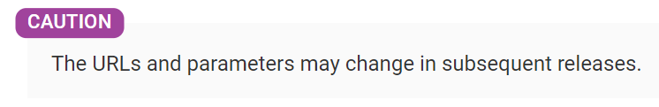



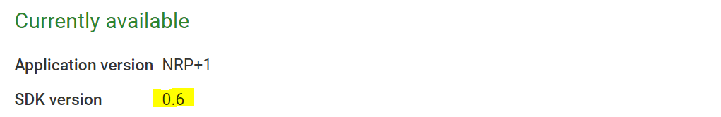
Preview environment
"TED Apps for eForms“ go into production on 14 November 2022
Early versions of the TED Apps for eForms in Preview environment.
Before testing, consult the eForms Preview environment for URLs and important information.
Notes:
What is the Preview environment:
The applications OP is currently developing are known as "TED Apps for eForms“ and are scheduled to go into production on 14 November 2022.
Early versions of the TED Apps for eForms are gradually being made available in Preview (test) and updates are documented on the eForms Preview environment page (https://docs.ted.europa.eu/home/eforms/preview/).
Before testing, please read carefully the eForms Preview environment page, where you will find all the URLs and application features per phase as well as important information.
On the right, screenshots of the Preview page as an example of what eSenders should be looking out for or be aware of before testing. For instance, notices submitted via API, should respect the version of the SDK accepted at any given point by eNotices2 Preview. The URLs and parameters will change in the future.

Slide 9
Using eForms APIs in Preview:
eNotices2
TED CVS
TED Viewer 2022

Slide 10
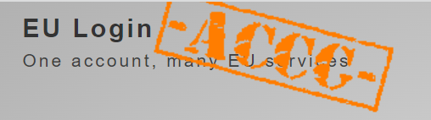


Steps for testing eNotices2 Preview APIs
https://enotices2.preview.ted.europa.eu
1
3
Have an EU-Login account in Acceptance
Get your API key in TED Developer Portal
Test
2
Have an eNotices2 account in Preview
https://ecas.acceptance.ec.europa.eu/cas
https://developer.preview.ted.europa.eu/home
Notes:
We would encourage that you start testing our Preview systems.
There are three steps before you can start testing eNotices2 Preview APIs:
Have an EU-login account in Acceptance
Have an eNotices2 account in Preview so that you can pair it to your API Key
Get your API Key from the TED Developer Portal also in Preview.

Slide 11
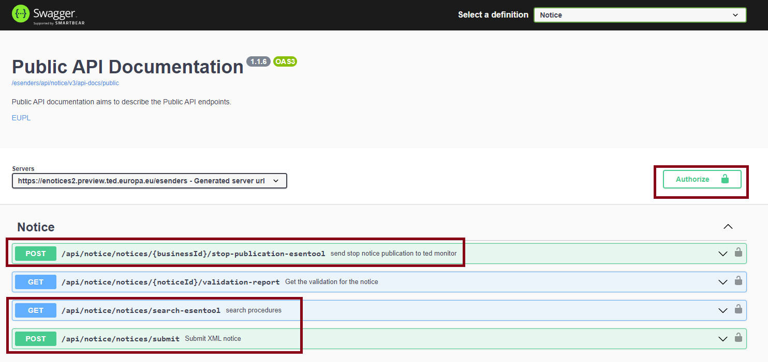
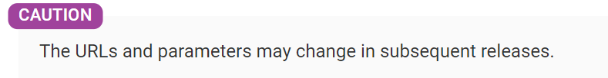
eNotices2 – APIs in Preview
https://enotices2.preview.ted.europa.eu/esenders/swagger-ui/
Authorise via Preview API key
Submit XML notice
Stop publication
Search
API documentation to come
Notes:
eNotices2- APIs in Preview:
Once you authorise yourself with your Preview API key, you can try the three available requests, submit XML notice, stop publication and search.
API documentation is not yet available in Swagger.
GET validation report request is not yet available in Preview.
Caution: The URLs and parameters will change in the future.

Slide 12
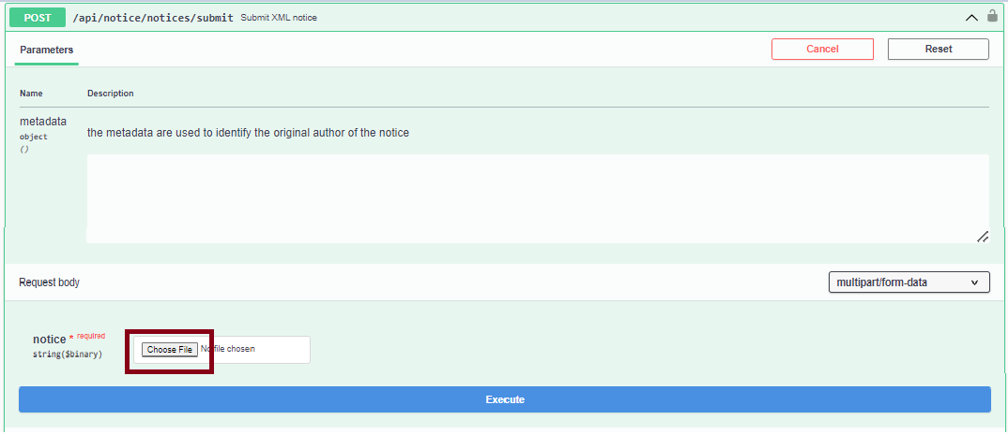
eNotices2 – APIs in Preview: Submit XML notice
https://enotices2.preview.ted.europa.eu/esenders/webjars/swagger-ui/index.html#/Notice/submitNotice
Notice examples are available on GitHub. For Preview, XML element <cbc:CustomizationID> should be consistent with the SDK version in eNotices2 Preview -
always consult eForms Preview environment page for the latest updates.
Notes:
Example of using Swagger to submit a notice.
Notice examples are available on GitHub (https://github.com/OP-TED/eForms-SDK/tree/develop/examples/notices).
For Preview, XML element <cbc:CustomizationID> should be consistent with the SDK version in eNotices2 Preview - always consult the eForms Preview environment page for the latest updates. The revision number is not used, as it is usually for non-breaking bug fixes; only major and minor version numbers are accepted, e.g. "0.6".
The current restriction is 4 MB for the request and for the size of the notice itself the limit is around 3 MB. These limitations may change in the future to prevent that possible abuse of the system would degrade the experience for users.
It is possible for OP to revoke API keys of eSenders abusing the systems or blocking their TED Developer Portal account altogether.

Slide 13
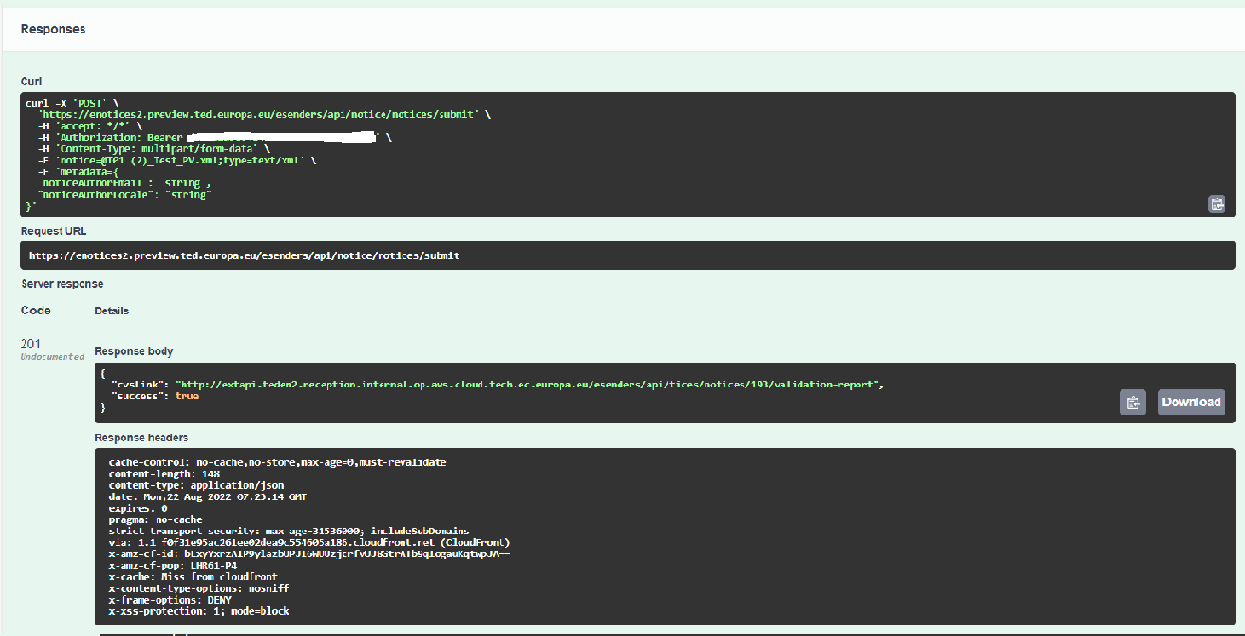
eNotices2 – APIs in Preview: Submit XML notice
https://enotices2.preview.ted.europa.eu/esenders/webjars/swagger-ui/index.html#/Notice/submitNotice
Notes:
Example of response for submit notice POST request

Slide 14
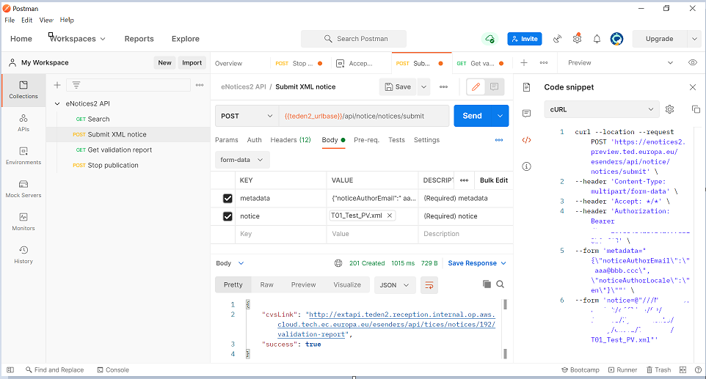
eNotices2 – APIs in Preview: Submit XML notice
Test via your preferred API solution
Notes:
You can test via your preferred API solution (example of Postman).

Slide 15
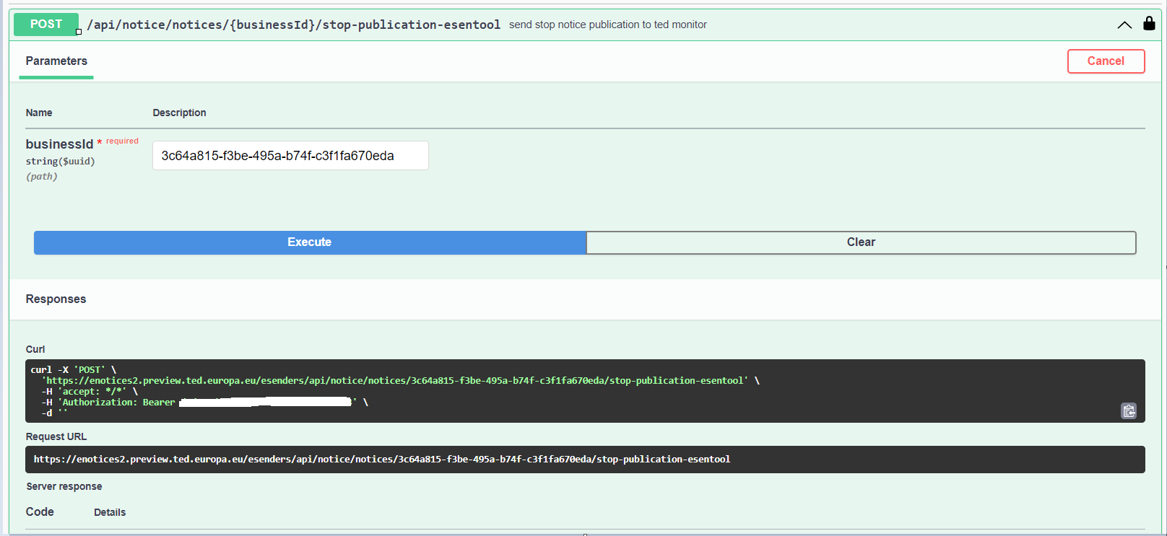
eNotices2 – APIs in Preview: Stop publication
https://enotices2.preview.ted.europa.eu/esenders/webjars/swagger-ui/index.html#/Notice/stopPublicationEsentool
Currently, the service works with NoticeID and not BusinessID (NoticeID + VersionID).
This will be fixed in the future.
Notes:
Example of Stop Publication POST request and response.
Currently, the service works with NoticeID and not BusinessID (NoticeID + VersionID). This will be fixed in the future.

Slide 16
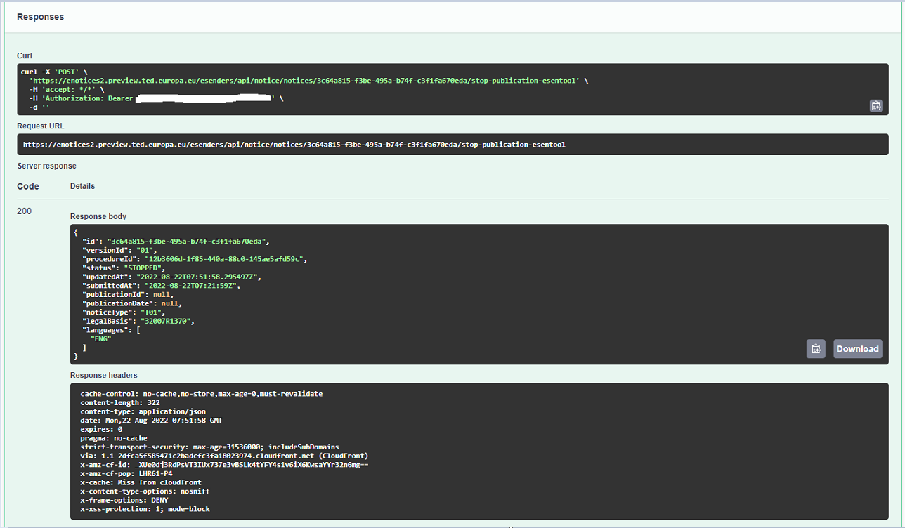
eNotices2 – APIs in Preview: Stop publication
https://enotices2.preview.ted.europa.eu/esenders/webjars/swagger-ui/index.html#/Notice/stopPublicationEsentool
Notes:
Example of Stop Publication POST request and response.

Slide 17
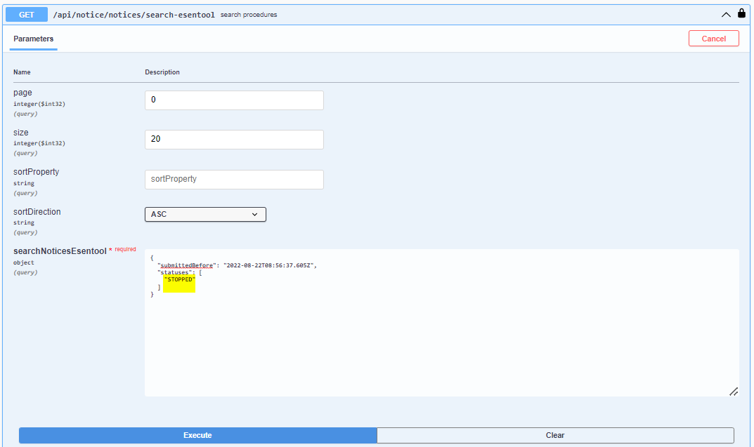
eNotices2 – APIs in Preview: Search notices
https://enotices2.preview.ted.europa.eu/esenders/webjars/swagger-ui/index.html#/Notice/searchProceduresEsentool
Notes:
Example of Search notices GET request for notices with status “STOPPED”.

Slide 18
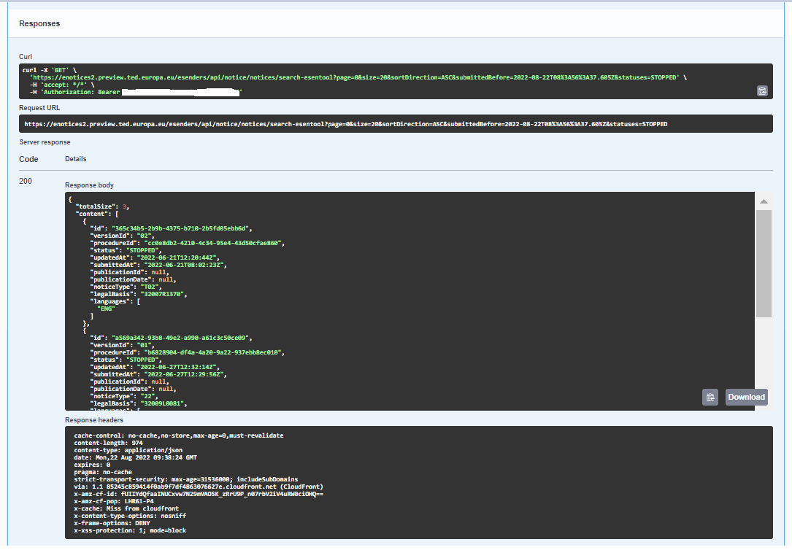
eNotices2 – APIs in Preview: Search notices
https://enotices2.preview.ted.europa.eu/esenders/webjars/swagger-ui/index.html#/Notice/searchProceduresEsentool
Notes:
Example of Search notices GET request response for notices with status “STOPPED”

Slide 19
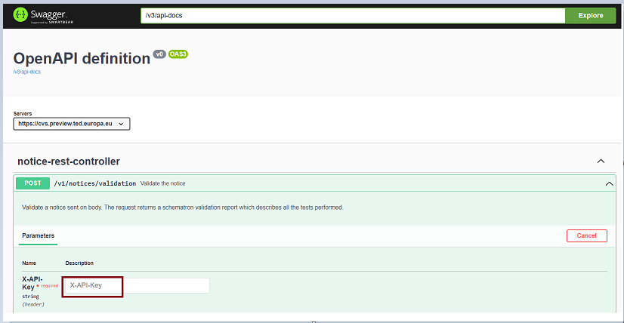
CVS – API in Preview
https://cvs.preview.ted.europa.eu/swagger-ui/
Authorise via Preview API key
API documentation on Swagger
Examples of “reports”
More translations of rules to come
Schematron files
Notes:
CVS – API in Preview:
Once you authorise yourself with your Preview API key, you can try the Validate notice request, which will fetch the report in SVRL (Schematron Validation Report Language) on the fly.
API documentation is available in Swagger.
For the latest updates and SDK versions on CVS Preview, please always consult the eForms Preview environment page.
Examples of “reports” are available on GitHub (https://github.com/OP-TED/eForms-SDK/tree/develop/examples/reports).
The translations of the rules are still work in progress and gradually made available on GitHub (https://github.com/OP-TED/eForms-SDK/tree/develop/translations).
If you want to validate on your side, you can use the Schematron files to create your own validator (https://github.com/OP-TED/eForms-SDK/tree/develop/schematrons).

Slide 20
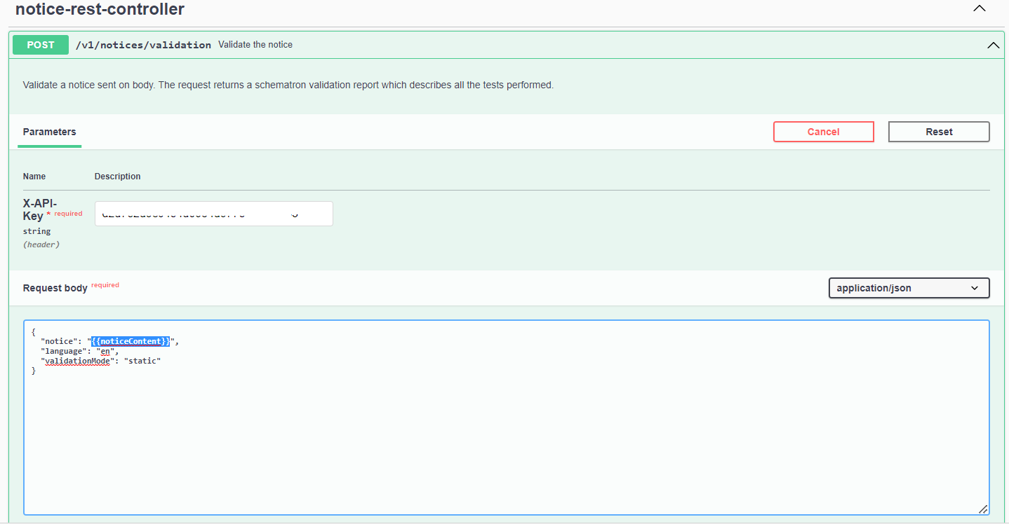
CVS – API in Preview
https://cvs.preview.ted.europa.eu/swagger-ui/
{{noticeContent}} should be Base64 encoded.
Notes:
Example of CVS API call.
{{noticeContent}} should be Base64 encoded.

Slide 21
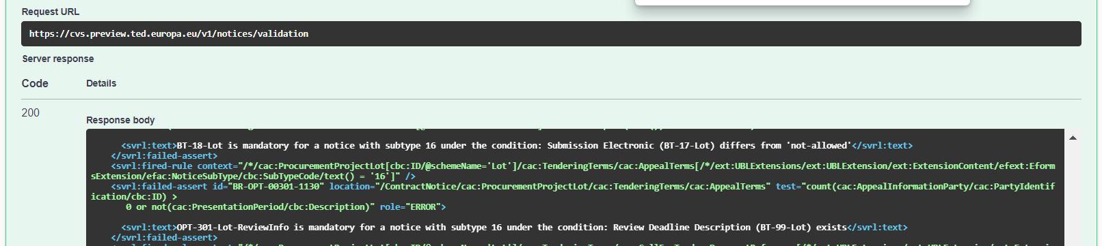
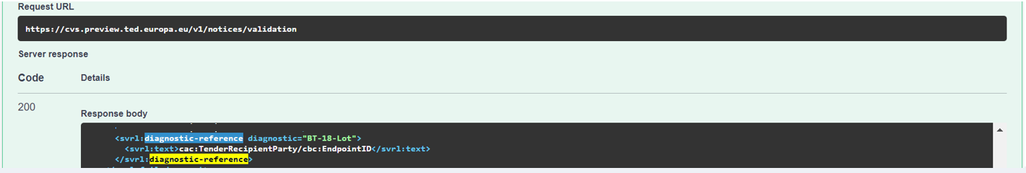
CVS – API in Preview
https://cvs.preview.ted.europa.eu/swagger-ui/
The SVRL will point to the location (XPath) of the error.
The text of the fired rule is returned in the language you passed as a parameter to your request
If a field is missing or forbidden, the location points to the container in which this field should be
and the diagnostic reference points to the precise XPath where this field is supposed to be
Notes:
Snippets of fetched validation report:
The SVRL will point to the location (XPath) of the error. The text of the fired rule is returned in the language you passed as a parameter to your request.
If a field is missing or forbidden, the location points to the container in which this field should be, and the diagnostic reference points to the precise XPath where this field is supposed to be.

Slide 22
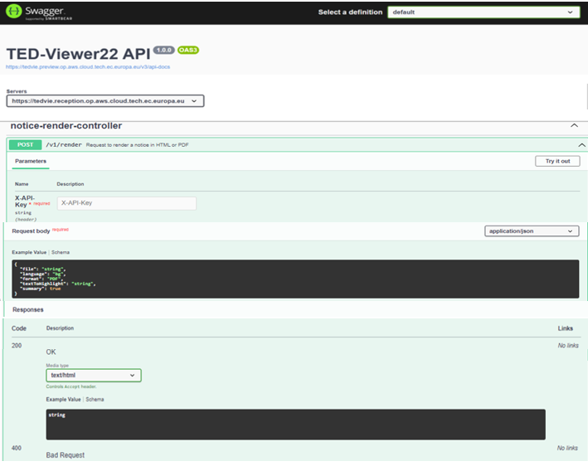
TED Viewer 2022 – API in Preview
Authorise via Preview API key
Render a notice in HTML or PDF
URL & documentation to come
Notes:
TED Viewer 22 – API in Preview:
The API in Preview for TED Viewer 2022 will be delivered by mid October 2022.
Once you authorise yourself with your Preview API key, you can try the Request to render a notice in HTML or PDF.
API documentation will be available in Swagger.
For the latest updates on TED Viewer, please always consult the eForms Preview environment page.
A notice created in the UI of eNotices2 or imported as XML can also be previewed in eNotices2 interface as HTML or PDF.

Slide 23
TED Developer Portal
Current Status in Preview
Further developments

Slide 24
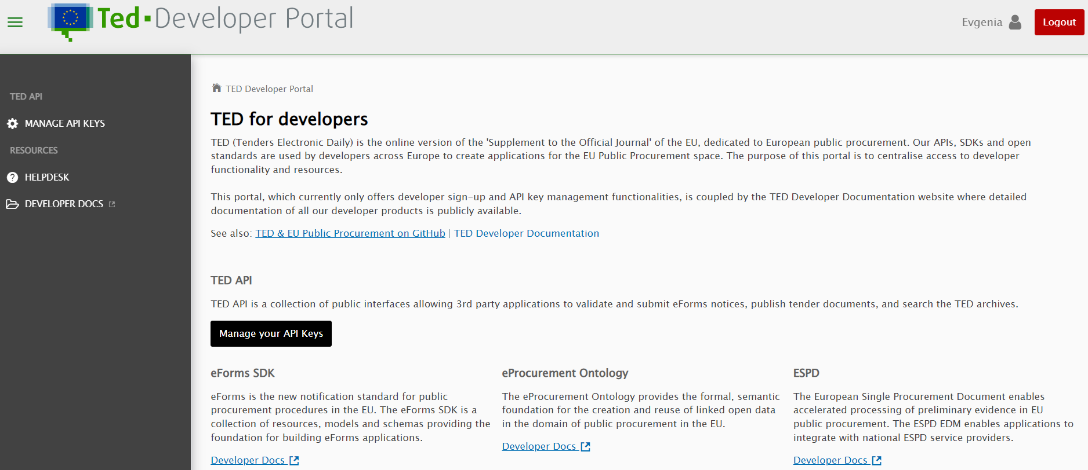
TED Developer Portal: Current status in Preview
https://developer.preview.ted.europa.eu/home
The portal currently allows eSenders to sign-up and obtain/manage their API key which is required for calling TED APIs.
For Preview, sign up with your Acceptance EU Login account
Notes:
TED Developer Portal: Current status in Preview
The portal currently allows eSenders to sign-up and obtain/manage their API key which is required for calling TED APIs.
For Preview, sign up with your Acceptance EU Login account

Slide 25
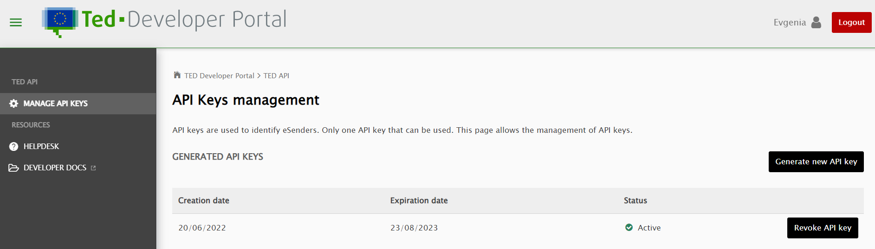
TED Developer Portal: Current status in Preview
https://developer.preview.ted.europa.eu/home
Only one API Key is allowed per EU Login account. Generating a new API Key will revoke an existing one.
For Preview, sign up with your Acceptance EU Login account
Notes:
Only one API Key is allowed per EU Login account. Generating a new API Key will revoke an existing one.

Slide 26
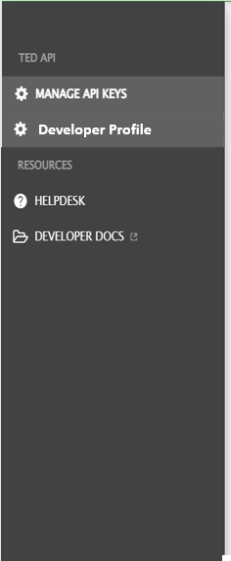
TED Developer Portal: Further developments
A dedicated section of docs.ted.europa.eu will document all APIs
TED Developer portal as a hub for TED developer services
Developer Profile for eSenders:
  eSender profile
  Receive OP notifications
  Make profile public
Notes:
TED Developer Portal: Further developments:
The portal is coupled by the TED Developer Documentation website where detailed documentation of all our developer products is publicly available. A dedicated section of docs.ted.europa.eu will document in the future all APIs.
The TED Developer Portal is envisioned to be a central hub for TED developer services. Our intention is to gradually add features for other developer groups that are interested in other TED developer products (e.g. eProcurement Ontology, ESPD), or data services (e.g. TED Semantic Web Service).
As a next step, we will aim to add by November 2022 a new feature in the TED Developer Portal, called Developer Profile (to be deployed in Preview and Production environment). The Developer Profile can be used by eSenders to set up/ manage their eSender profile as part of the sign-up process in the TED Developer Portal and before they are able to generate an API Key.
The new Developer Profile will also enable eSenders to receive important notifications from OP and make their profile publicly available to others as eSenders using eForms (should they wish for their profile to be public).

Slide 27
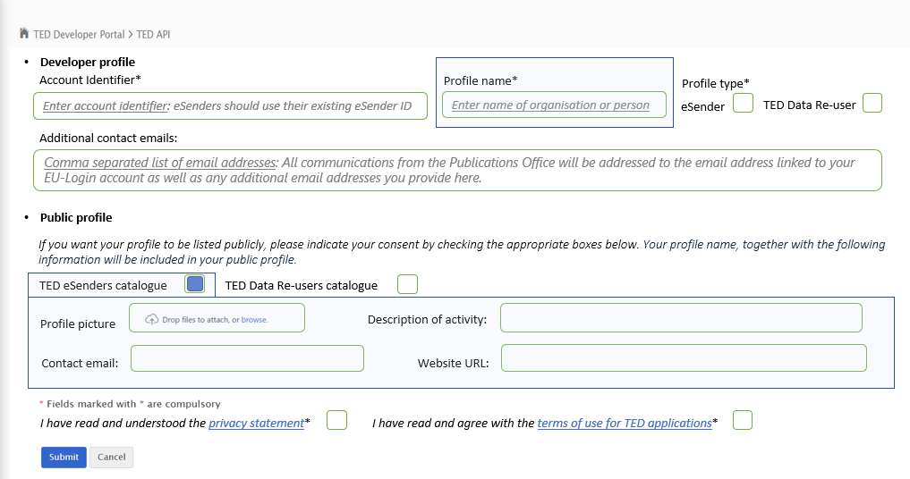
TED Developer Portal: Developer Profile
This mock-up of the Developer Profile is for visualisation purposes only and does not reflect the final development.
Notes:
This mock-up of the Developer Profile is for visualisation purposes only and does not reflect the final development.
OP will also be collecting information from eSenders, e.g. planned start date for submission of eForms notices.

Slide 28
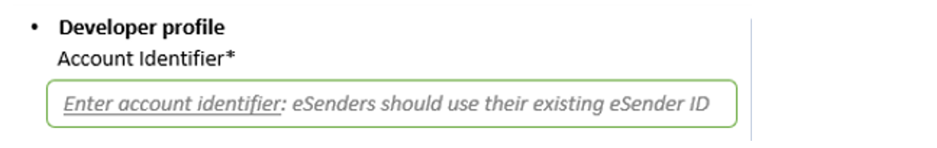
TED Developer Portal: What changes for eSenders
Public profile to replace SIMAP - List of TED eSenders (europa.eu)
Account identifier to replace eSender ID
Only one EU Login per eSender and account identifier
Use functional email address for EU Login
Notes:
TED Developer Portal: What changes for eSenders
The information eSenders provide in Public profile will be used (with their consent) to automatically generate a list of eSenders using eForms that will replace the page: SIMAP - List of TED eSenders (europa.eu). The SIMAP list will not be maintained with eForms.
eSenders should use their existing eSender ID for the Account Identifier or create a new one (5 to 8 alphanumeric characters). We will not be migrating eSender IDs from eSentool.
Account identifiers are unique and once assigned to an EU Login, they cannot be re-used.
Only one EU Login (and its email address) is allowed per eSender ID, i.e., Account identifier.
When setting up your eSender/ Developer profile in the TED Developer Portal, we would strongly recommend using a functional/ shared email address
instead of a personal email address.

Slide 29

Thank you for your Attention
Links:
https://docs.ted.europa.eu/home/
https://docs.ted.europa.eu/home/eforms/FAQ/
https://docs.ted.europa.eu/home/eforms/preview/
https://github.com/OP-TED
Any questions?
ted@publications.europa.eu
https://github.com/OP-TED/eForms-SDK/discussions/18

