Slide 1
Oliver Johnson and Arnold Kürsteiner
Point Topic
Implementing a Common Telecoms Ontology (CTO)
A Practical Framework for Telecommunications Data Integration

Slide 2

About us
UK-based broadband research house
Serves clients in telecoms, investment, government, academia
Transitioning more towards being a data company as client needs shift
Projects use inconsistent terminology due to different…
  data sources
  stakeholders
  requirements
  contexts
Implementing a Common Telecoms Ontology (CTO)

Slide 3







About our data
Our data is varied:
  cross-domain
  varied sources and vocabularies/namespaces
  commercial and institutional
Different projects/products present data and information in their own way
Many key terms are context-dependent/not clearly defined
  E.g. “Footprint”, “overbuild”, “service provider”, “operator”, “fibre”, “premises passed”
Organisational
Commercial
Geospatial
Socio-economic
Technical
Implementing a Common Telecoms Ontology (CTO)

Slide 4
Our challenge – and everyone’s
Develop standardised terminology, control complexity and number of data assets
Avoid ‘Siloisation’ and improve discoverability of data and information
Connect data across data lake and namespaces
Make insight accessible to employees, clients, outsiders and AI
Use best practice, achieve interoperability with exernal (e.g. EU) vocabulary (DCAT, EC, Dublin Core, FOAF)
→ Develop an ontology
Implementing a Common Telecoms Ontology (CTO)

Slide 5
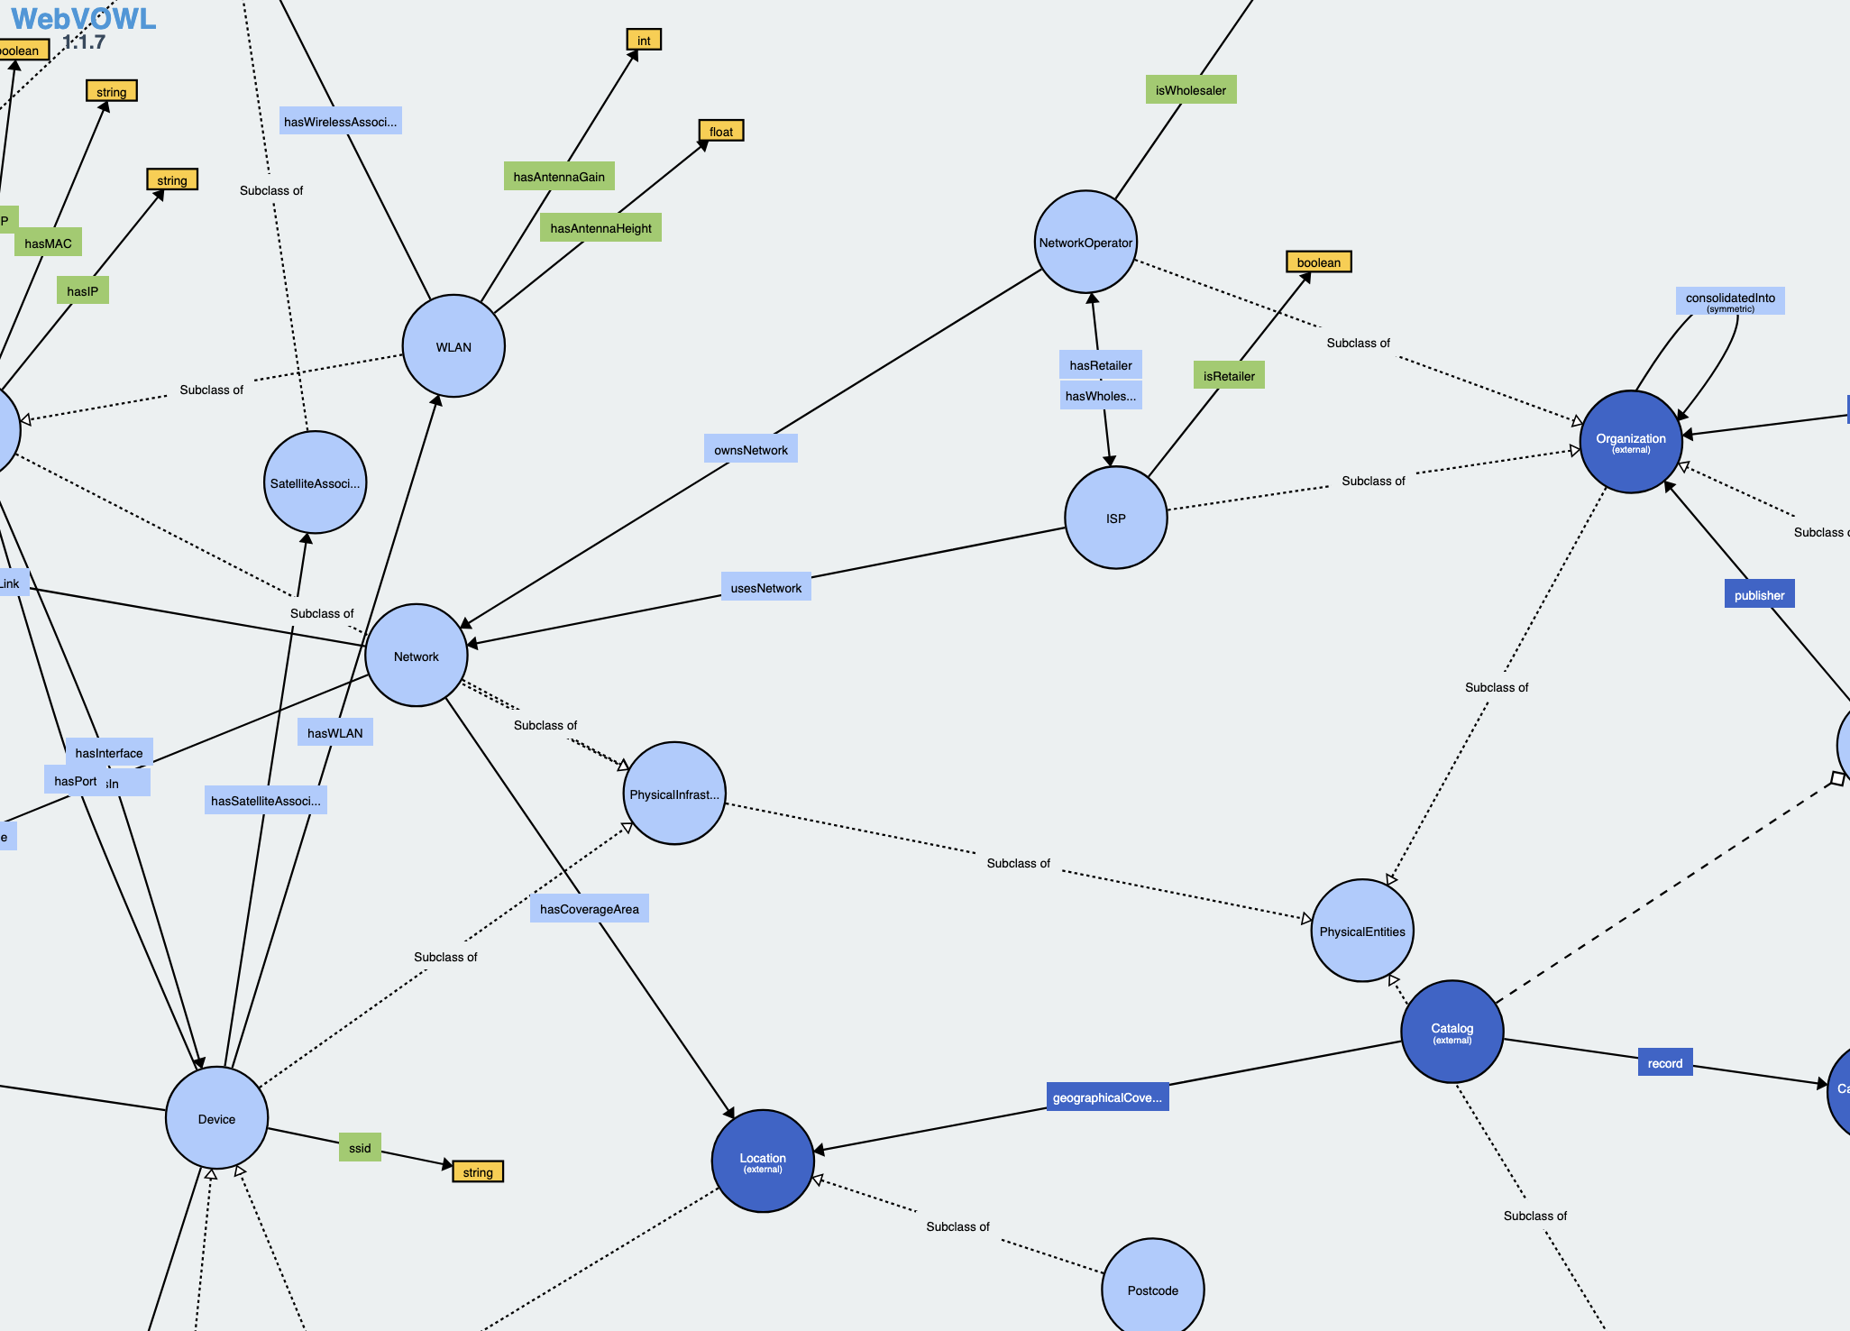
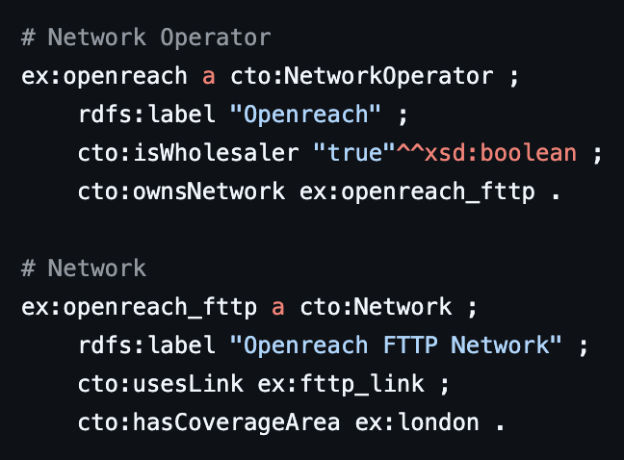
Common Telecoms Ontology (CTO)
Multi-domain, open-source telecoms ontology published in OWL language (GPL 3.0 license)
Focus on the commercial/organisational/service aspects of telecoms markets
Entities divided into: Class, Object Property, Data Property
Implementing a Common Telecoms Ontology (CTO)

Slide 6
Existing Applications
Serves as foundation for our commercial-use/business ontology (called ‘Point Topic Ontology’)
Allows us, and clients, to extract insight/query data faster and using simpler, standardised language (in Snowflake SQL)
Building new products/projects faster
Contribution to existing broadband research/academia (Broadband Coverage in Europe, Universiteit Gent)
Open-access knowledge base for commercial broadband entities and relationships, a ‘Wikipedia for telecoms’
Implementing a Common Telecoms Ontology (CTO)

Slide 7
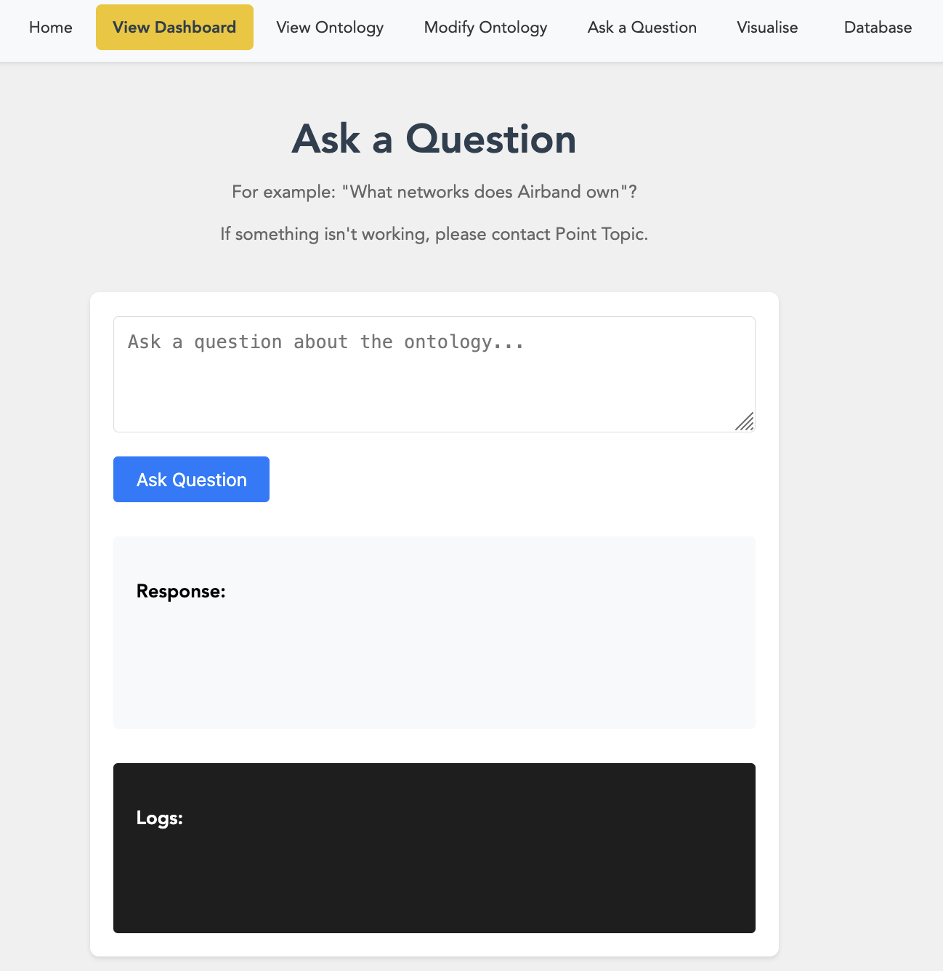
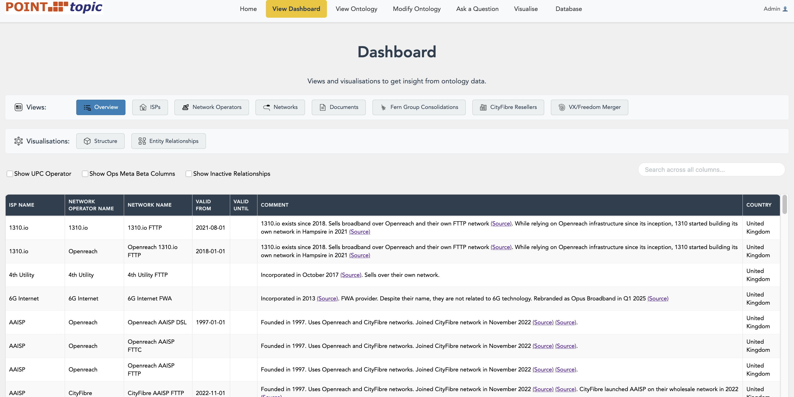
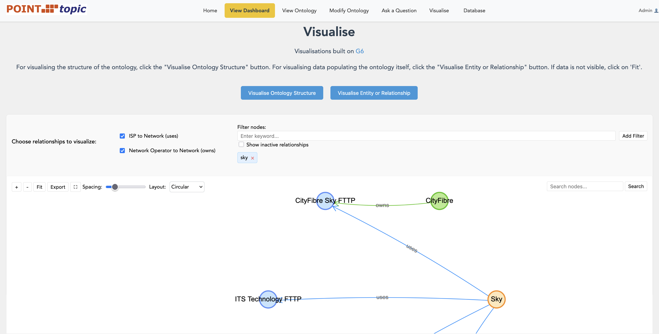
Web App
Open access:
https://ontology.point-topic.com/
Implementing a Common Telecoms Ontology (CTO)

Slide 8

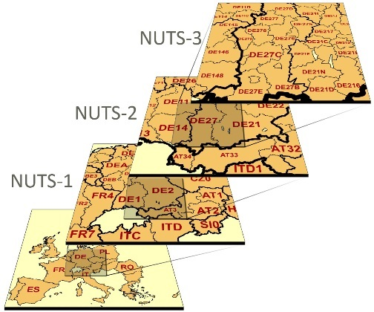










Relevance
Some of the data we are using in the ontology…
Organisational
Commercial
Geospatial
Common Telecoms Ontology (CTO)
Socio-economic
Technical
Logos are for illustration/example purposes only. These organisations are not affiliated with this project/Point Topic.
Implementing a Common Telecoms Ontology (CTO)

Slide 9
Relevance
(To our knowledge) only such telecoms ontology of its kind.
Fills the gap between the APIs and networks that share data across common ontologies
Integration with DCAT and EC-related vocabulary
Integrate diverse data sources in a structured way, including open-source data
Machine-readable documentation and AI compatible
Open access ontology and web app
Implementing a Common Telecoms Ontology (CTO)

Slide 10
Thanks!
https://ontology.point-topic.com/
www.github.com/Point-Topic/cto-ontology

