Slide 1
Bianca Csakany & Sofia Zapounidou
Publications Office, Metadata & Identifiers (A.2.002)
Value vocabularies for a linked data-enabled cataloguing tool
from labels to concepts

Slide 2
Status Quo
Change
  Use of descriptive metadata for general publications based on Marc21 and AACR2
  Use of local translation tables (ATTO) for multilingual displays
  Problem: duplication of work (translations and mappings)
  Problem: unclear semantics – lack of URIs
  Planification: Integration and simplification of current cataloging methods in a new tool
Value vocabularies for a linked data-enabled cataloguing tool: from labels to concepts

Slide 3
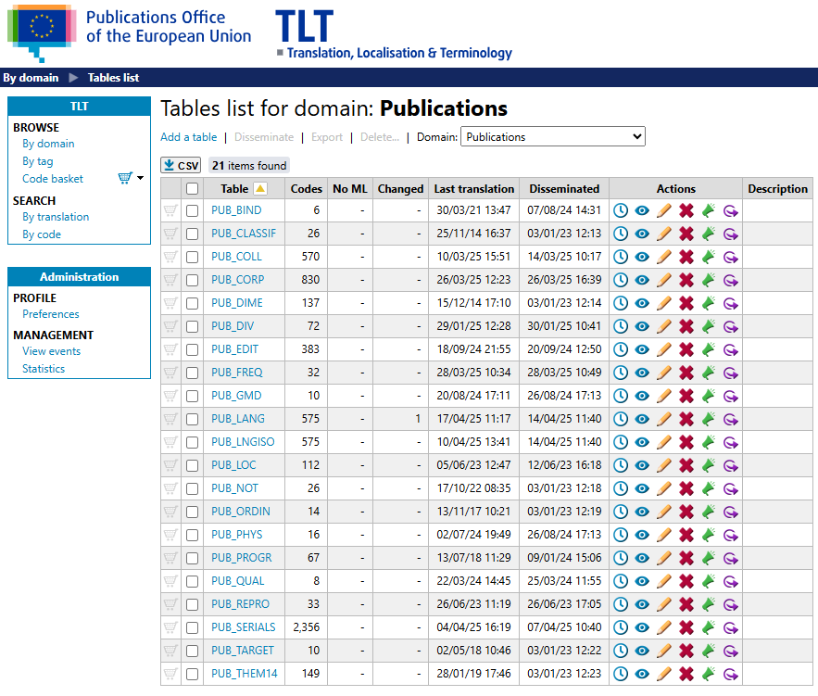
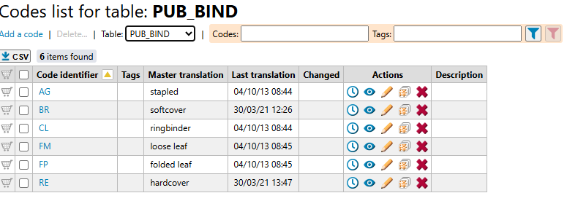
ATTO in numbers
21 tables
6.008 values
Value vocabularies for a linked data-enabled cataloguing tool: from labels to concepts

Slide 4
The ATTO project
2021
Evaluation
of ATTO tables
2022
Start mapping CDM to MARC21
Work on ATTO tables
2023
Creation and mapping of new ATs
2024
Work on remaining ATTO tables and mapping to AT
2025
New tool – abandon ATTO tables
Value vocabularies for a linked data-enabled cataloguing tool: from labels to concepts

Slide 5
→
Same semantics → Abandon ATTO table & check values
Compare semantics of ATTO tables and AT ones
Different semantics → Decide value per value
Check if an
ATTO value exists in an AT
Check AT semantics
Yes
No
different semantics
Create new AT
Provide draft definition for the AT
Map ATTO value (legacy data)
Create AT value (new data)
Provide draft definition for the value
Proper semantics
Map ATTO value (legacy data)
Use AT value (new data)
Provide draft definition (if needed)
Deprecate value?
Yes
No
Deprecate value in existing AT
Identify different label for the concept
Sources
Dictionaries & encyclopaedias
MARC21 & RDA vocabularies
ONIX
Value vocabularies for a linked data-enabled cataloguing tool: from labels to concepts

Slide 6
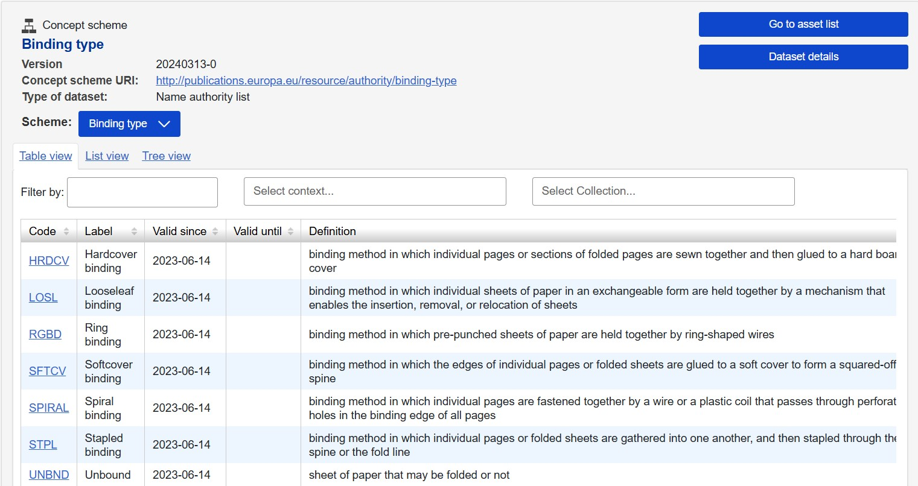
Example
Value vocabularies for a linked data-enabled cataloguing tool: from labels to concepts

Slide 7
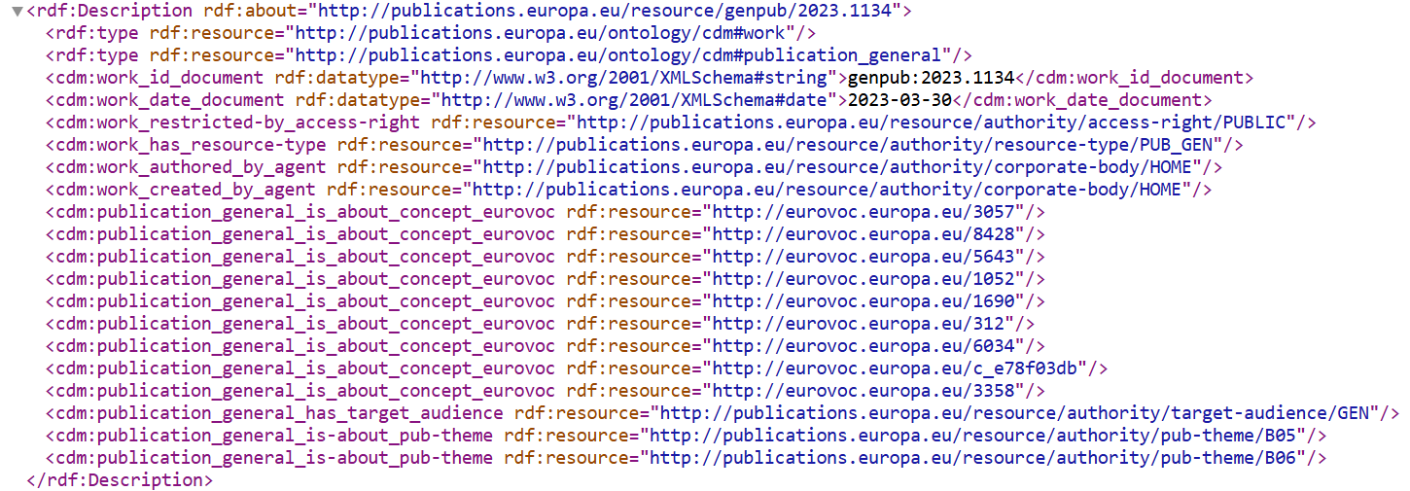
New CDM properties & AT values
Value vocabularies for a linked data-enabled cataloguing tool: from labels to concepts

Slide 8

(Anticipated) Results
AT
efficient
cataloging
public
access
more structure
new facets
OP portal
improved
quality
Value vocabularies for a linked data-enabled cataloguing tool: from labels to concepts

Slide 9

Our future with AI
Copyright Stock Images
Annotation tool for indexation
(based on former SeTA Metadata annotator)
Explicit semantics to train AI models
AI for summaries
Use AI to extract metadata directly from publications
Value vocabularies for a linked data-enabled cataloguing tool: from labels to concepts

Slide 10
Thank you for you attention!
Contact us via
BIANCA.CSAKANY@publications.europa.eu
Sofia.ZAPOUNIDOU@publications.europa.eu

