Slide 1
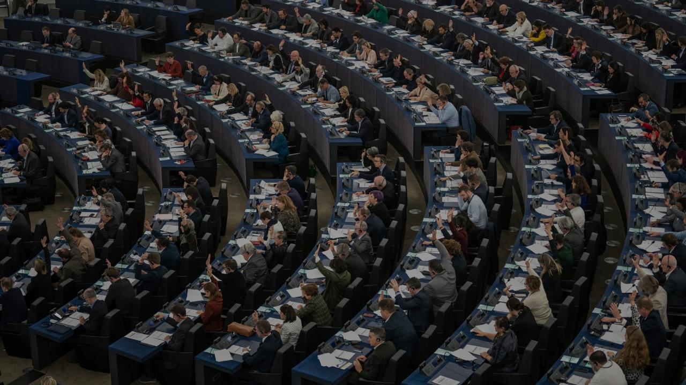



AI and LLM applied in compliance to the ELI-DL structure of the EP Open Data
Christie DAMNET & Jacques MILITELLO
European Parliament, Luxembourg
closeup@europarl.europa.eu

Slide 2
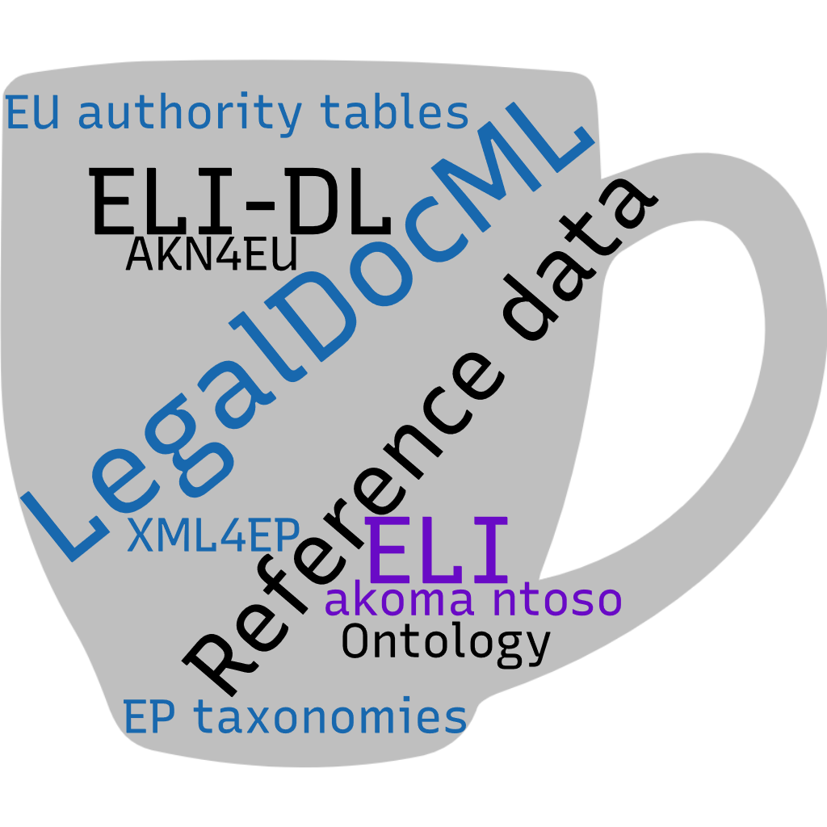
High-level structure of Open Data in EP

Slide 3

Use local LLM & AI
Upload TTL files from EP-ODP to GraphDB
Retrieval Augmented Generation (RAG) with Akoma Ntoso files of written questions of 2020 -> 24 to a vector database (graphDB)
https://data.europarl.europa.eu/dataset/parliamentary-questions_2024_49
Use ollama layer with existing opensource Large Language Model (LLM) GPT-OSS:20B to convert chat input into a search across the GraphDB and return its results in chat output
Build AI chatbot to interact with ollama using natural language (human user)

Slide 4

Use-case : (un)completeness of data
Aims:
improve content and quality of a dataset
data-enrichment
enhanced search functionalities
How:
Use AI to find missing metadata, files, ...
Use AI to complete those

Slide 5

Use-case : help human decision making
Aim:
enhance search and analysis of data across a large dataset
provide insights to enhance data quality
How:
- Use AI to make statements to improve quality of data by prompting it precise questions

Slide 6

Human vs AI queries
Human resources
more processing time
smaller dataset
training, skills needs
may get bored by repetitive tasks
can critical think, out of the box
AI based tool
less processing time
larger dataset
limited training need
shaped for repetitive tasks
do what is asked, frame-limited

Slide 7

Some ethical considerations...
AI = extended help to treat large amount of data.
AI allow automating very repetitive tasks
Human beings apply further critical thinking to exploit results.
Coexisting and collaborating human and AI
Enabling humans to thrive in while preserving their humanity

Slide 8

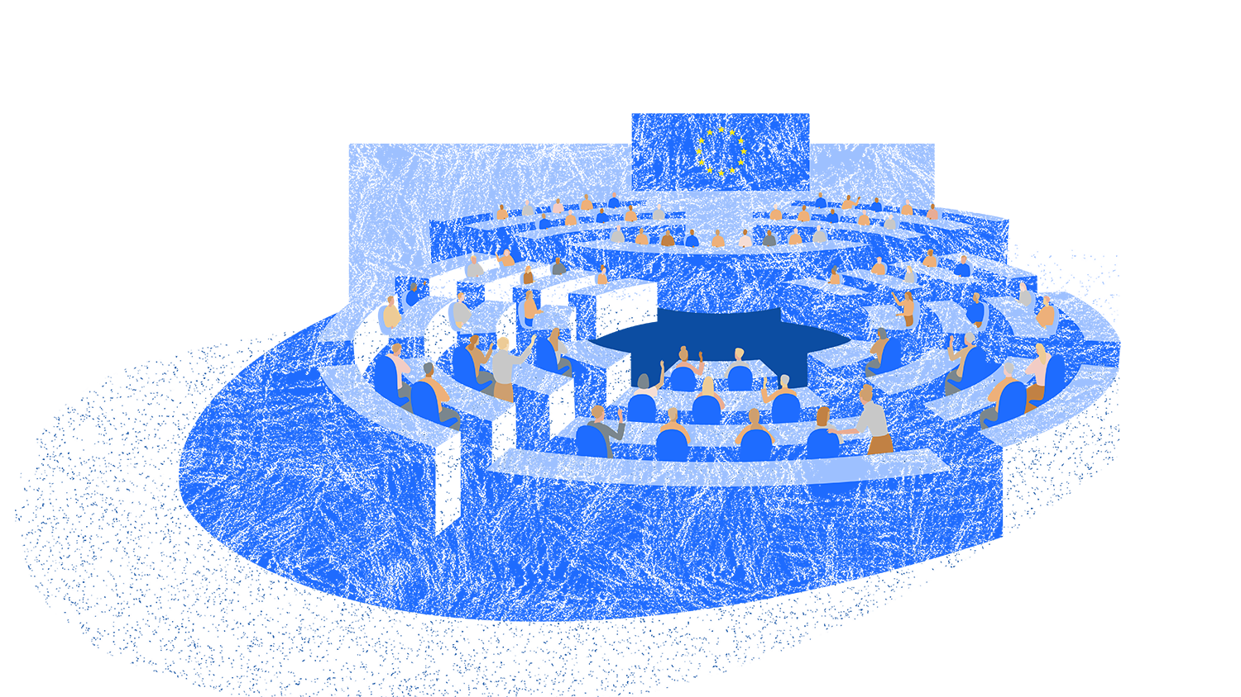
Further contact: closeup@europarl.europa.eu

