Slide 1

Towards a Dutch data space for cultural heritage
Enno Meijers - CTO Dutch Digital Heritage Network

Slide 2
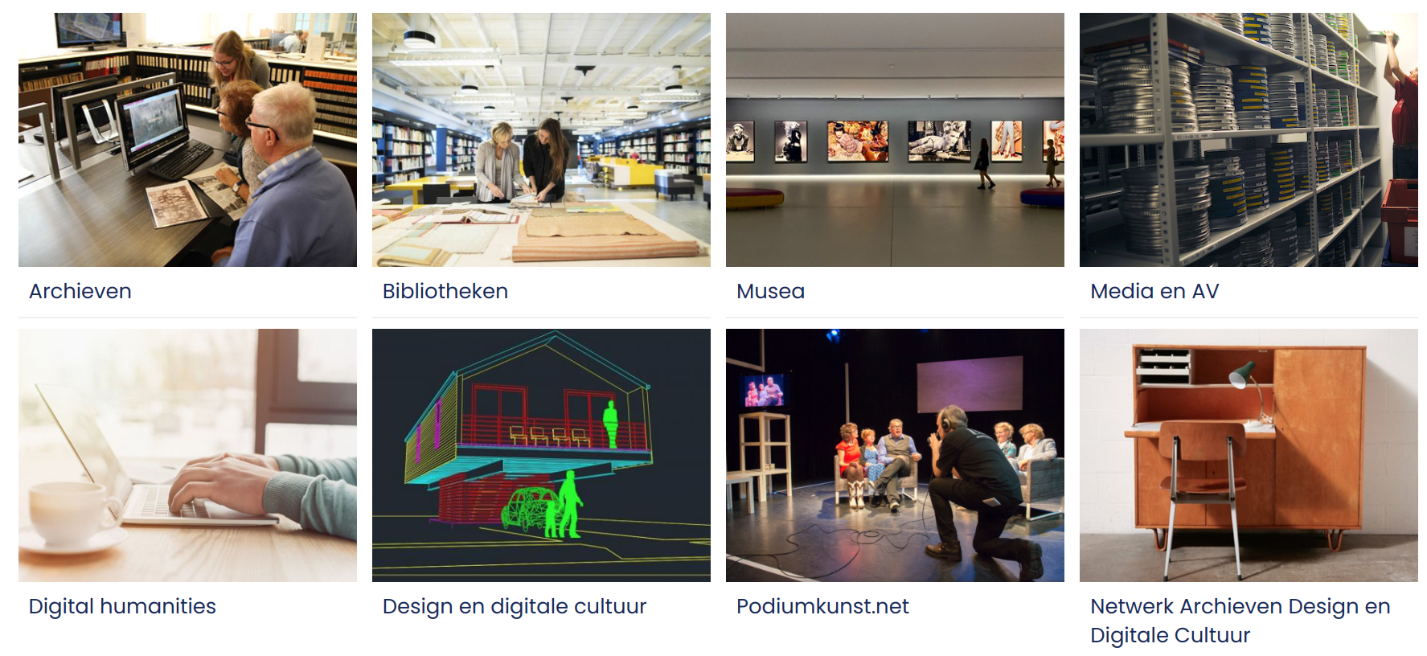

Dutch Digital Heritage Network (NDE)
Since 2015, the Dutch Digital Heritage Network has been responsible for implementing the National Digital Heritage Strategy.

Slide 3

The aim of the National Digital Heritage Strategy is to make digital heritage more accessible to everyone, enabling people and communities to experience heritage in the ways that suit them best.
https://zenodo.org/records/14760720

Slide 4
Goals for the network
Making heritage information widely usable
Implementing a sustainable approach, from source to end user applications
Fostering a dynamic understanding of heritage
Building a data space for cultural heritage for the entire Kingdom

Slide 5
Interoperability & Standards
Digital Heritage Reference Architecture
Requirements for publishing sustainable linked data:
  modelled according to a schema.org profile and an optional domain standard
  published with a DCAT3-AP compliant* dataset description
  using shared terminology thesauri, vocabularies
Requirements for collection management systems
Aligned to international standards and supporting FAIR

Slide 6
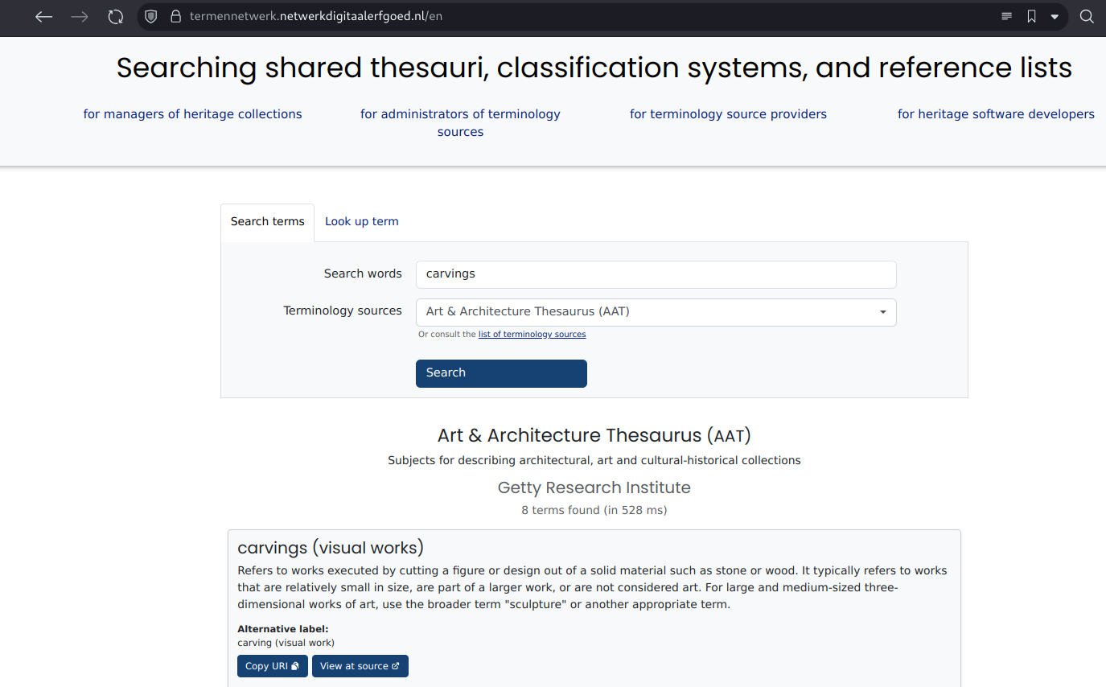

Network of Terms
powered by

Slide 7
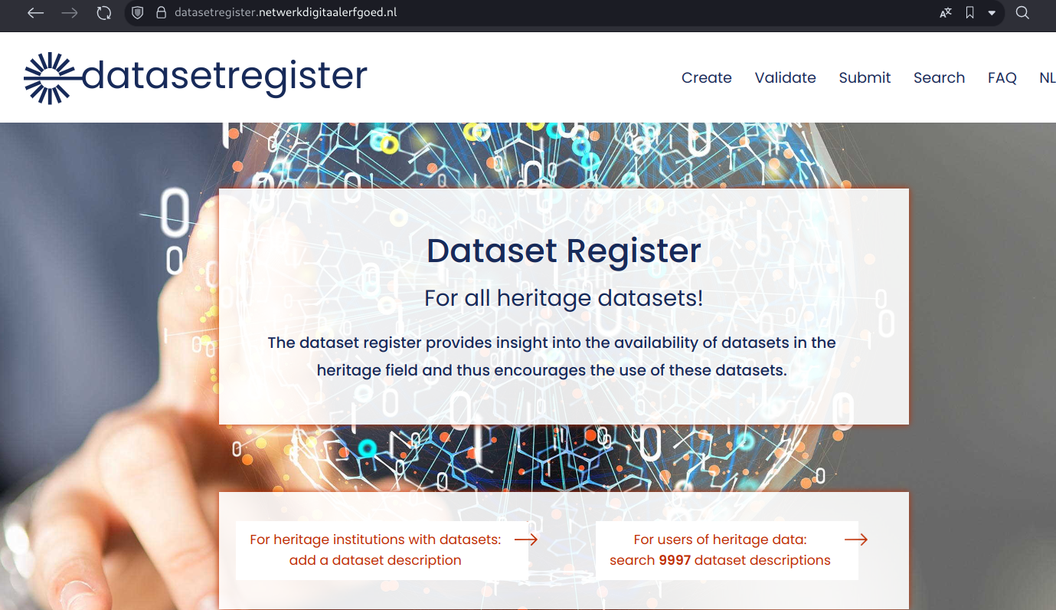
Data Catalog

Slide 8
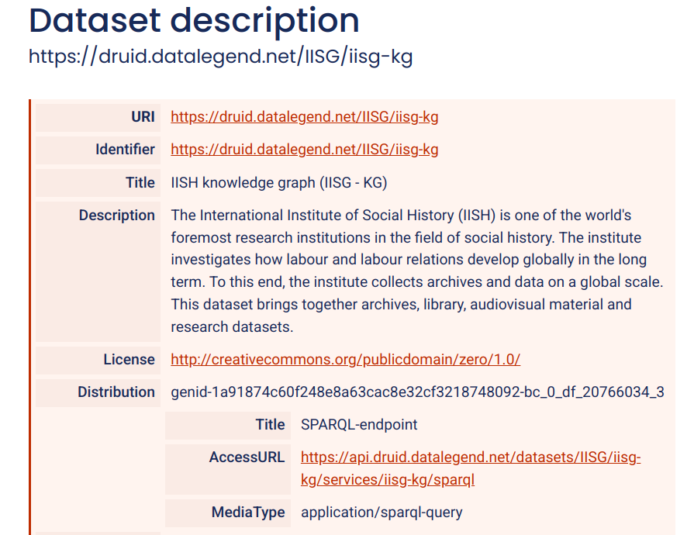

Slide 9
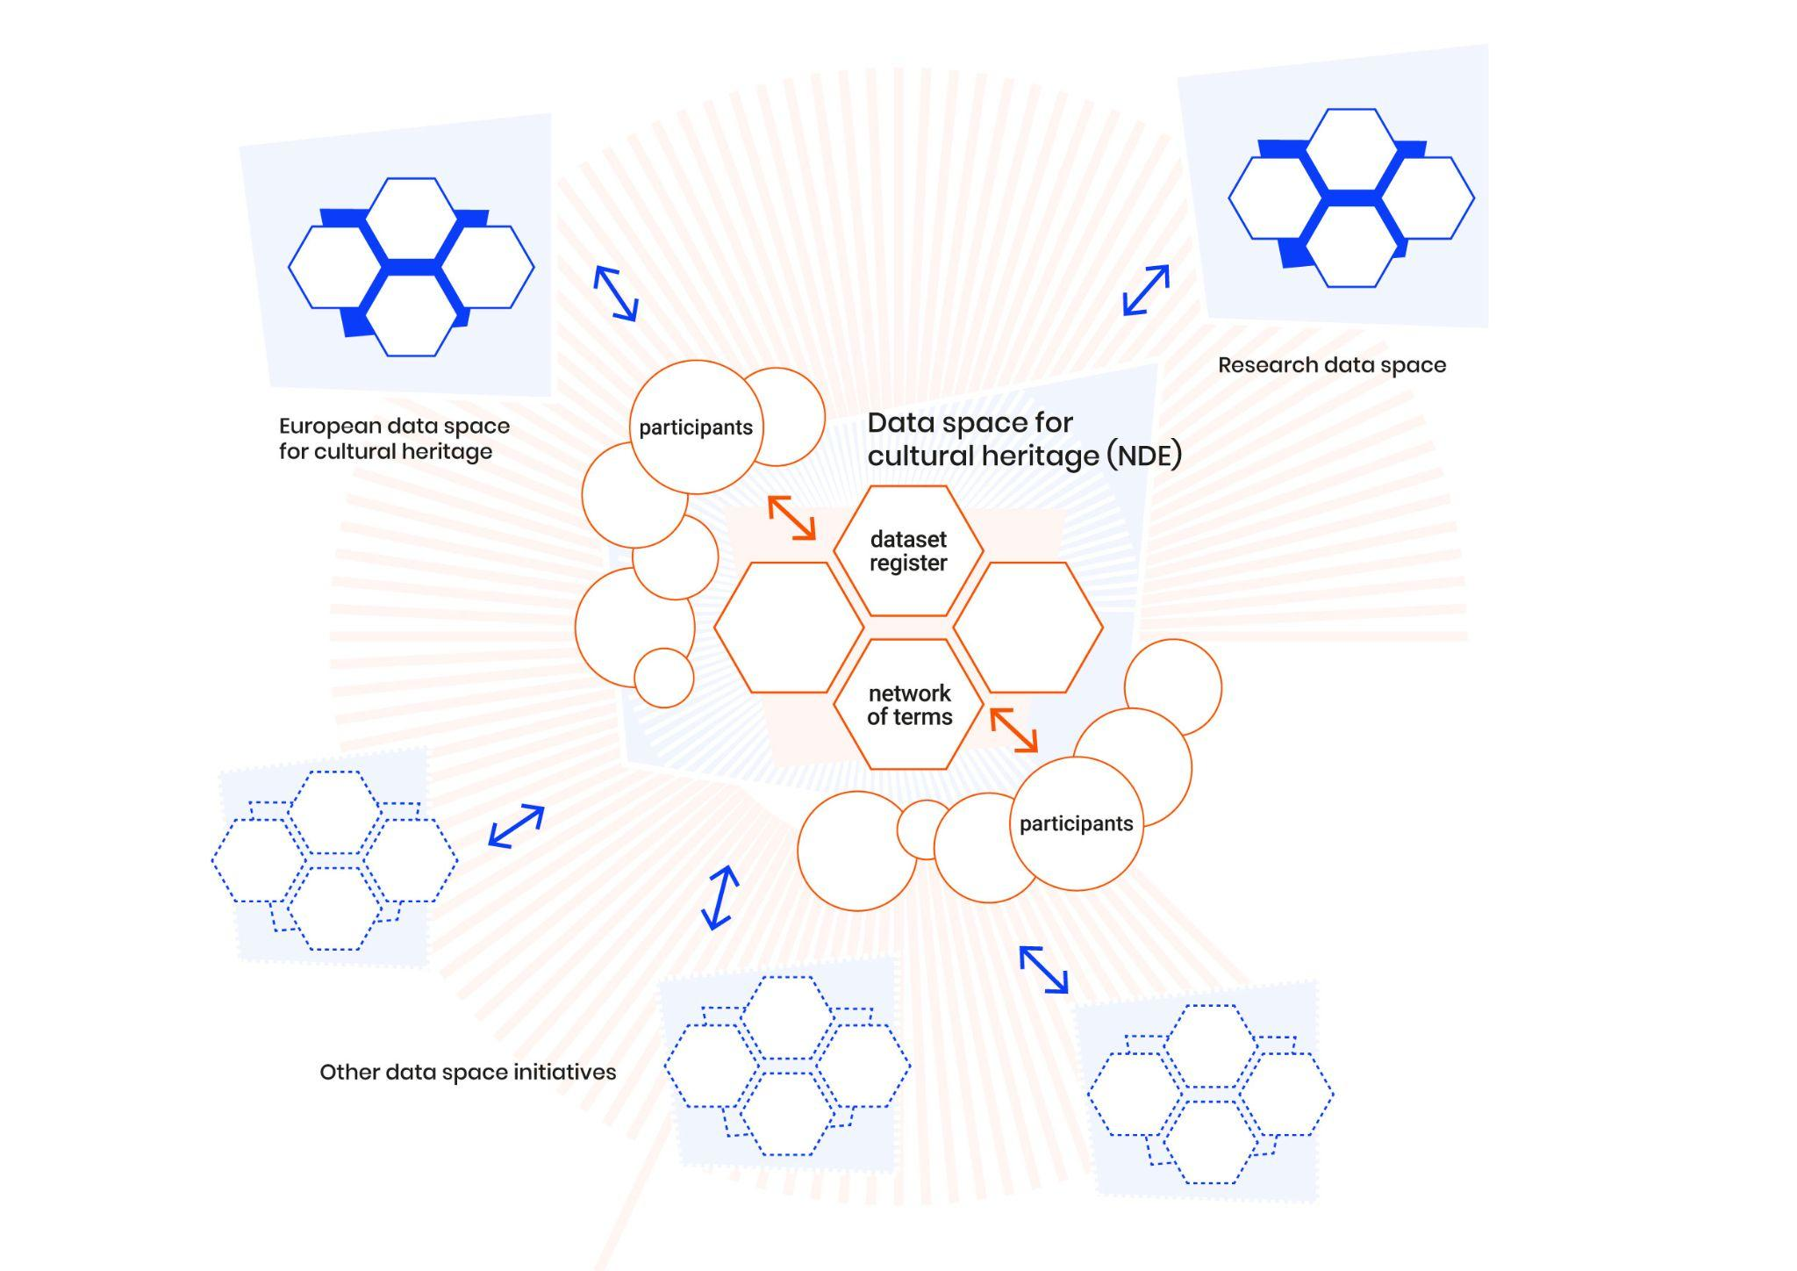
CLARIAH-NL
SSHOC-NL
(EOSC)
(ECCCH)
Europeana

Slide 10
Thank you!
https://netwerkdigitaalerfgoed.nl/en/
Enno Meijers - enno.meijers@kb.nl
https://mastodon.social/@ennomeijers

