Slide 1
Enrico Bignotti
CORDIS, Publications Office of the European Union
Unlocking EU-funded research
with the EURIO Knowledge Graph
Enhancing Accessibility and Interoperability of Research Information

Slide 2
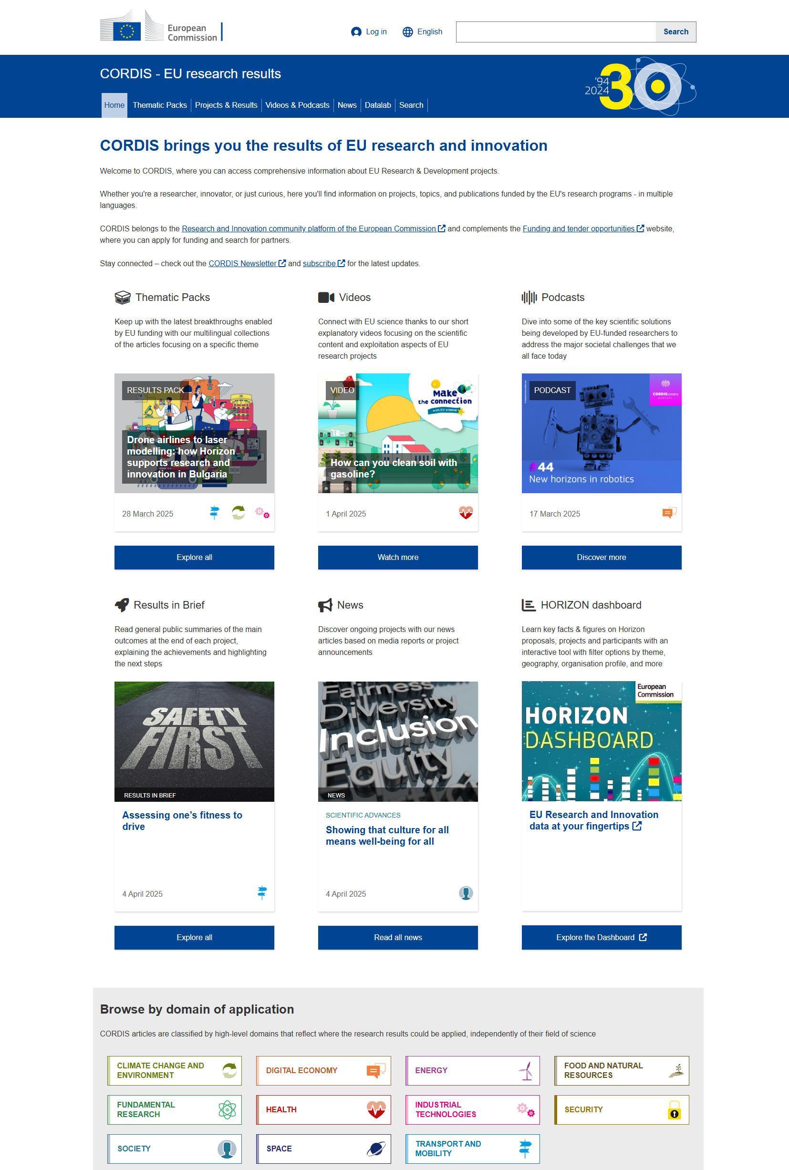
What is CORDIS?
The Community Research and Development Information Service (CORDIS) is the European Commission's primary source of results from EU-funded research and innovation projects.
It contains:
DATA: information on projects and results, e.g., project factsheets
EDITORIAL: multilingual products to disseminate research results
Unlocking EU-funded research with the EURIO Knowledge Graph

Slide 3
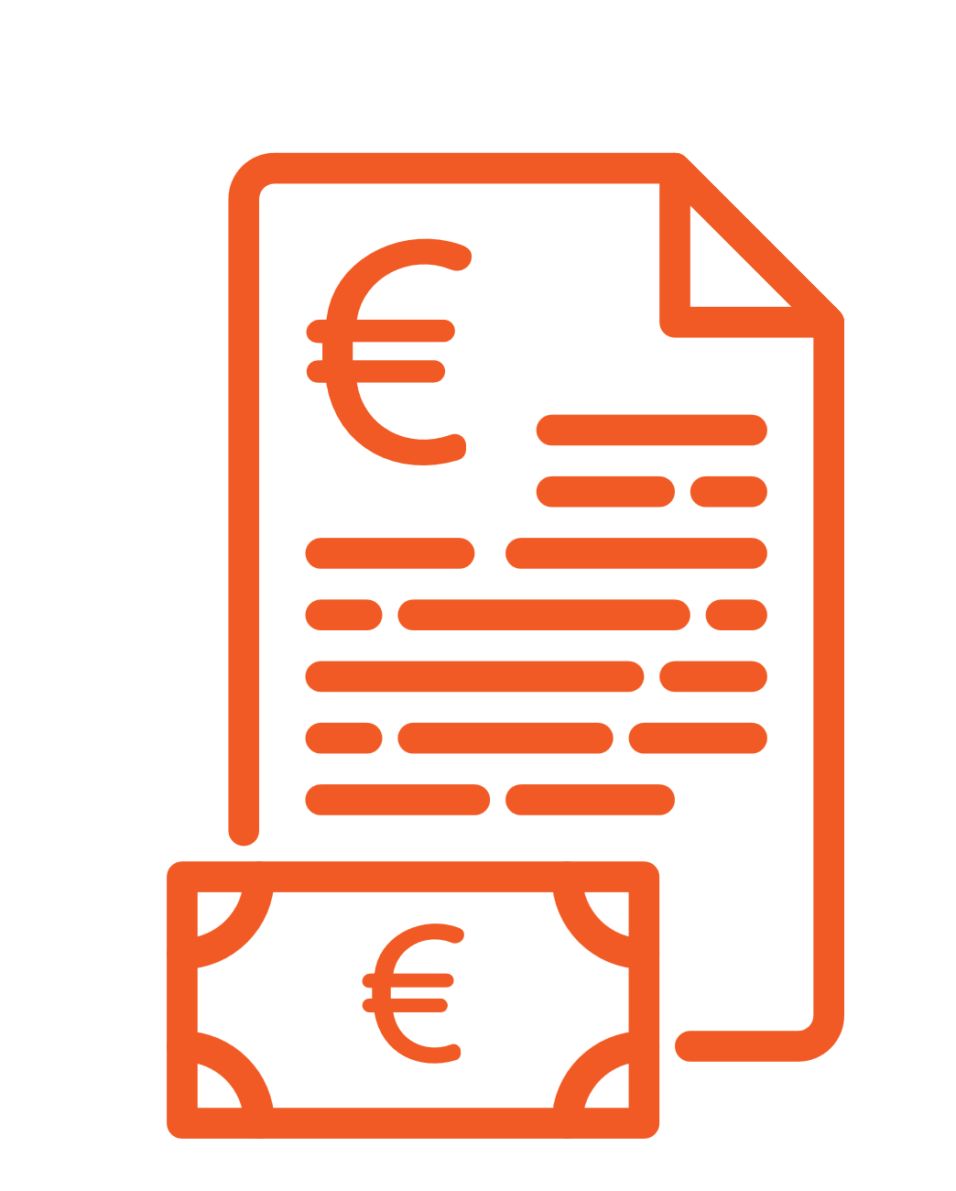



The EUropean Research Information Ontology (EURIO)
eurio:FundingScheme
eurio:Result
Designed to represent key aspects of project and results.
Includes funding programmes, funded projects, beneficiaries, and project results.
Based on existing ontologies (e.g., schema.org, DINGO) and reference data (e.g., EuroSciVoc taxonomy and NUTS codes).
eurio:Project
eurio:
isResultOf
eurio:funds
eurio:isInvolvedIn
Unlocking EU-funded research with the EURIO Knowledge Graph
eurio:Organisation

Slide 4
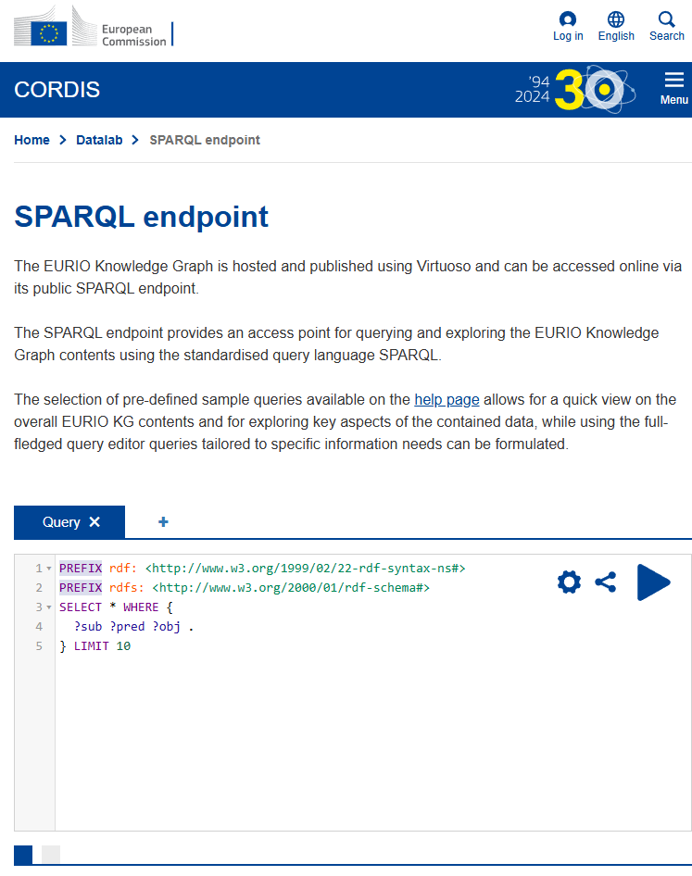
The EURIO Knowledge Graph
Populated with information from CORDIS modelled in accordance with EURIO
Contains data for funding framework programmes FP7, H2020 and Horizon Europe.
Accessible via a dedicated SPARQL endpoint at https://cordis.europa.eu/datalab/sparql-endpoint
Provides example SPARQL queries (including federated ones) in the “How to…” page at https://cordis.europa.eu/about/sparql
Unlocking EU-funded research with the EURIO Knowledge Graph

Slide 5












Data Curation Tool (DCT)
It transforms, validates, curates, and manages RDF data from XML sources into the EURIO Knowledge Graph.
It will use RML to transform XML into RDF, while SHACL shapes validate the RDF’s structure and detects conflicts.
Curation algorithms
RDF in temporary KG
KG addition
RML
RDF
Transformation SHACL shape
Conflict SHACL shape
Validation
Curation report
Unlocking EU-funded research with the EURIO Knowledge Graph

Slide 6
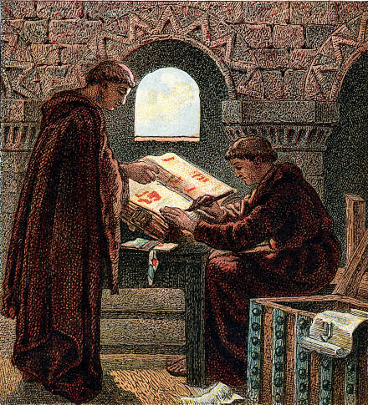
Curating the EURIO Knowledge Graph
EURIO KG Entity | Data quality | Data Enrichment | Sources
Publications & Deliverables | DOIs | Citations for impact evaluation | OpenAlex & OpenAire
Intellectual Property Rights (IPRs) | Validation of reported data | Abstracts to describe IPRs | EPO (Patents) & EUIPO (Trademarks)
Funding Schemes |  | Technology readiness levels (TRLs) | Topic descriptions
Unlocking EU-funded research with the EURIO Knowledge Graph

Slide 7






Enrichment workflows
Match by IDs:
DOIs (Publications)
Application Number (IPRs)
Unmatched results
Match
by title
Final set of unmatched results
EURIO KG
results
Matched results
Final set of matched results
For TRLs, we followed a different workflow and extracted the TRLs mentions from Topic descriptions
Unlocking EU-funded research with the EURIO Knowledge Graph

Slide 8
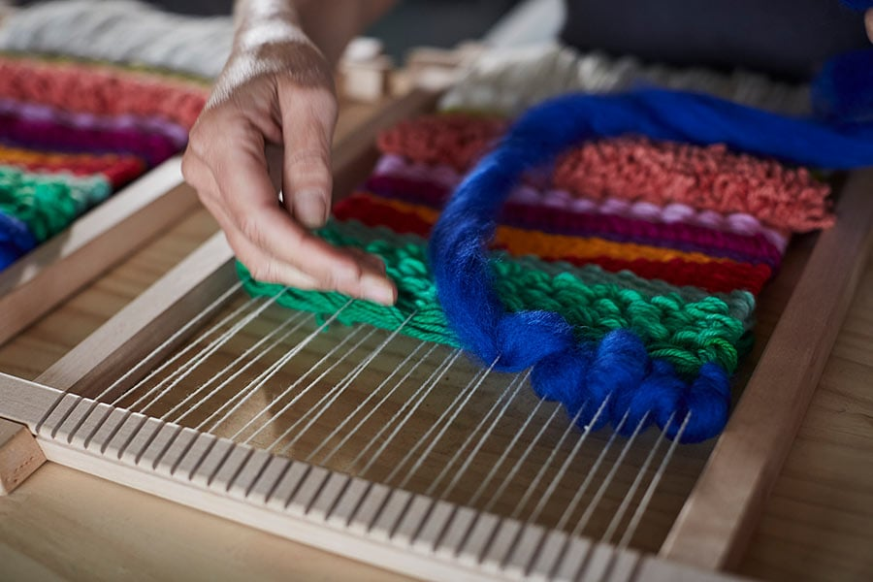
Enrichment representation
Link entities with owl:sameAs and extract enriched data subsets
Import subsets into Virtuoso for querying, using named graphs to separate original and enriched data
Challenges:
  Schema mismatches
  Converting non-RDF datasets like EUIPO
Unlocking EU-funded research with the EURIO Knowledge Graph

Slide 9

Future steps
Maintain enrichment information updated and extend the enrichment process to other LOD datasets
Expand the KG with additional data from the CORDIS website, such as editorial content
Reconcile information in the KG, such as organisations and authors
Unlocking EU-funded research with the EURIO Knowledge Graph

Slide 10
baya.remaoun@publications.europa.eu
enrico.bignotti@ext.publications.europa.eu
cordis.europa.eu

