Slide 1
Ghislain Atemezing, PhD
Linked Data Officer – Semantics and Ontology team / Operational Data Unit – European Union Agency for Railways
ERAKG: A Core Semantic Knowledge for Railways
Towards a more digital, flexible and integrated European railway system

Slide 2
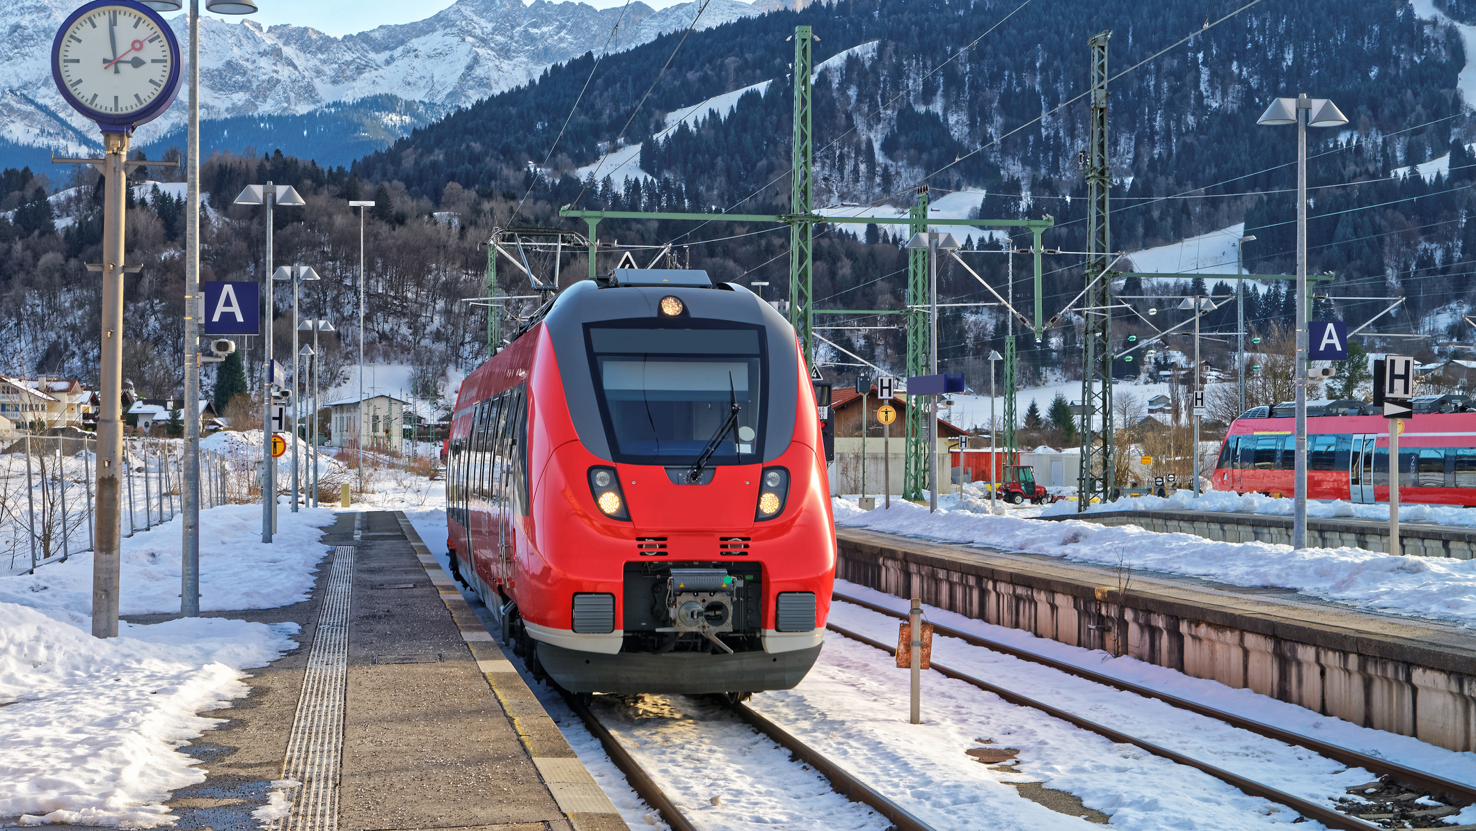
Agenda
ERA in a Nutshell
ERA Journey towards Data centric organization
A little semantics goes a long way rail...
  ERA Ontology
  ERA Knowledge Graph
Challenges
Demo
Q/A Session
ERAKG: A Core Semantic Knowledge for Railways

Slide 3

ERA in a Nutshell
European Union
Agency for Railways (ERA)

Slide 4
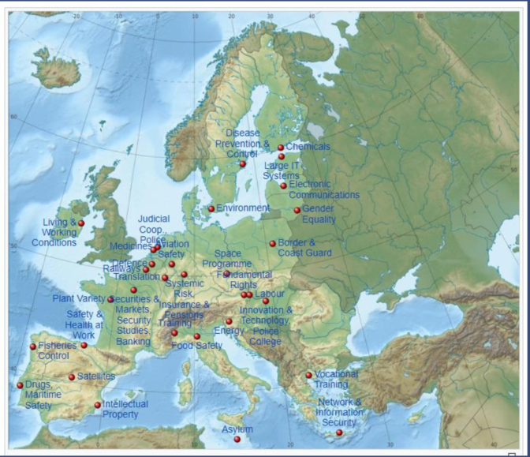
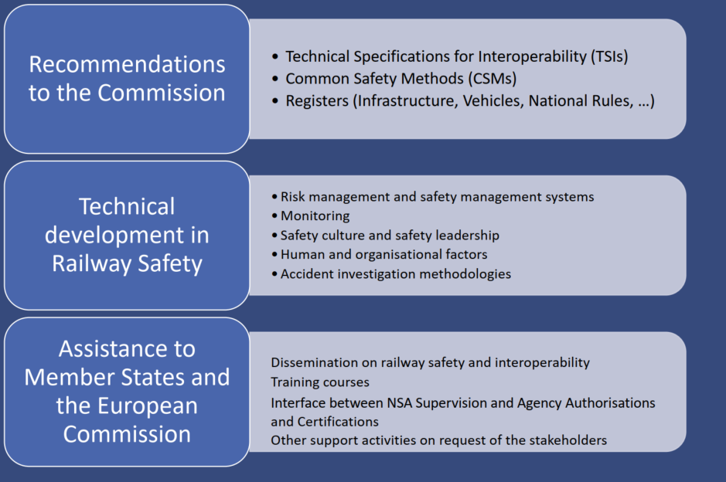

ERA Organization
Legal Framework: Agency Regulation (Regulation (EU) 2016/796 of the European Parliament and of the Council of 11 May 2016 on the European Union Agency for Railways)

Slide 5

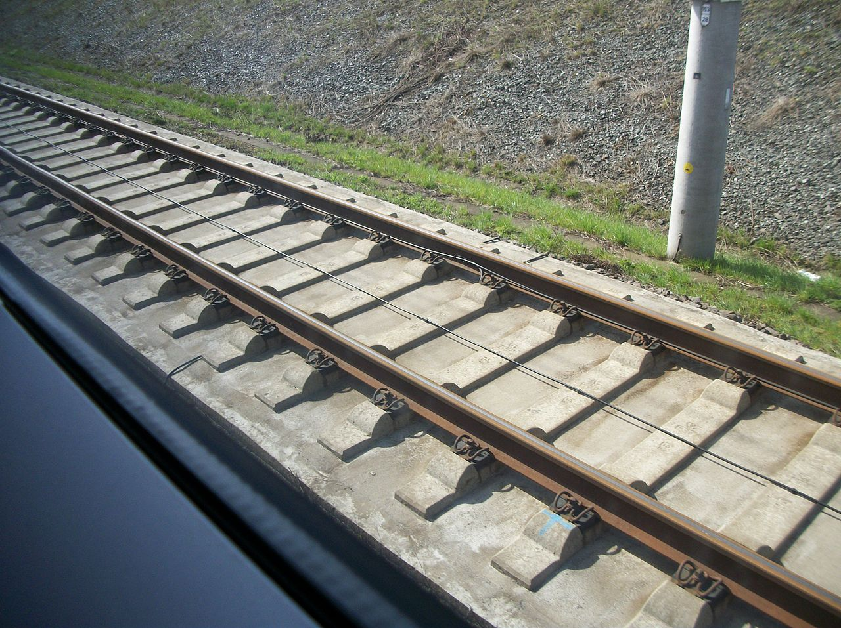
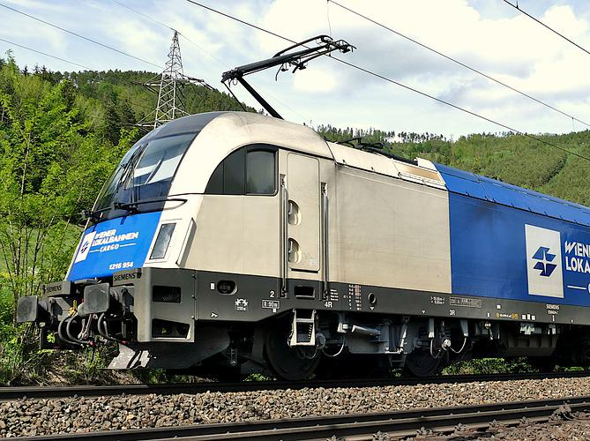
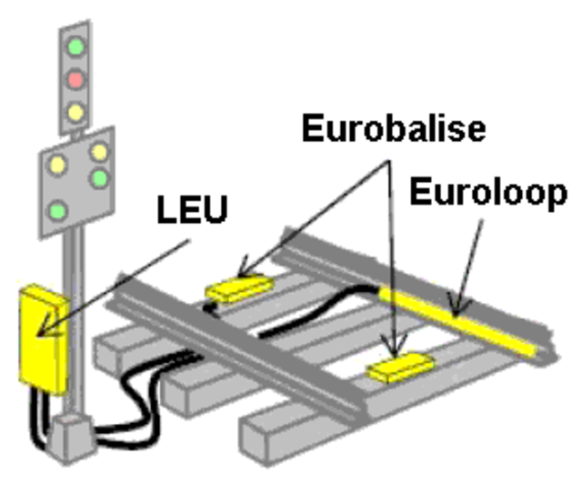
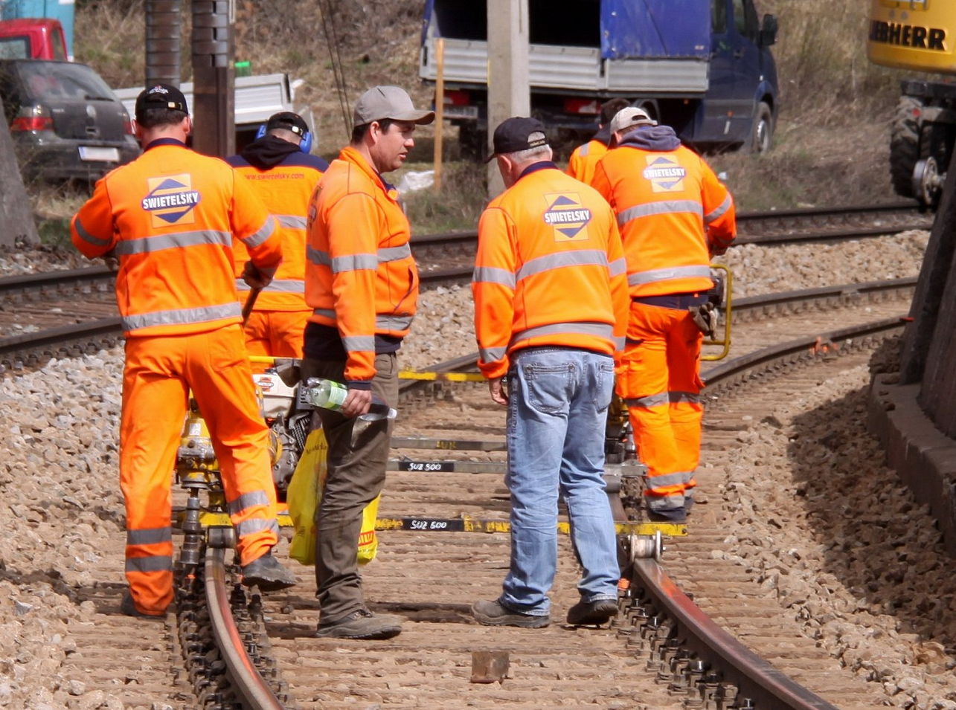
The railway system
(simplified)
Infrastructure
& Energy
Rolling stock
Signalling
Humans
Infrastructure managers
Railway undertaking
Entities in Charge of maintenance
Keepers
National Safety Authorities
National Investigation Bodies
Others, pls see Article 4(4) of the Directive 798/2016 for the full list

Slide 6

Legal background
Agency regulation
Regulation (EU) 2016/796
Interoperability directive
Directive (EU) 2016/797
Safety directive
Directive (EU) 2016/798
Implementing decisions era.europa.eu/Registers

Slide 7
REGISTERS @ERA
System | Full name | Accessiblity | Technical scope | Data owners
RINF | European Register of Infrastructure | Public | Infrastructure, energy and control-command signalling subsystem | Infrastructure managers (IMs )
ECVVR/NVR | European Centralised Virtual Vehicle Register & National Registers | Restricted | The rolling stock subsystem | Keepers + National Registration Entities (NRE)
EVR | European Vehicle Register | Restricted | The rolling stock subsystem | Successor of ECVVR/NVR
ERADIS | European Railway Agency Database of Interoperability and Safety | Public | Safety and interoperability documents | Railway Undertakings (RUs), National Safety Authorities (NSAs)
ERATV | European Register of Authorised Types of Vehicles | Public | The rolling stock subsystem | NSAs, ERA
OCR | Organisation Code Register | Public | EU rail Organisations data | Organisations, ERA
RDD | Reference Document Database | Public | National rules | Member States (MS), ERA
SRD | Single Rules Database | Public | Regulatory framework, limited to operational and fixed installation | Member States (MS)
SAIT- (SIS) | Safety Alert IT tool – Safety Information System | Restricted | Technical equipment | Railway players, ERA
VKMR | Vehicle Keeper Marking Register | Public | Vehicle Marking | Keepers - OTIF

Slide 8
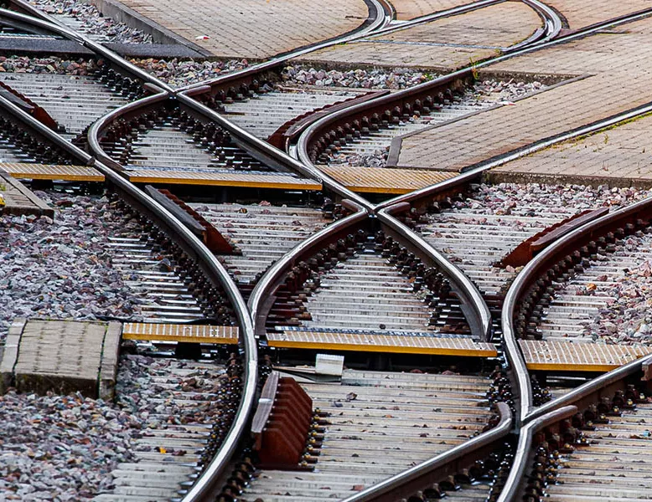
A LITTLE SEMANTICS GOES A LONG WAY RAIL

Slide 9

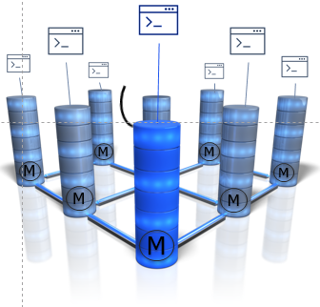

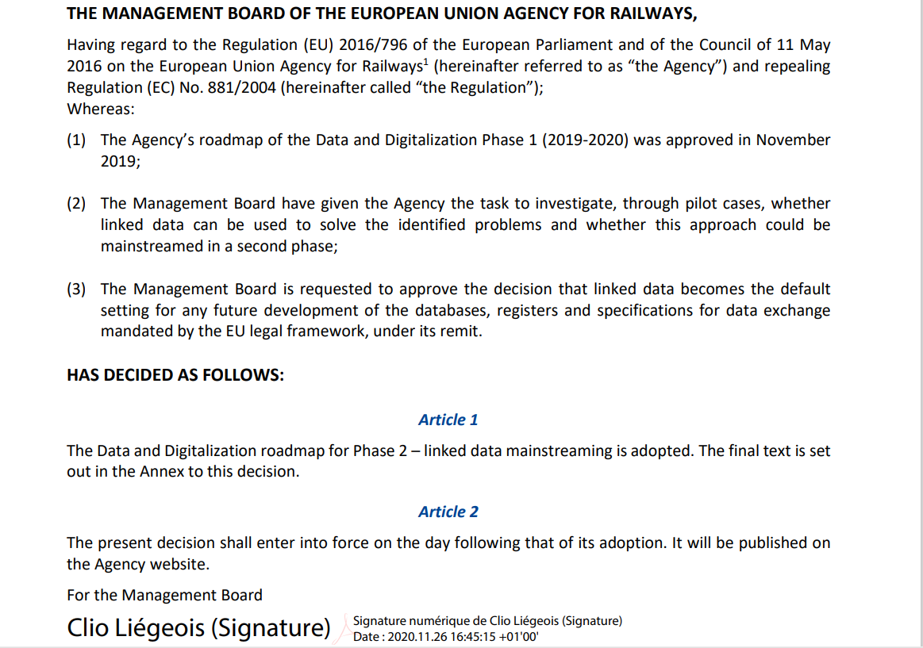
The Journey towards Data Centricity
2019
2021
2022
2024
2025
Management Board Linked Data Mainstream Decision
ERATV – ISS Pilot – ERADIS –
Organisations
Register of Railway Vehicles
Siloed data bases /registers
Around 12 DBs application oriented
Connected into Linked Data

Slide 10
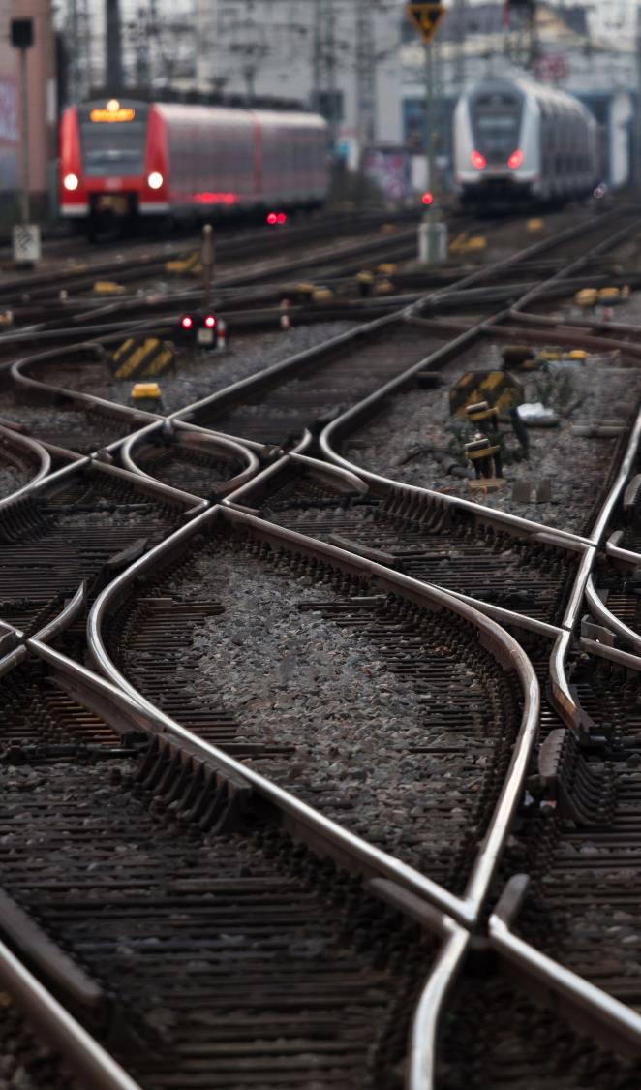
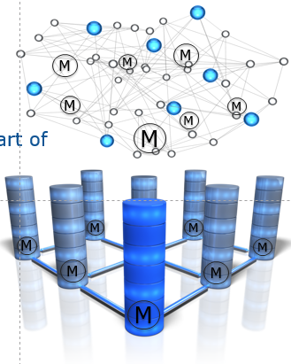
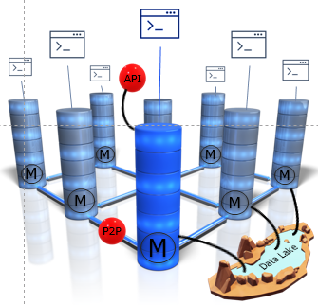

Data Centricity Essential
STOP to data models hidden in the application layer => an inflation of similar, yet different data models created by IT providers
YES to data models which are “freed” from the code and can be shared and linked with the knowledge graph = Ontology + data values
STOP THE SPREAD OF RELATIONAL DATABASES COUPLED TO APPLICATIONS AND NEW DIGITAL BARRIERS
STOP to application code modification each time there is a query, to interfaces and to APIs
=> IT development costs and vendor lock in
YES to open standards, Aligned with Interoperable Europe Programme, supporting DAC and capacity management

Slide 11
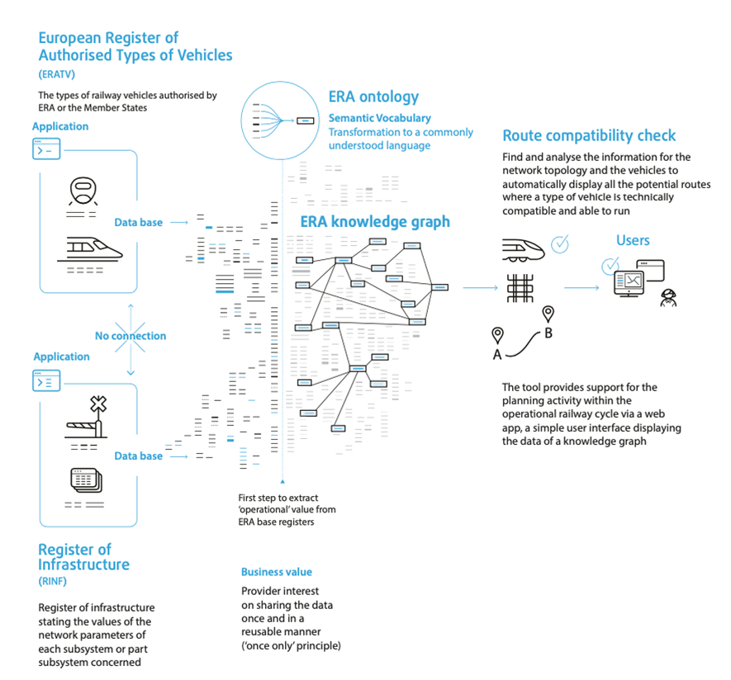
A successful PoC

Slide 12
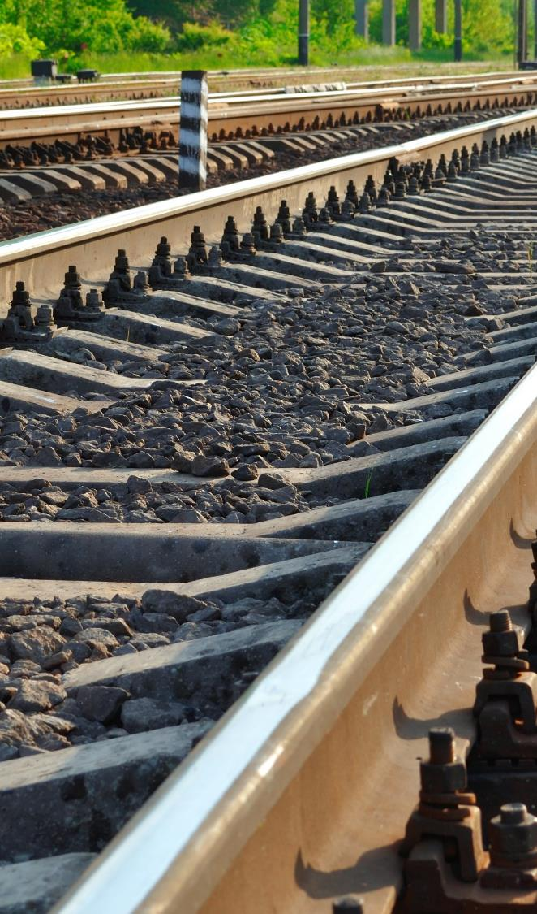
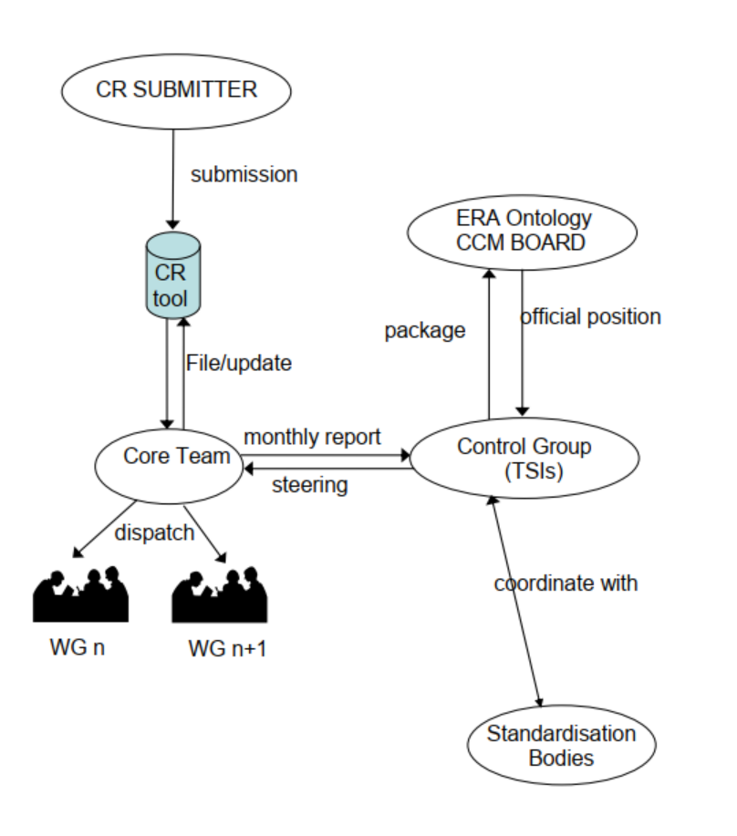
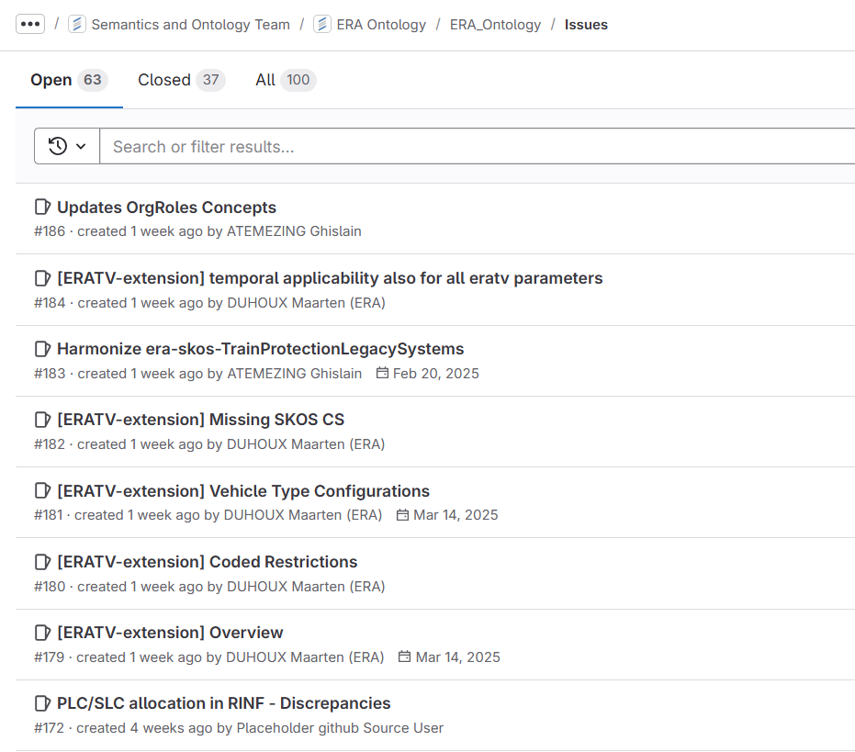
Ontology Governance
Who?
ERA team dedicated to the ERA Ontology work (Core Team) exchanging with ERA team dedicated to TSIs (Control Group) to submit to the CCM Board for approval.

Slide 13
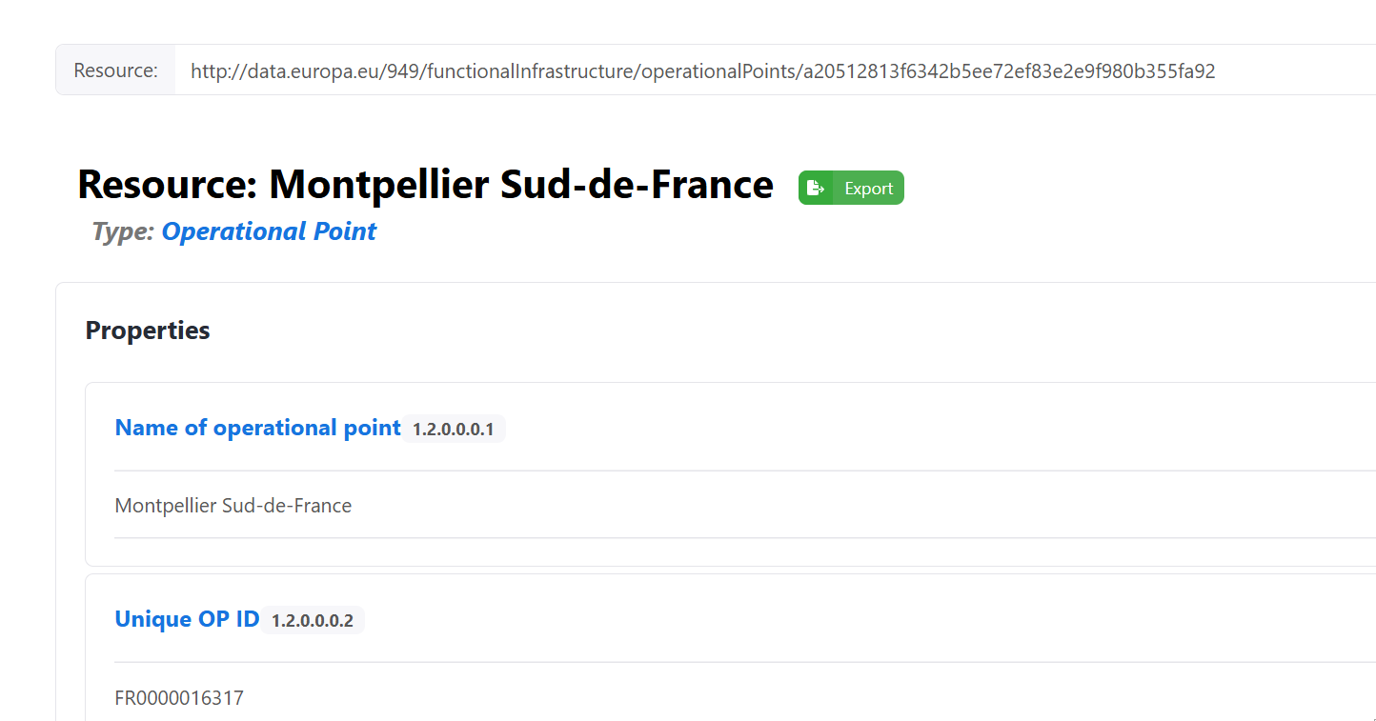
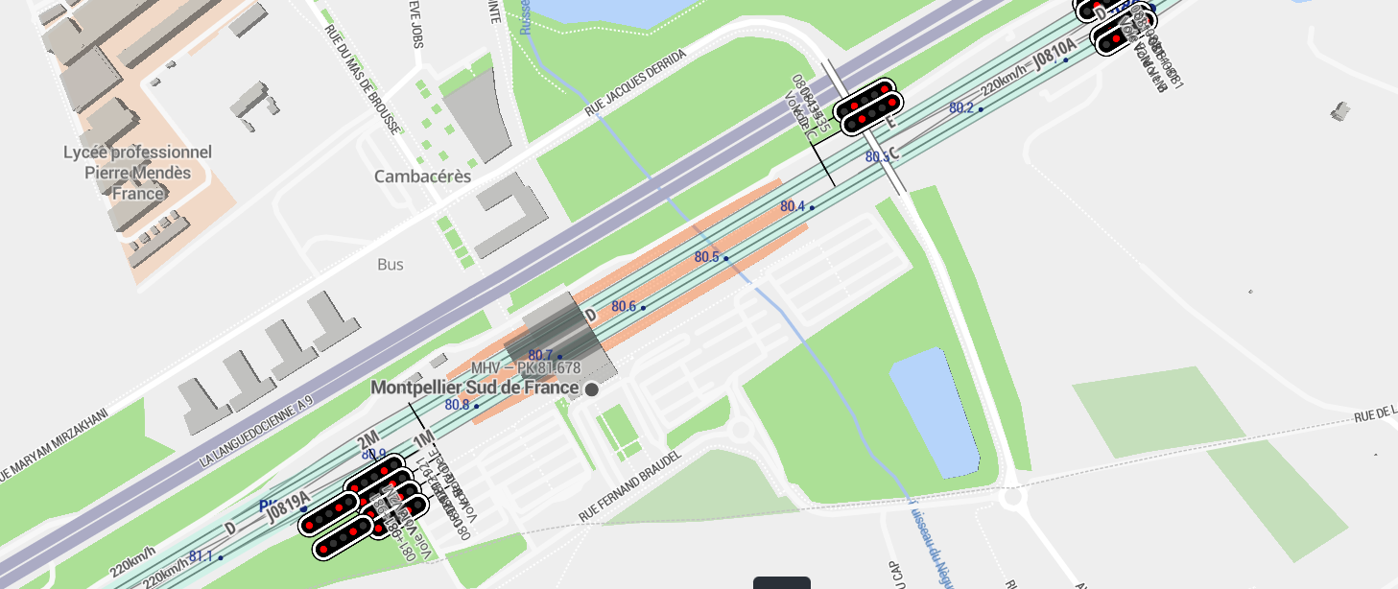
What are we modelling?
A station is an Operational Point (OP) at the beginning or end of a Section of Line (SoL), with a linear reference, containing a list of technical parameters to be provided by Infrastructure Manager (IM) according to Technical Specifications (TSIs).

Slide 14
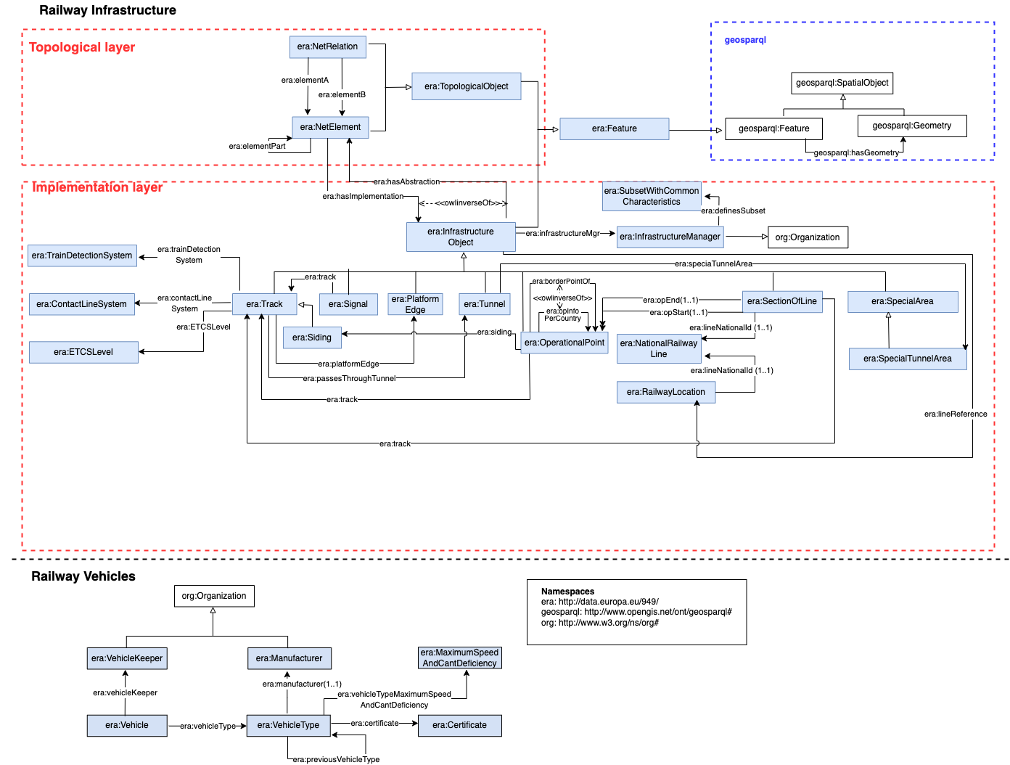
ERA Ontology Overview v.3.0.x
https://data-interop.era.europa.eu/era-vocabulary/

Slide 15



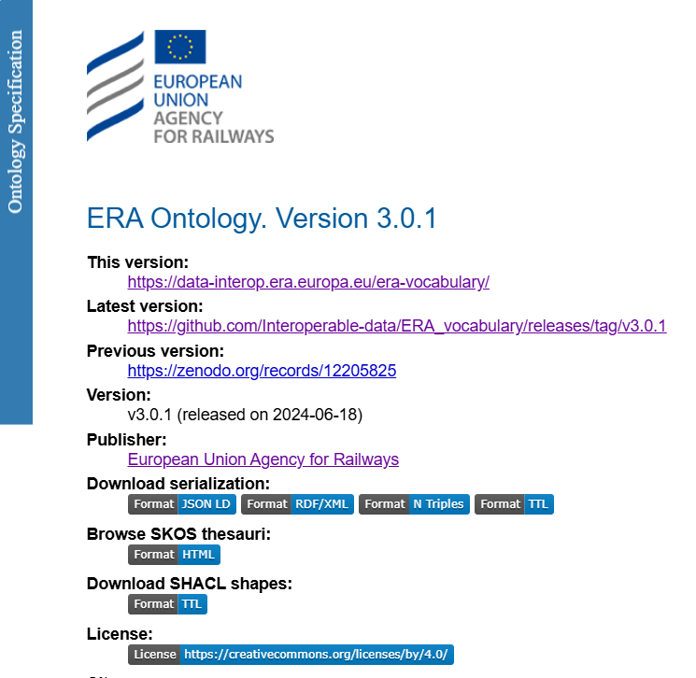
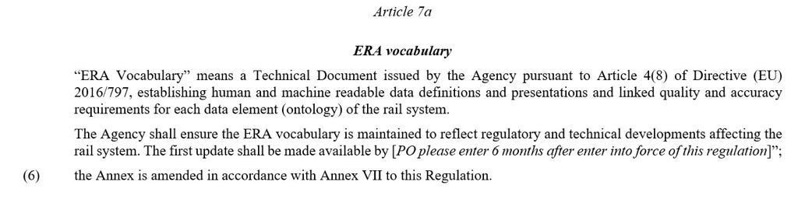
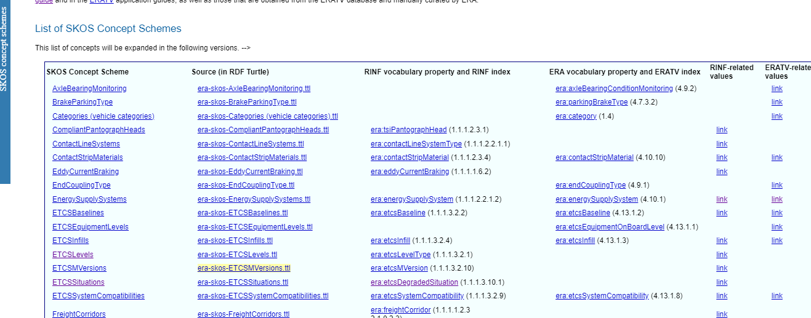

KG GENERATION PIPELINE
ERA as neutral ontology provider and identity provider for the data exchange in the EU Common European Mobility data space facilitating data interoperability in the Transport Sector
Harmonization of Processes
Sectorial Legal Basis
Harmonization of :
Terms – vocabulary – ontology governance
Reference data – taxonomies controlled vocabulary
Management of Code List reference data EVN, locations
ERA vocabulary (europa.eu)
Article 7 enacts semantic approach via ERA vocabulary/ontology
1st EU legal text enacting an ontology in the railway sector
SKOS Concept Schemes used in the ERA vocabulary (europa.eu)
Link to ERA eng. rules

Slide 16
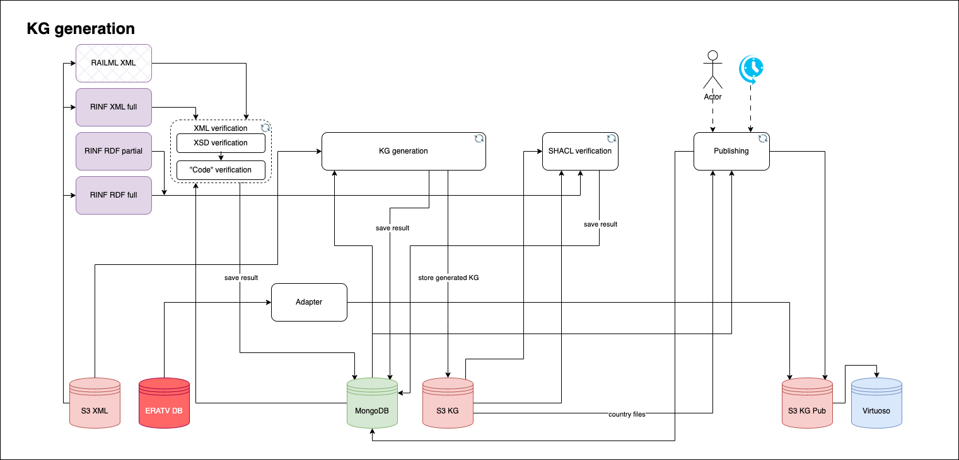
KG GENERATION PIPELINE

Slide 17
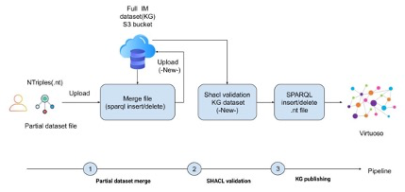
KG PARTIAL UPDATE

Slide 18
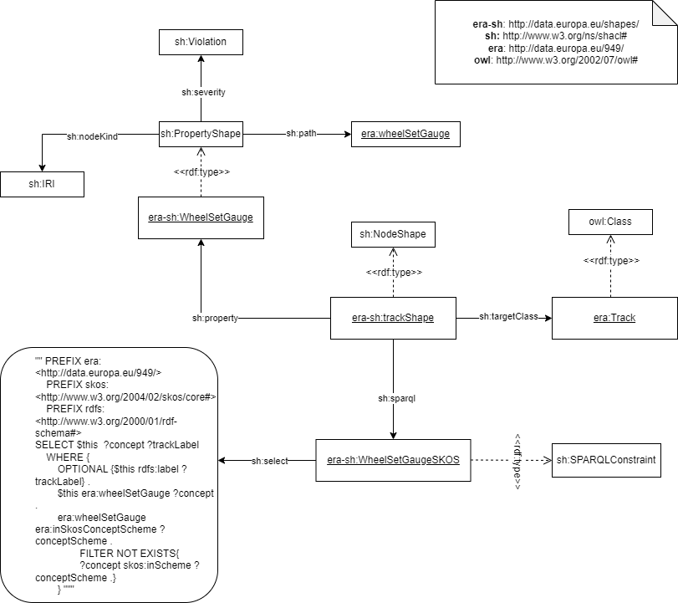
SHACL patterns
SHACL types | Total
sh:SPARQLConstraint | 60
sh:PropertyShape | 733
sh:pattern | 34
sh:NodeShape | 15

Slide 19
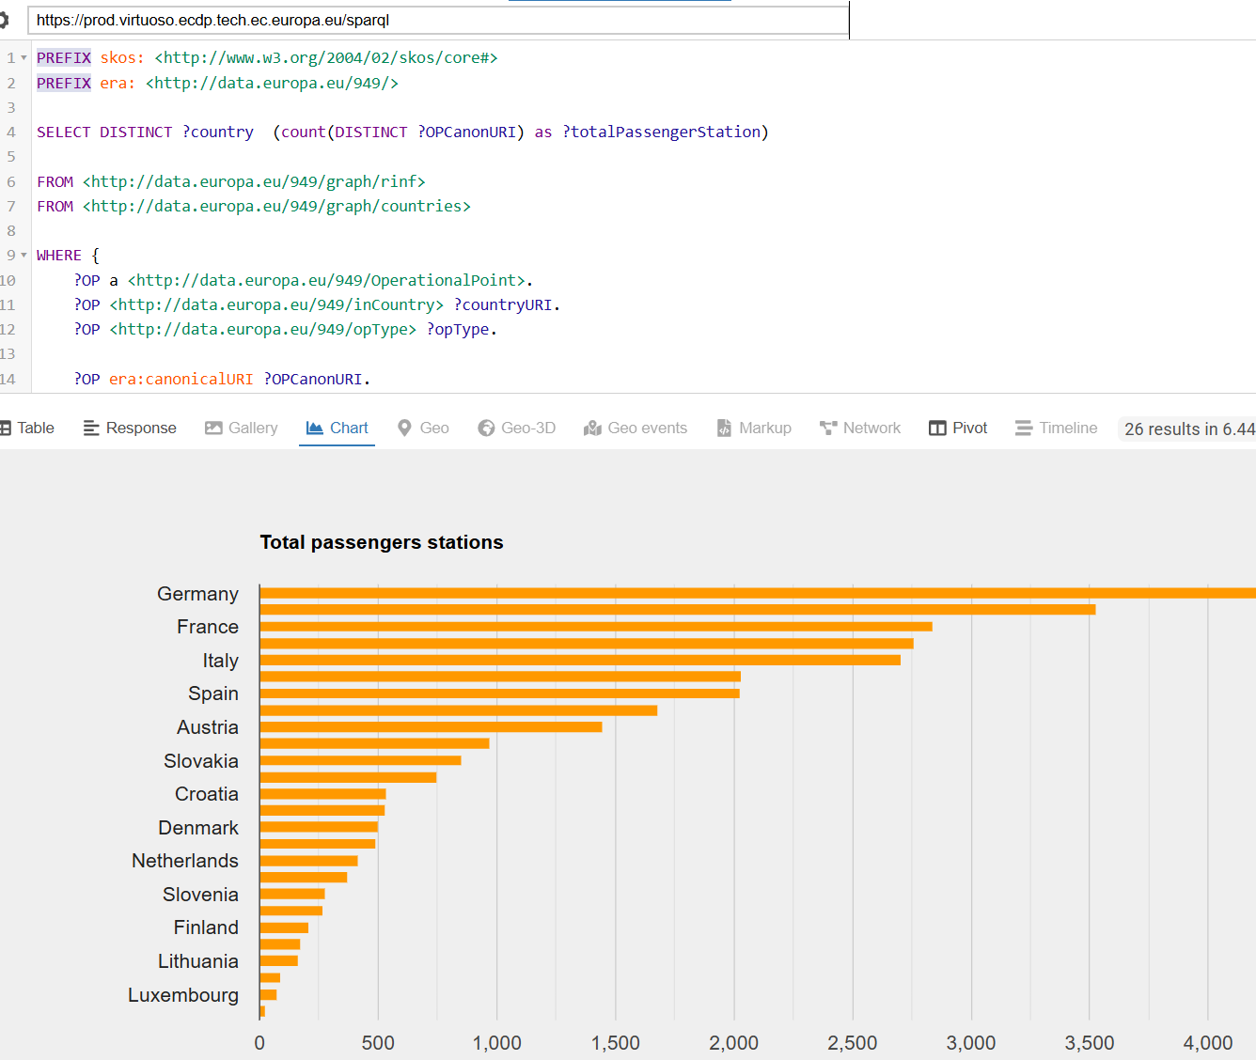
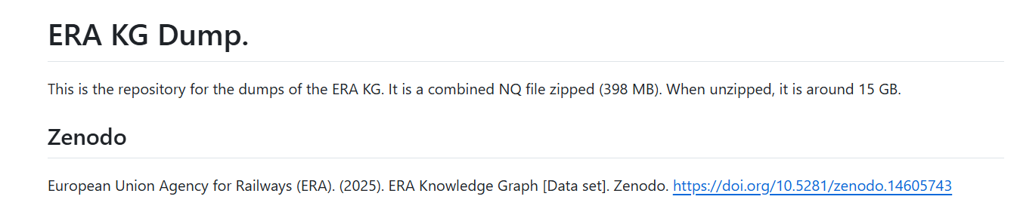
ERA Knowledge Graph
https://prod.virtuoso.ecdp.tech.ec.europa.eu/sparql
Named Graph | URI | Triples count
Infrastructure managers | http://data.europa.eu/949/graph/im | 18,287
ERA type of vehicles | http://data.europa.eu/949/graph/eratv | 210,715
EU countries | http://data.europa.eu/949/graph/countries | 28,175
Railway infrastructure | http://data.europa.eu/949/graph/rinf | 49,041,365
Reference code list | http://data.europa.eu/949/graph/skos | 10,238
Ontology | http://data.europa.eu/949/graph/ontology | 7,021
 | Total triples | 49,315,801

Slide 20
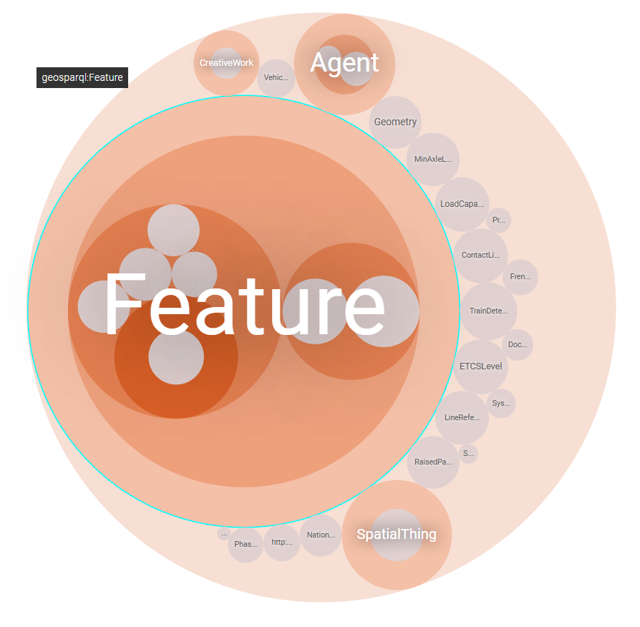
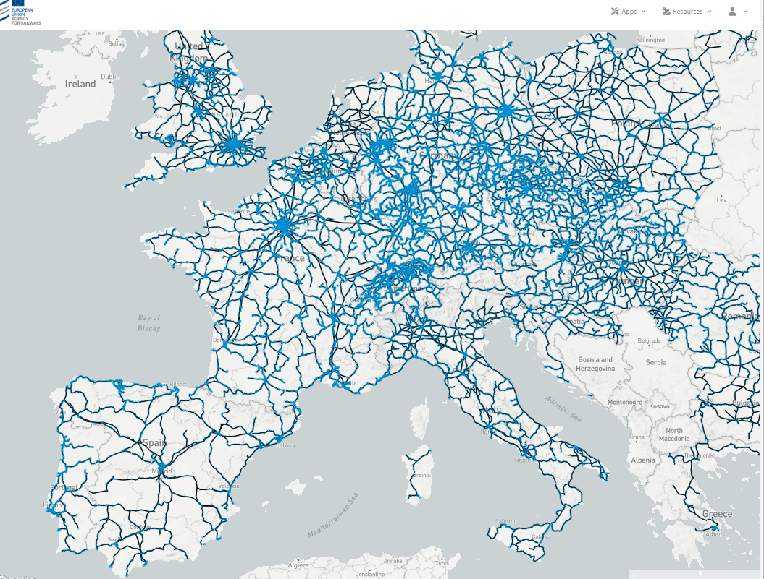
ERA — Map explorer (europa.eu).
More than 53 million triples
More than 31k lines of mappings
More than 100 SHACL shapes
+270k track segments described
+50k stations described
+50k geo-referenced objects (lat/long)
+2k Vehicle Types described
26 countries covered (EU countries)
ERA — Route Compatibility Check (europa.eu)

Slide 21

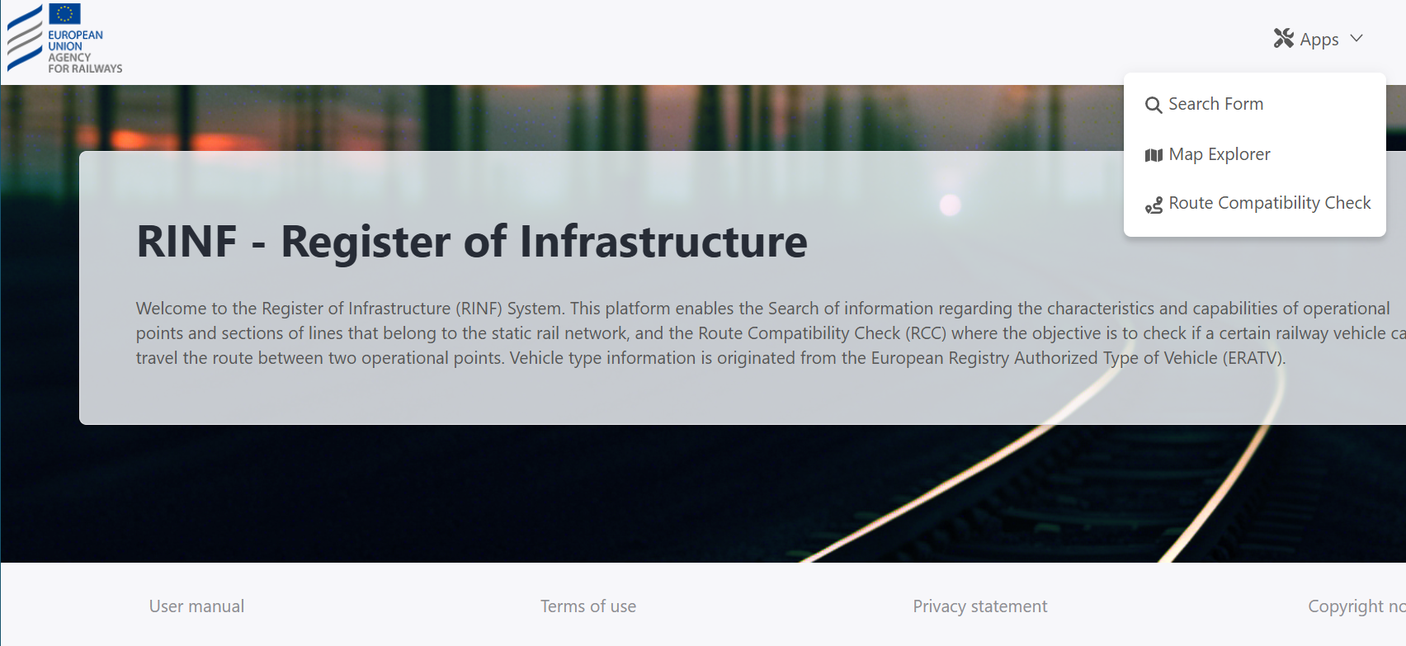
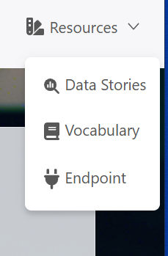
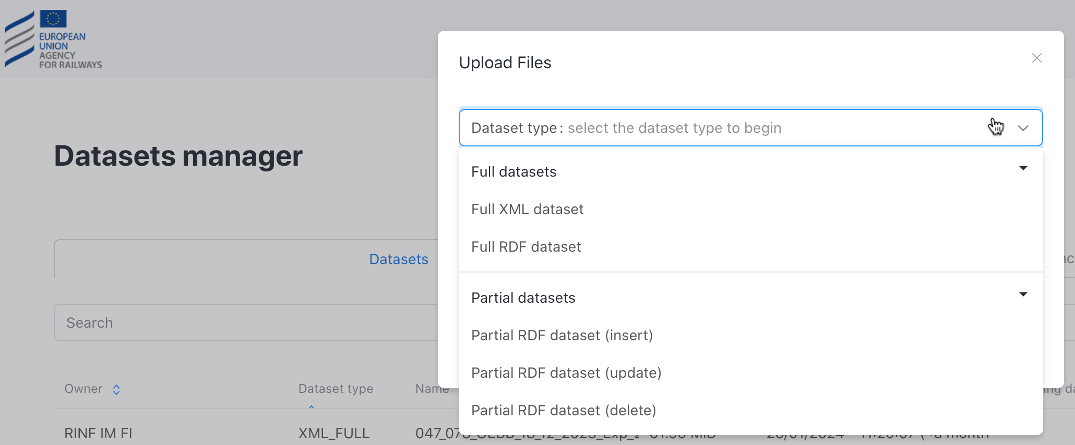
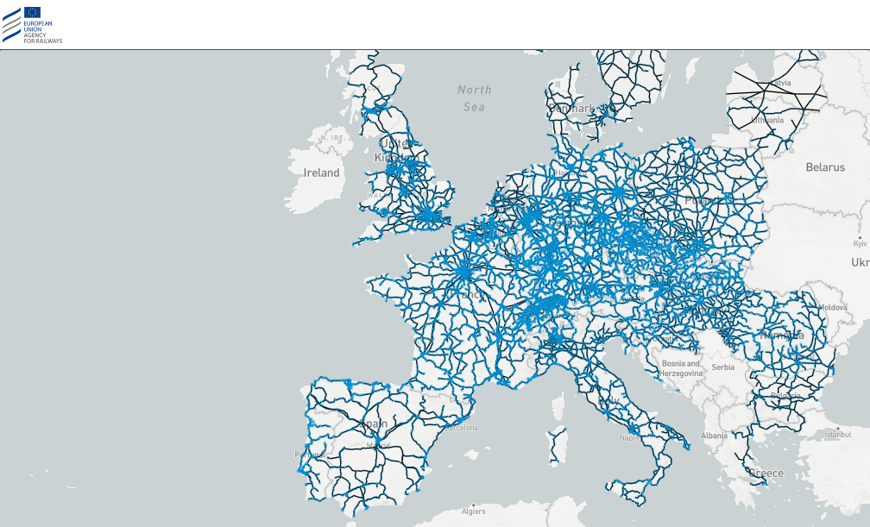
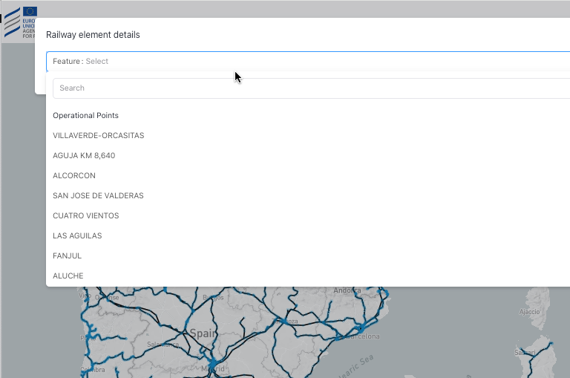
Applications
https://data-interop.era.europa.eu/

Slide 22
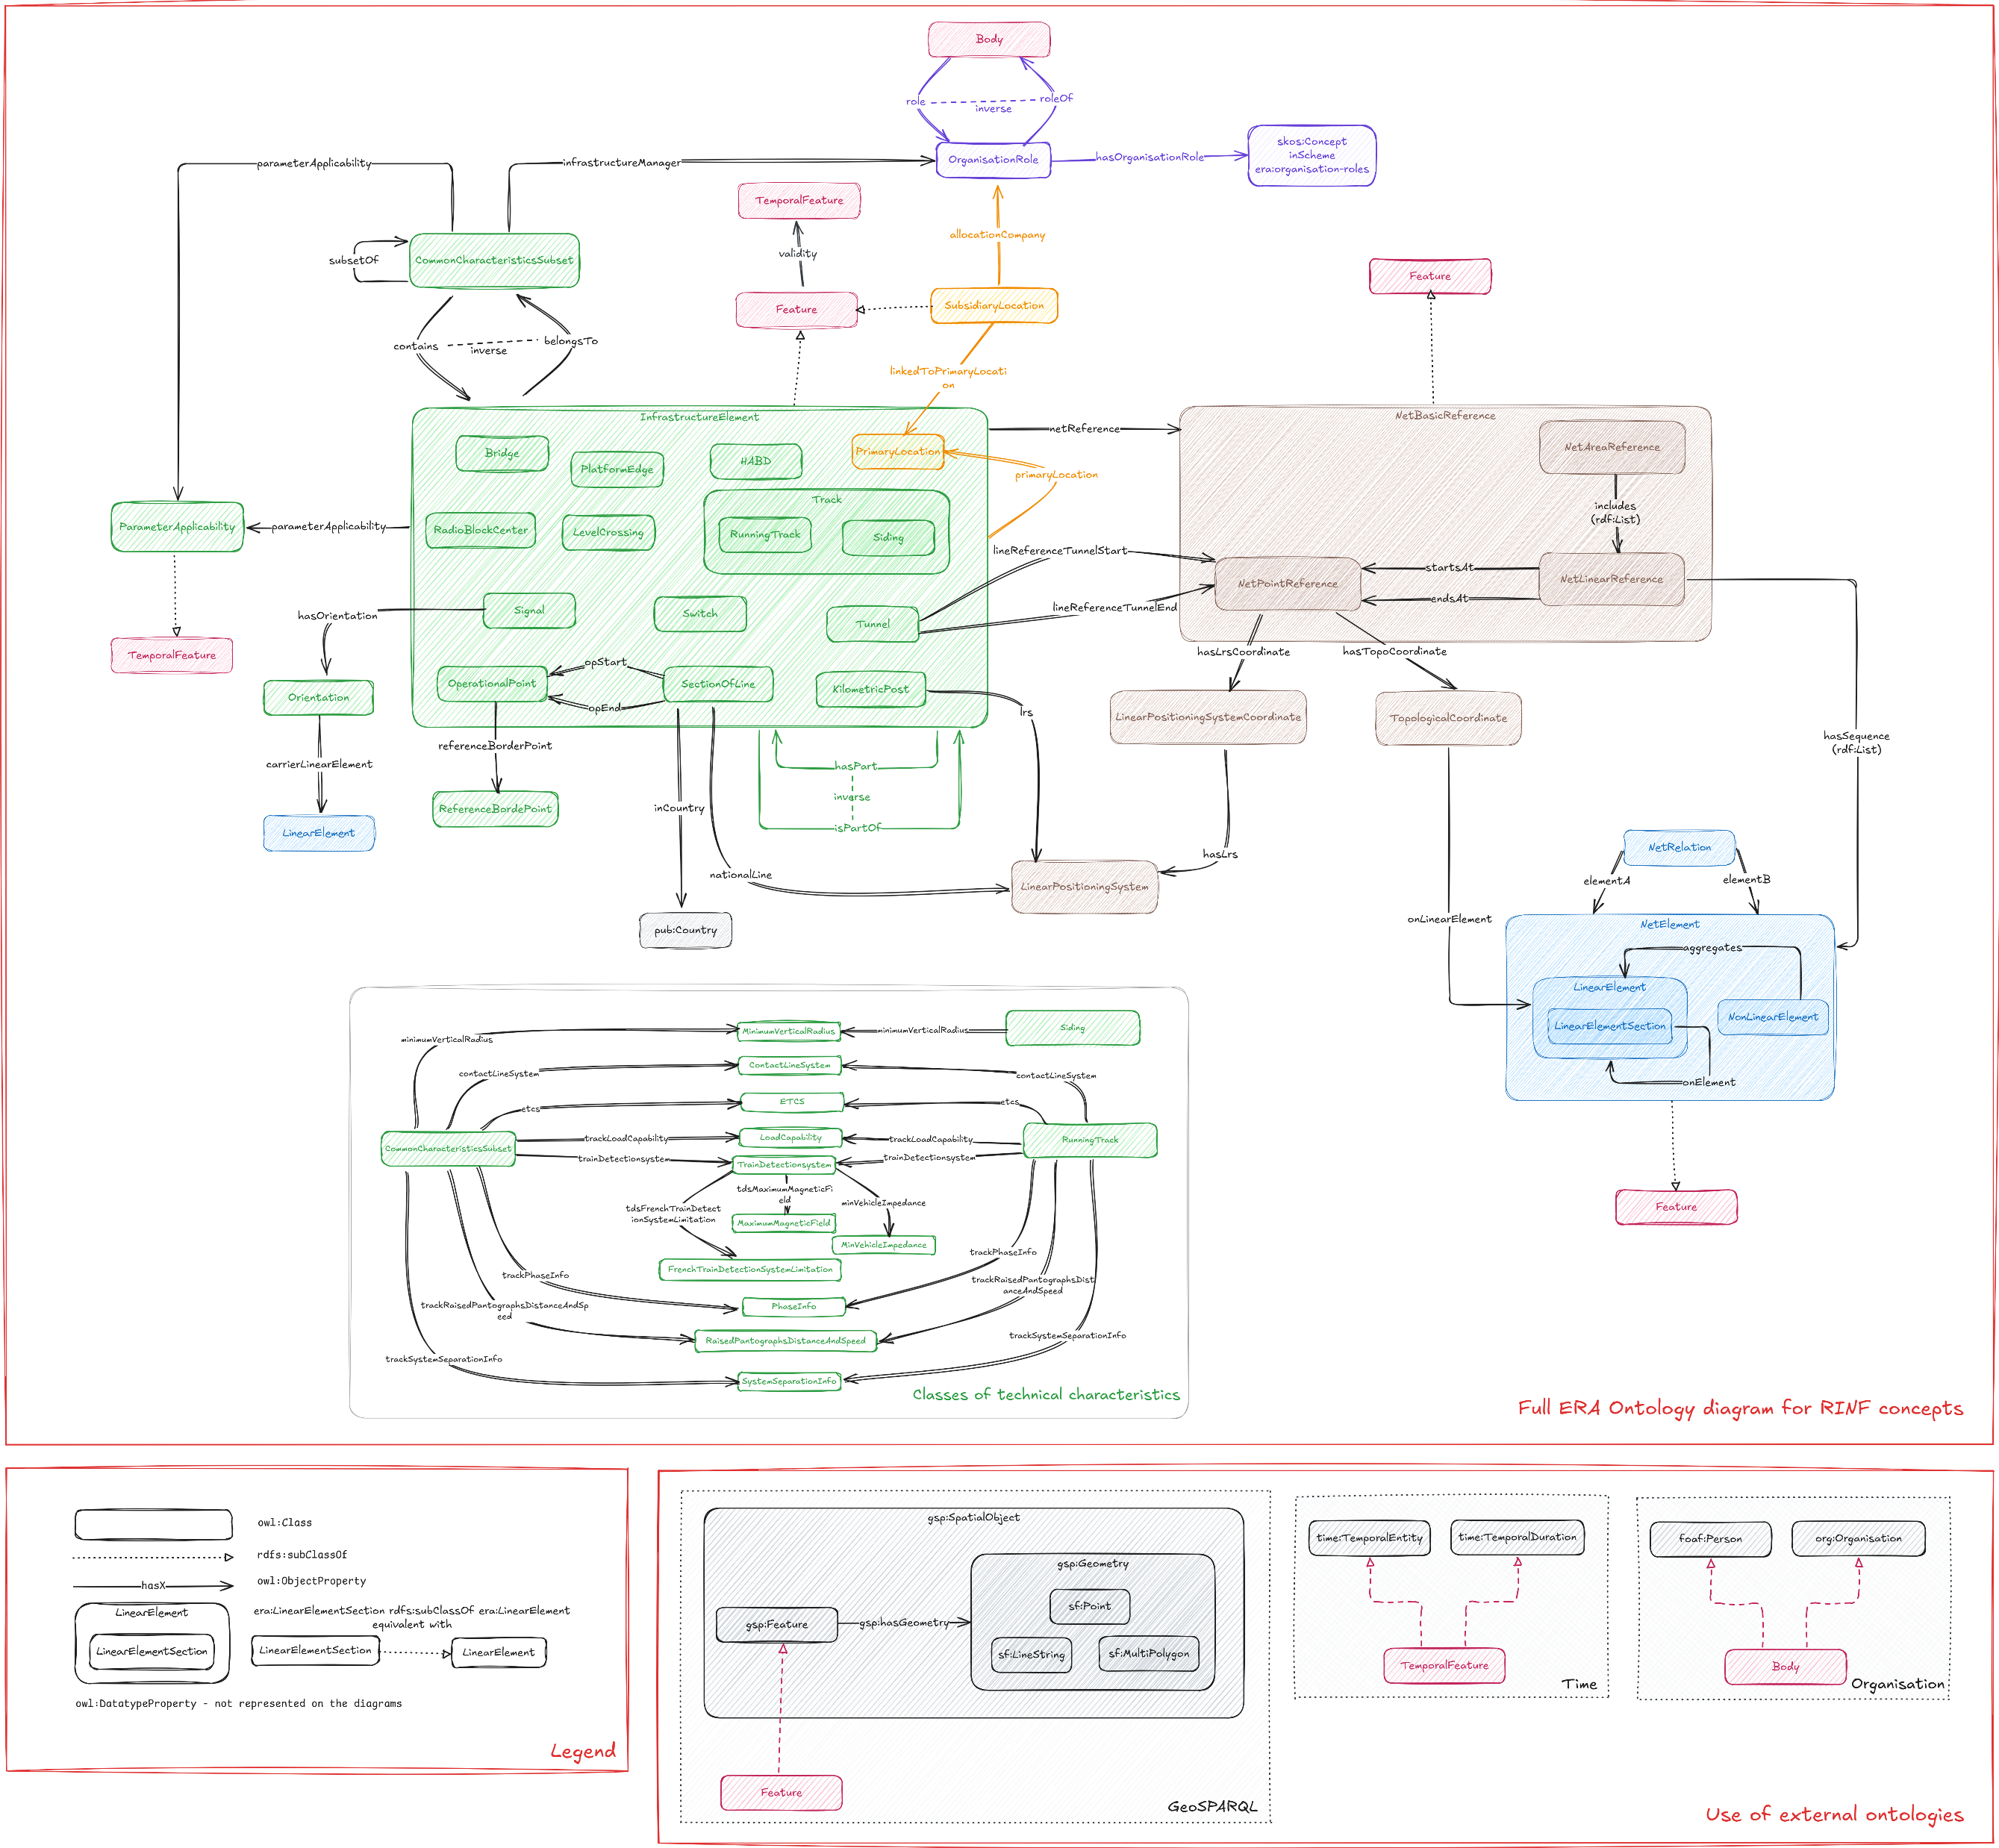
Integration of Micro-Level – Ontology v3.1.x
Use cases covered:
Route book data compilation
Tracks connectivity and navigability
Better geographical representation
Telematics locations data integration
Future planning for infrastructure
Ontology v3.1.0 (release on 31 March 2025)
https://gitlab.com/era-europa-eu/public/interoperable-data-programme/era-ontology/era-ontology/

Slide 23
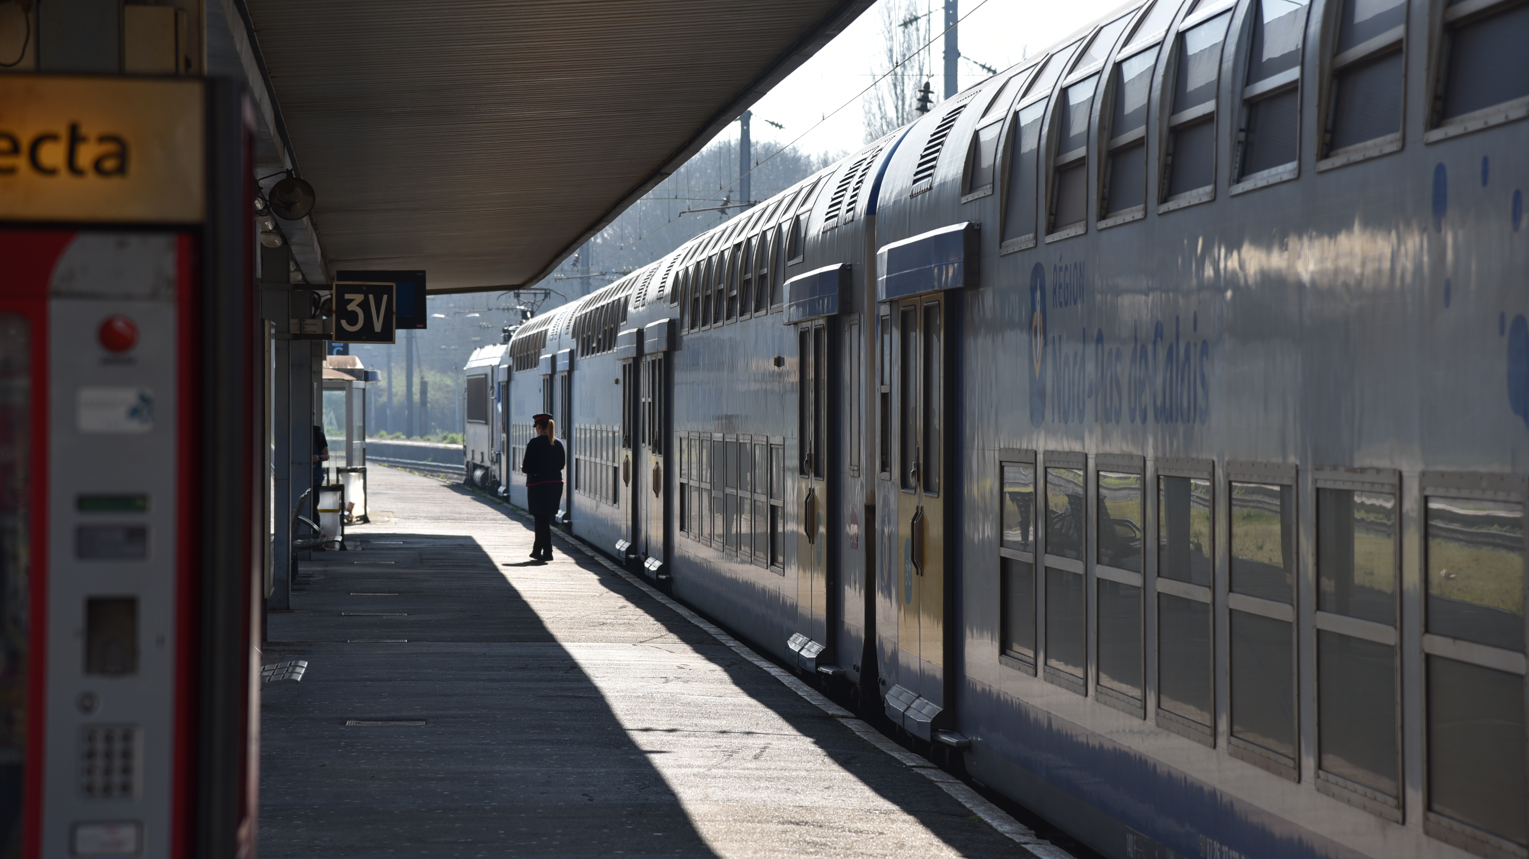
Challenges

Slide 24








The Challenges (1/2)
Multi-lingual aspect of the ontology, due to technical terms (EU languages)
  Harmonization of reference data used in different context
Coexistence of data compliant with different regulatory texts.
Scalability issue with SHACL rules in data provision of small updates
  Pyschacl vs Maplib vs Java SHACL librairies
Building rich application functionalities on top of KG
  The heavy burden of backwards compatibility requirement
Ontology alignment with other railway/transport standards

Slide 25
The Challenges – Technical (2/2)
Data quality dimensions
  Completeness
  Manual data provision and validation, prone to human error
  Undefined content (other, additional information, comments, etc.)
  Missing identifiers among different content types
Complexity of existing database structures
Data or information infused in the application logic
Complexity of organisations’ data
  Errors, typos, small differences
  Duplicate or not? Merging among different data sources
  Missing unique identifier, Organisation code optional or not existing
  Historical evolution

Slide 26

TAKE AWAY MESSAGE
Harmonisation of rail standards definitions with Ontology at EU level
Use of open software
Use of W3C and open standards
Agnostic to different formats XML schemas/ data bases
Aligned with other existing ontologies
Aligned with existing models (UMLs, XSD, etc.)
New questions to the knowledge graph formulated on demand
Backwards compatible with previous (in house) developments
Data more relevant than the application layer Easily extendable with other sources RINF and ERATV (partially) available as 4-star Linked Data
ERAKG: A Core Semantic Knowledge for Railways

Slide 27
Thanks!
ghislain.atemezing@era.europa.eu
https://data-interop.era.europa.eu
Interoperable data programme · GitLab

Slide 28

Demo Time

Slide 29
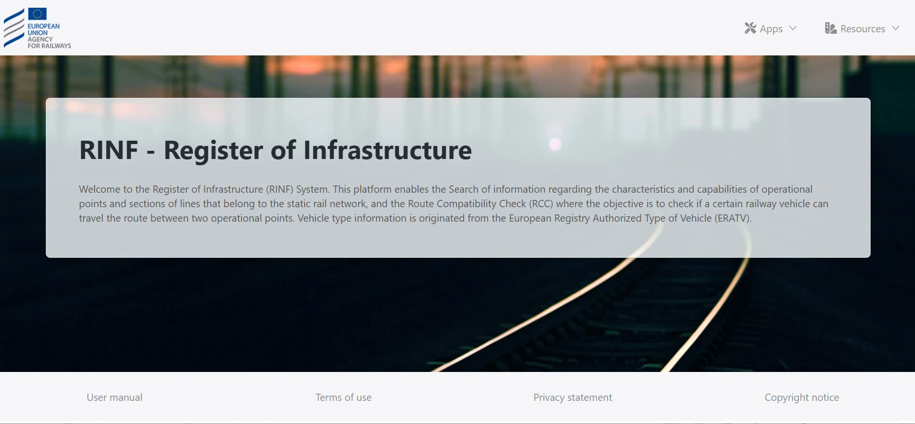
Demo - recording

