Slide 1
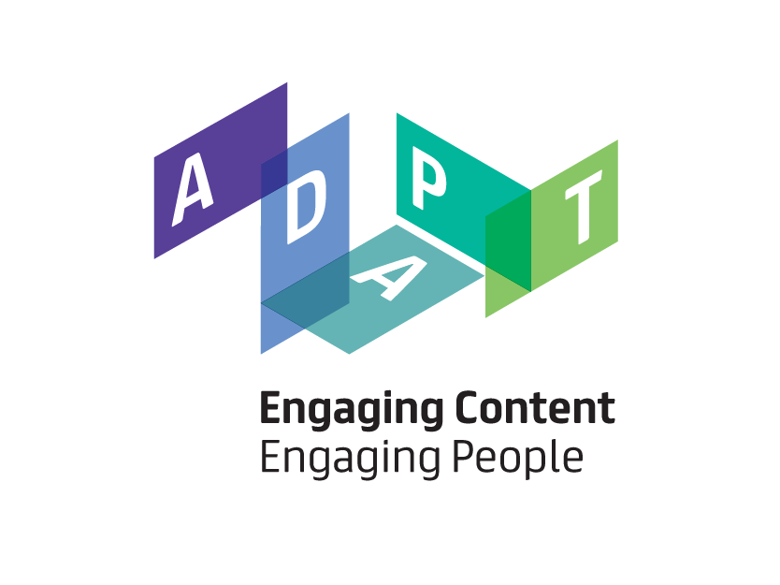
Harshvardhan J. Pandit, ADAPT Centre at Trinity College Dublin
pandithj@tcd.ie
Open Reference Data for Implementation of the AI Act

Slide 2
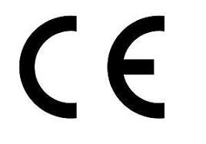
EU AI Act
Objective:
Protect health, safety and fundamental rights
Enable access to EU single market
for AI products/services
Part of New Legislative Framework
Product health and safety harmonization
across EU single market
A Risk-based approach to regulating AI
      Requires Product Certification & Surveillance for high-risk AI system
Specifically also regulates
General Purpose AI (GPAI) Systems
Unacceptable Risk: Prohibited (Art 5)
AI With Transparency Obligation
(Art 50)
High Risk: conformity assessment (Art 6-49)
Voluntary Codes of Conduct
(Art 95-96)
General Purpose AI (GPAI) Models
(Art 51-56)
Non-High Risk (Art 6.3, 80)
Open Reference Data for Implementation of the AI Act

Slide 3
Mapping to Emerging Concepts and Requirements
Regulatory Learning needs to be reconciled across multiple layers:
Implementing, delegated Acts
Standards
Guidelines, codes, best practice
Certification and surveillance decisions
Fundamental rights rulings
Sandboxes
Advisory panel and EAIB, EDPB
LL9: Fundamental Rights Adequacy: EC, EP, MS
LL8: Digital and Product Legislation Interplay: EC, EP, MS
LL7: AI Act Legislative Review Cycle: EC, EP, MS
LL6: Voluntary Guidelines: EC
LL5: General Purpose AI Rules: EC, NCA
LL4: Horizontal Rules and Standards: EC, NCA, JTC21,
LL3: Vertical Rules and Standards: EC, JTC21, MSA, NB
LL2: Organizational Learning – management system standards
LL1: Individual Learning – AI literacy & competences
Open Reference Data for Implementation of the AI Act

Slide 4
Complex Information Exchange
Oversight Authorities
AI systems are now regulated in the EU
New risks management and documentation obligations on AI Providers and AI Deployers
Requires lots of complex, multi-party information exchange
Many legal uncertainties, lots of regulatory learning needed – a ‘regulatory turn’ in AI Ethics
Multistakeholder engagement must represent citizen views on fundamental rights impact: reporting and redress, public observatories, incidents logs, legitimate regulatory learning
Semantic Web Technologies offer FAIR, open, extensible, decentralized models for AI Risk and Documentation
Standardized tools needed for regulatory info automation support for scaleable compliance and surveillance
AI Provider
Data Provider
Value Chain
AI Deployer
Model Provider
Affected Stakeholders
Open Reference Data for Implementation of the AI Act

Slide 5
Compliance Requirements
Extract and link concepts deemed relevant to satisfying each requirement into further SKOS concept scheme
Extract defined terms from Act as SKOS Concept Scheme (Art 3)
Separate atomic requirement statements from Act Provisions (Art 10.1 to 10.6) and add Requirement concept for each to a requirement collection
Article3-29 | training data
Article3-30 | validation data
Article3-31 | validation data set
Article3-32 | testing data
Article3-33 | input data
Article3-34 | biometric data
Article3-35 | biometric identification
Article3-37 | special categories of personal data
Article3-38 | sensitive operational data
Article3-50 | personal data
Article3-51 | non-personal; data
10.2. Training, validation and testing data sets shall be subject to data governance and management practices appropriate for the intended purpose of the high-risk AI system. Those practices shall concern in particular:
(a) the relevant design choices;
(b) data collection processes and the origin of data, and in the case of personal data, the original purpose of the data collection;
…..
(h)….
Article10-2-r1 | Training, validation and testing data sets shall be subject to data governance and management practices appropriate for the intended purpose of the high-risk AI system.
Article10-2-a-r1 | [Data governance and management practices shall concern in particular] the relevant design choices
Article10-2-b-r1 | [Data governance and management practices shall concern in particular] data collection processes and the origin of data, and in the case of personal data, the original purpose of the data collection
Open Reference Data for Implementation of the AI Act

Slide 6
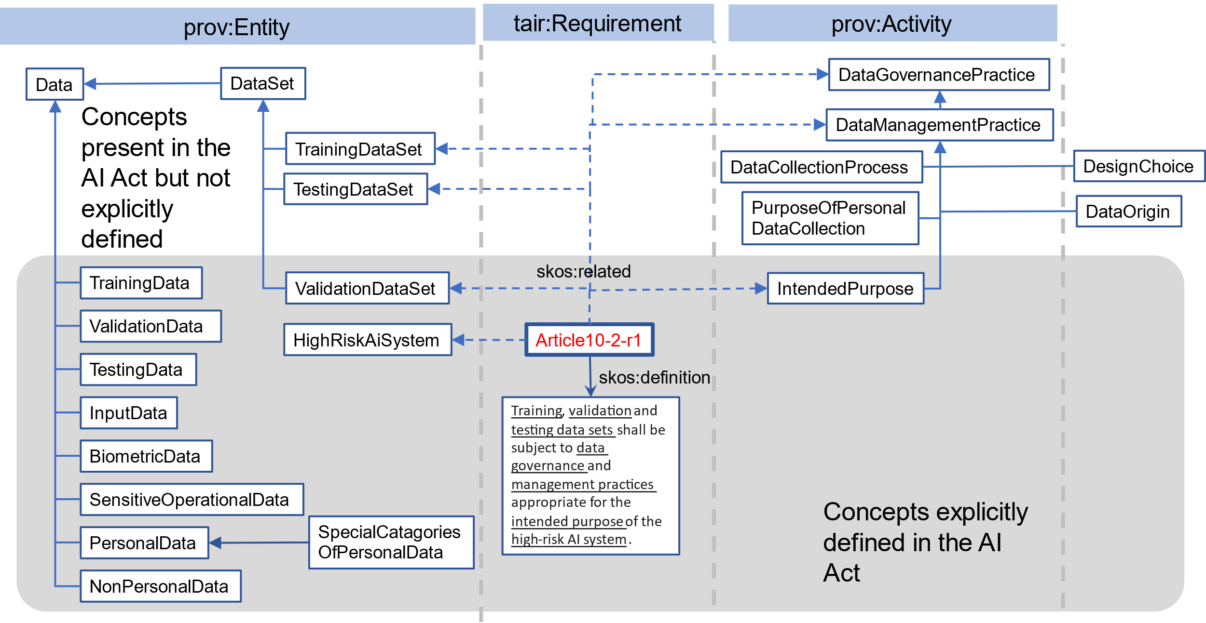
Compliance Requirements as a Knowledge Graph
skos:related
Open Reference Data for Implementation of the AI Act
skos:broader

Slide 7
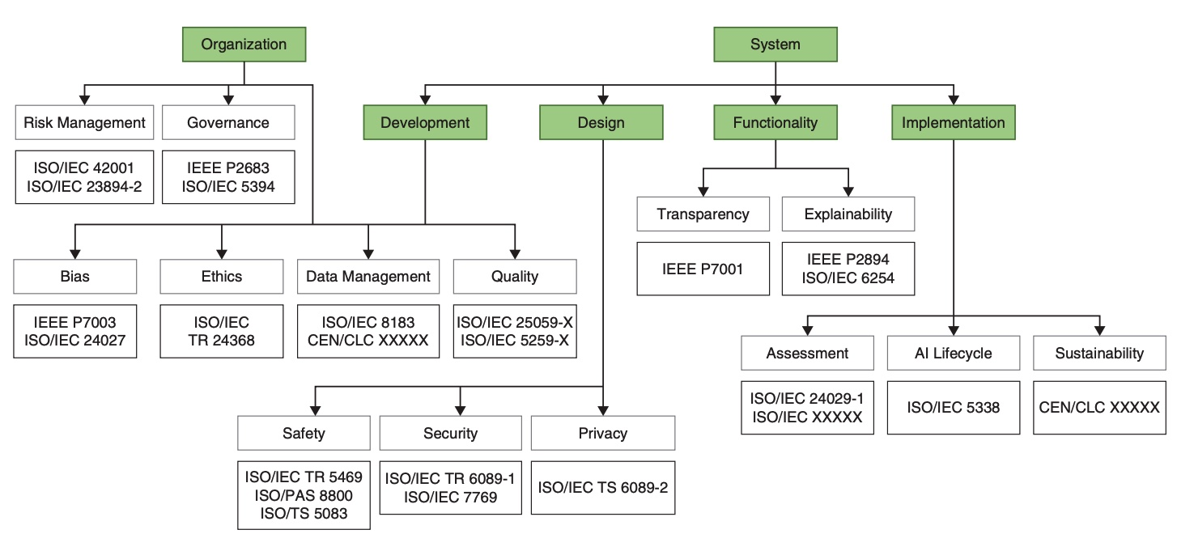
Standards Tracking
Open Reference Data for Implementation of the AI Act

Slide 8
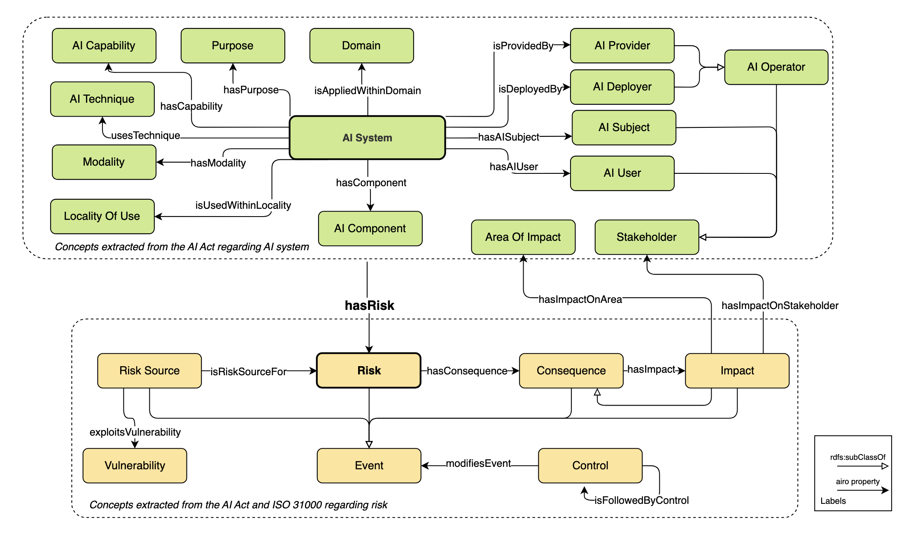
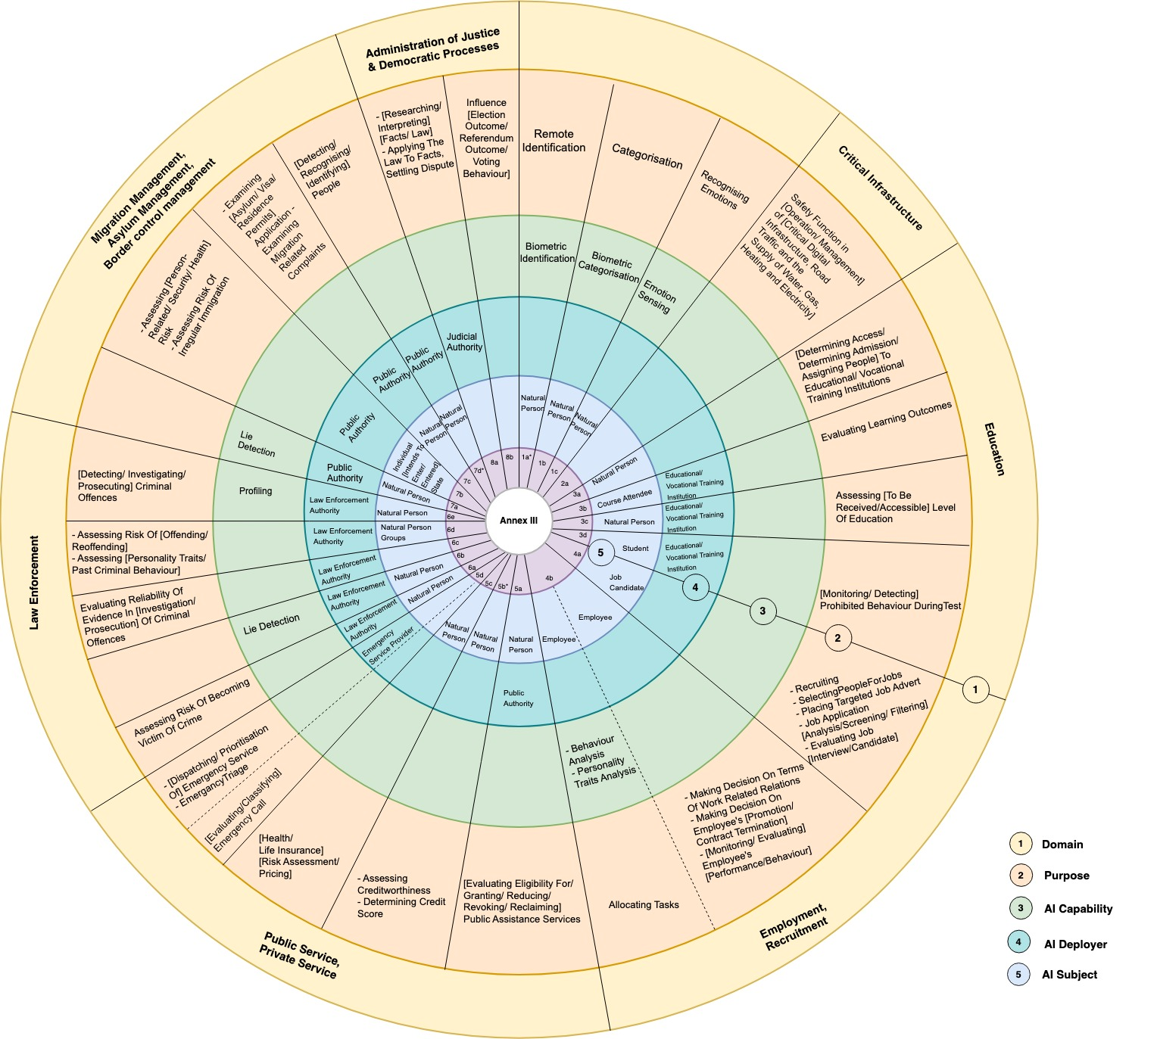
AI risks and mitigation measures models
  https://regtech.adaptcentre.ie
Delaram Golpayegani, Harshvardhan J. Pandit, and Dave Lewis. “AIRO: An ontology for representing AI risks based on the proposed EU AI Act and ISO risk management standards”. In: Towards a Knowledge-Aware AI. Vol. 55. IOS Press. 2022, pp. 51–65. https://doi.org/10.3233/SSW220008
Delaram Golpayegani, Harshvardhan J Pandit, and Dave Lewis. “To Be High-Risk, or Not To Be–Semantic Specifications and Implications of the AI Act’s High-Risk AI Applications and Harmonised Standards”. In: Proceedings of the 2023 ACM Conference on Fairness,
Accountability, and Transparency. 2023, pp. 905–915 https://doi.org/10.1145/3593013.3594050
Open Reference Data for Implementation of the AI Act

Slide 9
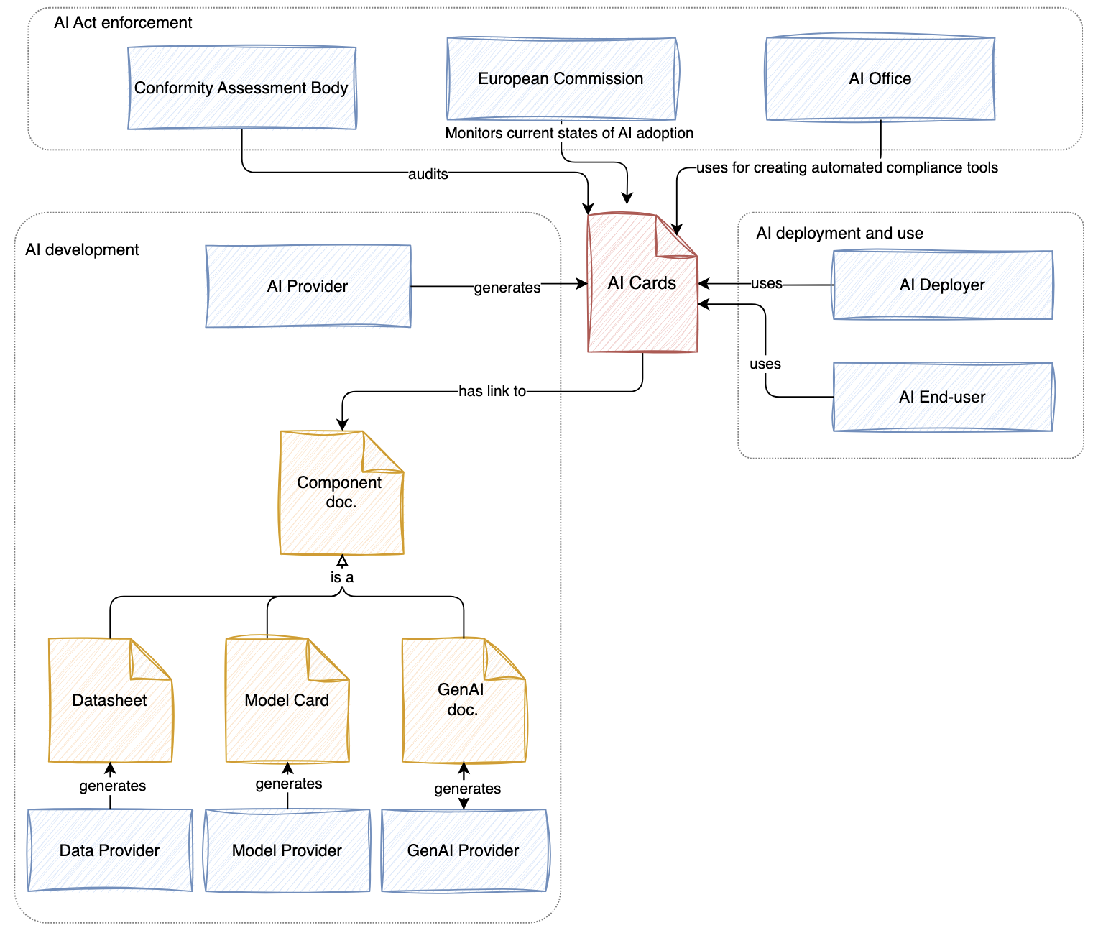
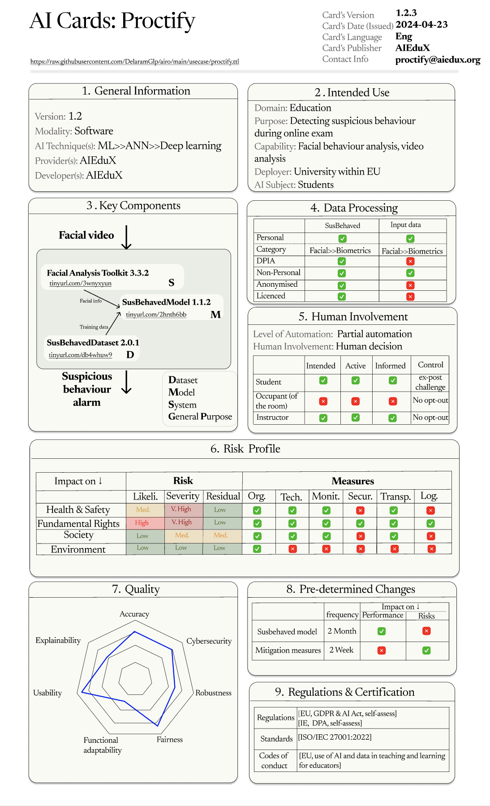
Technical documentation for AI systems
D. Golpayegani, I. Hupont, C. Panigutti, H.J. Pandit, S. Schade, D. O’Sullivan, and D. Lewis. “AI Cards: Towards an Applied Framework for Machine-Readable AI and Risk Documentation Inspired by the EU AI Act”. In: Privacy Technologies and Policy https://doi.org/10.1007/978-3-031-68024-3_3
Open Reference Data for Implementation of the AI Act

Slide 10
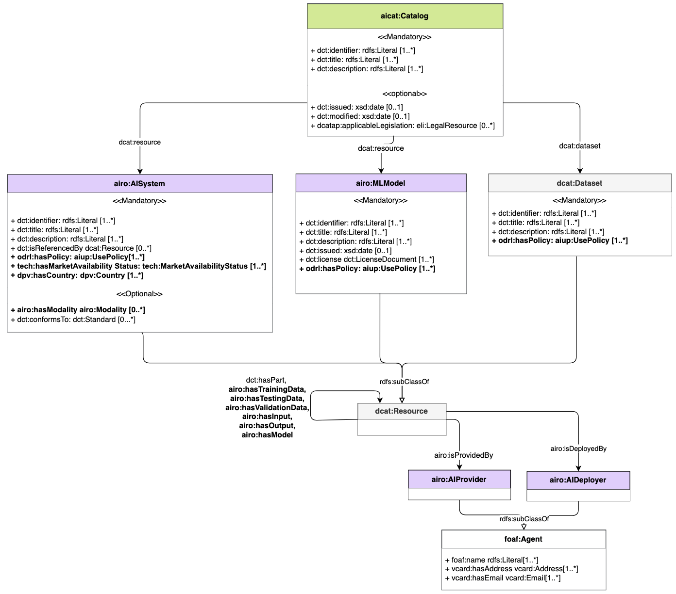
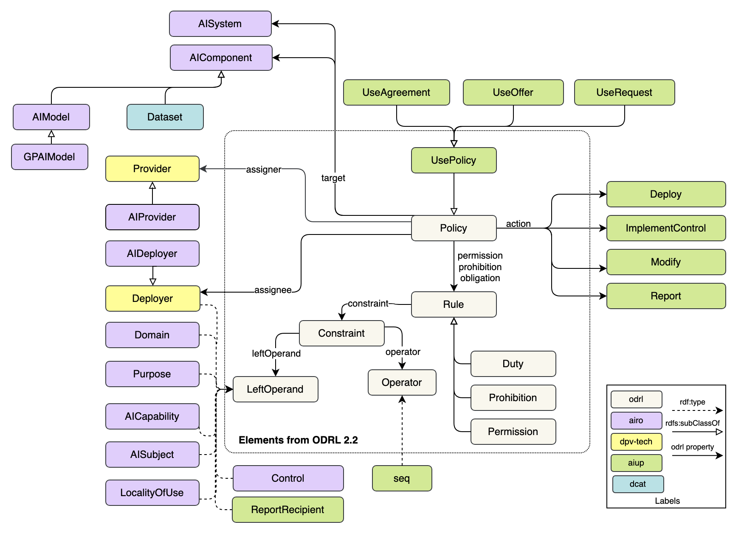
EU-Compliant Data & AI model catalogues
“AIUP: an ODRL Profile for Expressing AI Use Policies to Support the EU AI Act”, Delaram Golpayegani, Beatriz Esteves, Harshvardhan J. Pandit, and Dave Lewis, SEMANTiCS 2024
https://ceur-ws.org/Vol-3759/paper17.pdf
Open Reference Data for Implementation of the AI Act

Slide 11
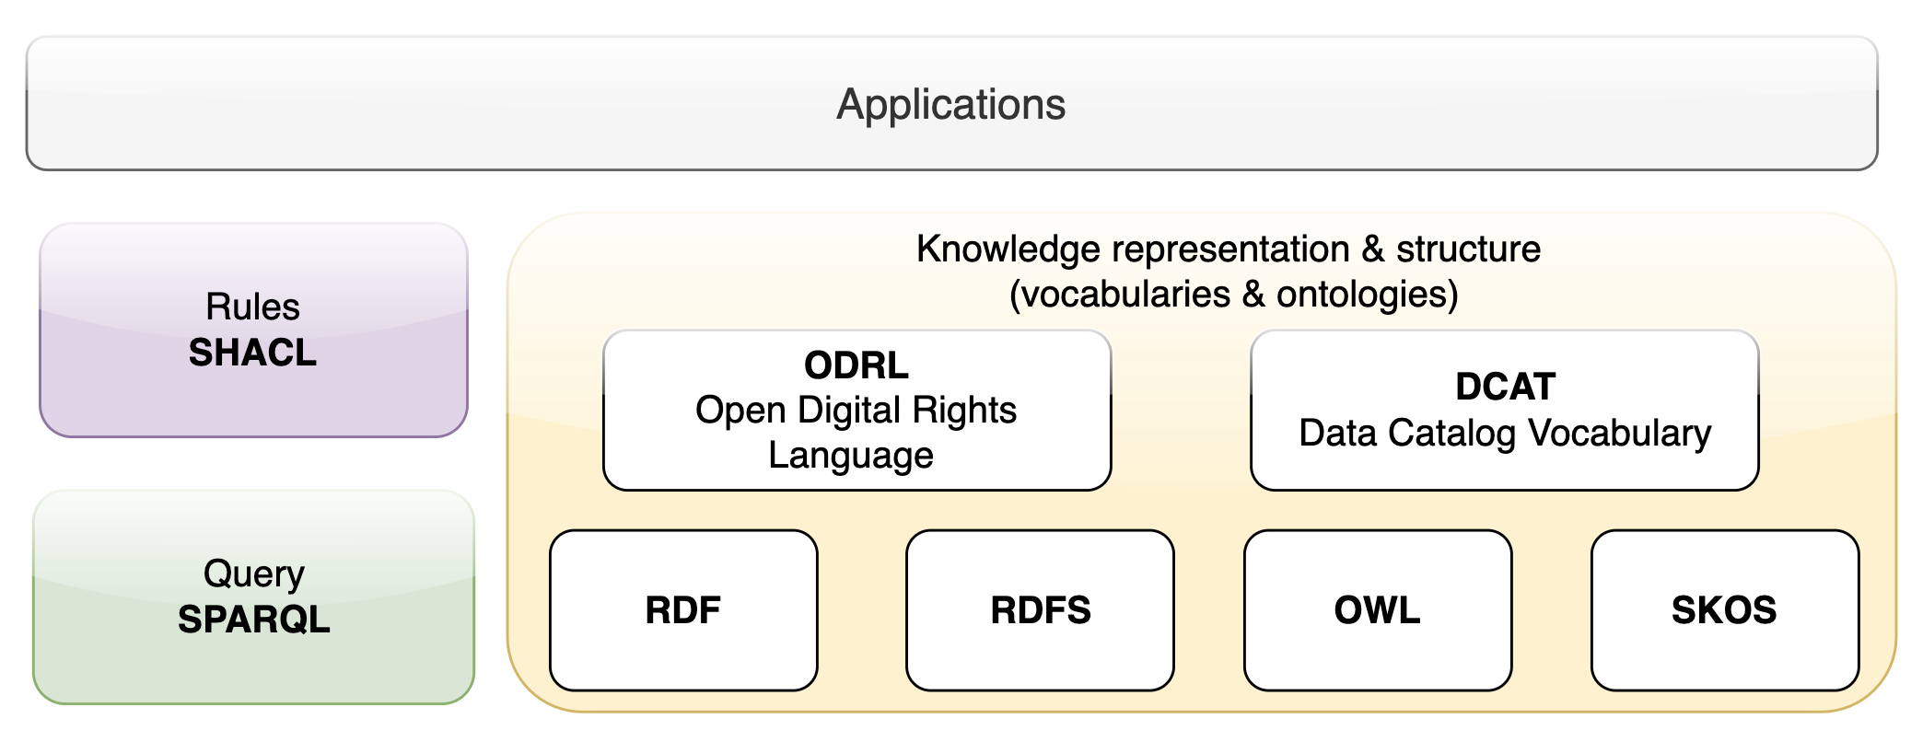
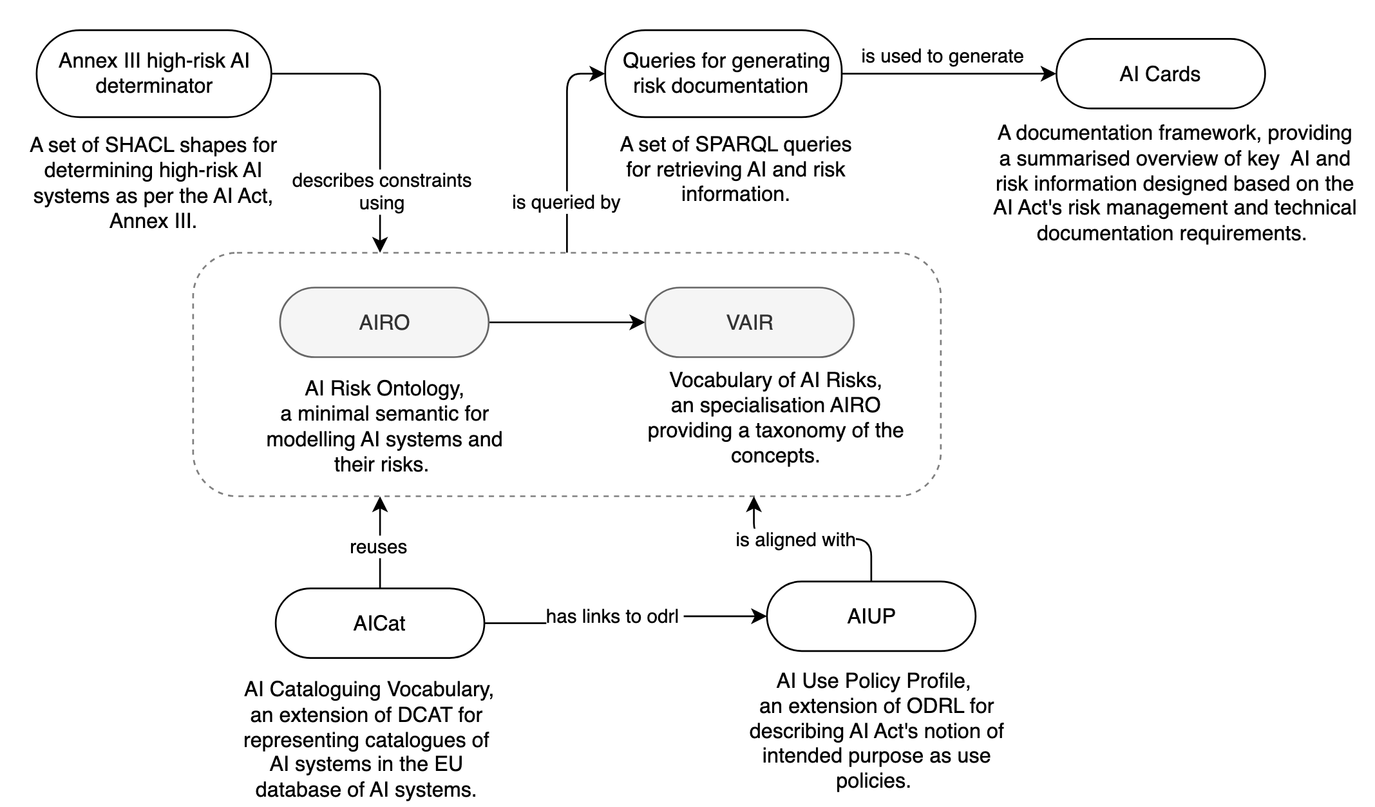
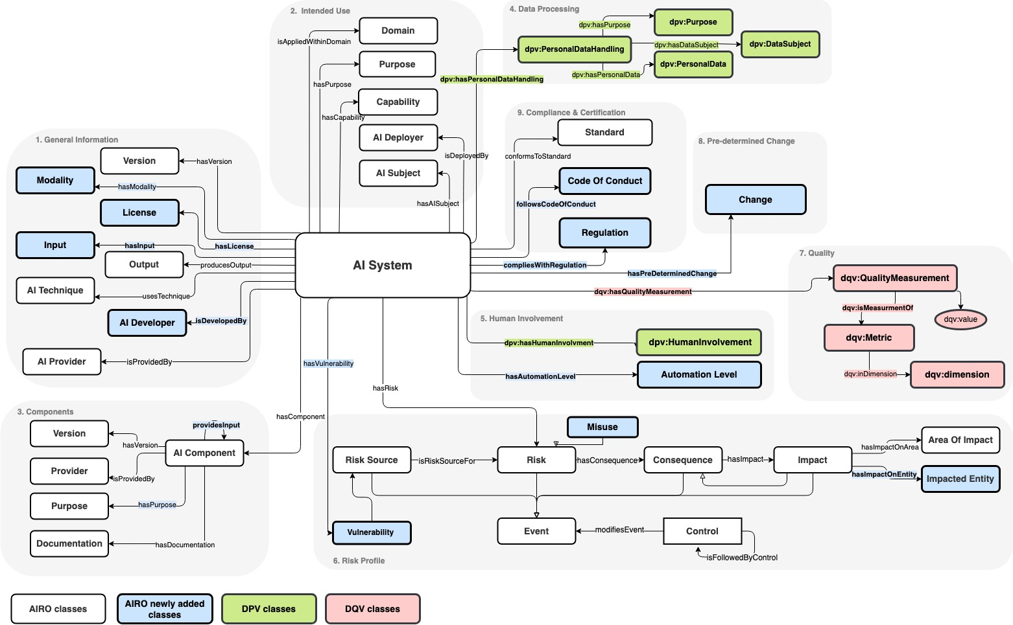
Bringing it all Together
  https://regtech.adaptcentre.ie
  https://w3id.org/dpv/
Open Reference Data for Implementation of the AI Act

Slide 12
Summary: Addressing AI Act Compliance Standards and Interoperability Challenges with SemWeb
AI Act Challenges
Interoperability Challenges
Semantic Web Benefits
AI Act is a Learning Framework
Provisional, extensible, progressively specific semantic vocabularies
Mappable & comparable Parallel development through name spaces
De Jure Standards focus on process vs info exchange
Mapping Act and harmonised standard into workable interoperability specifications
Semantic interoper., Serialisation and Web API integration
Need for broad stakeholder engagement
Open access availability, especially for SME, NGO, public sector
OSS tools for queries, constraints, rules, catalogues & user interfaces
Complex value chains
Specialised and extensible upper layer models for permissionless innovation in different sectors
Upper layer models, serialisation, API and access control
Open Reference Data for Implementation of the AI Act

Slide 13
Thanks!
For further info on models see:
https://regtech.adaptcentre.ie/
Collaboration opportunities:
https://harness-network.eu/
https://standict.eu/
https://foreseeproject.eu/
https://recitals-project.eu/
https://www.w3.org/community/dpvcg/

