Slide 1
Ioannis G. Fountoukidis and Eleni L. Dafli
AI-Driven Interoperability in Public Procurement Data
Knowledge Graphs, Ontologies, and Machine Learning for Trend Prediction

Slide 2
The need!
Fragmented procurement data hinders analysis and transparency
ePO and TED enable structured, interoperable representation
Recurrence in procurement relations acts as a diagnostic signal
AI-Driven Interoperability in Public Procurement Data: Knowledge Graphs, Ontologies, and Machine Learning for Trend Prediction

Slide 3
Our Approach.
Integration of:
Graph-based data modeling
Semantic ontologies (ePO)
AI-powered querying
Predictive Analytics & ML correction
Recurrence as a diagnostic signal
LLM-assisted commentary & voice interface
AI-Driven Interoperability in Public Procurement Data: Knowledge Graphs, Ontologies, and Machine Learning for Trend Prediction

Slide 4

Knowledge Graph Construction with ePO
- Data (2018–2023) in Neo4j
- Integration with ePO
- Unified semantic representation of nodes and relationships via n10s plugin
AI-Driven Interoperability in Public Procurement Data: Knowledge Graphs, Ontologies, and Machine Learning for Trend Prediction

Slide 5
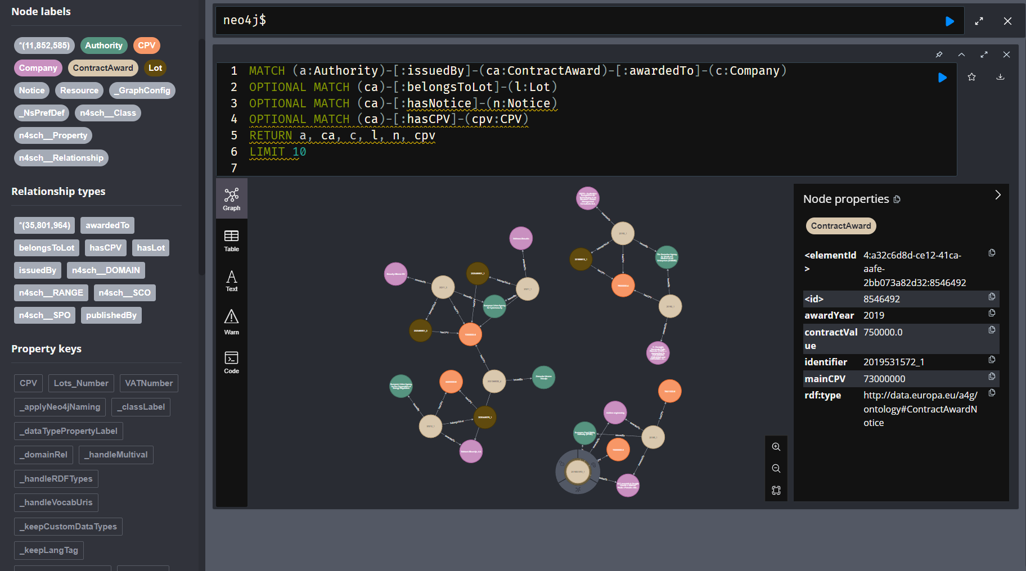
AI-Driven Interoperability in Public Procurement Data: Knowledge Graphs, Ontologies, and Machine Learning for Trend Prediction

Slide 6
Graph-based Predictive Features
Metrics:
Preferential Attachment (PA): likelihood of new links based on node degrees (“rich get richer”)
Adamic-Adar (AA): weighted common neighbors, discounts very popular nodes
Historical Volume (HV): recurrence of authority-company awards across years
AI-Driven Interoperability in Public Procurement Data: Knowledge Graphs, Ontologies, and Machine Learning for Trend Prediction

Slide 7
Machine Learning with XGBoost
ML for Link Prediction:
Features: PA, AA, HV extracted for each Authority-Company pair
Classifier: XGBoost (gradient boosting on decision trees)
Anti-leakage setup: training on past years (t) -> predicting next year (t+1)
Evaluation metrics: Precision, Recall, F1, AUC
AI-Driven Interoperability in Public Procurement Data: Knowledge Graphs, Ontologies, and Machine Learning for Trend Prediction

Slide 8
Evaluation Metrics
Precision: share of predicted links that are correct (how many of the “positives” are true)
Recall: share of true links that were predicted (how many of the real positives we captured)
F1-score: harmonic mean of precision and recall (balance of both)
AUC: overall ability of the model to separate true from false links (closer to 1 = better)
AI-Driven Interoperability in Public Procurement Data: Knowledge Graphs, Ontologies, and Machine Learning for Trend Prediction

Slide 9
Evaluation of Predictions
Training/validation split with stratification
Stable performance across CPVs and years
High predictive accuracy (AUC ∼0.99, strong precision & recall)
Confirms recurrence as a diagnostic signal in procurements networks
AI-Driven Interoperability in Public Procurement Data: Knowledge Graphs, Ontologies, and Machine Learning for Trend Prediction

Slide 10

AI-Powered Querying
Locally deployed Mistral-7B AI model
Converts natural language to Cypher queries
Empowers non-technical users to retrieve data
Generates automated commentary on prediction results
AI-Driven Interoperability in Public Procurement Data: Knowledge Graphs, Ontologies, and Machine Learning for Trend Prediction

Slide 11
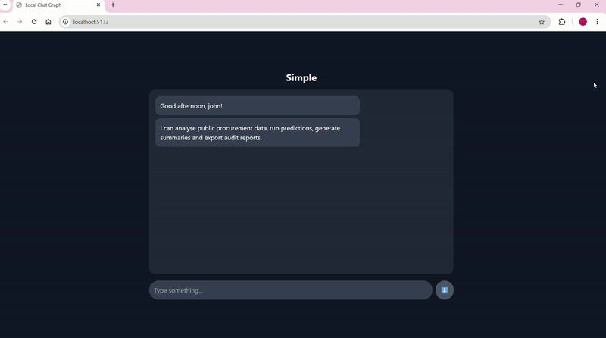
Web-Based User Interface
- User-friendly query input in natural language
- AI processes and returns results via Neo4j
- Real-time interaction and visualization
AI-Driven Interoperability in Public Procurement Data: Knowledge Graphs, Ontologies, and Machine Learning for Trend Prediction

Slide 12
Results
Standardized data structure using ePO
AI-based natural language querying
High predictive accuracy (AUC∼0,99, strong precision/recall across CPVs)
Automated commentary of results by LLM
Interactive, accessible data exploration
AI-Driven Interoperability in Public Procurement Data: Knowledge Graphs, Ontologies, and Machine Learning for Trend Prediction

Slide 13
Challenges & Future Work
Limited accuracy in complex queries
Need for extended Mistral-7B training
Cross-border interoperability and multilingual support
AI-Driven Interoperability in Public Procurement Data: Knowledge Graphs, Ontologies, and Machine Learning for Trend Prediction

Slide 14
Ioannis G. Fountoukidis: Department of Economics Aristotle University of Thessaloniki, Greece, ifountouk@econ.auth.gr
Eleni L. Dafli: School of Medicine Aristotle University of Thessaloniki, Greece, elendaf@auth.gr

