Slide 1
Kathleen Jennrich
Unit IV A 5 | Digital Ready Legislation, Interoperability, Once-Only​, Federal Ministry of Finance, Berlin, Germany
Interoperable
Legal Terms and
Data Matching

Slide 2
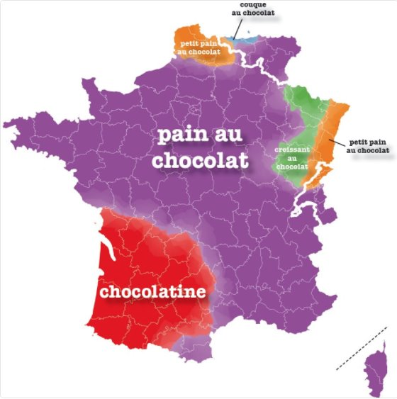
Pain au chocolat?​
Chocolatine?​
Speaking the Same ​Language:​Why Terminology Matters
„Atlas du français de nos régions“ by Mathieu Avanzi (Copyright)

Slide 3
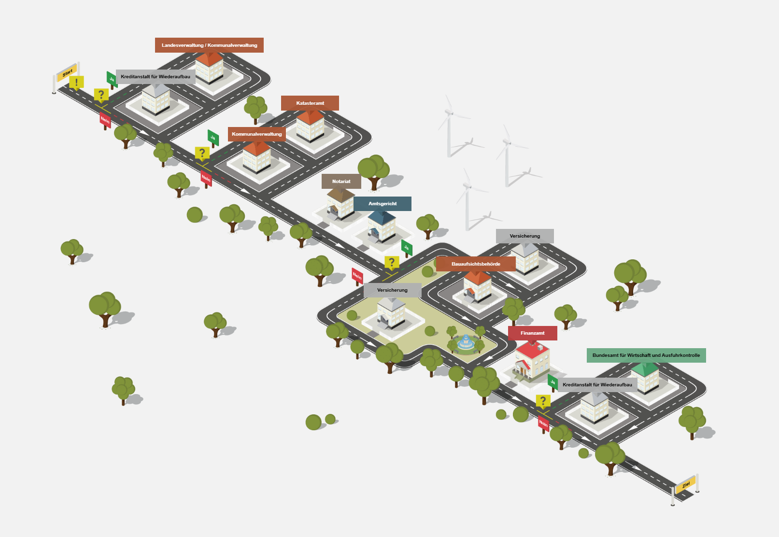
Buying a Property:
A Citizen’s Journey Through Bureaucracy ​
Source: https://www.amtlich-einfach.de/SharedDocs/Lebenslagen/Buerger/Wohneigentum_2019/html.html?view=render

Slide 4

Our Vision
Digital ready legislation that enables data reuse and exchange between digital public services through interoperable legal terms
Establishing the conditions for the Once-Only Principle to function as originally intended
Implementing Digital Readiness and Interoperability Checks to ensure seamless integration

Slide 5

A Challenge for Legislation: Dependencies and Connections between Different Laws​
§§
?
1,773 laws
with 50,738 paragraphs
2,795 ordinances
with 42,590 paragraphs
540,060 documents
in the Federal Law Database of the
Federal Office of Justice (BfJ)
Federal Government, 2022
Directory of
legal terms and
existing data sets

Slide 6

Identical Legal Terms, Different Definitions: The Root of an Inconsistent Data Landscape
Authority
A
Authority
B
§ 2 ff. Income Tax Act
Income
§ 11 ff. Social Code (SGB) II
Income
Data field A
Data field C
Data field B
Data field D
Data field C
Data field E

Slide 7

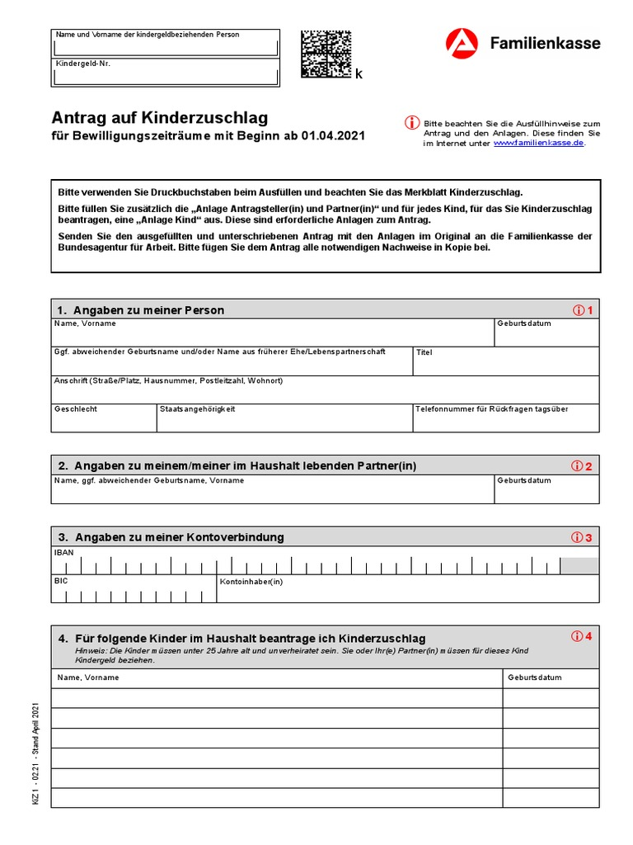
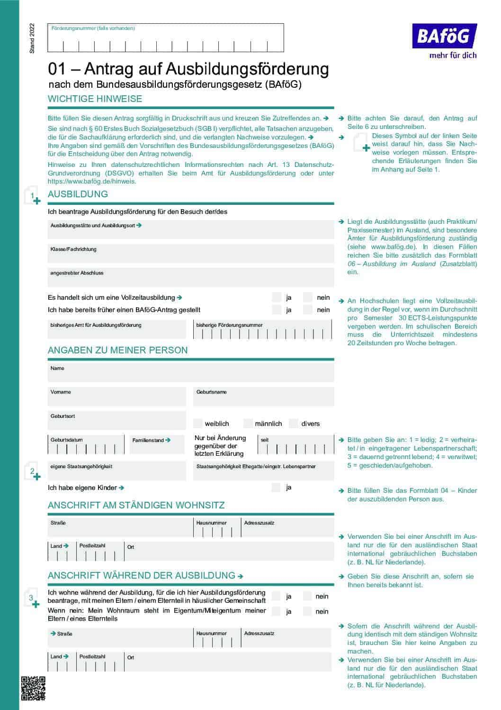

Fragmented Data Landscape in the Public Sector
Why do we enter the same data in different application forms?
Authority
A
Authority
B
§ 2 ff. Income Tax Act
Income
§ 11 ff. Social Code Book II
Income
Data field A
Data field C
Data field B
Data field D
Data field C
Data field E
The legal terminology is reflected in the data used in administrative procedures and online public service applications

Slide 8


Identifying and Mapping Legal Terms, Definitions and Dependencies with GenAI
Goal № 1
AI-supported directory of legal terms, including modularisation
Goal № 2
„Clear Terms.
Clear Data.“
AI-based development of a data structure for legal terms, their definitions, and modularisation.
eLexa is an intelligent text editor for the reuse of legal terms. The tool clearly visualises definitions, dependencies, and modules of legal terms.

Slide 9
GenAI-Supported Modularisation of Legal Terms from German Legal Code
GOAL
Using Generative AI to Identify Legal Terms, Dependencies, and Modules for Mapping to Data Fields and Developing Intelligent Assistants
SETTING
REQUIREMENTS
No legal terms
No benchmark
Accuracy
Consistency
Reproducibility
Scalability
Generic GenAI
Solution Pipeline
GenAI
Focus
Directory of legal terms
Bills
Identifying relevant legal terms and references
Modularisation
Data field mapping
Focus
Intelligent assistants

Slide 10
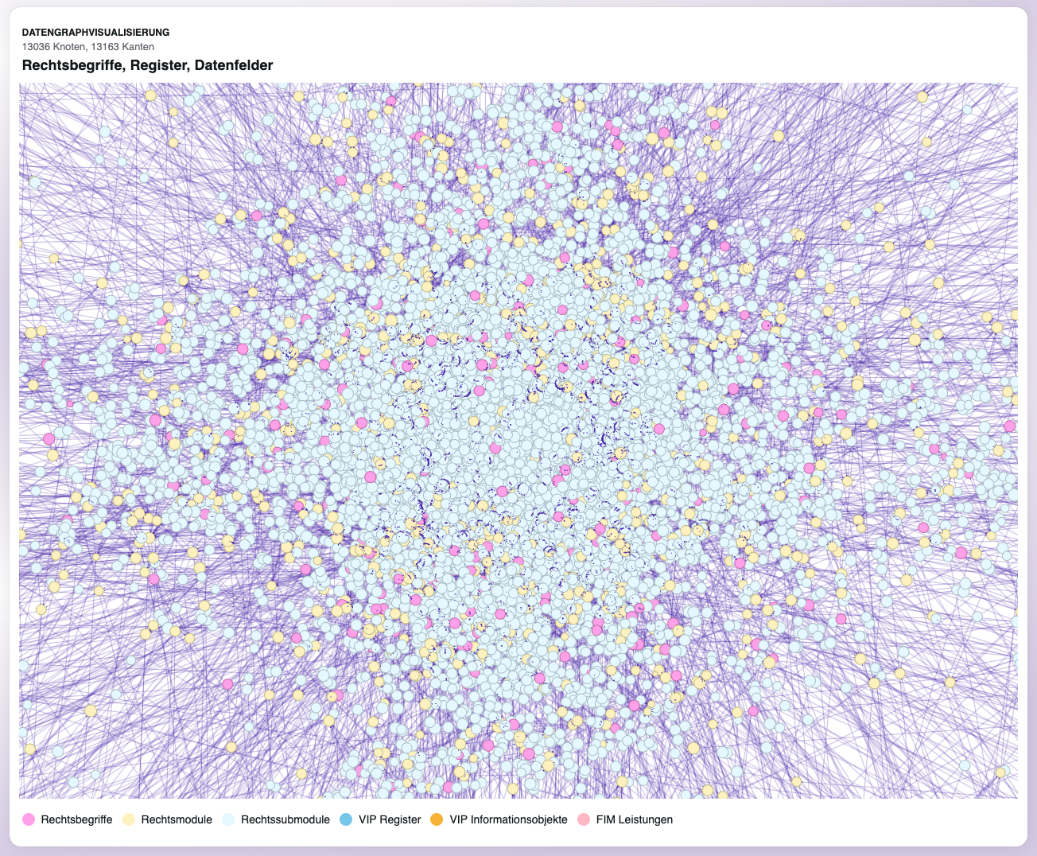
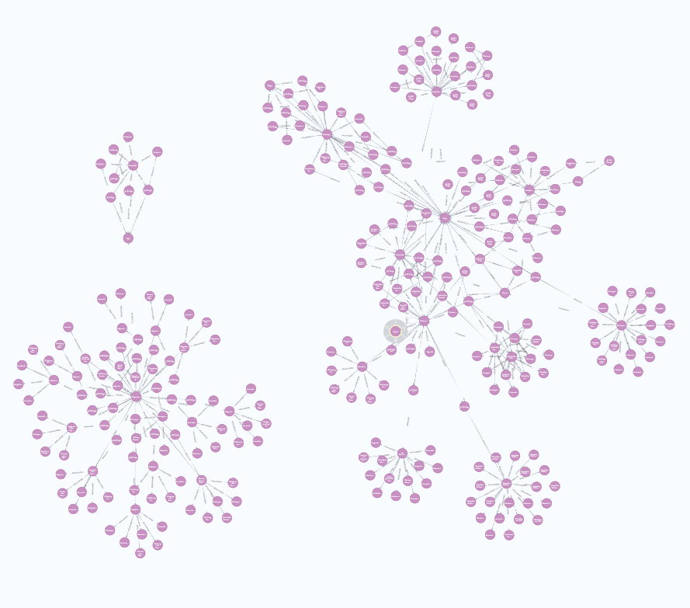
AI-Generated Knowledge Graph:
The Foundation for Intelligent Assistants
The entire knowledge graph
A fragment of the knowledge graph

Slide 11

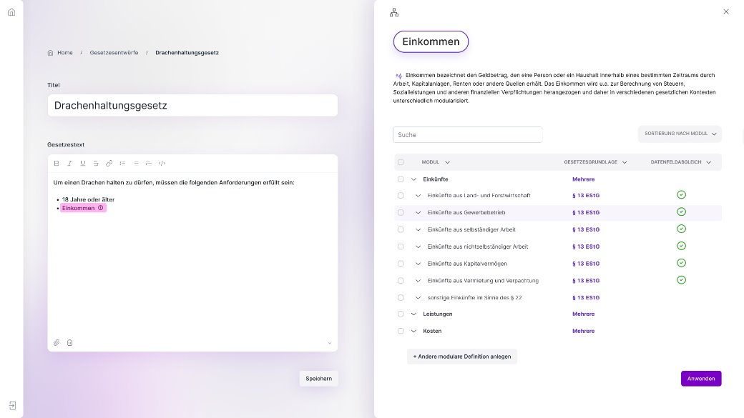
eLexa – The Intelligent Assisant forLegislative Drafters to Simplify Legal Terms
„law on keeping dragons “
„income“
eLexa is an intelligent assistant for legislative drafters, designed to provide clear legal terms and facilitate data reuse.
The application suggests definitions of legal terms to legislative drafters, with modules linking legal terms refer to data fields from public administration databases.

Slide 12
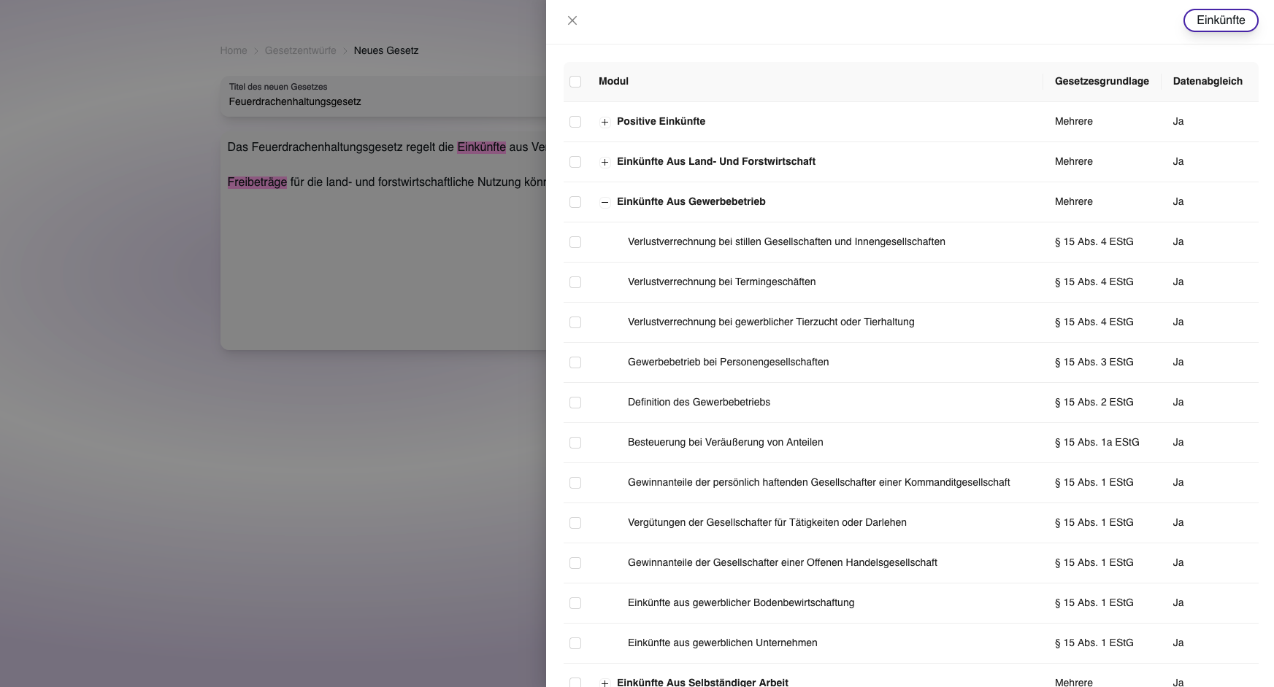
eLexa: Transparency in Legal Terms and Data Landscape
What is eLexa?
For legislative drafters
Intelligent text editor for drafting up bills
Intelligent recognition of legal terms and suggestion of term definition
Definitions, legal basis, and legal term modules with one click
Transparency
Reusability
Automation
Up-to-Date

Slide 13
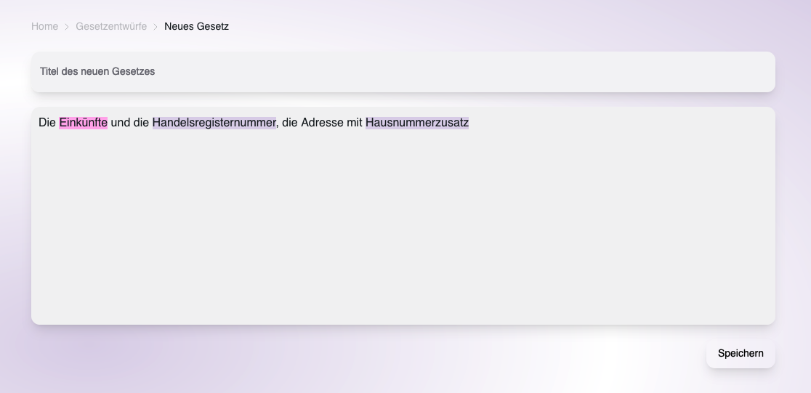
Clear Definitions. Clear Data.
The Legal Term Modelled in the Data Field
„title of the new bill“
„new bill“
„revenue“
„commercial register number “

Slide 14
“eLexa” Helps Legists Consider
Data Structures when Drafting Bills
„commercial register number “

Slide 15

Interoperability:
The Power of Seamless Communication
Efficient digital processes depend on digital-ready legislation.
Laws and data must be harmonized together for seamless interoperability.
We must carefully define data fields, metadata descriptions, and data standards.

Slide 16

„Paths are made by walking.“– Franz Kafka
Photo by Pixabay: https://www.pexels.com/photo/asphalt-road-under-cloudy-sky-56832/

Slide 17
Contact
Kathleen Jennrich​
Federal Ministry of Finance, Berlin, Germany​
Unit IV A 5 | Digital Ready Legislation, Interoperability, Once-Only​
once-only@bmf.bund.de; sio@bmf.bund.de​
+49 30 18 682 3399​

