Slide 1
ENDORSE 2025
SELEN: Semantic ELicitation ENvironment
Armando Stellato – Manuel Fiorelli – Tiziano Lorenzetti – Andrea Turbati Pierfrancesco Tommasino – Tiziano Di Condina – Luca Berloco

Slide 2
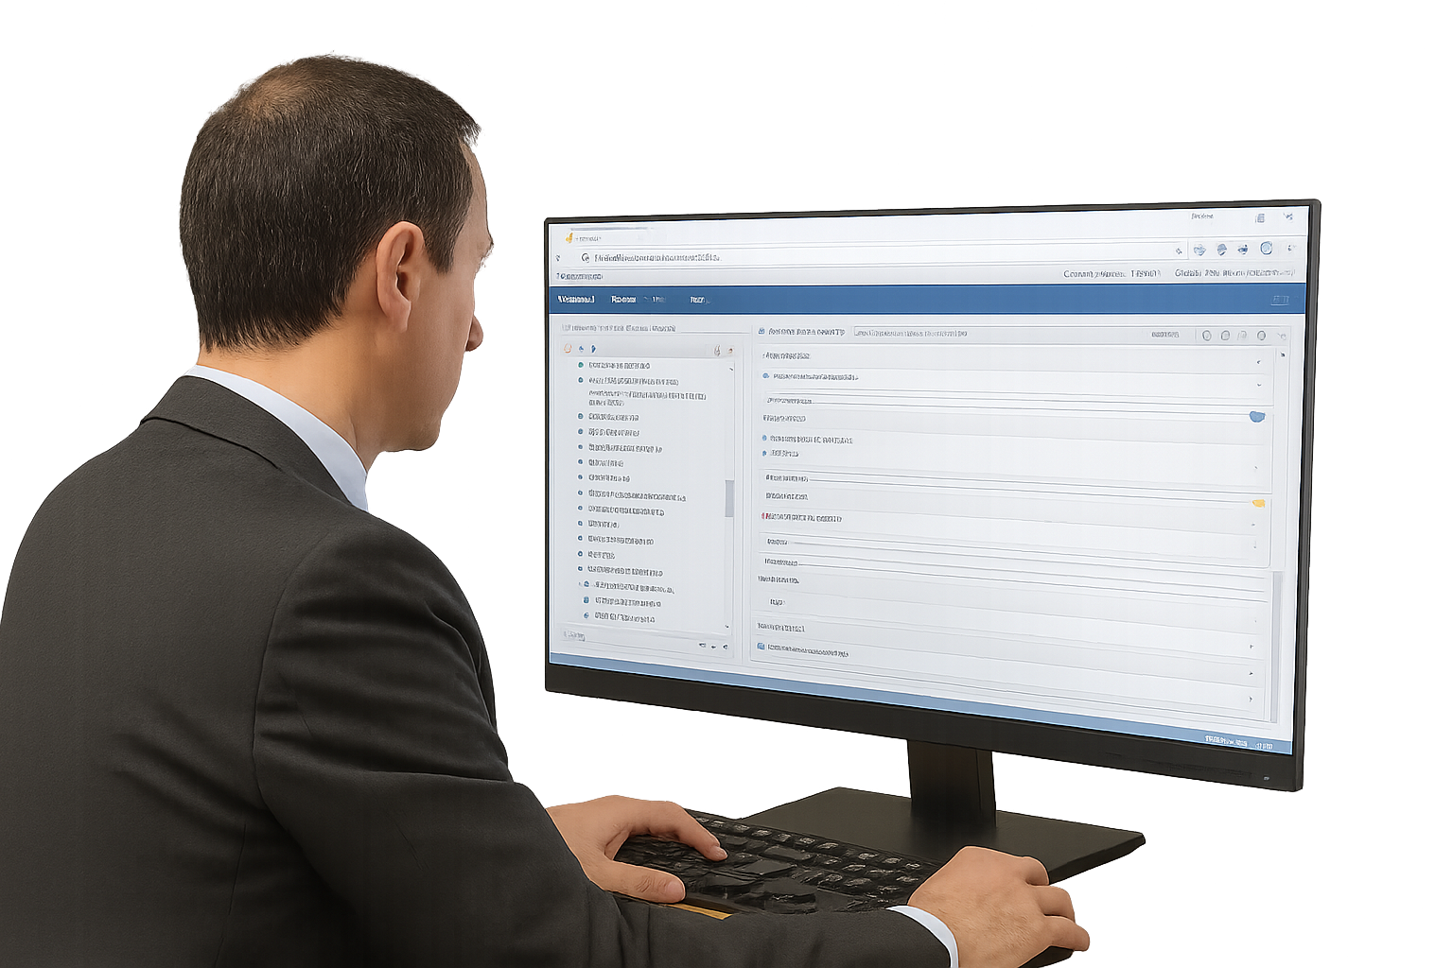
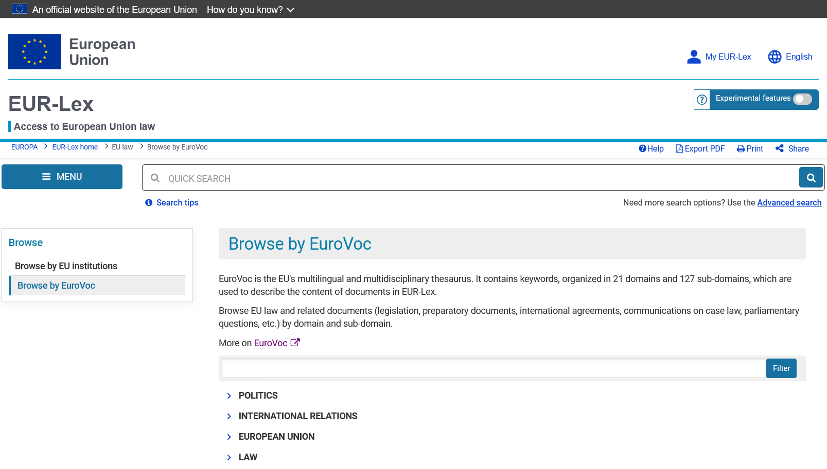
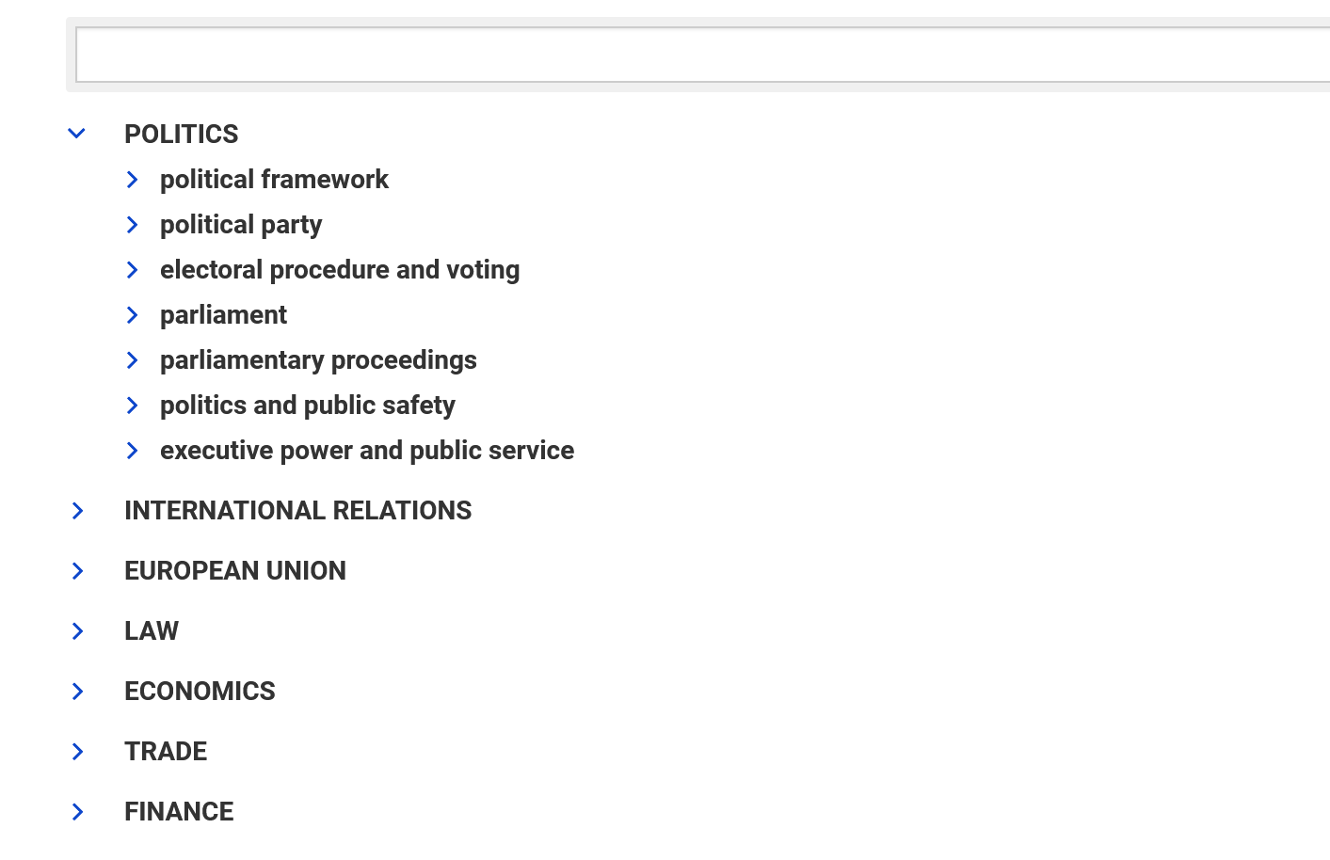
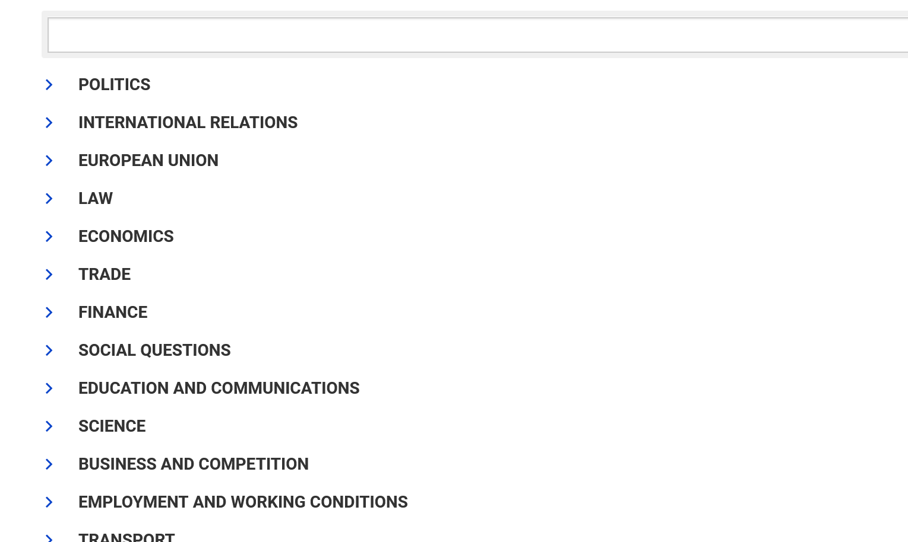
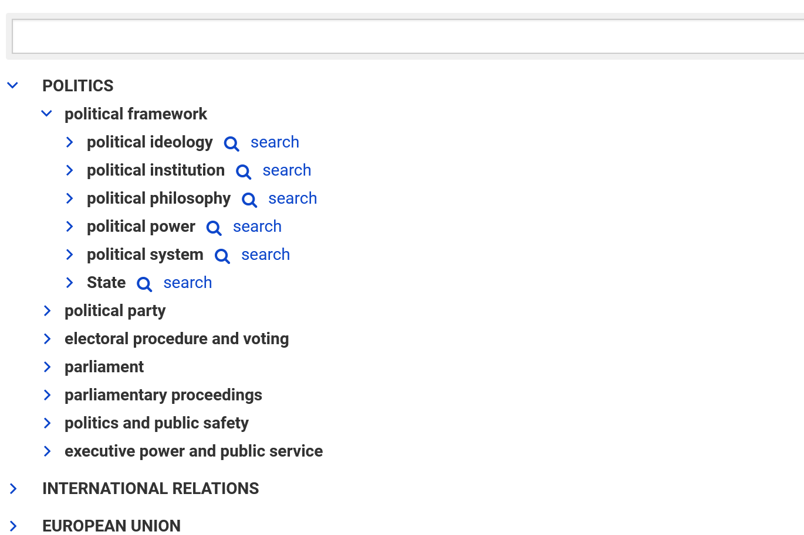
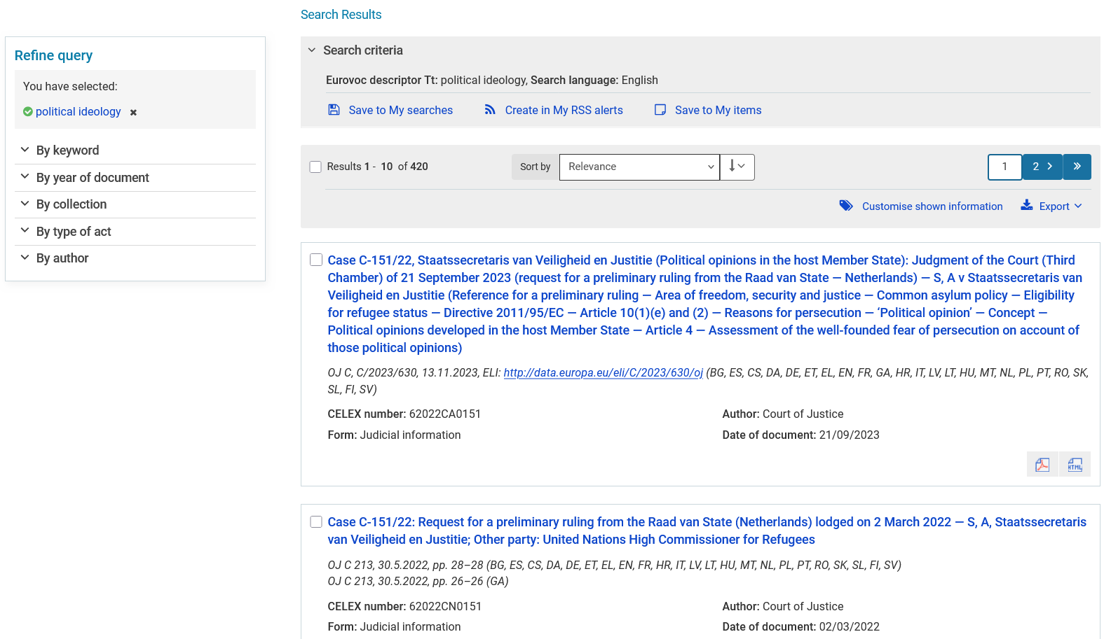
KOS for (digital) Archives
Thesauri (and other KOSes) enable:
Semantic browsing
Semantic search
Query expansion
Federated access
And more
SELEN: Semantic ELicitation ENvironment
Gen AI

Slide 3
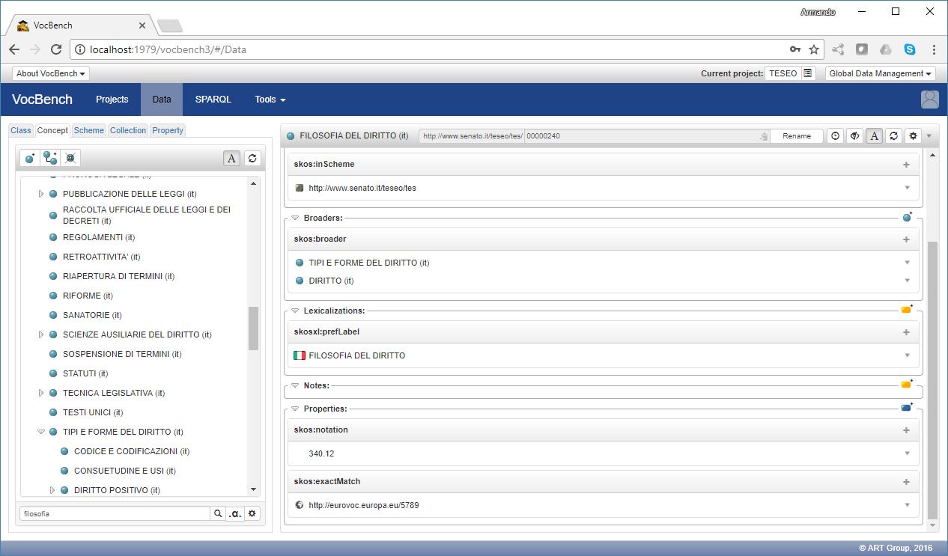
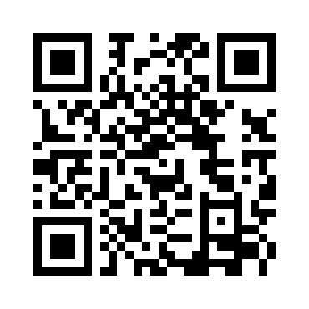
VocBench 3
An open‑source, free‑to‑use, collaborative platform for maintaining ontologies, thesauri, lexicons, and, more generally, datasets conforming to Semantic Web and Linked Data standards
Initially supported by the ISA² programme, it is currently funded by the DIGITAL programme
Development managed by the Publications Office of the EU (OP)
https://vocbench.uniroma2.it/
SELEN: Semantic ELicitation ENvironment

Slide 4

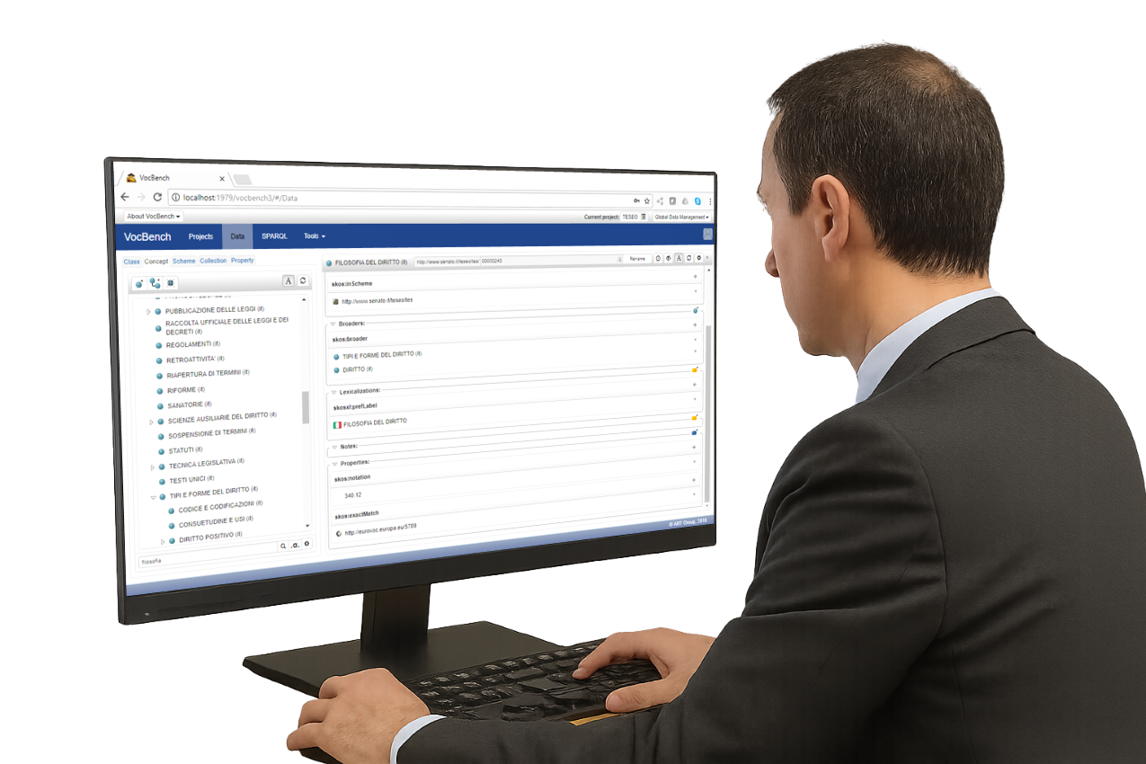
Why SELEN
____ _____ _ ______ _ _
/ ___|| ____| | | ____| \ | |
\___ \| _| | | | _| | \| |
___) | |___| |___| |___ | |\ |
|____/|_____|_____|_____||_| \_|
Collaborative KOS development
SELEN: Semantic ELicitation ENvironment

Slide 5

Why SELEN
____ _____ _ ______ _ _
/ ___|| ____| | | ____| \ | |
\___ \| _| | | | _| | \| |
___) | |___| |___| |___ | |\ |
|____/|_____|_____|_____||_| \_|
Document Tagging
Thesaurus/Ontology Evolution
+
–
Semantic Annotation
Knowledge Acquisition
Collaborative KOS development
ex:75980-60-8
rdf:type ex:Chemical ;
ex:casNumber "75980-60-8" ;
rdfs:label "diphenyl(2,4,6-trimethylbenzoyl)phosphine oxide"@en;
ex:mayDamage ex:fertility .
SELEN: Semantic ELicitation ENvironment

Slide 6


SELEN
The OP started the development of SELEN (Semantic ELicitation ENvironment) to:
address the urgent need for automation through textual corpora analysis
streamline the development workflow inside VocBench
Requirement analysis
today's focus
scope of the platform
functionalities
conceptual and technical considerations
expected benefits
Design
Platform implementation
Document tagging
First release (Q4 2025)
Additional use cases
SELEN: Semantic ELicitation ENvironment

Slide 7

Functional Requirements
Document tagging
Thesaurus/Ontology Evolution
Health hazards
1st release focus
+
-
TPO
Semantic Annotation
Knowledge Acquisition
ex:75980-60-8
rdf:type ex:Chemical ;
ex:casNumber "75980-60-8" ;
rdfs:label "diphenyl(2,4,6-↩
trimethylbenzoyl)phosphine↩
oxide"@en;
ex:mayDamage ex:fertility .
SELEN: Semantic ELicitation ENvironment

Slide 8
Non-functional requirements
Non-functional goals:
availability
usability
maintainability
Text-engineering framework:
Apache UIMA
Document interface:
Apache Tika
Selected after a survey based on:
general criteria (e.g., licensing and programming language)
specific criteria (e.g., orchestration mechanism and granularity)
SELEN: Semantic ELicitation ENvironment

Slide 9






Architecture
file manager
____ _____ _ ______ _ _
/ ___|| ____| | | ____| \ | |
\___ \| _| | | | _| | \| |
___) | |___| |___| |___ | |\ |
|____/|_____|_____|_____||_| \_|
dataset origin
SELEN: Semantic ELicitation ENvironment

Slide 10

Architecture (Limited to the first‑release scope)
CMIS
File system
File system
RDF4J
Annif
Mockup
REST API
File Manager
Dataset Origin
Doc Tagging
Thes Evolution
Data Manager
Extension Points
file manager
____ _____ _ ______ _ _
/ ___|| ____| | | ____| \ | |
\___ \| _| | | | _| | \| |
___) | |___| |___| |___ | |\ |
|____/|_____|_____|_____||_| \_|
PF4J
Spring Boot
Java
SELEN: Semantic ELicitation ENvironment
dataset origin

Slide 11
Last touches
Integrate Annif as an implementation of document tagging
Evaluation on a corpus of interest to the OP:
  Comprising heterogenous documents tagged with EuroVoc concepts
  Unlike existing datasets (EURLEX57K, MultiEURLEX, KEVLAR), which focus on legal documents published on EUR-Lex
    Interesting to see how performance varies with respect to these
SELEN: Semantic ELicitation ENvironment

Slide 12
Discussion (1)
Openness of the architecture: the ability to plug in multiple implementations tailored to different constraints (e.g., hardware availability, time constraints, model availability, and performance)
Integration with other systems
Orchestration capabilities
Document tagging is related to (extreme) multi-label text classification
SELEN complements existing systems such as Annif and TemitUp through orchestration capabilities:
  Interaction with document stores
  Human involvement through VocBench
SELEN: Semantic ELicitation ENvironment

Slide 13
Discussion (2)
High availability
  Containerization
  Stateless architecture
  Monitoring API
Usability
  Integration with VocBench
  Interactive API documentation (SwaggerUI)
Maintainability
  Source code documentation
  Consistent coding standard
  API documentation
  Modular architecture & plugin system
  Test suite
workload distribution & quick failure recovery
(with a data manager suitable for the execution environment – possibly cloud-based)
SELEN: Semantic ELicitation ENvironment

Slide 14
Intended Benefits
Support application of reference material
  Document tagging
  Semantic Annotation
Streamline reference data development
  Thesaurus/Ontology Evolution
  Knowledge Acquisition
TL;DR
coverage
precision
timeliness
human effort
SELEN: Semantic ELicitation ENvironment

Slide 15
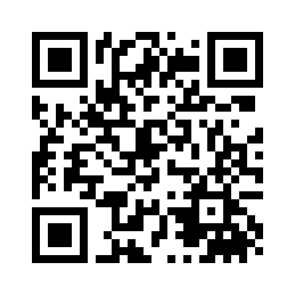
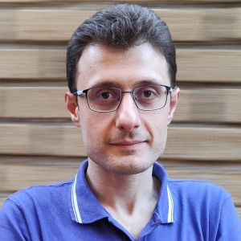
Thanks!
Manuel Fiorelli
Tor Vergata University of Rome
https://art.uniroma2.it/fiorelli
https://www.linkedin.com/in/manuel-fiorelli-67859b27a

