Slide 1


Marcel Fröhlich
Director Services, eccenca GmbH & Co-chair OMG Enterprise Knowledge Graph Platform Task Force
DPROD
Data Products Standard Using Ontologies
Unlocking Value Through Shared Semantics

Slide 2

DPROD
Data Products Standard Using Ontologies
Unlocking Value Through Shared Semantics
DPROD - Data Products Standard Using Ontologies

Slide 3

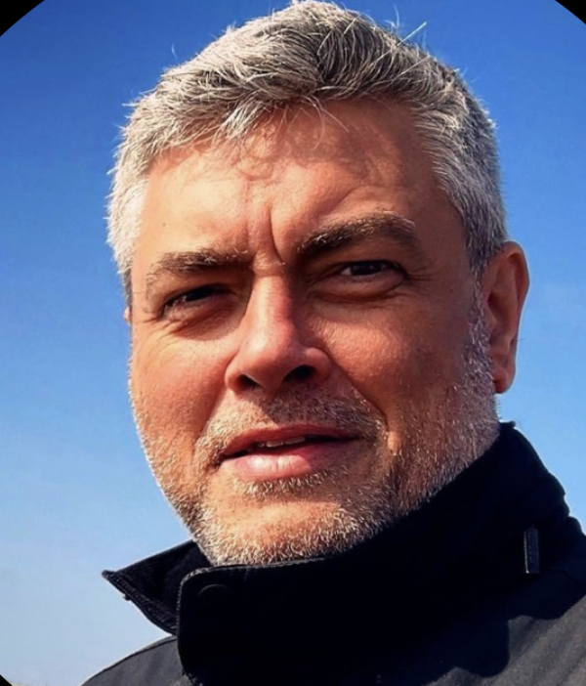
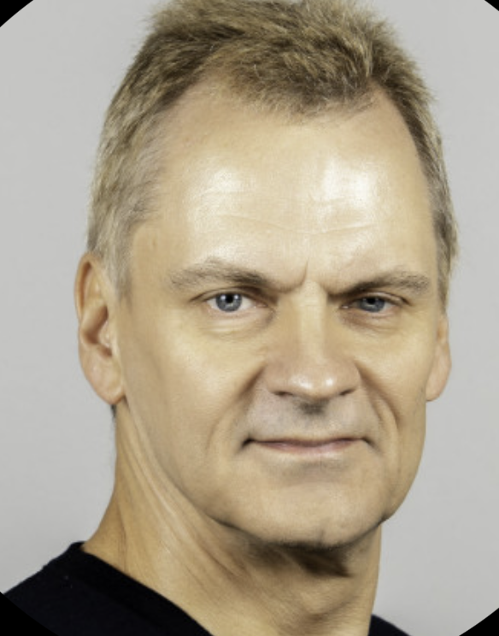
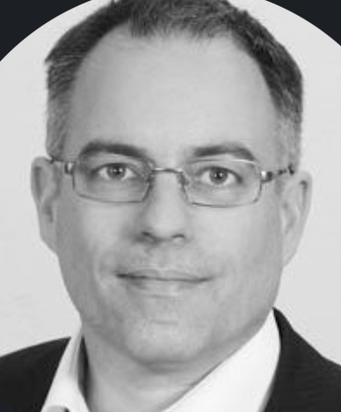
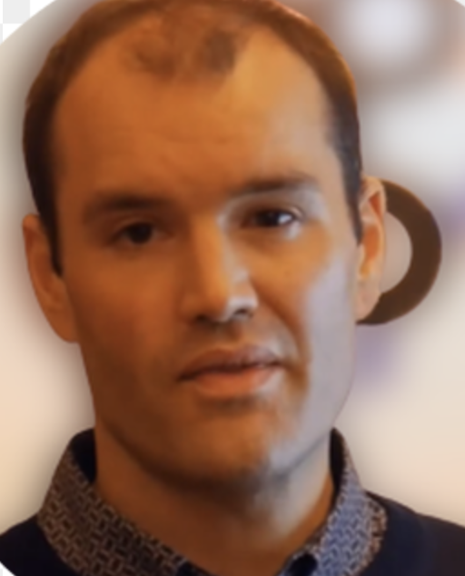
How DPROD Came To Be

Slide 4




Metadata Standards – for Consistency, Discoverability, Interoperability & Scalability
Data Product
Standardization
Consistency
Scalability
Discoverability
Interoperability

Slide 5
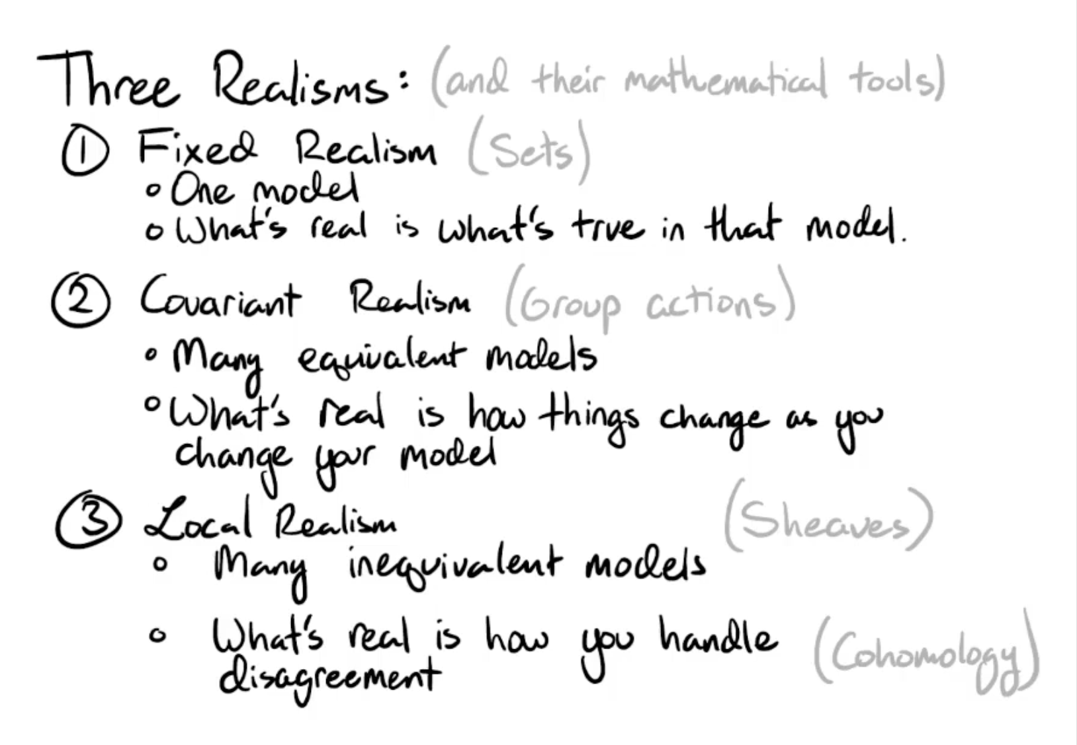
Shared Semantics Is Hard! Why?
Source: YT , David Jaz Myers

Slide 6
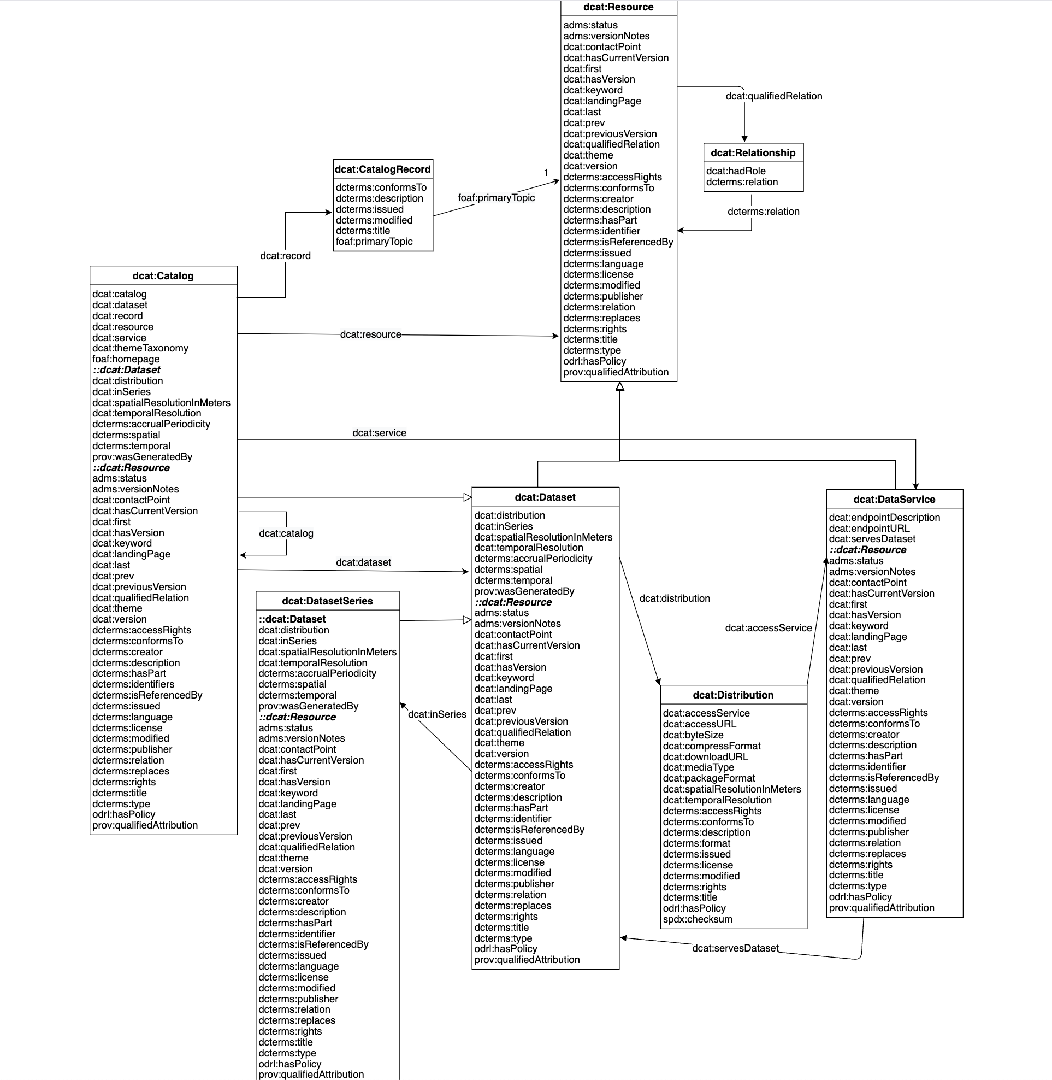
DCAT v3
https://www.w3.org/TR/vocab-dcat-3/

Slide 7
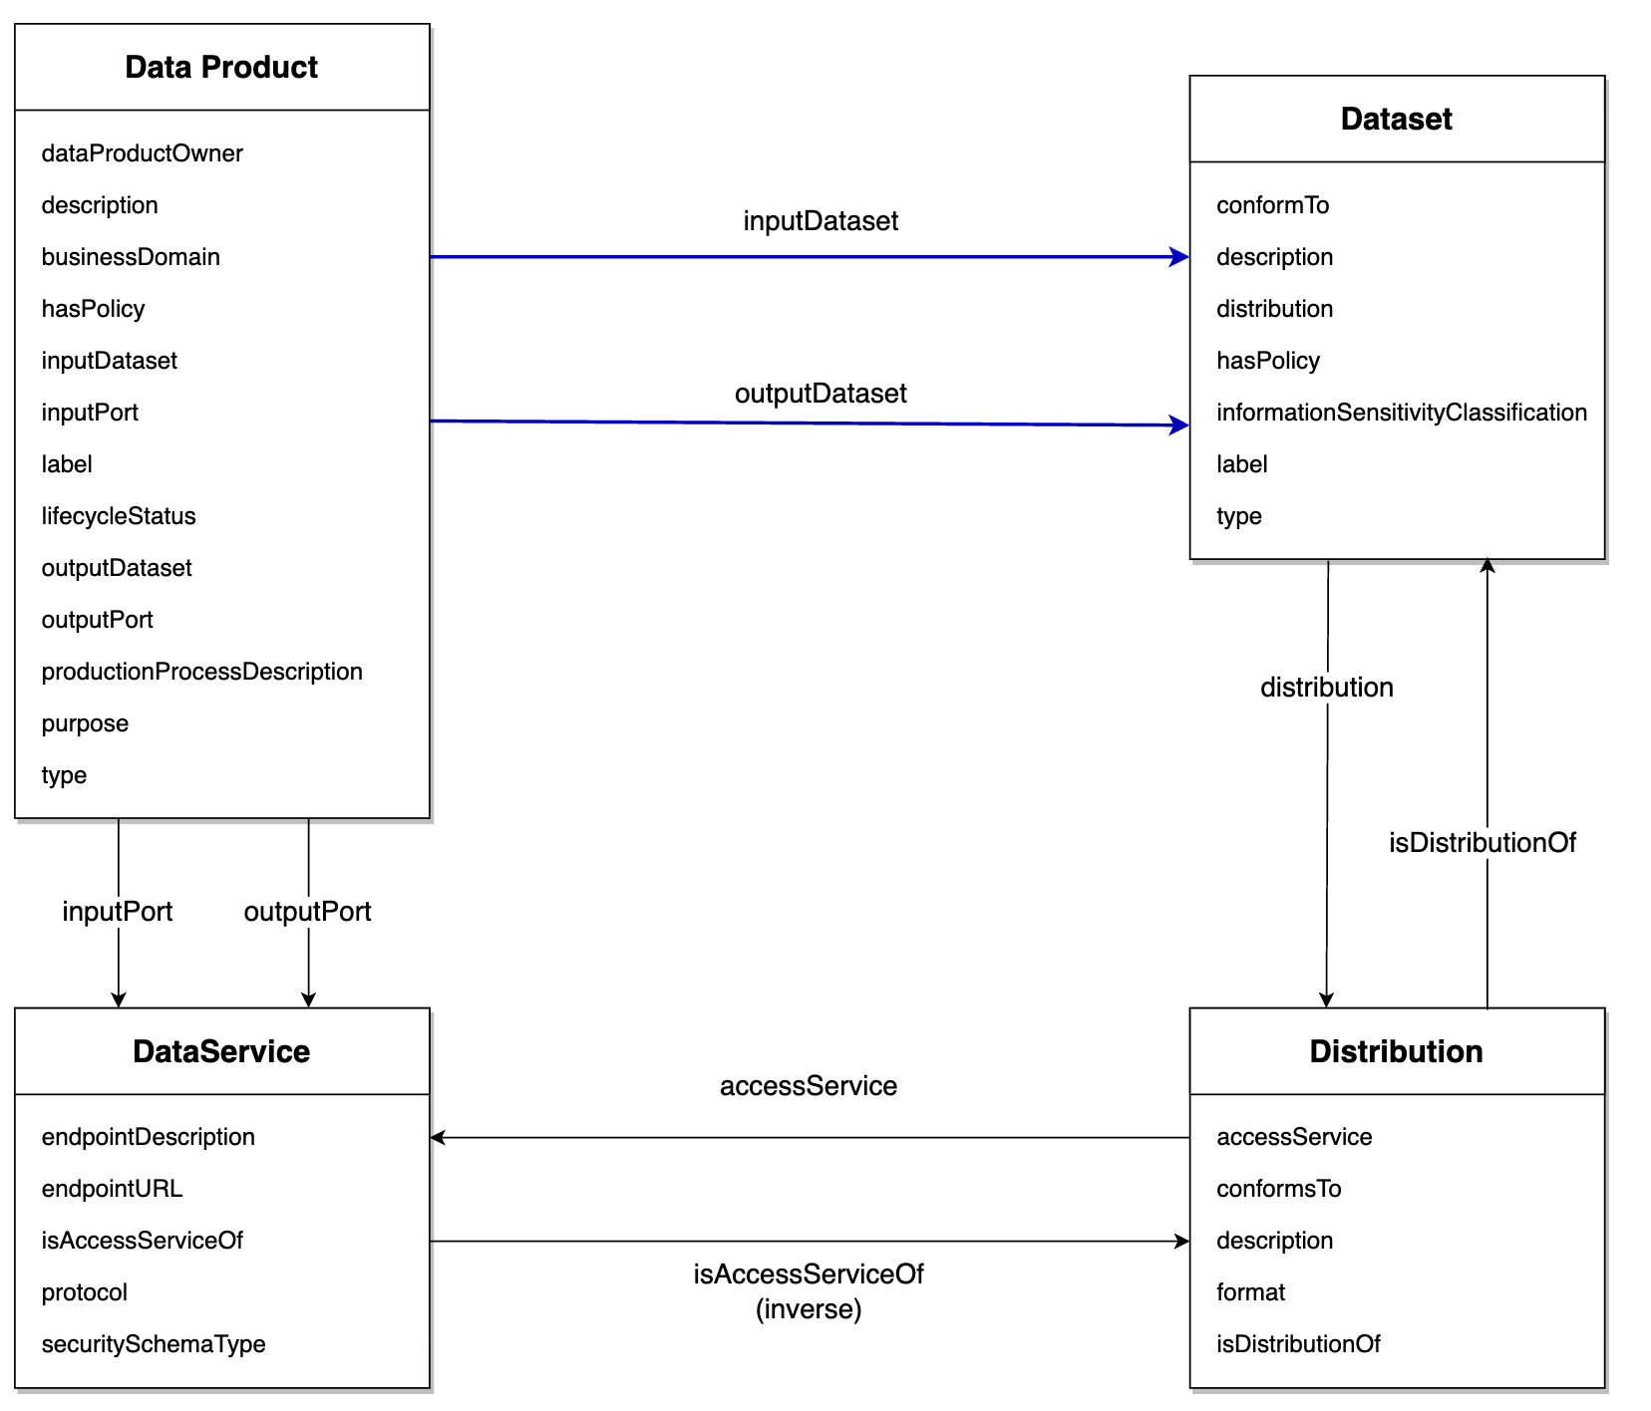
Introduction to DPROD
Managed & governed collection of data
Collection of data conform to a logical model
Digital interface:
access to a dataset
Specific representation of a dataset

Slide 8
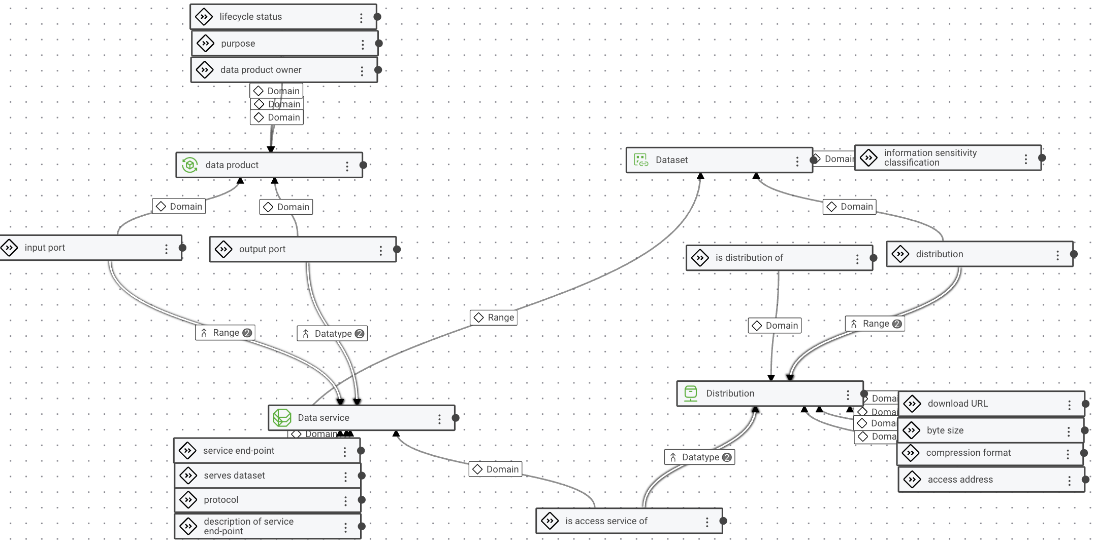
Two-part Standard: Ontology & SHACL Shapes

Slide 9
SHACL vs OWL
OWL 2
  Geometry of the logical theory – logical rules in description logics
  Open World Assumption
  Global – Local tension
  Very powerful, but mostly not properly understood
SHACL 1.1, soon 1.2
  Topology (shape) of the data
  Closed world assumption
  Local by design
  Forces OWL to be local when mixed into the same ontology
  Forcing the assumptions of one local view on everybody else

Slide 10
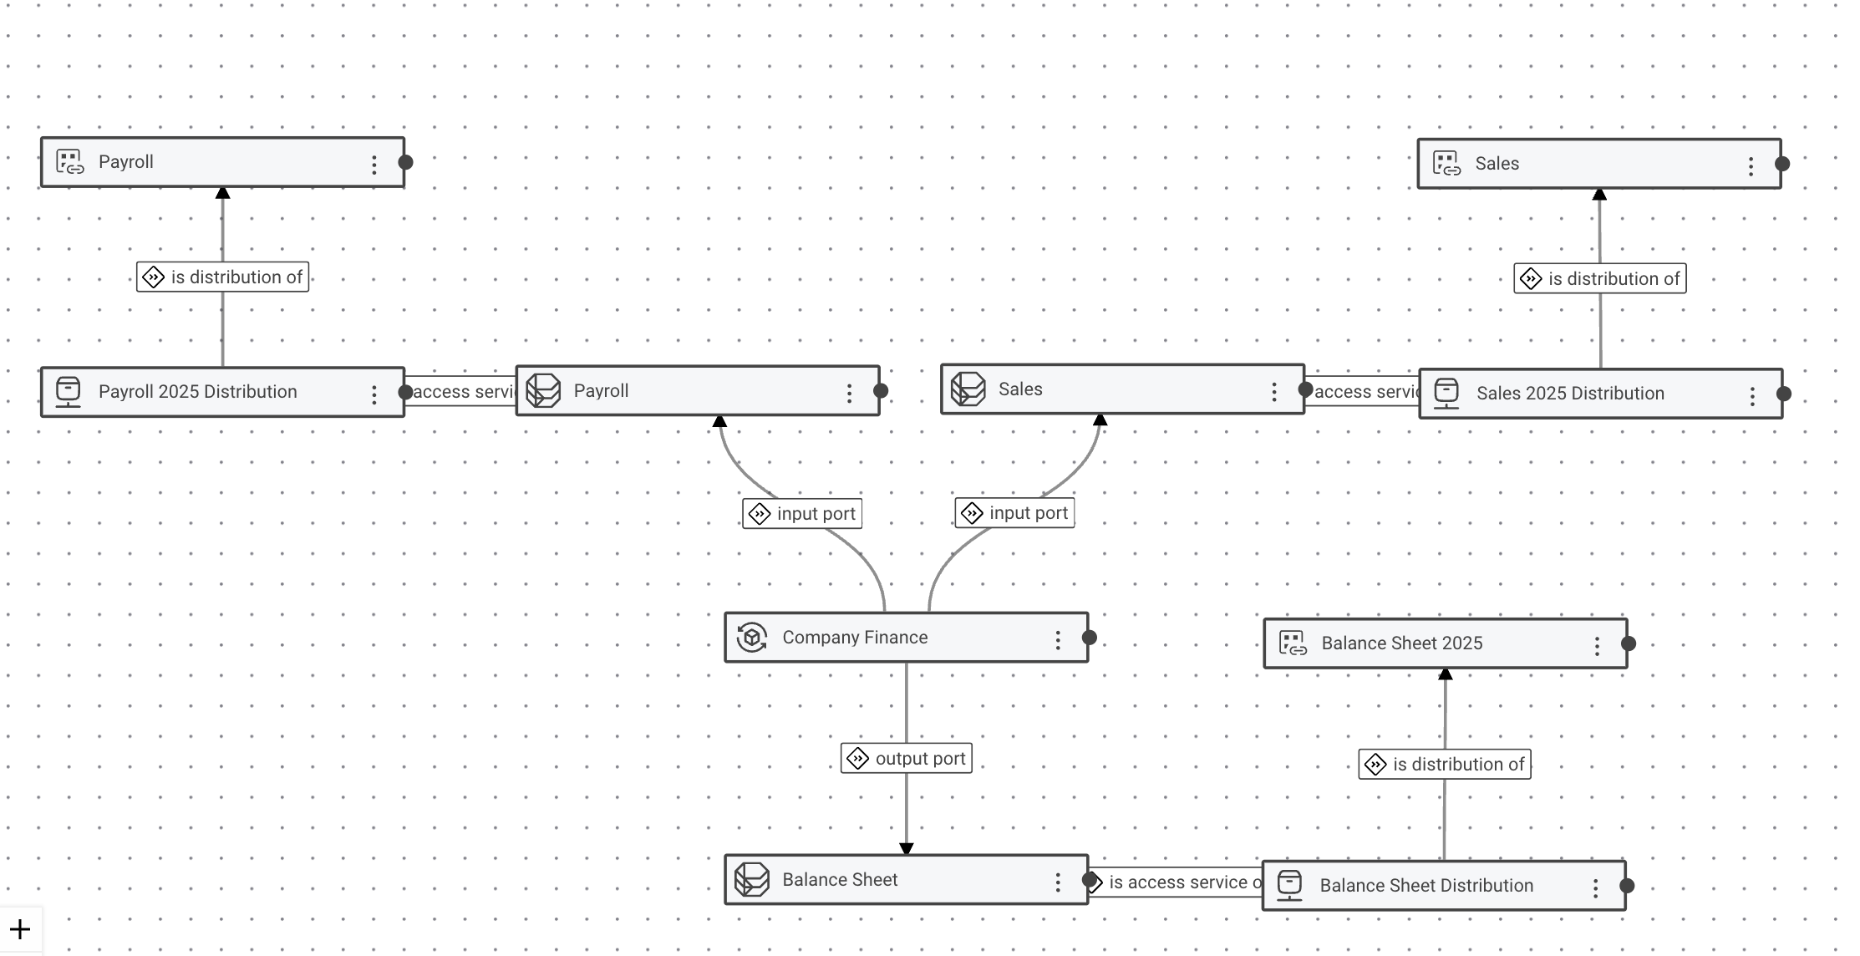
Company Finance Data Product Example
- datev
- SalesNow
Take a look yourself:
https://dprod.eccenca.com/

Slide 11




DPROD Potential as Enabler for AI & LLM
Reduce noise: High-Quality, Curated Input
Understand specialized topic: Domain-Specific Context
Anchor your data: Feature Engineering
Ensure compliance & auditability: Governance

Slide 12
Roadmap DPROD
Data Contracts
  Let’s discuss
    Do you use data contracts – how?
    Which existing standards matter?
    What is the right level of abstraction for DPROD
Other topics floating around
  ODRL
  MCP (Model Context Protocol)
What are we missing?

Slide 13


Let's talk​ about our​ Academic​ Program.
We are offering research licences.

Slide 14
Thanks!
marcel.froehlich@eccenca.com

