Slide 1
Managing Complexity in Semantic Data Mapping
A Test-Driven Development Approach
Maria Keet, PhD
R&D Manager, Meaningfy

Slide 2
Outline
Introduction
  The problem to address
  Aim
A new methodology and tool
  What Mapping Workbench is
  How Mapping Workbench solves the problem
Conclusions

Slide 3
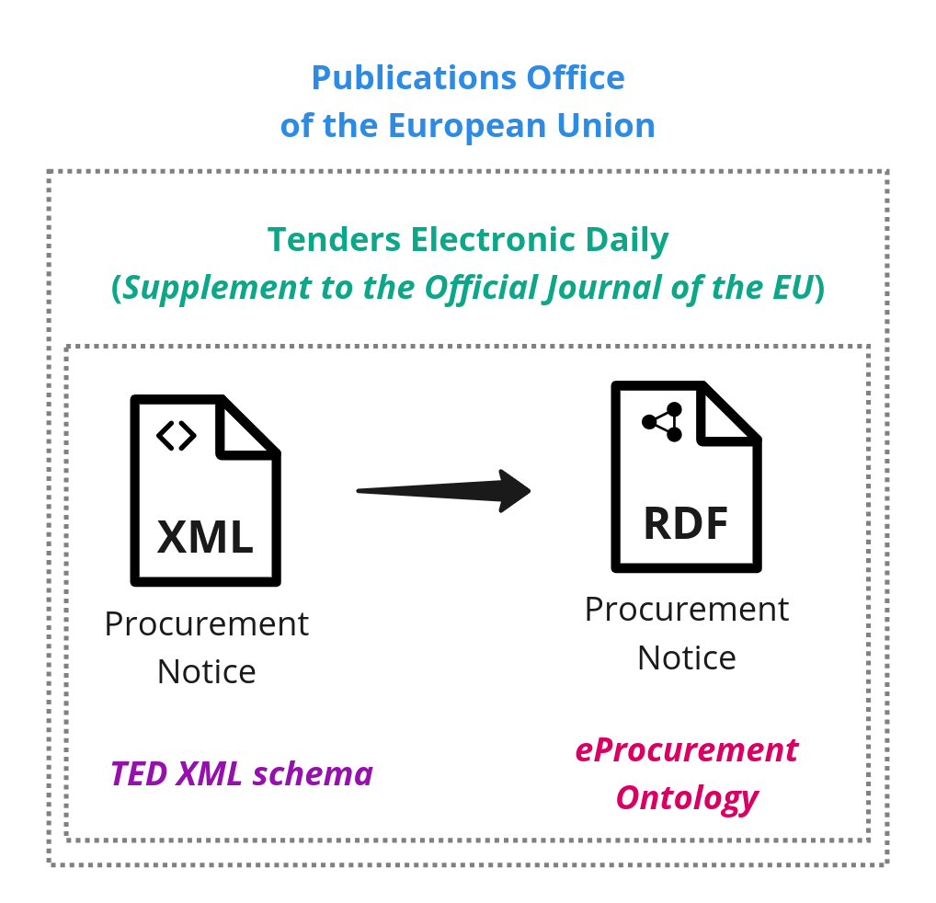



The Story
A journey from legacy data to interconnected meaning
"Our story begins with a common challenge faced across the EU: public procurement data buried in legacy XML files… but eagerness for a future powered by semantics and semantic technologies awaits."
Many ‘messy’ XML procurement notices
Clean Knowledge
Graph with high
quality information

Slide 4
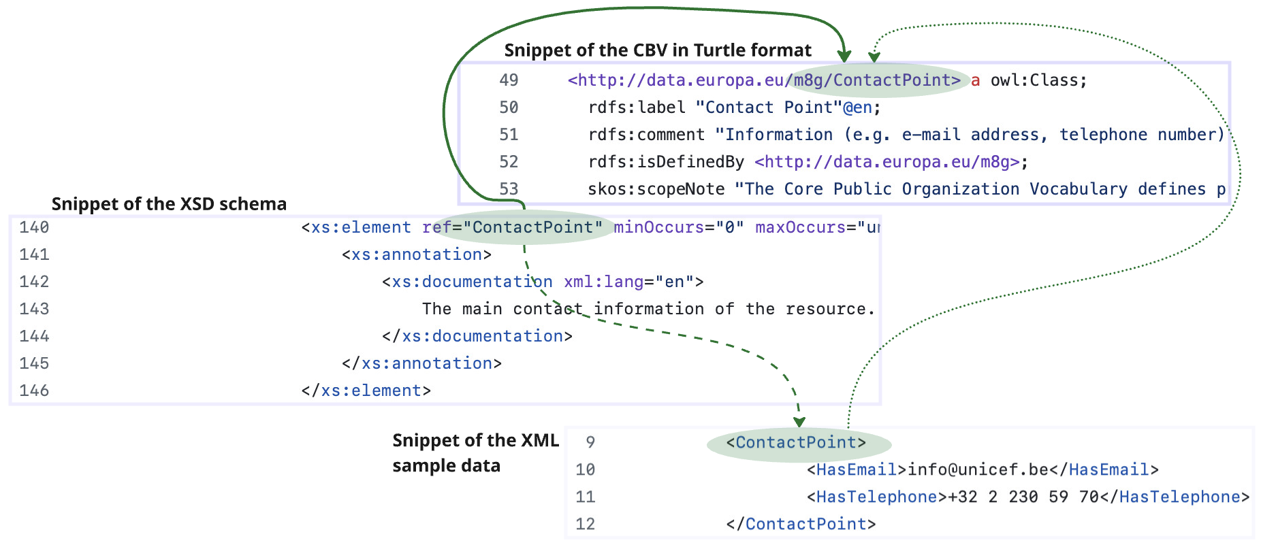
Superficial assumptions: a neat orchestration
Snippet of the model in Turtle format

Slide 5

The Quest for a Solution: “Let’s manually map XML to RDF”F!"
Challenges for our task, and generally:
Too many concepts (>1,500 XPaths!), across
40+ document types (high complexity)
Data in 2 formats with evolving schemas
  Standard Forms (5 schema versions)
  eForms (13 versions, … and continues today)
Ontology versions (started v3, now v5)
Errors creep in if not extremely carefully managed, manual validation is painful

Slide 6

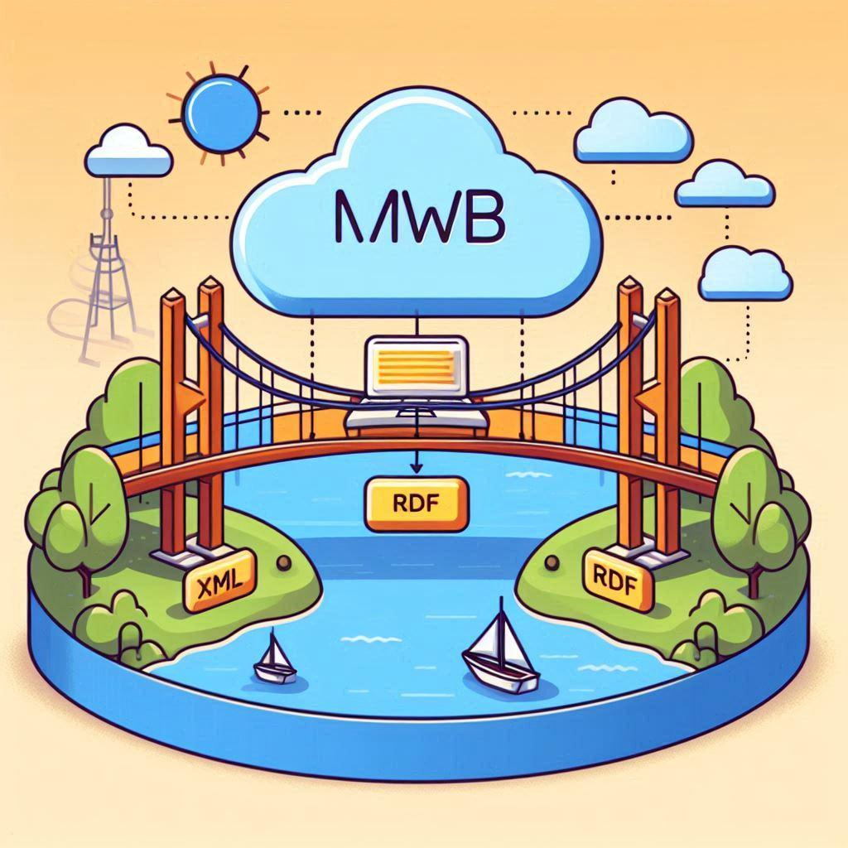
We need a structured, test-driven approach
Ontology
From Chaos to Control
(complexity management)

Slide 7
A new methodology and tool

Slide 8
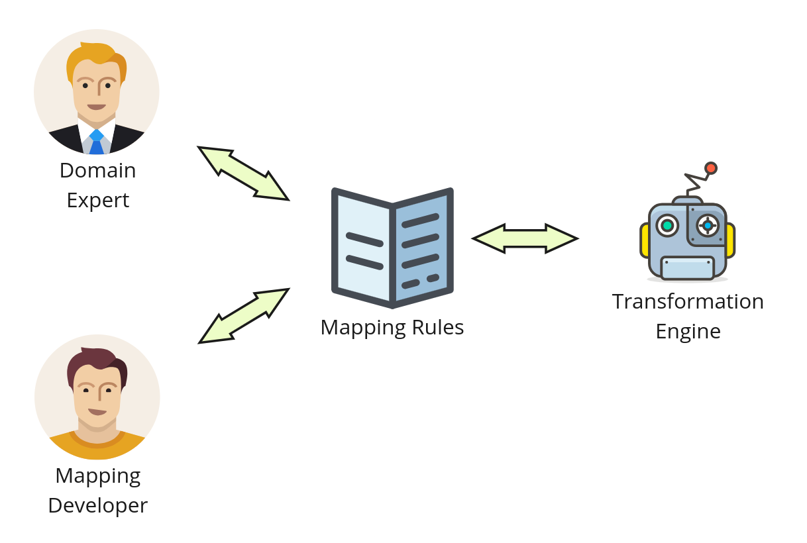
A new, structured approach
Key requirements:
One place to manage complexity without drowning in tooling
Collaboration between experts and engineers
Mappings must be testable, explainable, and maintainable
Methodological approach to mapping
A platform to support the full mapping lifecycle

Slide 9
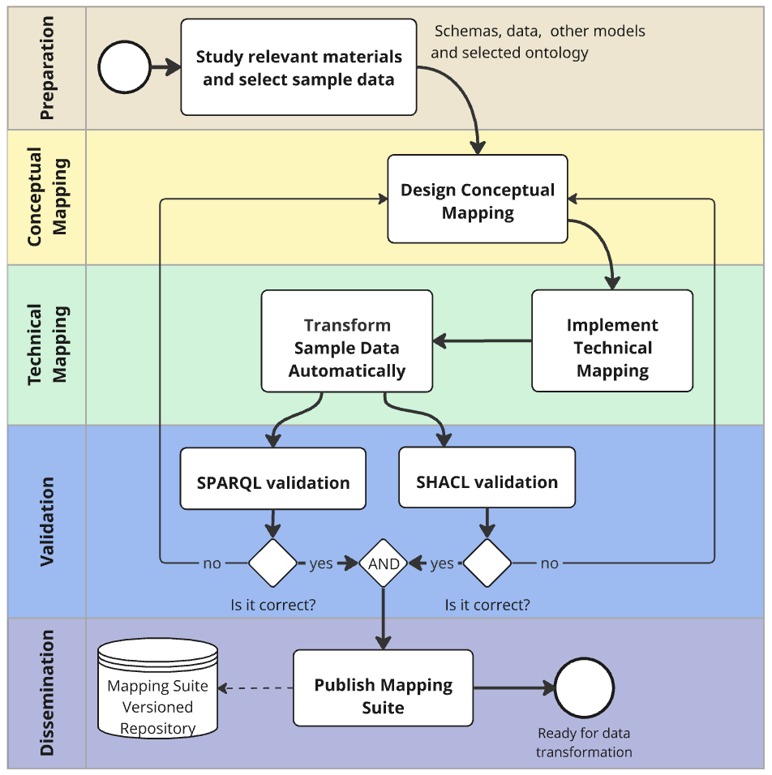

Slide 10
Support for the approach: Mapping Workbench
Integrated Development Environment for building Knowledge Graphs from legacy data with semantic precision
Methodology: Conceptual mapping, technical mapping, validation, and dissemination
Test-Driven Validation: Automatically generated SPARQL/SHACL checks
Collaborative Workflow: Business experts + developers in one workspace
Multi-Format Support: RML, RML Mapper (currently); YARRML, SPARQL Anything, Morph-KGC Python/Java (planned)

Slide 11
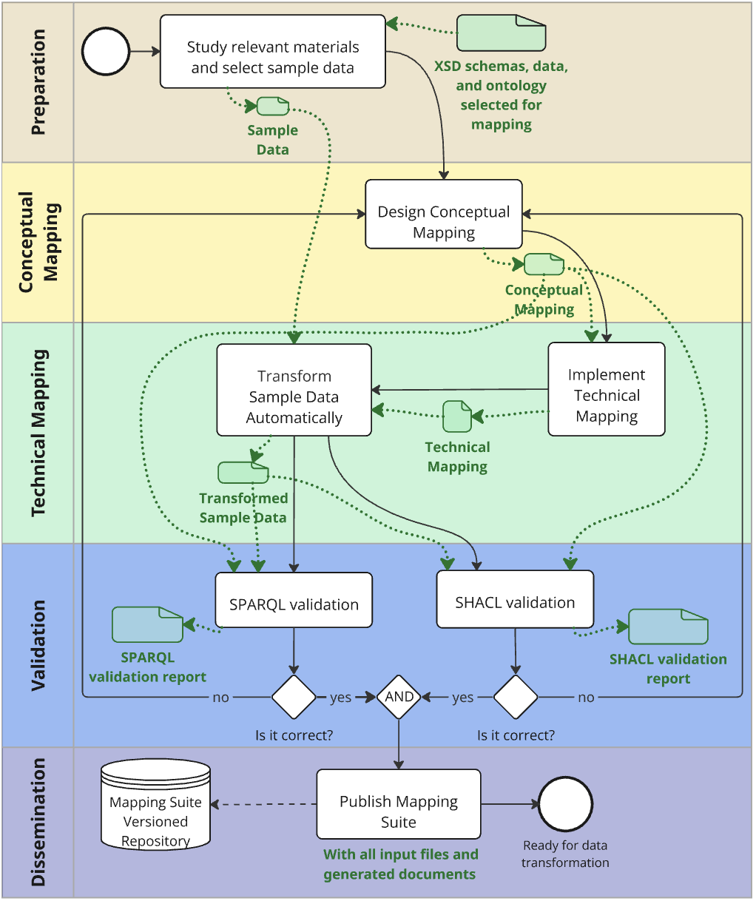
How MWB works – methodology
Input: Legacy data (XML/CSV/JSON files)
Step 1: Conceptual Mapping (CM)
Business/semantic experts define:
  "XPath → Ontology path mappings"
  Example:
  Contract/Title → epo:Contract/dct:title
SPARQL property path:
  Example:
  ?this dct:title ?value .
Continued on next slide

Slide 12
How MWB works – methodology
Step 2: Technical Mapping (TM)
Developers implement:
  RML rules (TriplesMaps)
  Handles non-isomorphic transformations (XML → RDF)
  Tools: RML, RML Mapper (more soon)
Step 3: Validation
Automated checks:
  SHACL data shapes
  SPARQL ASK (generated from CM)
  Reports: XPath coverage
Output: Semantic knowledge graph (RDF)

Slide 13
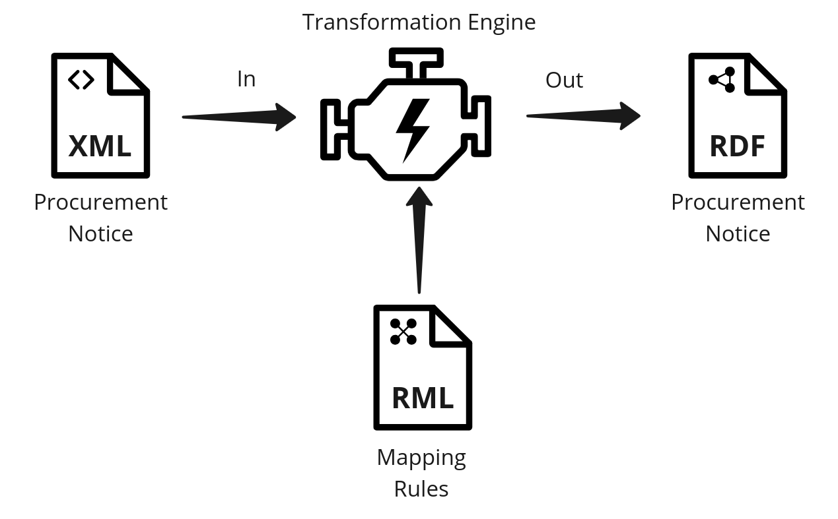


The use case: Build a high-quality Public Procurement KG
I want to build the Public Procurement Knowledge Graph, so that I can enable Data-Driven Policy Making
Let’s start thinking of data transformation from the current data to a KG
Marc
(Public Procurement Expert)
Alice
(Semantic Engineer)
There are XML to RDF transformation engines.
We need to develop the mapping rules.

Slide 14

Source - What do we map?
I want these elements from the XML file in the Knowledge Graph
I can pinpoint them by their XPath expression.
Marc
(Procurement Expert -
Lawyer or Administrator)
Paul
(Procurement XML Data Engineer)
ND-ProcedurePlacePerformance | Place Performance
BT-5131-Procedure | Place Performance City
/*/cac:ProcurementProject/cac:RealizedLocation /cac:Address
/*/cac:ProcurementProject/cac:RealizedLocation/cac:Address /cbc:CityName

Slide 15
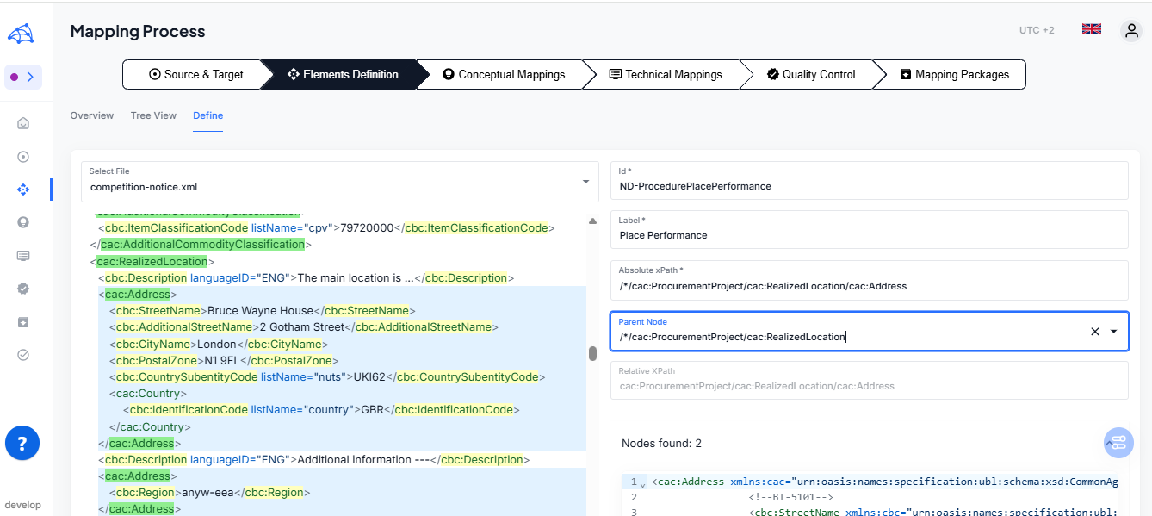
Define XML Fields & Nodes

Slide 16
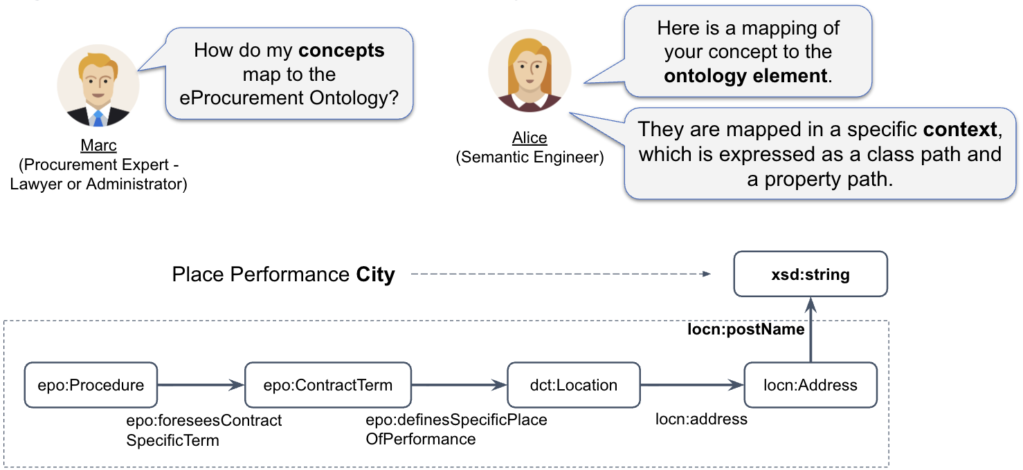
Target - To what do we map?

Slide 17
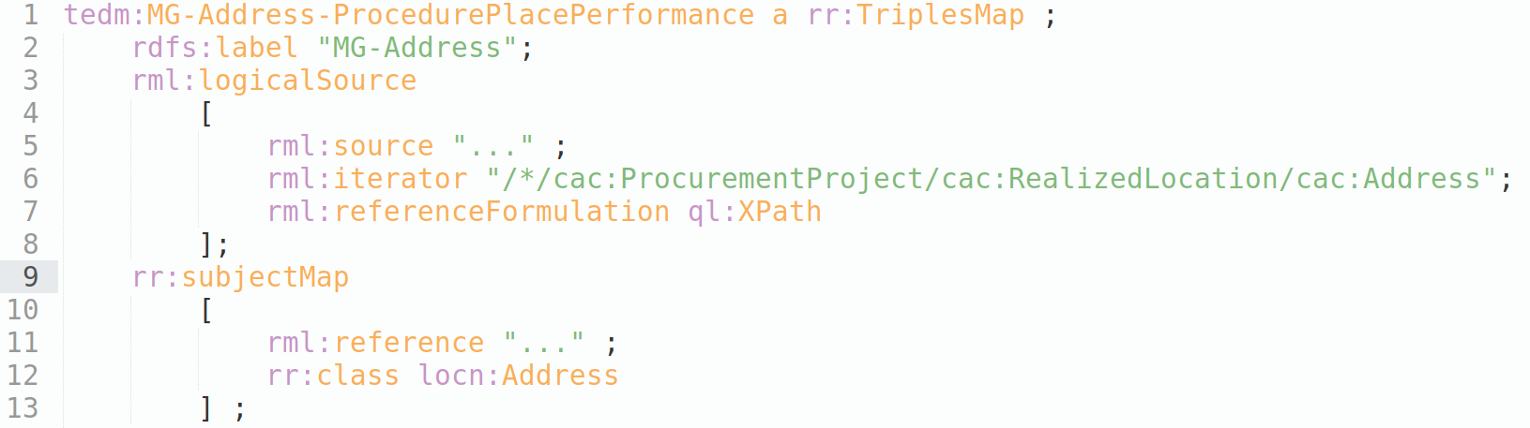
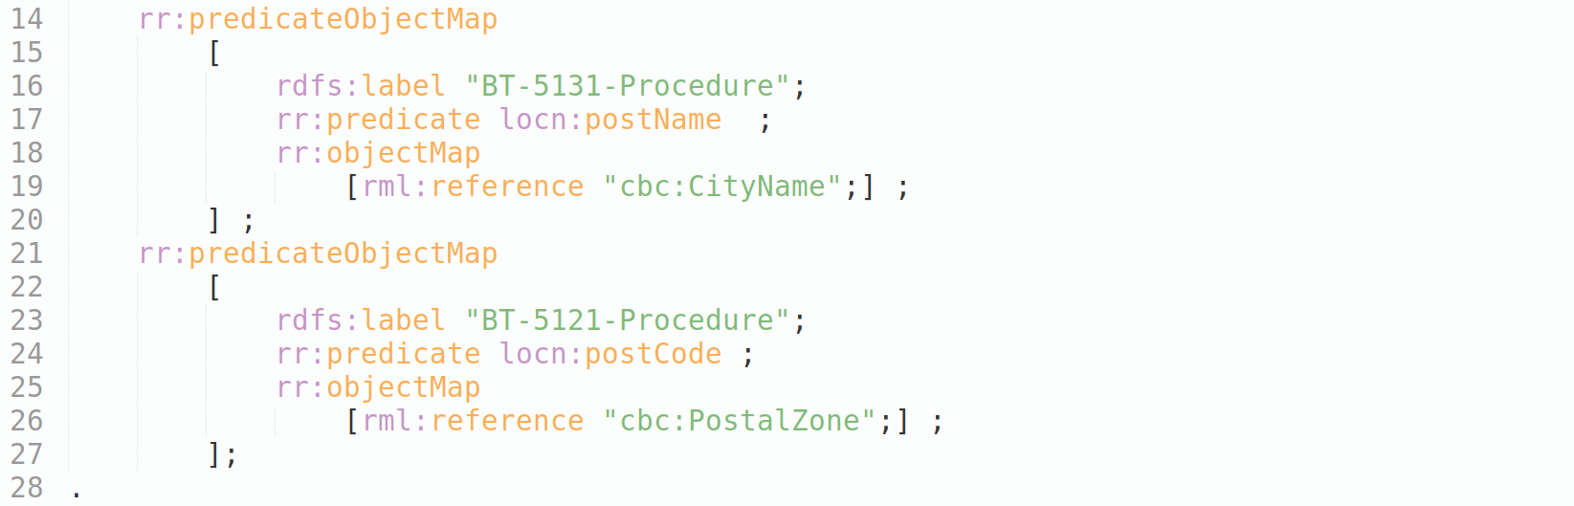
Implement as Technical Mappings
We finished!
… Right?!
Marc
(Procurement Expert -
Lawyer or Administrator)
Now that we agree on how entities map for humans,
let me translate them for the machines, i.e., implement in RML.
Alice
(Semantic
Engineer)

Slide 18



How do we validate?
What can you tell me about the quality of the mappings and transformed data?
We can answer accuracy and correctness questions
by transforming sample data sets and validating the results.
Marc
(Procurement Expert -
Lawyer or Administrator)
Alice
(Semantic Engineer)
Based on SHACL shapes and SPARQL queries automatically generated from the mappings

Slide 19
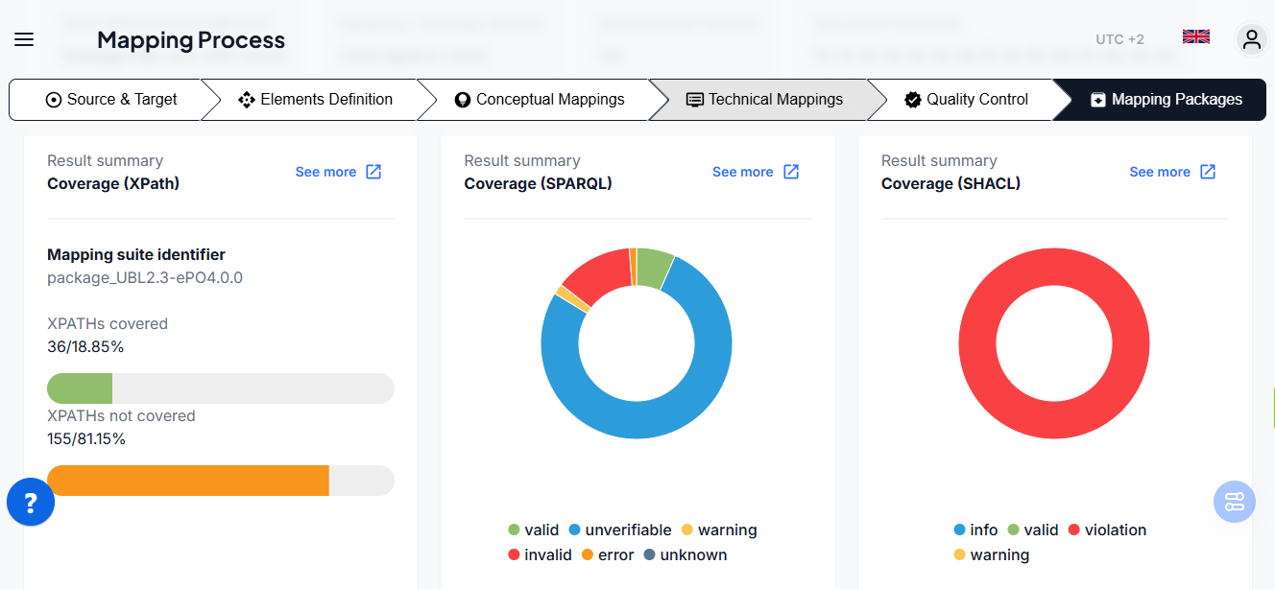
Example - TDD-based reports summary
How much of the input data is covered by the mapping rules?
How many mapping rules are testable?
Did we implement each rule correctly?
Does the transformed data conform to the designed data shapes?

Slide 20
Wrapping Up

Slide 21
Contribution to semantic interoperability & knowledge graph construction
Establishing a structured methodology for high quality XML-to-RDF transformation
Championing test-driven knowledge engineering with the notion of the conceptual mappings
Introducing a mapping IDE to systematise and streamline semantic data integration
A scalable foundation applicable to other subject domains, reinforcing the role of semantics in enabling AI-ready, machine-readable government data

Slide 22
Benefits
🧩 Manage complexity
  A consistent and test-driven methodology helps manage over 1,000+ data points and schema changes with confidence.
🤝 Bridge expertise by working collaboratively (developers and experts).
⚙️ Speed up mapping process by working in an integrated environment (IDE) that guides users through the process.
🔍 Find gaps before runtime usage
  Validation reports (SHACL, SPARQL, XPath coverage) help uncover issues before they impact quality.

Slide 23
Mapping Workbench
Managing Complexity in Semantic Data Mapping
https://mw.meaningfy.ws/

