Slide 1
Mark Vanin, Fawad Khan and Felix Engel
TIB – Leibniz Information Centre for Science and Technology, Hanover
Collaborative Ontology Development through Advanced Tools and Features

Slide 2
Agenda
Intro / Motivation
Ontology Curation Platform (OCP)
Vocabulary Development Tool (VDST)
Demo
Collaborative Ontology Development through Advanced Tools and Features

Slide 3
Semiconductor Industry
Semiconductor production: A complex and Interconnected industry
Highly dynamic supply chains with short product cycles and deep interdependencies across sectors
Demands a robust and standardised industrial reference communication framework
Collaborative Ontology Development through Advanced Tools and Features

Slide 4














SC4EU - Project
True Demand-Driven Semiconductor Supply Chains for Europe (SC4EU) Project
  EC funded Innovation Action
  Runtime 01.12.2023 - 20.11.2026
  14 Partners
Goal: improved accuracy of demand signals, to mitigate chip shortages
Approach: anonymous Multi-Party Computation (MPC) Surveys
  gather demand data across stakeholders chip industry
  Semantic Web-Based Ontologies (Digital Reference ontology)
    Structure and interpret survey content
    Streamline project internal and external communication
Collaborative Ontology Development through Advanced Tools and Features

Slide 5
SC4EU - Challenges
Challenge
  enable truthful demand sharing without exposing sensible information
  unambiguous data collection via survey series
  analysis of survey series (e.g. monthly)
  quasi-standardization of terminology
Impact/Result
  survey Knowledge Graph
  interpreted via (quasi standard) Digital Reference Ontology
  federation of distributed sources (enrichment)
  … for analysis and decision-making
Collaborative Ontology Development through Advanced Tools and Features

Slide 6
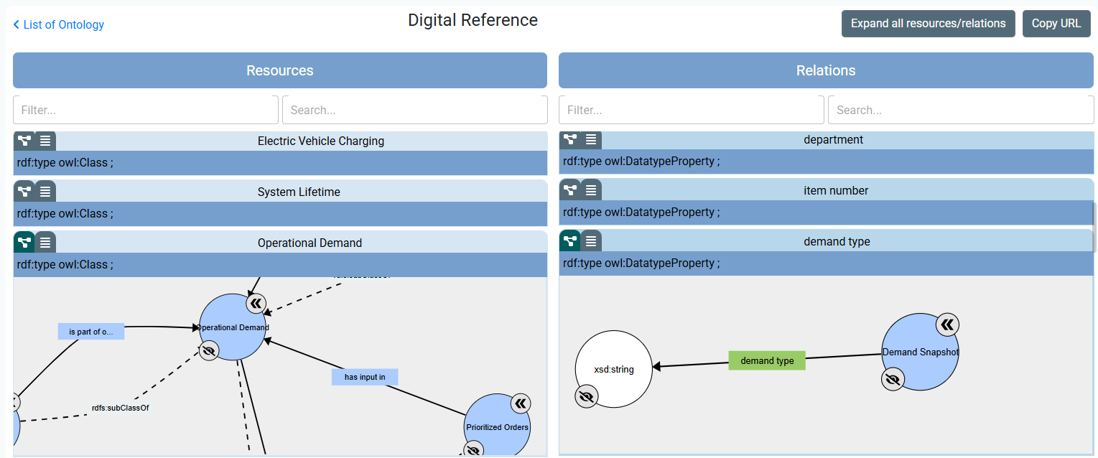
Digital Reference Ontology (DR)
Serves as the reference framework for digitalizing semiconductor supply chains
Provides semantic structure for 16 general fields (Organization, Planning, Process, …)
Extensive coverage, but does not address all SC4EU topics
Used as a semantic specification: Quasi-Standard
Classes: 1239
Object properties: 878
Data properties: 625
Collaborative Ontology Development through Advanced Tools and Features

Slide 7

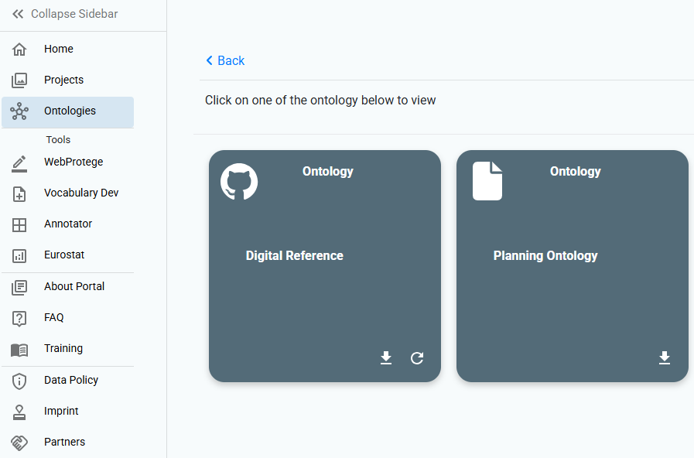

Ontology Curation Portal (OCP)
Key Objectives: Support joint development of a common understanding (semantics, DR Ontology)
    collaboration: Experts and Knowledge Engineers
    collecting distributed ontologies
    visualization, dev tracking, ...
Collaborative Ontology Development through Advanced Tools and Features

Slide 8
Vocabulary Development Support Tool (VDST)
Challenge
  Some SC4EU relevant DR concepts missing
  Inconsistent use of existing DR labels and definitions
  No automation of agreement processes
Example
  Future Demand versus Forecast
  Desired Inventory Coverage versus Desired Inventory Reach
Collaborative Ontology Development through Advanced Tools and Features

Slide 9
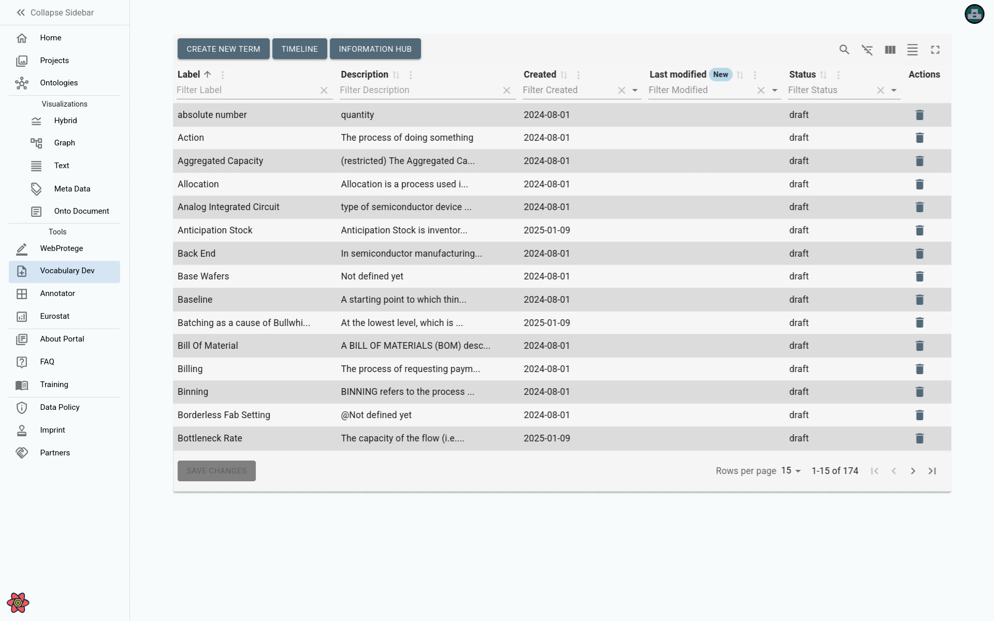
VDST - Video
Collaborative Ontology Development through Advanced Tools and Features

Slide 10

This project has received funding from the European Union’s Horizon 2020 Research and Innovation programme under Grant Agreement No 101139949

Slide 11
Thank you for attention!
Website: https://service.tib.eu/ocp

