Slide 1
Don't Erase, Inform! The DE-BIAS Approach to Detecting and Contextualizing Harmful Language in Cultural Heritage Collections
Orfeas Menis Mastromichalakis
National Technical University of Athens
Antoine Isaac
Europeana Foundation

Slide 2
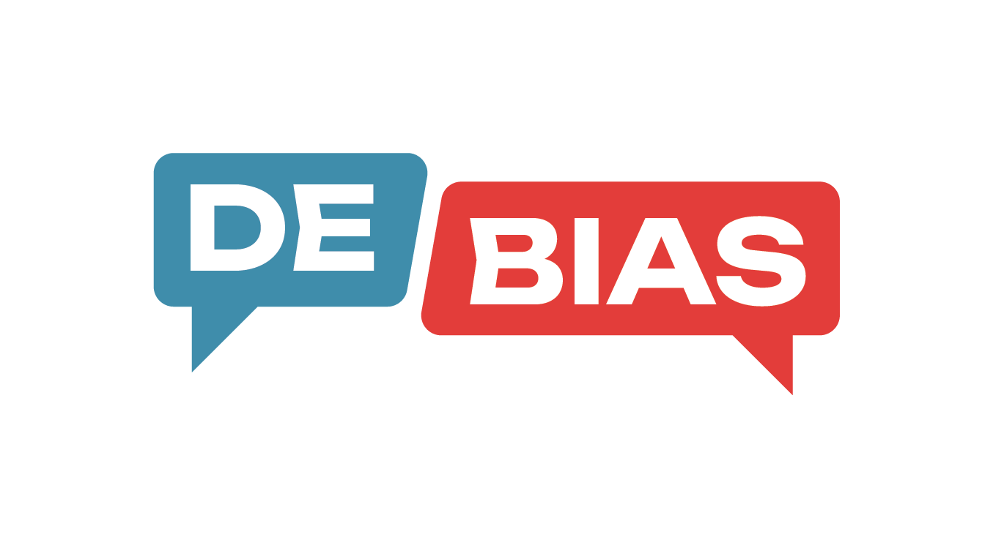
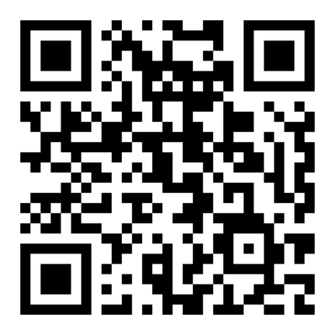



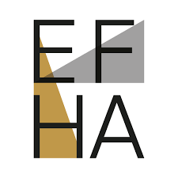
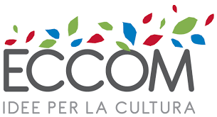

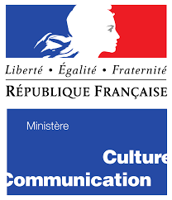




DE-BIAS: Detecting and cur(at)ing harmful language in cultural heritage collections
Promoting a more inclusive and respectful approach to describing cultural heritage.
Read more!

Slide 3
Harmful Language in CH
Term for people with disability. It suggests a person is ‘less than’ their contemporaries and that they are weak, inferior or useless.
Title: “Home for Invalids Annual Report, 1902”
Description: “List of invalids residing at the home, with notes on their physical and mental deficiencies.”
“Oriental” homogenizes diverse Asian identities and reflects Western exoticism.
Title: “Oriental Lady in Traditional Costume”
Description: “Photograph of an Oriental woman wearing exotic attire, likely taken in a bazaar setting.”
This term has long been used to dehumanize and harm Native Americans and Indigenous people, labeling them as uncivilized or primitive.
Title: “Savages of the Amazon”
Description: “A missionary's account documenting the customs of local savage tribes in Brazil.”
This term refers to the Khoikhoi people, who live in the western part of South Africa. It is a Dutch colonial term, first used in the 17th century, and was based on an imitation of the sound of the Khoikhoi language.
Title: “Portrait of a Hottentot Woman”
Description: “An ethnographic study of a Hottentot female from Southern Africa, displayed for educational purposes.”
3

Slide 4
Harmful Language in CH
Cannot simply remove terms
Offensive today, but part of the historical record. Deleting them erases context.
Need to inform, not censor
Flag and explain terms to support ethical access, transparency, and inclusion.
General tools fall short
Tools built for moderating contemporary harmful content (e.g. social media toxicity filters) may miss CH-specific contexts.
Impacts on metadata quality
Outdated terms hurt searchability (e.g., “invalid” vs. “disabled person”).
4

Slide 5
The DE-BIAS Approach
Curated a multilingual vocabulary of harmful terms
We built a structured vocabulary by working with CH professionals, researchers, and affected communities. Each entry includes a curated explanation of why the term may be considered harmful today, ensuring cultural and historical specificity and supporting accurate, respectful detection.
Developed a harmful language detection tool
Using the vocabulary, we created a tool that flags harmful terms in metadata using both traditional NLP techniques and large language models (LLMs).
Applied the tool at scale and integrated it into real-world platforms
We deployed our tool both as a standalone web app and via integration with major CH platforms like Europeana and MINT.
5

Slide 6

The DE-BIAS Vocabulary
Covers 5 languages: English, German, French, Italian, and Dutch
Almost 700 terms
Major topics: migration, colonial history, gender, sexual identity, and ethnicity (but also include disability, class, religion, and other categories)
Co-created with marginalized communities and supported by academic research
Incorporating revised and updated pre-existing vocabularies with clear attribution of sources
Following SKOS standard
Published in EU vocabularies¹
Suggested Term
Suggestion Note
hasSuggestedTerm
hasSuggestionNote
Contentious Issue
Contentious Term
hasContentiousTerm
hasBiasCategory
Category
¹https://op.europa.eu/en/web/eu-vocabularies
6

Slide 7
The Vocabulary
Contentious Term | Contentious Issue |  |  | Suggestion Note |  | Suggested Term | Category
Invalid | Term for people who have been made weak or have a disability through illness or injury. Today it is widely viewed as offensive as it suggests a person is ‘less than’ their contemporaries and that they are weak, inferior or useless. |  |  | This term is highly offensive or derogatory and should not be used. |  | Disabled person | (Dis)Ability
Hermaphrodite | The word comes from Latin and Greek, named after Hermaphroditus, (...) These terms are now regarded as outdated and stigmatizing. |  |  | This term can be used if it refers to animals or plants; the use when referring to people is advised against. (...) |  | Intersex; (...) Intersex person | Gender
Suggested Term
Suggestion Note
hasSuggestedTerm
hasSuggestionNote
Contentious Issue
Contentious Term
hasContentiousTerm
hasBiasCategory
Category
7

Slide 8




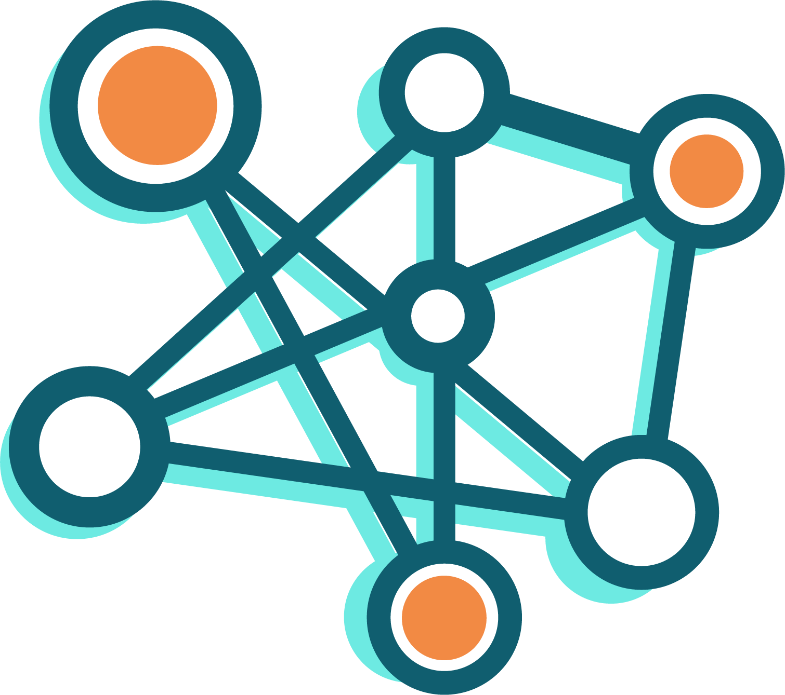
Detecting Harmful Language
Exotic
Invalid
Finocchio
Ape
Exotisch
Dwarf
Frog
List of invalids residing at the home, with notes on their physical and mental deficiencies.
List of invalids residing at the home, with notes on their physical and mental deficiencies.
Gipsy settlement on the outskirts of the city.
The Gipsy Kings performed a sold-out show featuring their signature blend of flamenco, salsa, and pop.
The Gipsy Kings performed a sold-out show featuring their signature blend of flamenco, salsa, and pop.
The system rejected the user’s input because the format was invalid.
The system rejected the user’s input because the format was invalid.
Compound Word Splitter
NER
Input Texts
LLM
Tokenization
Lemmatization
Filtering
Detected Terms
Vocabulary
String Matching
8

Slide 9
The Tool
Compound Word Splitter
NER
Input Texts
LLM
Tokenization
Lemmatization
Filtering
Detected Terms
Vocabulary
String Matching
TL;DR vocabulary-based fuzzy string matching and LLM for disambiguation
9

Slide 10
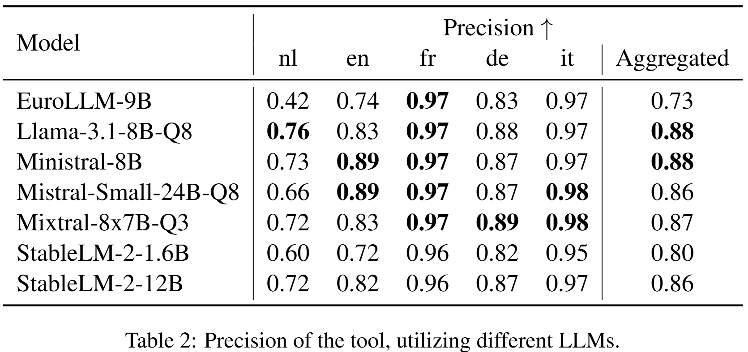
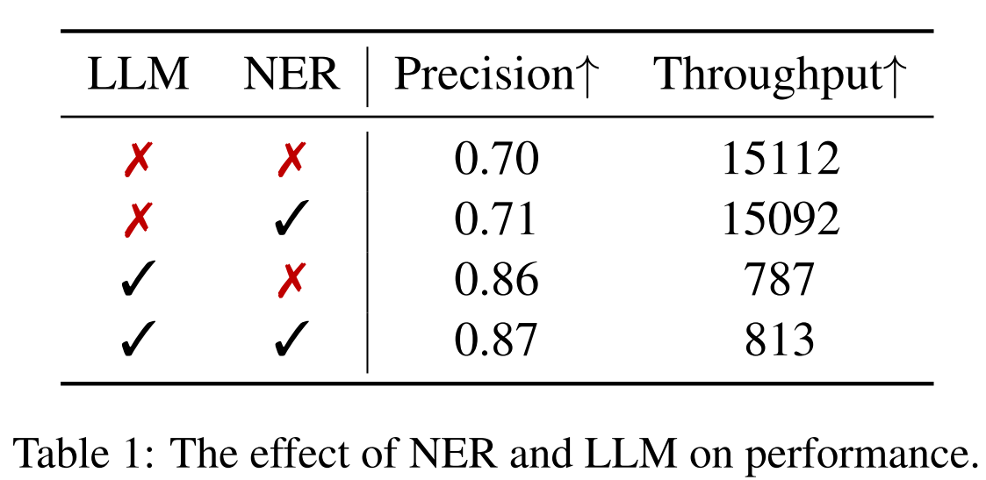
Experiments & Evaluation
Evaluation Dataset
3,700 annotated texts covering all 687 terms of the vocabulary
145 participants contributed in CrowdSourcing campaigns
Benchmarking Dataset
5 million records totaling over 690 million characters
10

Slide 11
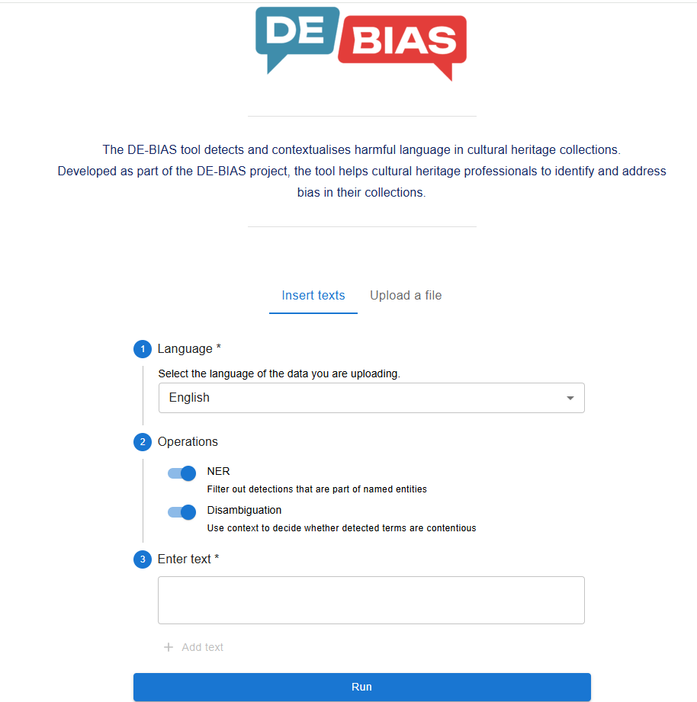
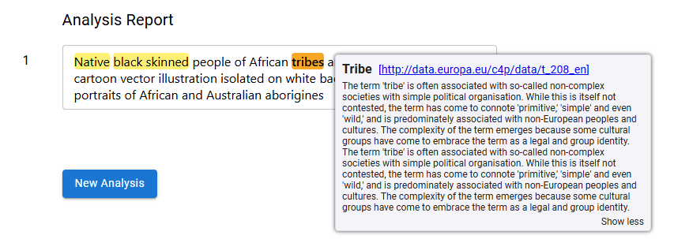
Application & Impact
Standalone tool and open API
We provide a user-friendly web application² and an open API, allowing individual researchers, archivists, and institutions to use the tool independently of platform constraints.
²https://debias-tool.ails.ece.ntua.gr
11

Slide 12
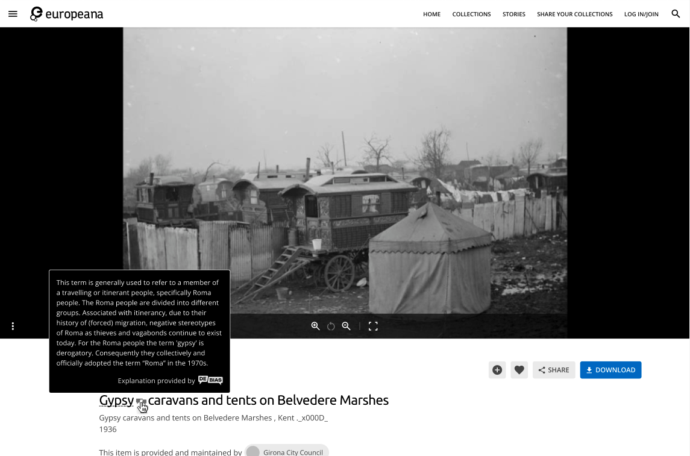
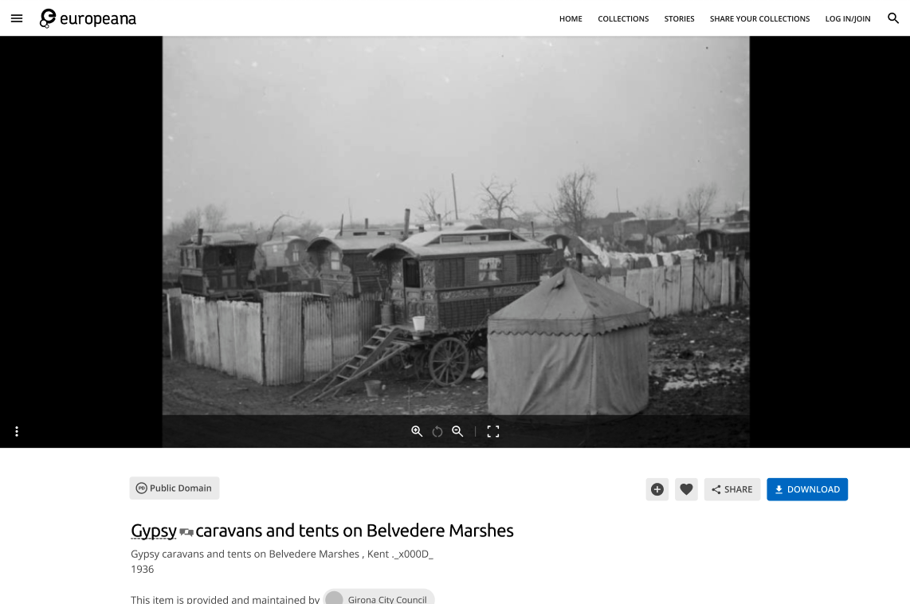
Application & Impact
Standalone tool and open API
We provide a user-friendly web application² and an open API, allowing individual researchers, archivists, and institutions to use the tool independently of platform constraints.
Integrated with major CH platforms
Our tool has been integrated with CH platforms such as Europeana and MINT, enabling institutions to detect harmful terms directly within their metadata pipelines, and platforms to inform about the detections.
12

Slide 13
Application & Impact
Standalone tool and open API
We provide a user-friendly web application² and an open API, allowing individual researchers, archivists, and institutions to use the tool independently of platform constraints.
Integrated with major CH platforms
Our tool has been integrated with CH platforms such as Europeana and MINT, enabling institutions to detect harmful terms directly within their metadata pipelines, and platforms to inform about the detections.
Wide-scale deployment
The tool has processed over 7.9 million records across five languages, enriching metadata, and supporting more equitable access to CH collections.
13
²https://debias-tool.ails.ece.ntua.gr

Slide 14
Challenges & Limitations
Multilinguality
There is no consistent behavior of the libraries and LLMs among different languages.
Certain problems may require language-specific solutions.
Difficulty to assess the results without knowledge of the language.
Working with LLMs
Controlling the output format is not always easy, especially with smaller LLMs, making parsing the results challenging.
Incorrect reasoning / hallucinations can sometimes lead to a correct decision, especially if the task is a Yes/No question.
Context-sensitive interpretation
Besides the in-text context that may help disambiguate whether a term is used in a contentious manner, in many cases, additional metadata (e.g., creator, date) or even the object itself (e.g., an image) is needed to interpret it accurately.
14

Slide 15
Thank you
Thanks to all the partners and individuals that contributed to DE-BIAS and brought this project to life!
menisorfeas@gmail.com
Orfeas Menis Mastromichalakis, Jason Liartis, Kristina Rose, Antoine Isaac, and Giorgos Stamou. 2025. Don’t Erase, Inform! Detecting and Contextualizing Harmful Language in Cultural Heritage Collections. In Proceedings of the 63rd Annual Meeting of the Association for Computational Linguistics (Volume 1: Long Papers), pages 21836–21850, Vienna, Austria. Association for Computational Linguistics.

