Slide 1
Semantic Challenges in Harvesting Data from Data Spaces
Pavlina Fragkou, Simon Steuer, Maria Westermann, Paolo Seromenho do Espirito, Teresa Barrueco Sanchez, Nataliya Rozbroj Jasinkaja, Beatriz Fernandez Nebreda, Maria Apostolou and Mariela Rodriguez Otazo

Slide 2
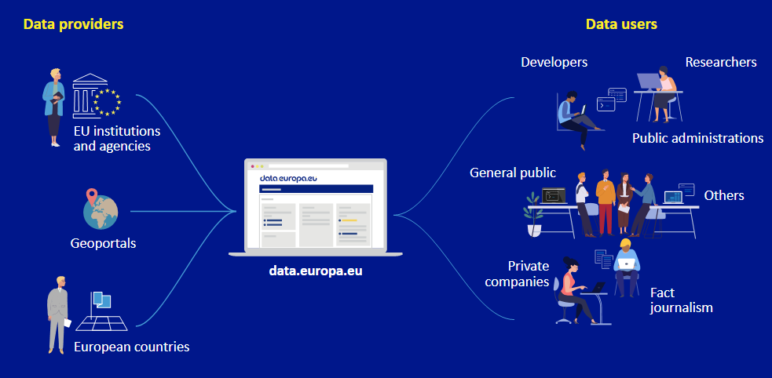
Data.Europa.eu
Has been set up by the EC to implement EU open data and reuse policies under the legal acts adopted by the EU institutions and EU MS.
Acts a bridge between the data providers and data users
Semantic Challenges in Harvesting Data from Data Spaces

Slide 3
Data.Europa.eu – Fostering metadata ecosystem
Open challenges:
European strategy for data
Revised Open Data Directive i.e., High Value Datasets
Sharing of sensitive data
data.europa.eu goal: give access and foster the reuse of European open data among citizens, business and organizations by collecting metadata following the common data model (DCAT-AP).
Problems encountered:
the number of catalogues to be harvested by each stakeholder (might differ from the ones hosted in their national portal);
the technology used (i.e., CKAN, ECAN etc) requiring implementation and support of different software options;
Semantic Challenges in Harvesting Data from Data Spaces

Slide 4
Data.Europa.eu – Fostering metadata ecosystem
Problems encountered (cont):
incompleteness or duplication of the information provided;
use of a different semantic model for representing metadata information for the different datasets requiring thus mapping (often with human intervention) to DCAT-AP;
use of different license types on a national level.
Problems tackled by:
using sparql queries to identify and collect missing or erroneous information
further analysis using analytic tools (such as Jupiter).
Semantic Challenges in Harvesting Data from Data Spaces

Slide 5
Metadata Quality Measurement
Methodology for measuring criteria based on FAIR principles:
(F) findability – (A) accessibility – (I) interoperability - (R) reusability and contextuality
Use of the Metadata Quality Assessment (MQA) tool to:
help data providers and portals check metadata quality including:
  compliance with DCAT-AP using DCAT-AP shacl shapes
  data accessibility,
  machine readability of the referenced data and use of licenses
Results are stored as W3C Data Quality Vocabulary used to describe the quality of a dataset.
Semantic Challenges in Harvesting Data from Data Spaces

Slide 6
Open Challenges
Problem: metadata quality remains poor.
Need: incorporating more sophisticated methods in metadata harvesting process and manipulation, for example:
• once only-effort for publishers of datasets;
• semantic integration (i.e., understanding on the meaning of the used concepts) and effective mapping of provided metadata;
• release of better-quality metadata and data for effective findability, accessibility and reusability;
• adaptation of aggregation techniques
• Use of artificial intelligence tools.
Semantic Challenges in Harvesting Data from Data Spaces

Slide 7
Future steps
explore several technologies including LDES event streams to capture the dataset change over time which will have an impact in the harvesting process;
experiment with Large Language Models and AI tools for metadata curation and improvement of search functionality;
improve the methodology to automatize the data model mapping process;
enhance the metadata quality assessment tool with more semantic assets
Semantic Challenges in Harvesting Data from Data Spaces

Slide 8
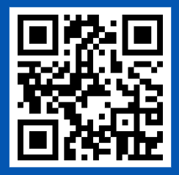
Thanks!
Stay up to date with open data. Subscribe to our newsletter:
op-data-europa-eu@publications.europa.eu

