Slide 1
Peter Lubrich (BASt), Mario Scrocca (Cefriel)
lubrich@bast.de, mario.scrocca@cefriel.com
Enhancing cross-border mobility data sharing with mobilityDCAT-AP
The journey so far and the next steps for mobilityDCAT-AP

Slide 2
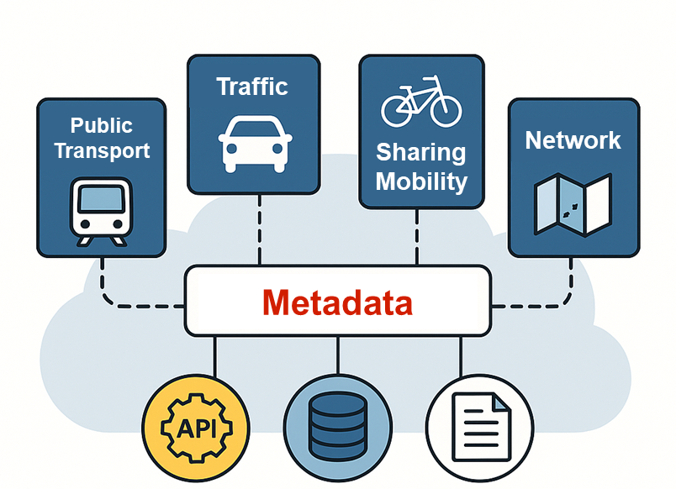
Context
Developing Intelligent Transportation Systems (ITS) and enabling Mobility-as-a-Service (MaaS) requires the collaboration of different mobility stakeholders and mandates for data-sharing solutions
Open data best practices are promoted by the EU Commission to support cross-portal and cross-border data reuse
Metadata are key elements to describe existing digital assets and enable their findability
Enhancing cross-border mobility data sharing with mobilityDCAT-AP
Image credits to ChatGPT

Slide 3
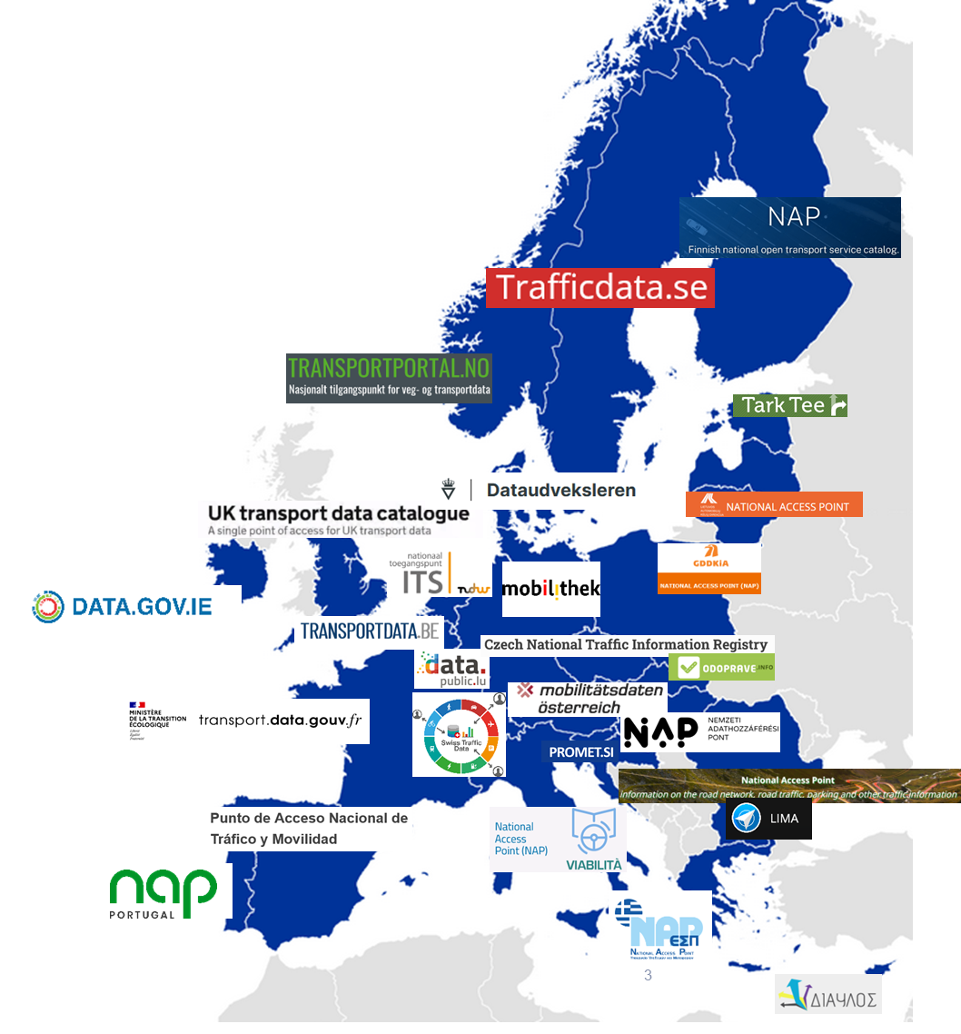

NAPs in Europe
The ITS Directive 2010/40/EU and its Delegated Regulations required each EU Member State to set up a National Access Point (NAP) to publish mobility data
30+ operational NAPs in Europe
Problem: fragmentation of mobility data platforms (formats, standards, access interfaces, etc.)
The NAPCORE project (https://www.napcore.eu) aims at coordinating all NAPs in Europe on an organizational and technical level
Enhancing cross-border mobility data sharing with mobilityDCAT-AP

Slide 4
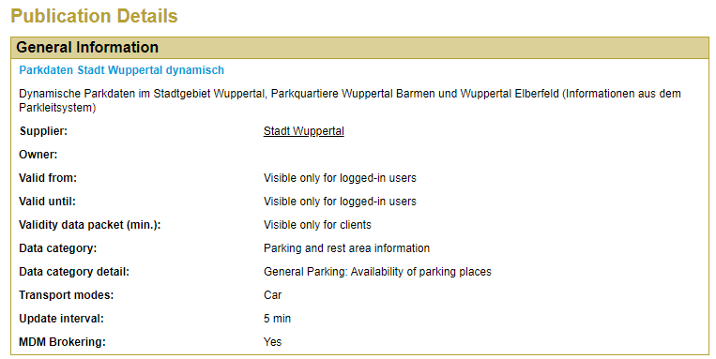
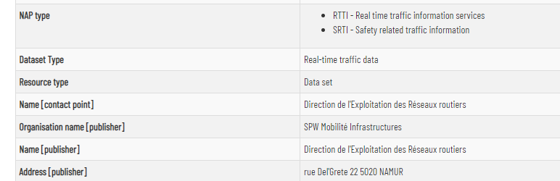
Why is a metadata specification needed?
MDM (former German NAP)
Different terminology (e.g., supplier vs. publisher)
Different set of metadata (e.g., NAP type)
Different values for metadata properties (e.g., proprietary set of data categories only used in a specific NAP)
Not machine-readable (e.g., unstructured descriptions, not parsable, no API)
Transportdata.be (former
metadata schema
of Belgian NAP)
Enhancing cross-border mobility data sharing with mobilityDCAT-AP

Slide 5

Coordinated Metadata Catalogue (CMC)
The Coordinated Metadata Catalogue (CMC), defined under the former EU EIP project, represented a first elaboration towards NAP metadata harmonisation in the mobility domain (link)
Feedback on the Coordinated Metadata Catalogue:
  Widely accepted among NAP operators
  Recommended by EC for implementation
  However, skepticism because of proprietary approach, compatibility for established metadata specifications wished
Enhancing cross-border mobility data sharing with mobilityDCAT-AP

Slide 6
Linked Open (Meta)Data enters the stage!
Mobility Domain Stakeholders 🤝 Semantic Web Experts
The definition of a DCAT-AP extension bridging the gap between metadata initiatives that consider the specific requirements of the mobility domain and the set of recommendations and best practices for metadata in data catalogues
DCAT-AP
Extension "DCAT-AP.de"
Extension "GeoDCAT-AP"
…
Extension “napDCAT-AP"
Enhancing cross-border mobility data sharing with mobilityDCAT-AP

Slide 7

Linked Open (Meta)Data enters the stage!
Mobility Domain Stakeholders 🤝 Semantic Web Experts
The definition of a DCAT-AP extension bridging the gap between metadata initiatives that consider the specific requirements of the mobility domain and the set of recommendations and best practices for metadata in data catalogues
The specification has been previously referred to as napDCAT-AP, then changed to mobilityDCAT-AP to clarify its applicability to any mobility data portal.
DCAT-AP
DCAT-AP
Extension "GeoDCAT-AP"
Extension "DCAT-AP.de"
Extension "GeoDCAT-AP"
Extension “mobilityDCAT-AP"
Extension "DCAT-AP.de"
…
…
Enhancing cross-border mobility data sharing with mobilityDCAT-AP

Slide 8
mobilityDCAT-AP Timeline
Kickoff NAPCORE
(Sep 2021)
Roadmap and Requirements (Jun 2022)
Conceptual Model (Oct 2022)
Public Review Phase
Final Conceptual Model (Mar 2023)
Implementation and Docs
Release v1.0.0
(Oct 2023)
Release v1.0.1 (Apr 2024)
Feedback from early adopters
Release v1.1.0 (Jan 2025)
Extended support for validation
Next major release
(~Q4 2025)
https://w3id.org/mobilitydcat-ap!
Enhancing cross-border mobility data sharing with mobilityDCAT-AP

Slide 9
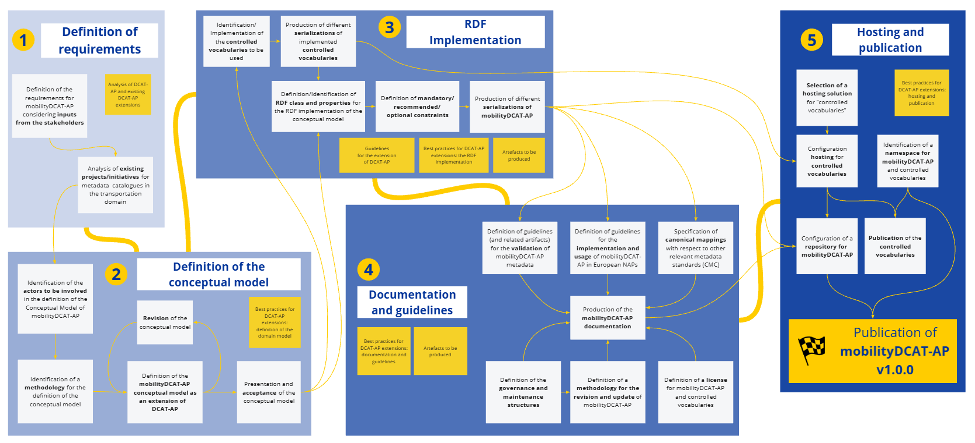
Roadmap towards mobilityDCAT-AP
NAPCORE Paper on Roadmap and Requirements https://ceur-ws.org/Vol-3235/paper22.pdf
Generic Roadmap for a DCAT-AP Extension https://doi.org/10.5281/zenodo.7053405

Slide 10






Requirements for mobility data
Mobility Data
Ownership
Content Info
Quality Info
Temporal Info
Geographical Coverage
Access Info
Conditions for use
Data format
NAPCORE Paper on Roadmap and Requirements https://ceur-ws.org/Vol-3235/paper22.pdf

Slide 11
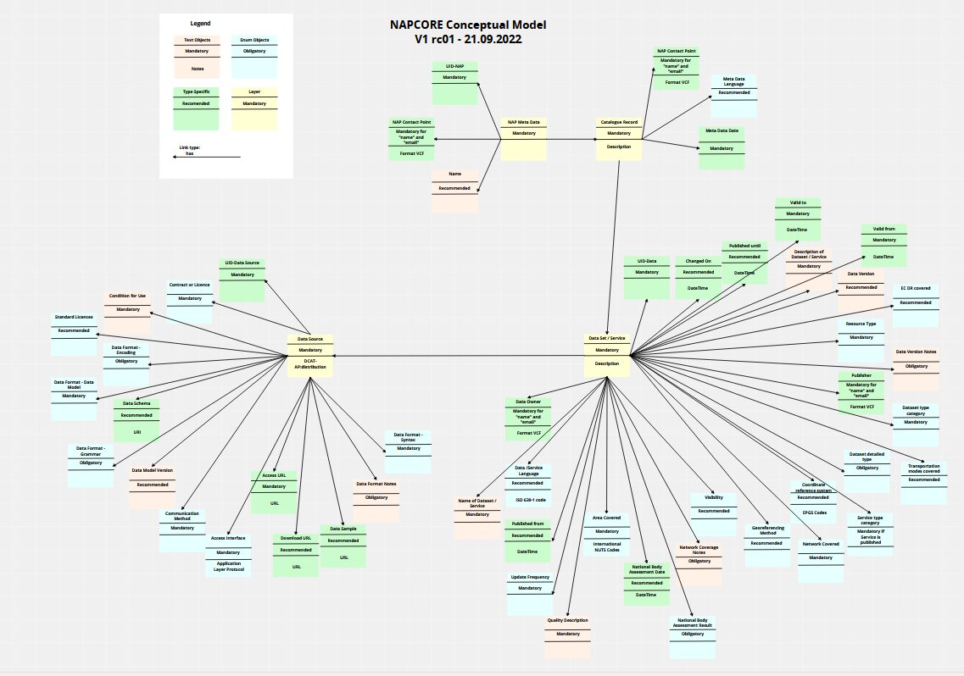
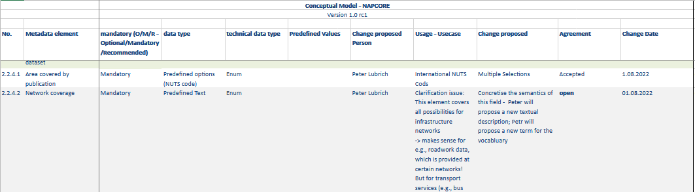
Conceptual model
2 additional classes newly defined (MobilityDataStandard, Assessment)
48 additional properties
  Mainly alignment with geoDCAT-AP
  12 newly defined (10 associated with specific lists of admissible values)
Several obligation levels changed
Several usage notes refined
Public review phase involving mobility stakeholders.
Excel file and diagram to collaborate and collect feedback from non-technical persons.
Enhancing cross-border mobility data sharing with mobilityDCAT-AP

Slide 12
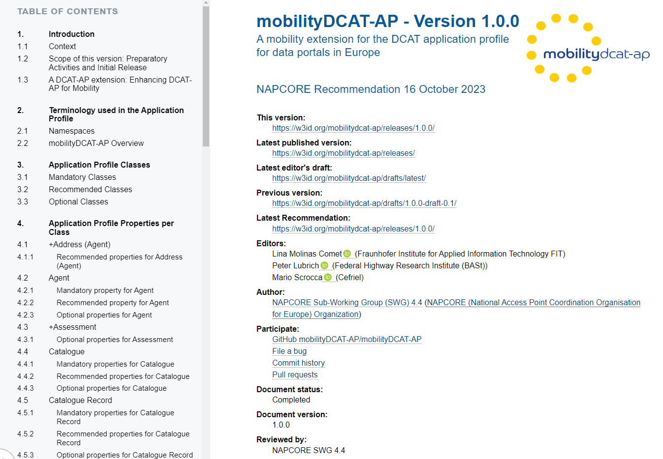
Implementation: Specification
mobilityDCAT-AP HTML Documentation defined using the ReSpec tool
Machine-readable serializations in different RDF formats: RDF/XML, Turtle, JSON-LD
SHACL shapes for the automatic validation of metadata, i.e., to check if a set of metadata comply with the specification
Enhancing cross-border mobility data sharing with mobilityDCAT-AP

Slide 13
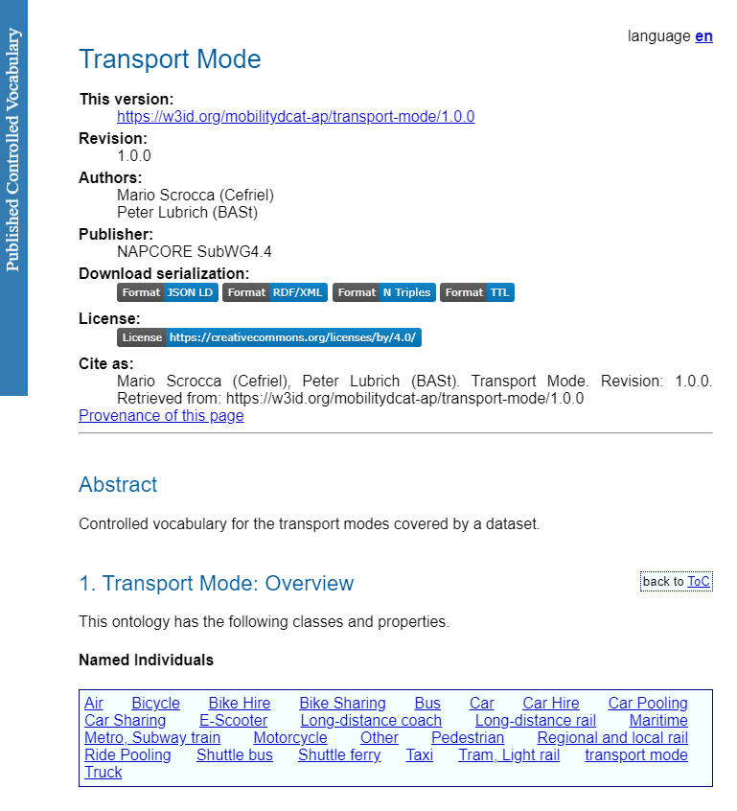
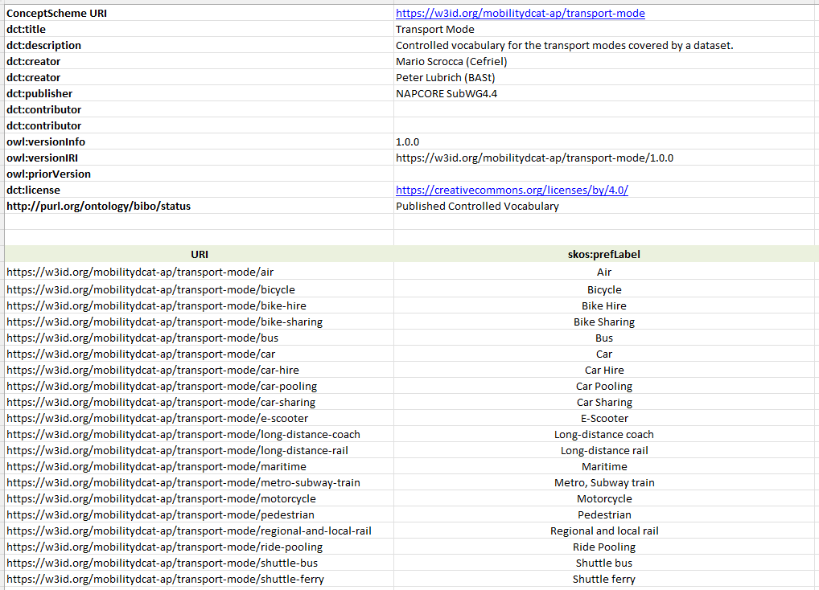
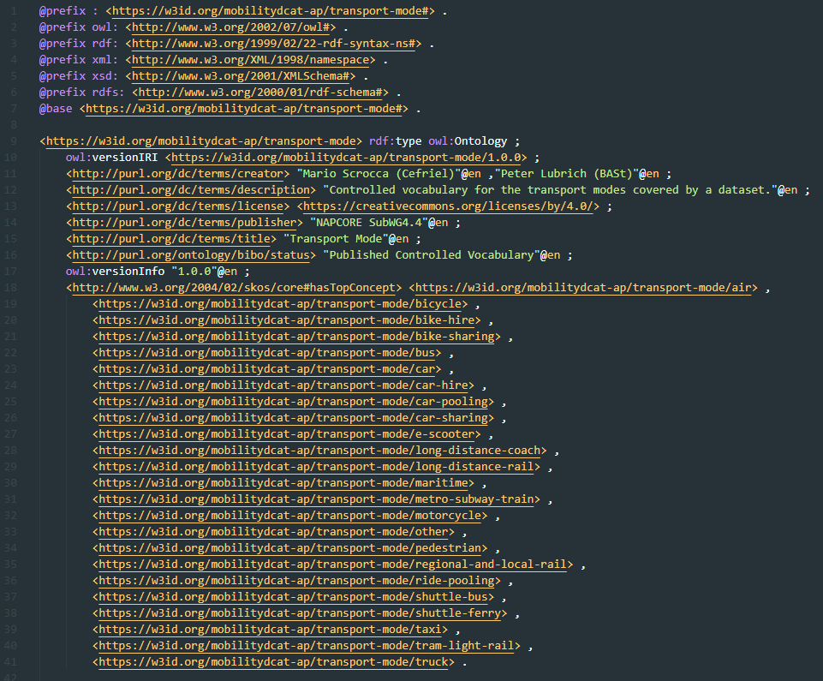
Implementation: Controlled Vocabularies
The mobilityDCAT-AP specification also defines “recommended values” to be used for certain properties (e.g., transport modes)
If possible, we reused recommendations from DCAT-AP or GeoDCAT-AP or referred to existing vocabularies
  8 vocabs from the Publications Office of the EU reused in mobilityDCAT-AP
mobilityDCAT-AP defines 10 new controlled vocabularies using SKOS
  11th vocabulary deprecated in v1.1.0 thanks to collaboration with the Publications Office of the EU for updating values in Frequency
HTML
Docs
Excel
RDF serialization
Enhancing cross-border mobility data sharing with mobilityDCAT-AP

Slide 14
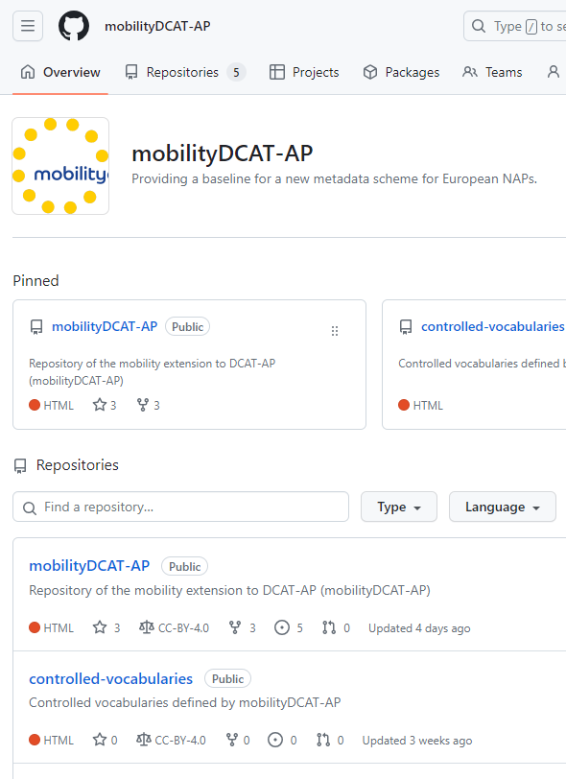
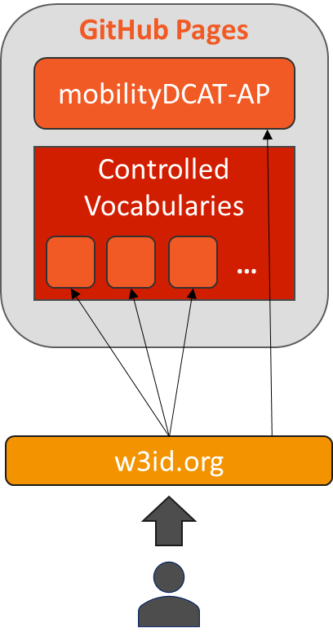
Hosting and Publication
GitHub is used to store, collaboratively edit and make available online all the artefacts associated with mobilityDCAT-AP
A GitHub organisation (link) was created to host the specification and the controlled vocabularies, and to assign rights to users
Persistent URI and content negotiation enabled via w3id: https://w3id.org/mobilitydcat-ap
Enhancing cross-border mobility data sharing with mobilityDCAT-AP

Slide 15
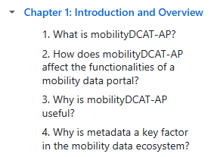
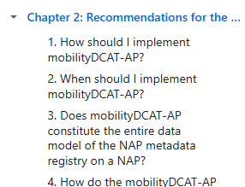
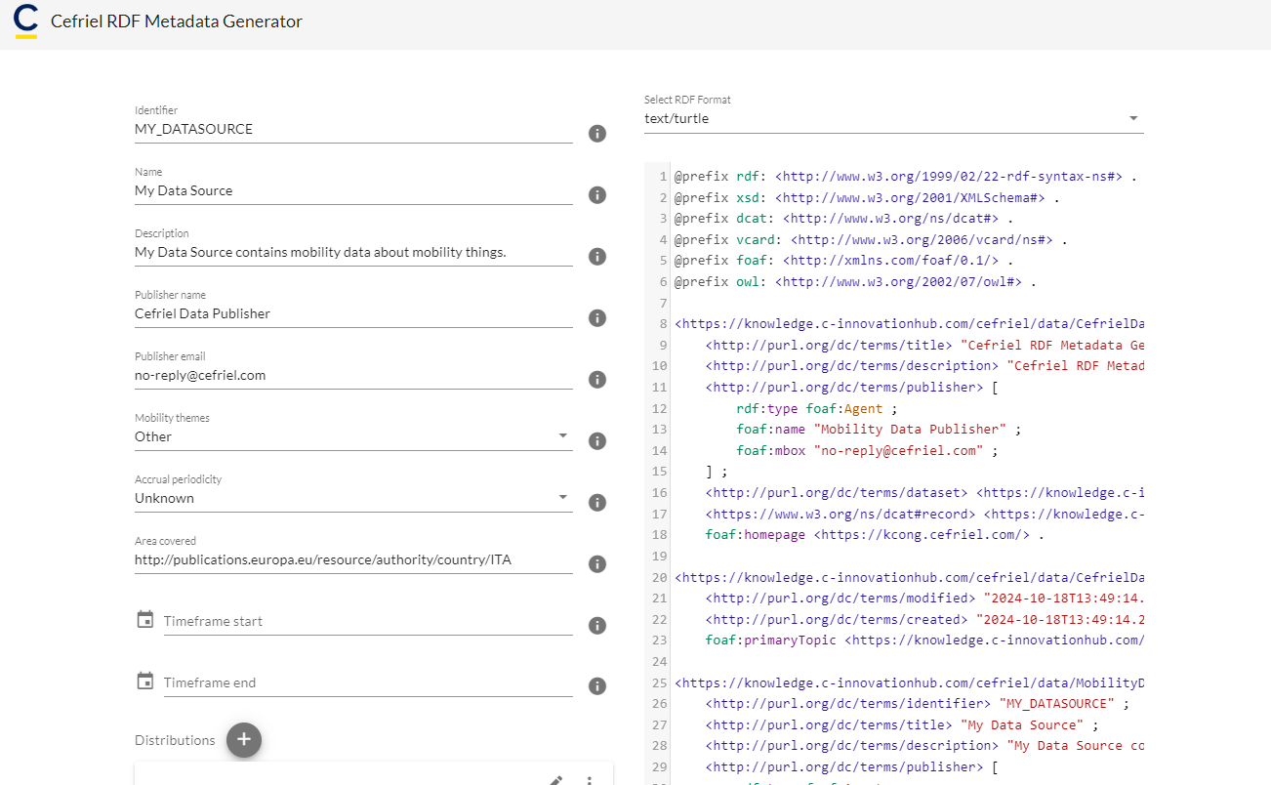
Support Resources
Wiki Documentation: provides a generic introduction and answers to Frequently Asked Questions to support the implementation of the specification
Generator Tool: web app to experiment with the minimum profile of mobilityDCAT-AP
Webinars (intro, validation) and 1:1 support through NAPCORE
…
…
Enhancing cross-border mobility data sharing with mobilityDCAT-AP

Slide 16
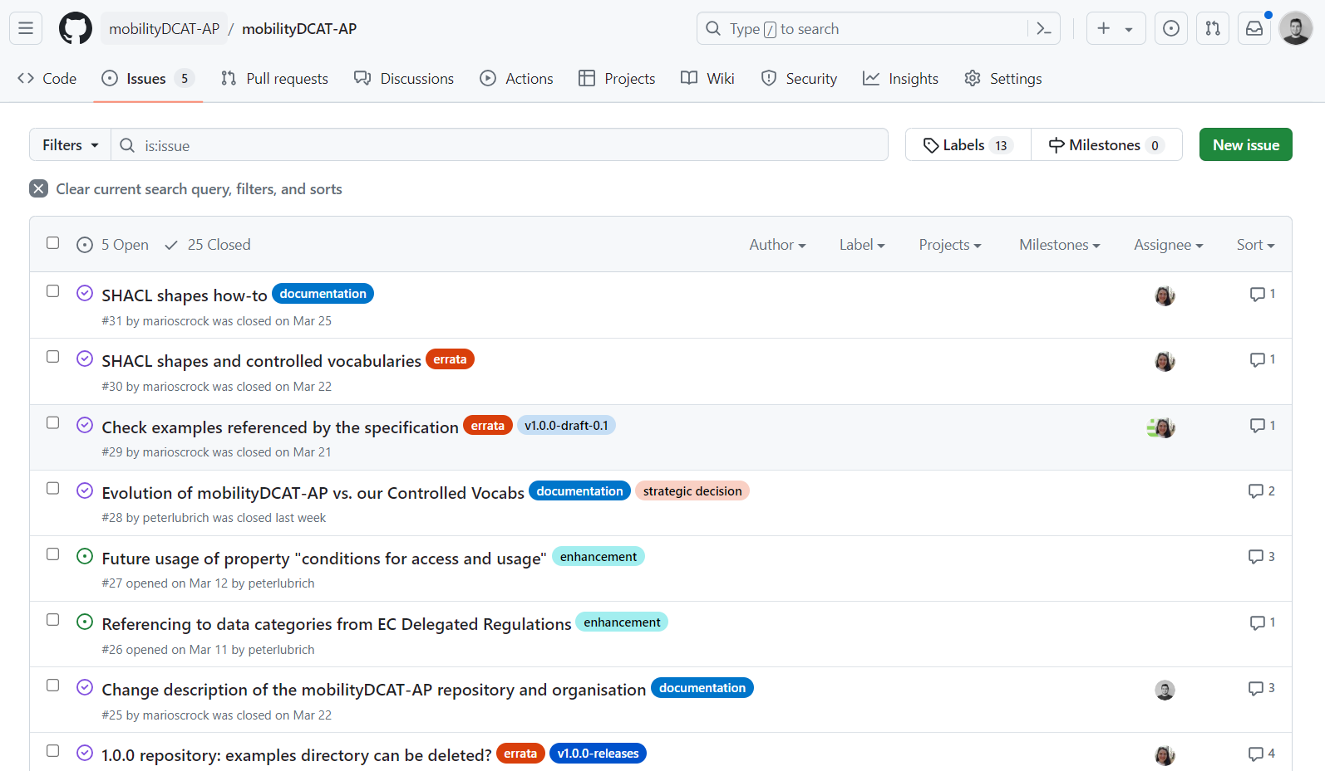
Collaboration and Maintenance
Everyone is invited to open an issue on GitHub to propose a use case not covered by the specification and/or to share any feedback
Issues are discussed online and considered for the development of mobilityDCAT-AP according to release cycles and rules defined for maintenance and governance (cf. link)
Collaboration with SEMIC to keep alignment among related specs
Enhancing cross-border mobility data sharing with mobilityDCAT-AP

Slide 17
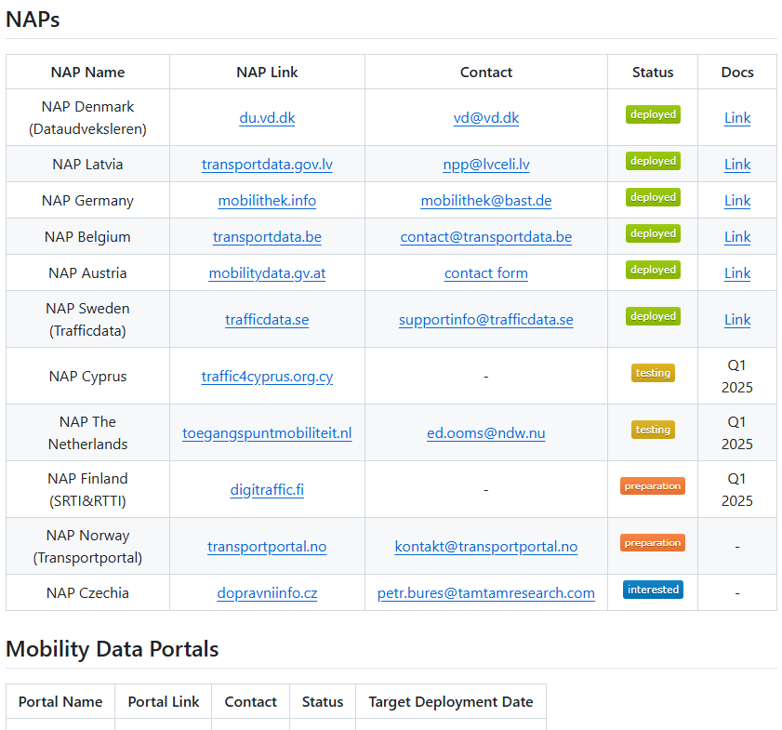
List of adopters
GitHub Repository: https://github.com/mobilityDCAT-AP/adopters
Already 6 NAPs implement the spec and more are working on it
To create awareness, keep track of its adoption, and help potential new adopters in finding existing implementations
Enhancing cross-border mobility data sharing with mobilityDCAT-AP

Slide 18
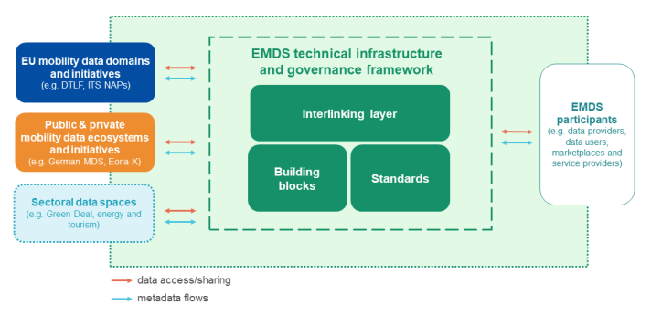
mobilityDCAT-AP and the EMDS
The objective of the European Mobility Data Space (EMDS) is to support data sharing, data agreements among mobility data stakeholders and secure data exchanges
Metadata are a key enabler to support the “Interlinking Layer” of the EMDS and the discovery of data offerings
mobilityDCAT-AP is part of the EU recommendations for the implementation of the EMDS and a preliminary analysis has been performed to check its compatibility with EMDS requirements [1]
Enhancing cross-border mobility data sharing with mobilityDCAT-AP
[1] https://op.europa.eu/s/z773

Slide 19

Metadata for the EMDS
deployEMDS is an EU project contributing to further developing and deploying the common EMDS by means of real-life implementation projects in 9 European cities and regions
Adopting mobilityDCAT-AP as reference metadata specification. But… mobilityDCAT-AP is not enough for the EMDS!
  Specific requirements can be considered to improve the next releases of mobilityDCAT-AP (e.g., access and usage rights based on ODRL)
  However, Offerings Descriptions require additional metadata not focusing only on a data catalogue perspective, but covering relevant aspects for dataspaces
mobilityDCAT-AP
Offering Description
Resources(s)
Description
Data Quality
License Terms
*license terms associated with offerings may be different and more specific
SLA
Pricing
…
Cf. DSSC Blueprint: https://dssc.eu/space/BVE2/1071256347/Data,+Services,+and+Offerings+Descriptions
Enhancing cross-border mobility data sharing with mobilityDCAT-AP

Slide 20
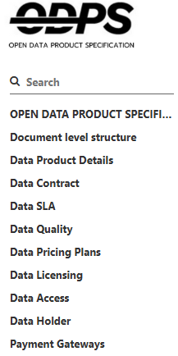
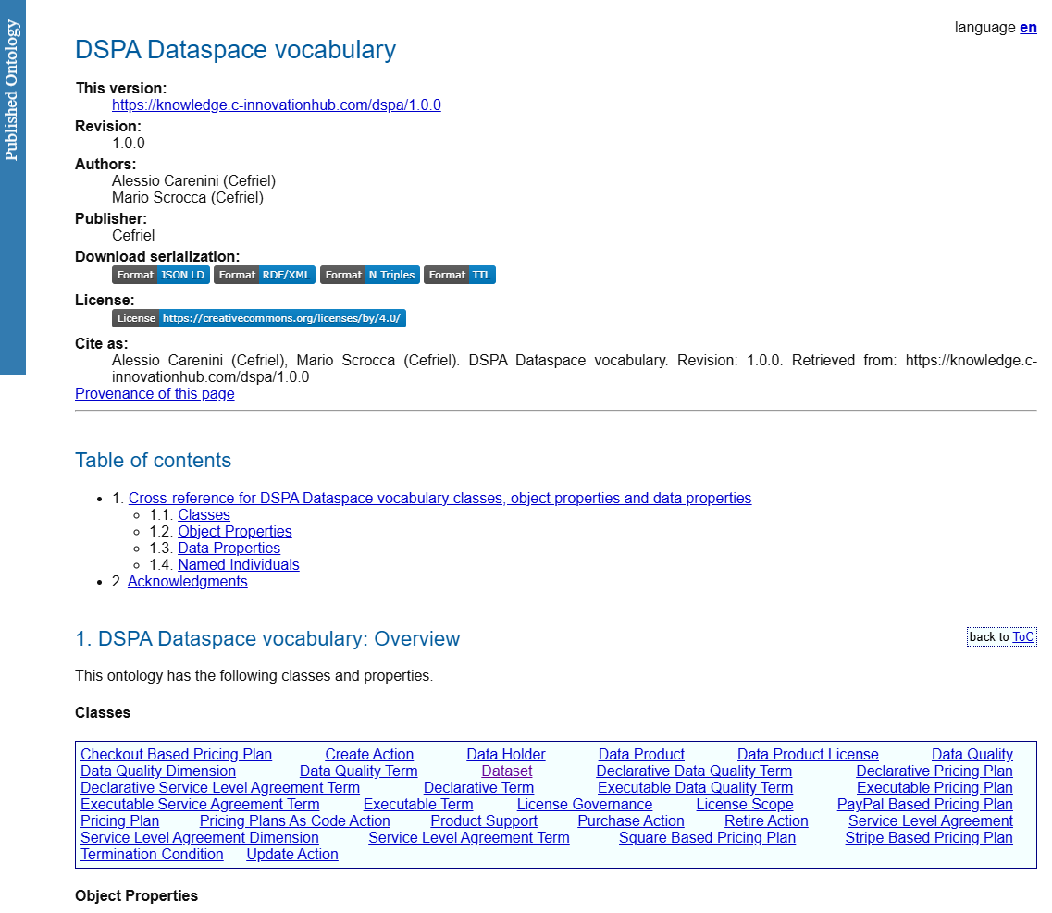
Metadata for the EMDS
DCAT and its application profiles (AP) may support the description of the resources, not the full offerings
mobilityDCAT-AP and other domain-specific extensions (e.g. healthDCAT-AP) are needed to better describe resources considering domain requirements
A different metadata specification should cover minimum “domain-agnostic” requirements for the description of dataspace offerings
The Open Data Product Specification (ODPS) is a well-established specification to describe data products and covers relevant aspects, but it is YAML-based
Proposal: define and maintain a DSPA vocabulary for data spaces aligned with ODPS and DCAT. Based on this core vocabulary, different APs can be defined.
Ongoing investigation within deployEMDS on defining a first draft of DSPA:
https://cefriel.github.io/dspa/dspa/latest/index.html
Enhancing cross-border mobility data sharing with mobilityDCAT-AP

Slide 21
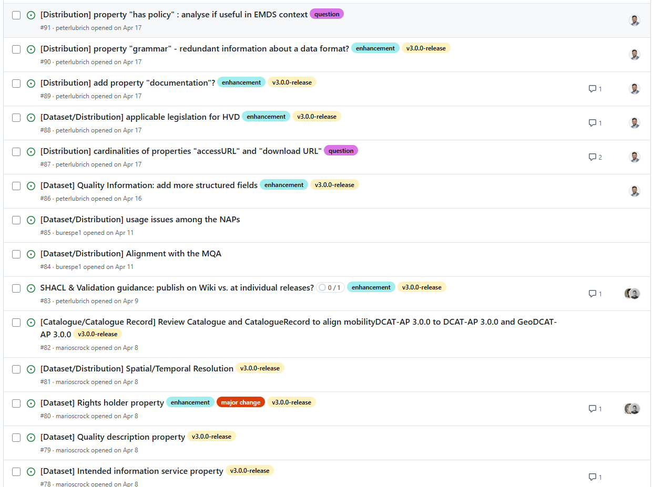


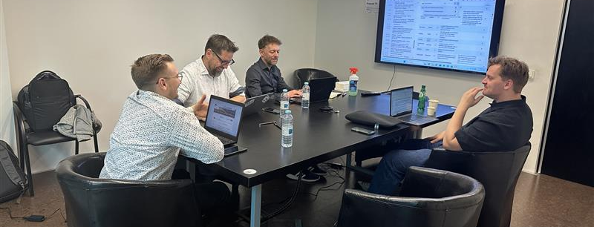
Next steps
Alignment with DCAT-AP 3.0.0 and GeoDCAT-AP 3.0.0
Editor Workshop in Porto (April 2025)
Outcome reported as a series of issues in GitHub for discussion with the community
Planned release Q4 2025
NAPCORE-X: New funding phase of NAPCORE 2025–2027
Maintenance and update of specifications and controlled vocabularies (e.g., considering DR)
Support for NAP operators
Automatic metadata generation from mobility standards (e.g., Datex II)
Guidelines for harvesting (e.g., OAI-PMH, LDES)
Collaboration workshops between NAPCORE and deployEMDS
Enhancing cross-border mobility data sharing with mobilityDCAT-AP

Slide 22

Thanks!
Discover and contribute at
github.com/mobilityDCAT-AP
Peter Lubrich lubrich@bast.de
Mario Scrocca mario.scrocca@cefriel.com

