Slide 1
Xueying Deng, Matthias De Geyter, Bart Matthys, Casper Van Gheluwe,​
David Vermeir, and Matthias Stevens.
AI & Algorithms Expert Center, Interuniversity Microelectronics Centre (imec)
Flemish Health Data Space Implementation
Technical Overview and Challenges

Slide 2
Agenda
Why Health Data Space?
Technical Implementations
Takeaways
Flemish Health Data Space Implementation

Slide 3
Why Health Data Space?
Flemish Health Data Space Implementation

Slide 4

Why Health Data Space ?
Flemish Health Data Space
Flemish Health Data Space Implementation

Slide 5
Why Health Data Space ? - Project goals
Mapping government needs regarding data-driven policy, population health & care management and health data space
Mapping these needs against national and international technological enablers: Gaia-x, IDSA, VSDS (Flemish Smart Data Space - LDES),...
Validate via a use case-driven approach: based on technical and business use cases
Providing insights and expertise and transferring them to the administration, so that a roadmap can be developed for further large-scale rollout
Flemish Health Data Space Implementation

Slide 6
Technical Implementations
Flemish Health Data Space Implementation

Slide 7
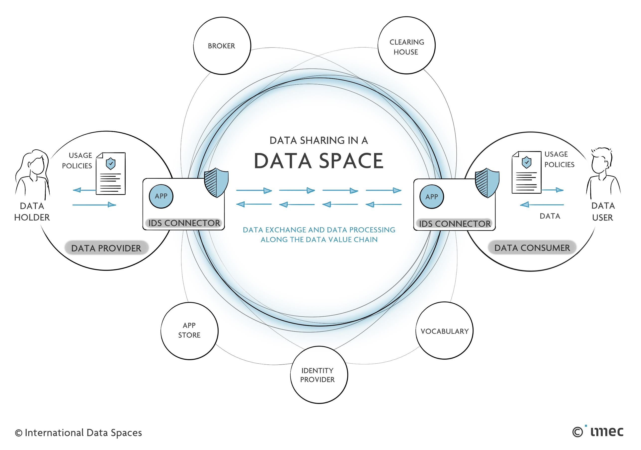
Technical Implementations – Design
Flemish Health Data Space Implementation

Slide 8
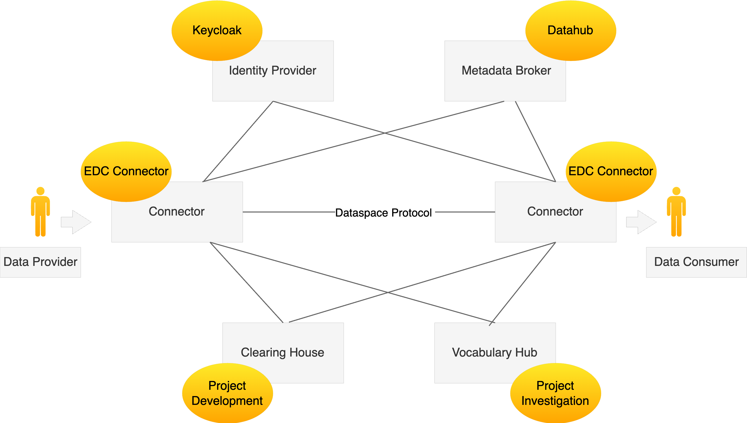
Technical Implementations – Design
Flemish Health Data Space Implementation

Slide 9




Technical Implementations – Vocabulary hub
Management platform for data schemas within a data space, offering schema validation and semantic annotations
Data models - Semantic Interoperability (Need toolkits to easy barriers)
    FIWARE Smart Data Models
    Fast Healthcare Interoperability Resources (FHIR) and OMOP (Observational Medical Outcomes Partnership)
        No readily available data plane supports FHIR or OMOP implementations
        The data obtained from the project was aggregated rather than person-centric centric data (privacy protection)
  Linked Data Event Stream (LDES) : Flemish Smart Data Space (VSDS)
        Converting health data to the LDES format is challenging, especially in identifying the proper data model in the medical care domain
        Installation of the LDES components
Flemish Health Data Space Implementation

Slide 10


Technical Implementations – Vocabulary hub
Vocabulary hub - Tools (Neither service yet supports machine-to-machine integration for communicating with the connector)
  Semantic Treehouse (TNO)
  IDS Vocabulary Provider
One-size-fits-all data model does not exist in the medical field, need future projects
Flemish Health Data Space Implementation

Slide 11
Technical Implementations – Design
Flemish Health Data Space Implementation

Slide 12

Technical Implementations – Metadata Broker: Datahub and Data Discovery
The Metadata Broker manages metadata for secure and interoperable data exchange. It enables discovery, ensures standardization, and supports trusted data sharing without storing actual data
Datahub (Acryl Data and LinkedIn) for hosting metadata
  Other tools with similar functions include Amundsen, Atlas, Marquez, OpenDataDiscovery, and OpenMetadata
Machine-to-Machine Data Discovery
  The metadata populated by the EDC lacks a precise specification (different interpretation of DCAT (Data Catalog Vocabulary))
    Explored: Metadata Flanders portal (Harvest DCAT)
  The current metadata provided by the EDC connector does not include annotations or validations of sharing or shared data itself
  Can we use SHACL? (RDF onboarding and learning curve of SHACL)
Flemish Health Data Space Implementation

Slide 13
Technical Implementations – Design
Flemish Health Data Space Implementation

Slide 14

Technical Implementations – Eclipse Dataspace Components (EDC) Connector
A connector in the IDSA framework is an interface that enables participants to exchange data within a data space. It ensures data sovereignty, supports interoperability, and handles tasks like authentication, authorization, and data transfer
Interoperability: the connector's ability to work seamlessly with other connectors
  Implement Data Space Protocol and the relevant protocols associated with GAIA-X
Extensibility: The potential for customization and enhancement of the connector
  Modular architecture that supports the integration of extensions
Community Support and Active Development: Ongoing development
  GitHub discussions and Discord channels
Flemish Health Data Space Implementation

Slide 15
Technical Implementations – Design
Flemish Health Data Space Implementation

Slide 16

Technical Implementations – Identity Provider: Keycloak
Decentralized Identity and Access Management Solutions
  Decentralized Web Nodes (DWN)
  Decentralized Claims Protocol (DCP)
  iShare Trust Framework
Central Identity Provider (IdP) Solutions
  OAuth DAPS
  OAuth using Keycloak (or other IdP that supports Private Key JWT)
    Build on widely accepted technologies
    Supported by the EDC Connector as external IdP
Flemish Health Data Space Implementation

Slide 17
Technical Implementations – Design
Flemish Health Data Space Implementation

Slide 18
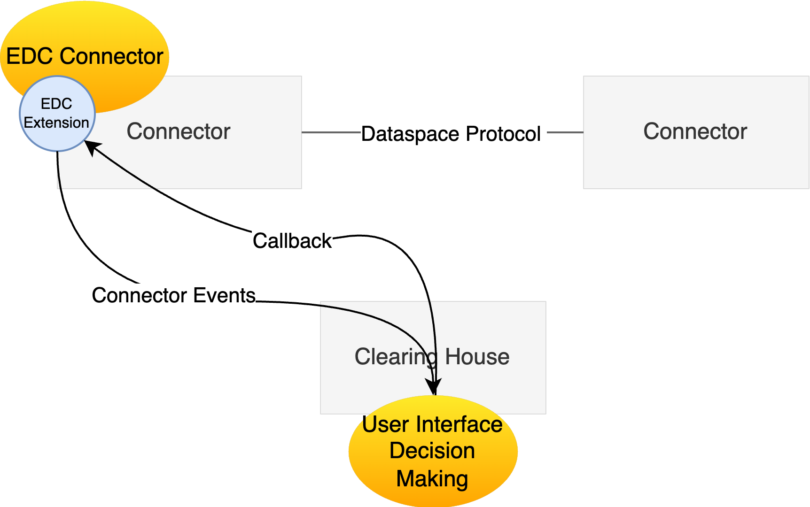
Technical Implementations – Clearing House (Project Development)
Function Scope
  The health authority needs to have transparency of all transactions occurring within the data space
  Align to RAM 4.0: Providing essential services such as clearing, monitoring and settlement for all financial and data exchange transactions
Flemish Health Data Space Implementation

Slide 19
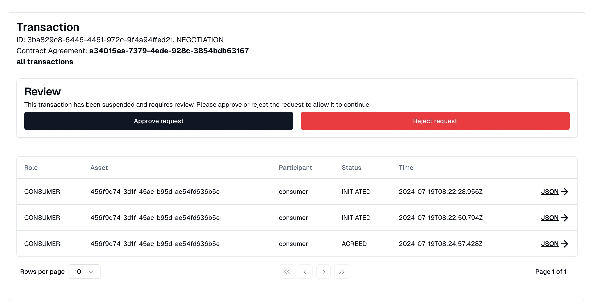
Technical Implementations – Clearing House (Project Development)
Flemish Health Data Space Implementation

Slide 20
takeaways
Flemish Health Data Space Implementation

Slide 21
Takeaways
We successfully built a minimum viable data space that has been deployed on the customers’ sides
Remaining Challenges
  Semantic interoperability has been partially achieved at the metadata level (DCAT) but not at the data level
  The implementation of a clearing house can vary significantly according to requirements, as no definitive answer is provided by RAM
  Distributed identity utilizes verifiable credentials for machine-to-machine communication, which is still in the theoretical specification stage
Flemish Health Data Space Implementation

Slide 22
Agenda
Why Health Data Space?
Technical Implementations
Takeaways
Flemish Health Data Space Implementation

Slide 23
Useful Links
​Project Confluence: Health Data Space - Confluence (atlassian.net)
Final report: Flemish Health Data Space Final Report (Dutch)
Project demo video: HDS-Demo.mp4 (Please request access)
Research publication: Flemish Health Data Space Implementation: Technical Overview and Challenges
Flemish Health Data Space Implementation

Slide 24
THANKS

Slide 25
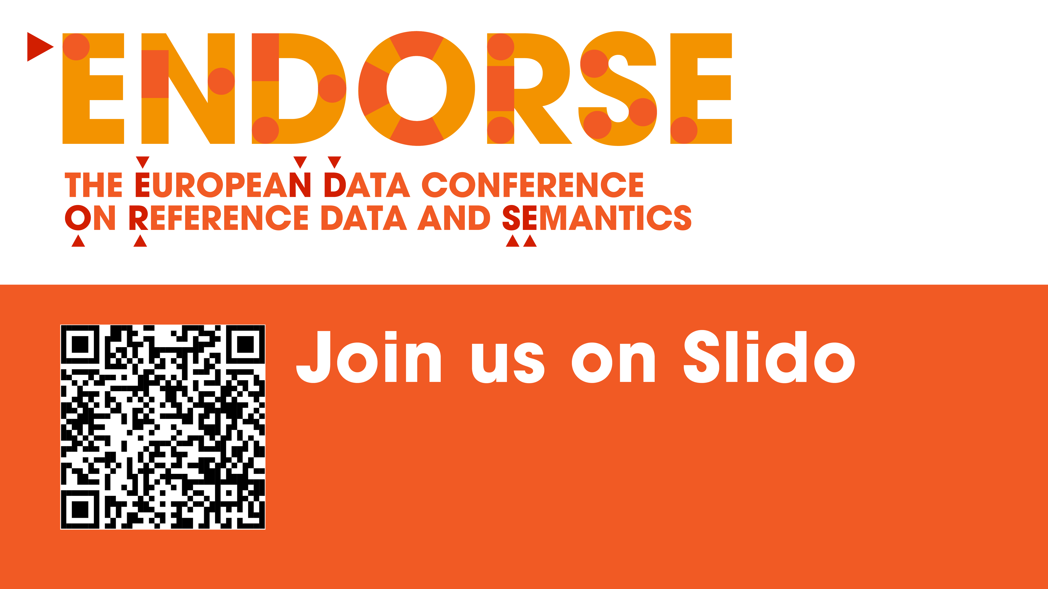

Slide 26
Florian Hölken
Scientific Researcher
Smart City Urban Heat Monitoring using a Solid-based Dataspace

Slide 27
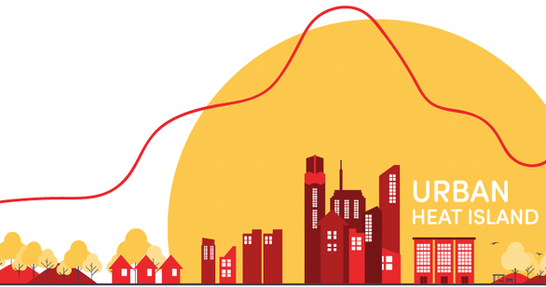
Goal & Vision
Smart city application
Urban heat island problem
Leverage heterogeneous data
Inform citizens
Fine-granular environmental data
Citizen participation
Source: https://community.wmo.int/en/activity-areas/urban/urban-heat-island - Accessed on May 20, 2025
Smart City Urban Heat Monitoring using a Solid-based Dataspace

Slide 28

Key Requirements
Distributed data from diverse stakeholders
Decentralized and privacy infrastructure
Data sovereignty
Mechanism for discovering relevant datasets
Interoperability
Integration and visualization
Generated by DALL·E 3
Smart City Urban Heat Monitoring using a Solid-based Dataspace

Slide 29
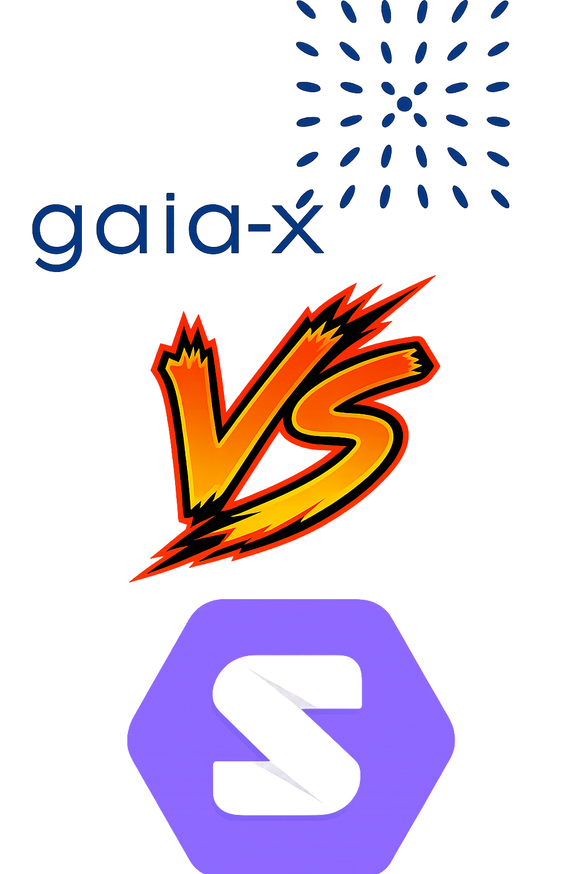

Dataspace
Dataspace Definition
"A dataspace is a data management abstraction that provides support for managing heterogeneous data sources without requiring full integration up front."
Halevy, A., Franklin, M. J., & Maier, D. (2005). From databases to dataspaces: A new abstraction for information management. ACM SIGMOD Record, 35(4), 27–33. https://doi.org/10.1145/1147376.1147381
Smart City Urban Heat Monitoring using a Solid-based Dataspace

Slide 30
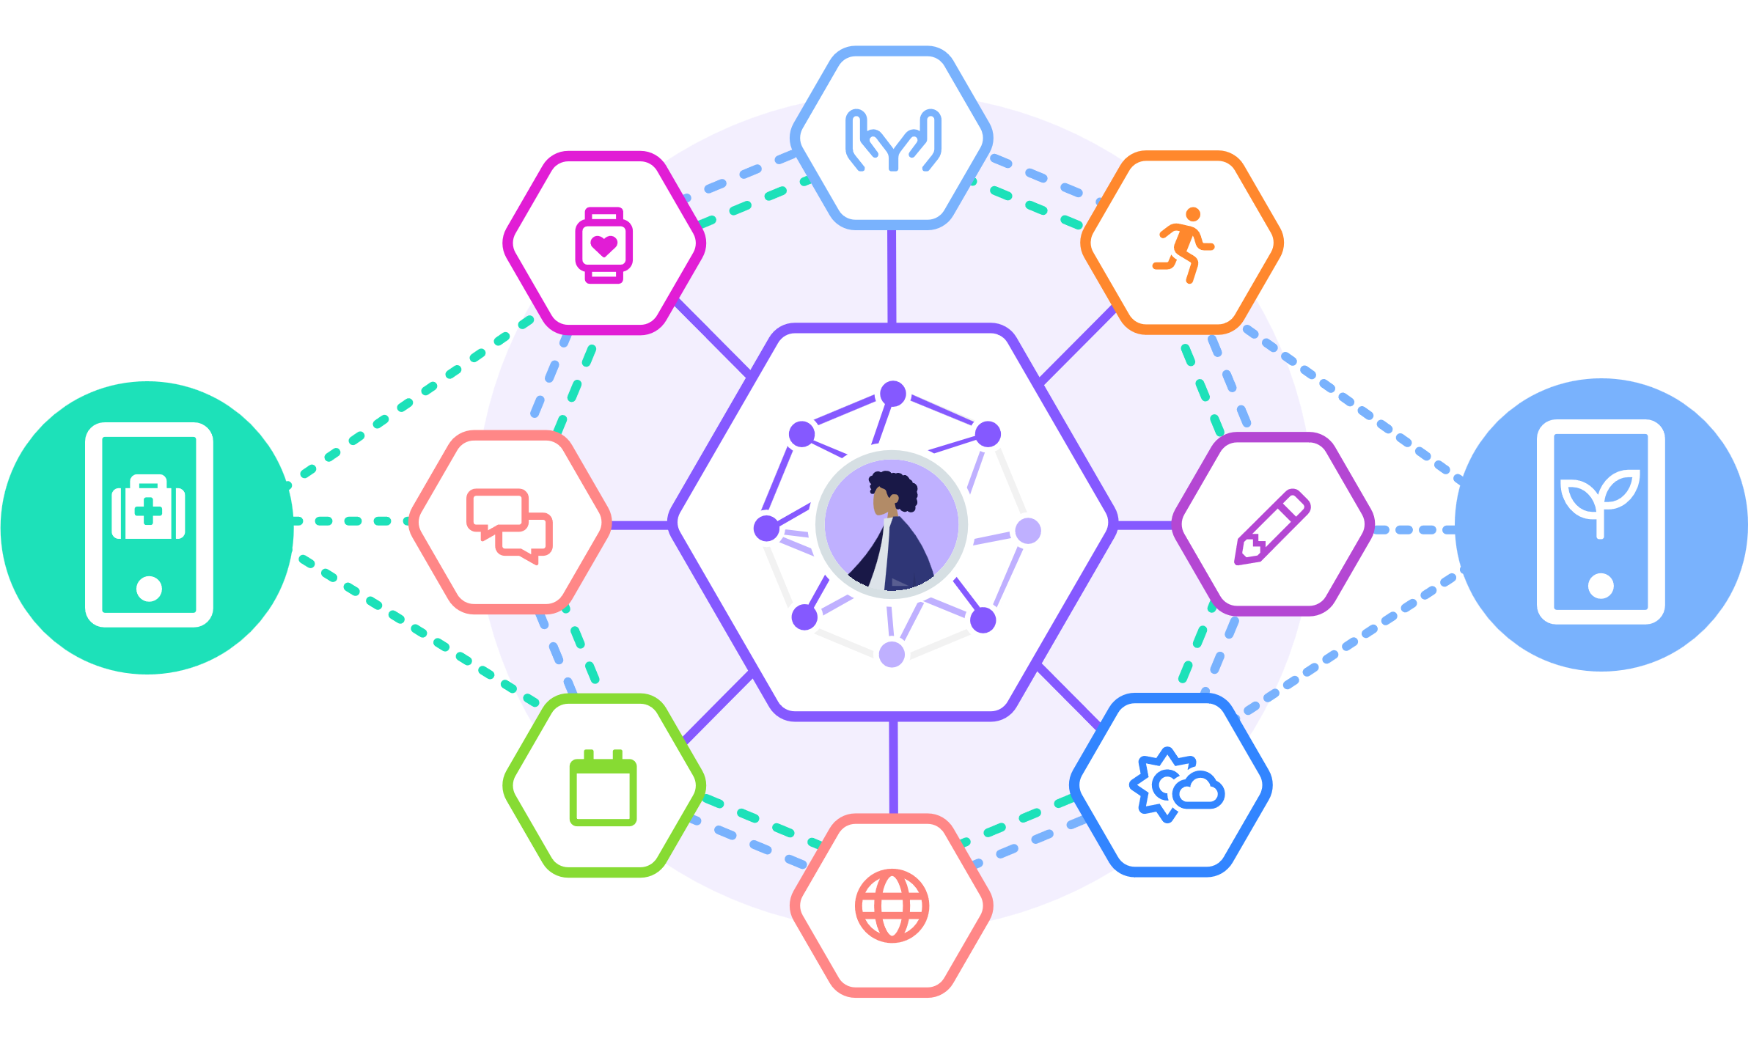
Solid
Decentralized, user-controlled data storage
Personal Pods with access control
WebID for decentralized identity
Solid-based dataspaces combine decentralization with interoperability
Suitable for citizen participation
Source: https://solidproject.org/image/interoperability-tour.svg - Accessed on May 16, 2025
Smart City Urban Heat Monitoring using a Solid-based Dataspace

Slide 31





Solid Apps and Dataspace Apps
Solid App | Dataspace App
Direct permission for application | Integrates data across multiple storages
Operates on a single user’s pod | Data must be discovered, harmonized and aggregated
Smart City Urban Heat Monitoring using a Solid-based Dataspace

Slide 32
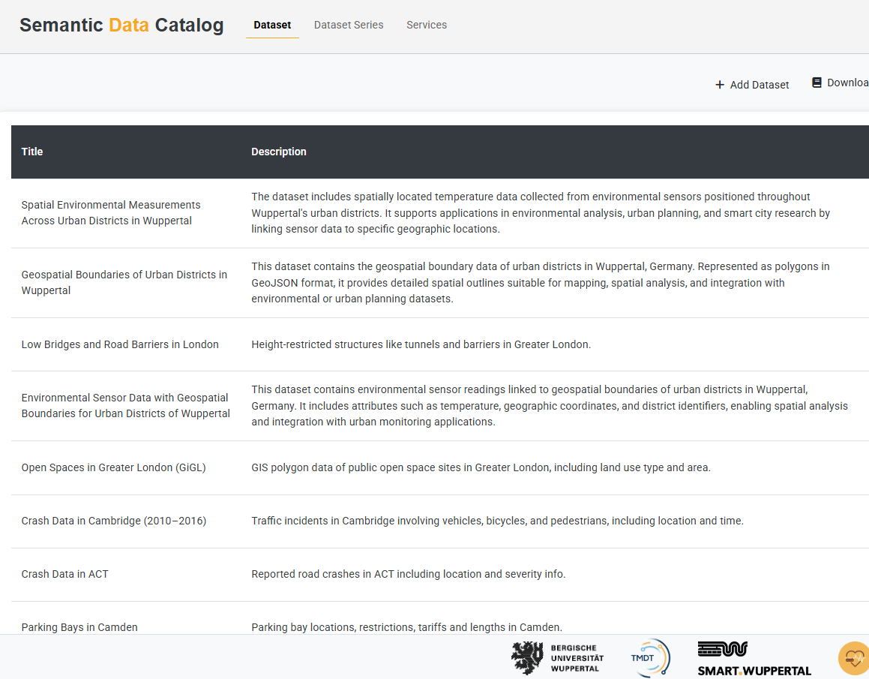
Semantic Data Catalog
Solid no support for dataset discovery
Index and describe datasets
Based on DCAT
Extended with semantic models
Supports FAIR
Hölken, F., Paulus, A., Meisen, T., & Pomp, A. (2025, April). Bridging the discovery gap in Solid dataspaces with a semantic data catalog. Publication Date Open.
Smart City Urban Heat Monitoring using a Solid-based Dataspace

Slide 33
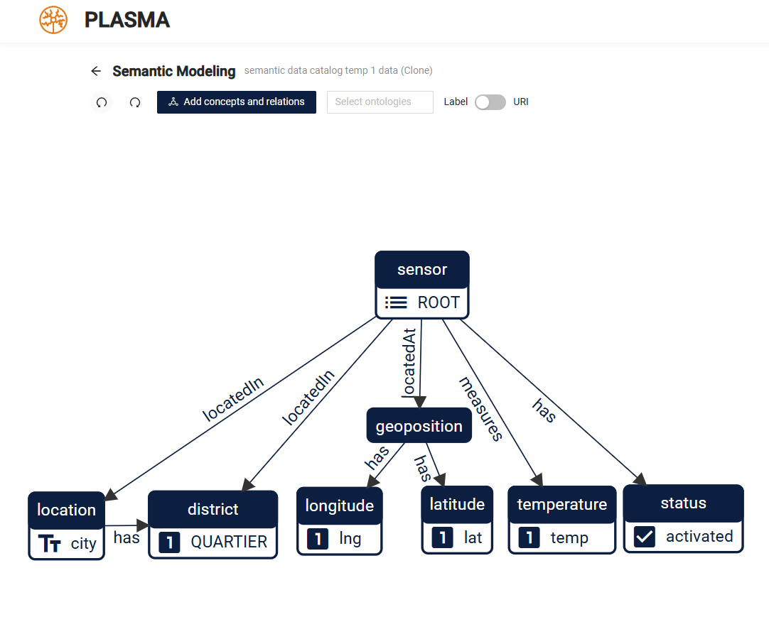
Semantic Models
Semantic Model Definition
"A dataspace is a data management abstraction that provides support for managing heterogeneous data sources without requiring full integration up front."
Vu, B., Knoblock, C. A., & Pujara, J. (2019). Learning semantic models of data sources using probabilistic graphical models. Proceedings of the 2019 World Wide Web Conference (WWW '19), 1944–1953.
Source: http://plasma.uni-wuppertal.de - Accessed on May 28, 2025
Smart City Urban Heat Monitoring using a Solid-based Dataspace

Slide 34
General Overview of developing a Dataspace Application using Solid
Create Semantic Model
PLASMA
Developer
Create Dataset Entry
Discovery & Identification
Semantic Data Catalog
Retrieval Info
Application
User
Load Datasets
Mapping & Normalization
Enduser
Unified Data
Visualization
Smart City Urban Heat Monitoring using a Solid-based Dataspace

Slide 35
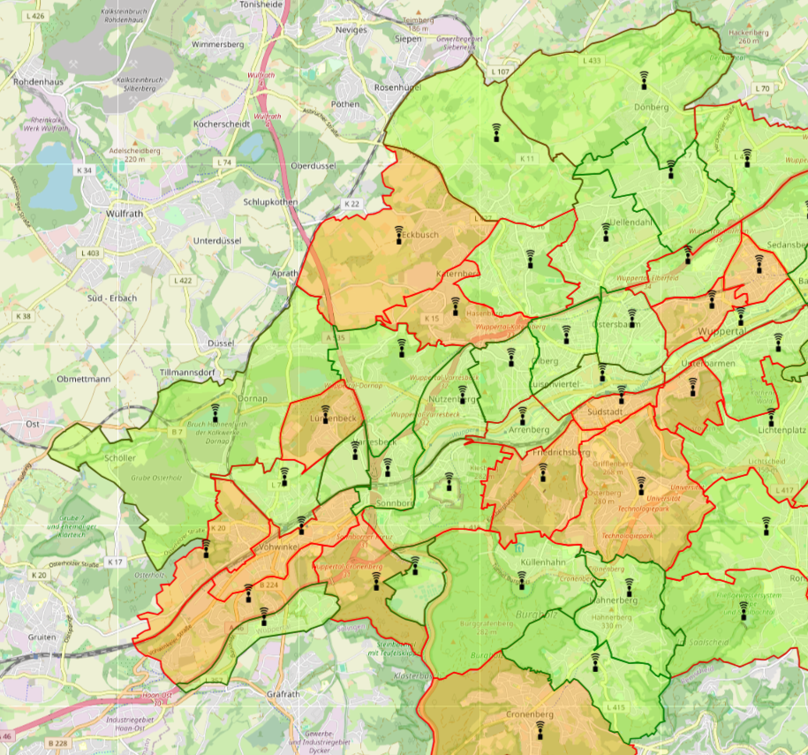
Smart City Urban Heat Monitoring
Test Setup
3 Community Solid Server (CSS)
Semantic Data Catalog
Datasets
Geospatial dataset
Heterogeneous temperature datasets
Hölken, F., Paulus, A., Meisen, T., & Pomp, A. (2025). Smart city urban heat monitoring using a Solid-based dataspace. In Proceedings of the Third International Workshop on Semantics in Dataspaces (SDS 2025), Portorož, Slovenia.
Smart City Urban Heat Monitoring using a Solid-based Dataspace

Slide 36
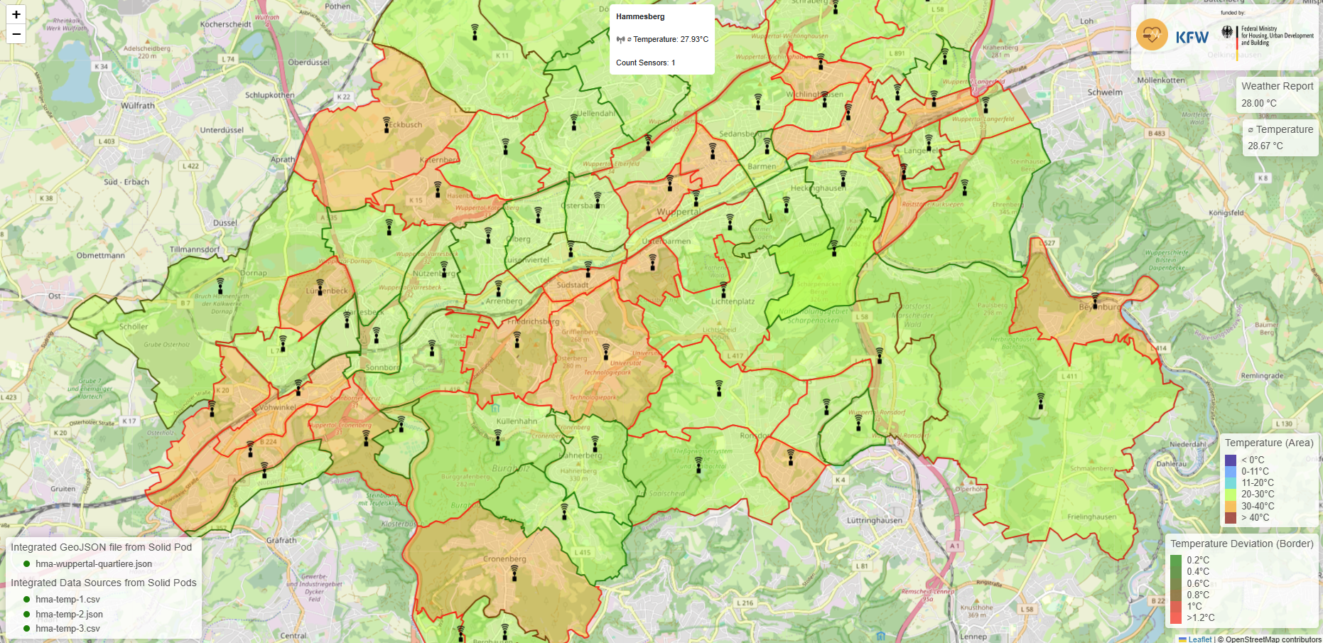
Smart City Urban Heat Monitoring
Smart City Urban Heat Monitoring using a Solid-based Dataspace

Slide 37
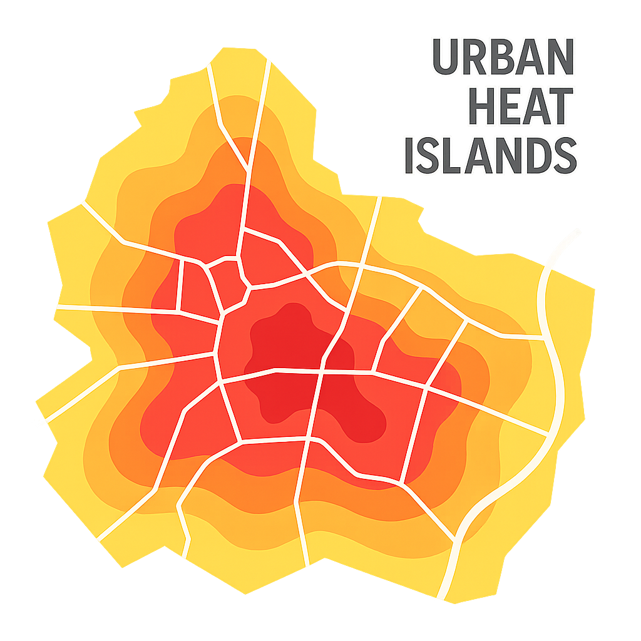
Limitations & Future Work
Limitations
Batch data
Public datasets
Manual discovery of relevant data
Manual identification of relevant data
Manual schema alignment
Future Work
Build scalable, real-world solution
Generated by DALL·E 3
Smart City Urban Heat Monitoring using a Solid-based Dataspace

Slide 38
Conclusion
Demonstrated minimal Solid-based dataspace
Utilized by Urban Heat Island App
Integrated heterogeneous data
Enabled decentralized, privacy data access
Showcased feasibility through a working prototype
Foundation for participatory urban data ecosystems
Smart City Urban Heat Monitoring using a Solid-based Dataspace

Slide 39
Thank you for your attention!
Any Questions?
Contact: hoelken@uni-wuppertal.de

