Slide 1
Riitta Alkula
Digital and Population Data Services Agency, Helsinki, Finland
Semantics Matter in Every E-Service Situation
The Finnish Interoperability Platform and tools (FI-Platform)

Slide 2
Old Challenge…
Swift cross-border data flows, also crossing different European language areas, require that data is also semantically interoperable, if we are to boost public services and the data economy.
We have to find the meaning of the piece of information regardless of its various presentations and formats.
While everyone agrees in theory that interoperability is important, in practice, it is not easy to agree on common definitions.
Semantics Matter in Every E-Service Situation

Slide 3
…and a Generally Viable Solution...
The problem can be solved by using language-independent codes or classifications, where concepts are presented as character strings and the interpretation is presented as labels that convey the interpretation in words.
Using common code lists that enable interoperability in various uses cases like reporting, statistics and between information systems used providing digital public services.
But: agreeing on common semantics is difficult without proper tools.
→ That's why we wanted tools that would enable subject matter experts, rather than IT implementers, to create and manage specifications.
Semantics Matter in Every E-Service Situation

Slide 4
…and New Way Implementing the Solution
Reference Data Tool
A non-typical technical solution
A cloud-based service and platform for managing, publishing and sharing common code lists and reference data.
The user can create simple code sets as well as hierarchical code sets, code set extensions, and variants of code sets.
Functions as a public web site where anyone can browse and download (Excel, JSON) the code sets and their metadata.
Based on the so-called interoperability methodology, which defines the principles for modelling linked data and reusing existing semantic specifications.
The Reference Data Tool is one of a family of multilingual tools, collectively named as FI-Platform.
The specifications are both human- and machine-readable, and are based on semantic and linked data principles (for instance universal URI identifiers).
Semantics Matter in Every E-Service Situation

Slide 5
The FI-Platform is a Combination of a Method and Tools
The Interoperability Method defines principles
The three browser-based tools to be used as a semantic suite
The Method defines the principles and approaches to create linked data and maintain semantic interoperability.
A key element is the consistency and reuse of existing semantic specifications: making maximum use of previously developed terminologies, code sets and data models.
Thanks to the visual user interface, users do not need to know technical specific-ations. Tools make them under the hood.
The Terminologies Tool, an application for creating and managing domain-specific terminologies and concepts, i.e. glossaries and concept taxonomies.
The Data Vocabularies Tool for managing and publishing data vocabularies and application profiles (data models).
The Reference Data Tool for managing, publishing and sharing common public sector reference data, like code lists, codes, and classifications.
Semantics Matter in Every E-Service Situation

Slide 6
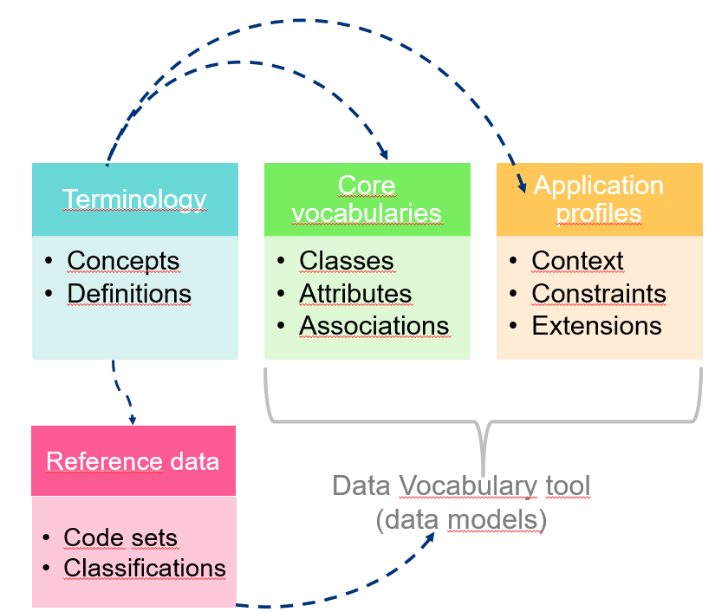
Reuse of Semantic Metadata
Concepts are linked to code sets as well as individual codes, explaining their meaning.
Reference data can be integrated to data models, so that code sets are (re)used as a fixed list of values for an attribute in data model.
This allows reference data to be linked to other internet resources, thereby creating open linked data, where others can refer to published resources.
Semantics Matter in Every E-Service Situation

Slide 7
Use Case 1: Standardized Financial Reporting Codes
Technical description and content of the data, like list of accounts and classification of services, are issued on Reference Data Tool, where they can be downloaded in Excel format or retrieved via the API interface.
On the Terminologies Tool, there are terminologies for financial management and for interpreting the data fields of Electronic Financial Reporting (XBRL).
The smallest code sets in this collection have only a few codes, the largest more than 3100 code values.
The code sets also include extensions like linking of two code sets or specify inference or calculation rules needed in reporting.
Since year 2021, all municipalities (308), and wellbeing services counties (22) must report their financial data to the State Treasury in an automated XBRL or CSV format.
The needed code sets are published on the Reference Data Tool. New code sets are published annually.
Currently, there are about 50 code sets. They are bilingual (Finnish and Swedish), some even trilingual (also in English).
Semantics Matter in Every E-Service Situation

Slide 8
Use case 2: Case of Unrealized Costs
Reference Data Tool has about 20 user organisations and contains more than 1100 code sets.
Some other use cases:
CSC - IT Center of Science: Reference data for research data administration, like funders, contribution roles etc.
Finnish Forest Centre: Classifications used in forest inventories, natural sites, forest types, etc.
City of Vantaa: Classifications used for basic education administration, like course type, period status, student type etc.
Finnish wellbeing services counties were founded in 2021, but their codes were not specified in the legislation.
Three key agencies responsible for base registers, and exchanging large amounts of data, defined common set of codes together.
With common codes, no need for massive data mapping in data exchange → cost savings!

Slide 9
Summary
Lessons learned
Conclusion
Everyone praise interoperability, but costs are unevenly distributed. Do only users benefit and publishers cover all costs?
Common specifications serve efficiency, as redundant work is avoided and the tools ensure up-to-date resources.
Without proper tools for editing and publishing, it is hard to get concrete results.
Linked data, semantics and knowledge graphs are only now starting to hit home.
It is important to have a common governance model (method) and harmonized metadata.
For true interoperability, you need communities to produce specifications.
Challenge: It takes time to create communities, so we should start now.
Call to Action: We need broader discussion on semantic information modeling in the context of cross-border information exchange.
Semantics Matter in Every E-Service Situation

Slide 10
Thank you!
Contact: riitta.alkula@dvv.fi
Reference data tool: https://koodistot.suomi.fi/
More: https://dvv.fi/en/interoperability-platform

