Slide 1
Sotiris Leventis, Qognity
George Mikros, Hamad Bin Khalifa University
Fotios Fitsilis, Hellenic Parliament
Augmented LEOS:
Semantic Innovations for AI-Driven Legislative Drafting

Slide 2
What is LEOS?
Open-source platform by the European Commission
Ensures legal format compliance and structure
Focused on digital transformation of legislative drafting
Limitations: AI automation, interoperability features, integration aspects
Augmented LEOS: Semantic Innovations for AI-Driven Legislative Drafting

Slide 3
Motivation and scope
Current drafting tools gaps
Limited automation & AI support
Fragmented semantic assets
Multilingual drift
LEOS
Strong baseline for structured drafting
Gaps remain in verification, alignment, and cross-system interoperability
Augmented LEOS: Semantic Innovations for AI-Driven Legislative Drafting

Slide 4
Motivation and scope
Proposal: intelligent, compliant, interoperable processes, machine-readable by design, Linked to EU vocabularies, persistent Ids and other legal systems
Objective: Augment LEOS with semantics and hybrid, auditable AI to deliver validation, multilingual consistency, and traceable outputs.
Augmented LEOS: Semantic Innovations for AI-Driven Legislative Drafting

Slide 5
Introducing Augmented LEOS
Embedded UI Extensions
  Add-ons with semantic features
  Linked to smart functionalities
Smart Functionalities
  Verification & Conformance
  Multilingual & Terminology Alignment
  Assisted Drafting & Change Tracking via hybrid & auditable AI
Augmented LEOS: Semantic Innovations for AI-Driven Legislative Drafting

Slide 6
Hybrid AI Approach
Best of all worlds
  Rule-based legal analysis
  LLM assistance for suggestions and automation
  Keep provenance and human-in-the-loop
  AI-enabled automation when preferable
Benefits
  Interpretability
  Transparency
  Less legal ambiguity
Augmented LEOS: Semantic Innovations for AI-Driven Legislative Drafting

Slide 7
Agents
Verification agents
  Citation/definition consistency, conformity checks.
Linguistic/multilingual agents
  Clarity aids + cross-language consistency.
Change-tracking & automated drafting agents
  Version diffs + structured drafting prompts (hybrid AI: rules + generative).
Augmented LEOS: Semantic Innovations for AI-Driven Legislative Drafting

Slide 8
Connectors
EU Legal: EUR-Lex, CELEX databases, legal acts, directives, regulations, case law and court decisions
Knowledge: Legal ontologies and controlled vocabularies, national legal databases, treaties, conventions and jurisprudence
Publication: Official journals and legal gazettes document management systems, audit and compliance tracking tools
Augmented LEOS: Semantic Innovations for AI-Driven Legislative Drafting

Slide 9
System Αrchitecture
Distributed, modular, interoperable platform
Support for deployment in the cloud or on-premise
Augmented LEOS: Semantic Innovations for AI-Driven Legislative Drafting

Slide 10
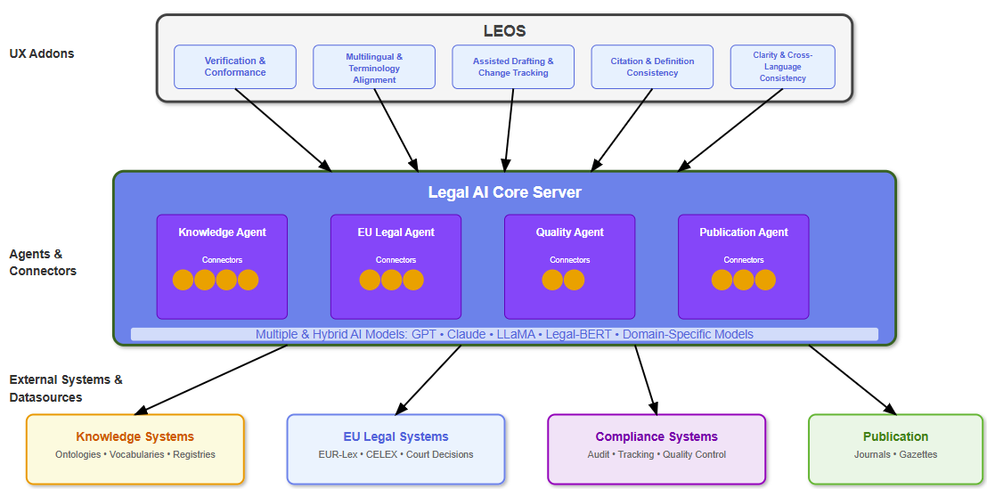
System Αrchitecture
Augmented LEOS: Semantic Innovations for AI-Driven Legislative Drafting

Slide 11
Roadmap to implementation
Framework Setup
  Platform components implementation: UX Addons, Agents, Connectors
  Quick wins: Term alignment + citation/definition validation + multilingual drift alerts
Feedback and fine tuning
  Model and dataset development
  Legal, ethical alignment with AI Act
Augmented LEOS: Semantic Innovations for AI-Driven Legislative Drafting

Slide 12
Roadmap to implementation
Pilot Testing
  Real-environment trials, feedback loops
  KPIs: fewer verification errors, higher translation-consistency, reduced time-to-conformant draft.
Deployment & Maintenance
  Sustainable operations, scalability
Augmented LEOS: Semantic Innovations for AI-Driven Legislative Drafting

Slide 13
Conclusion: From Semantic Blueprint to Practice
Augmented LEOS sets the next-gen standard: semantic by design, interoperable, machine-readable
A model for cross-border digital law-making that advances Digital Europe’s goals for open, reusable public-sector data
Hybrid AI & modular platform of embedded UX addons, agents, and connectors
Augmented LEOS: Semantic Innovations for AI-Driven Legislative Drafting

Slide 14
Contact: sotiris.leventis@qognity.com

