Slide 1

Sven Lieber 0000-0002-7304-3787
Data manager at the Royal Library of Belgium (KBR), Brussels
Opening up Belgian Cultural Heritage Reference Data with Wikibase

Slide 2
Agenda
GLAM* use case MetaBelgica
Decentral vs Central solution
Conclusion and next steps
*Galleries, Libraries, Archives, Museums
Opening up Belgian Cultural Heritage Reference Data with Wikibase

Slide 3

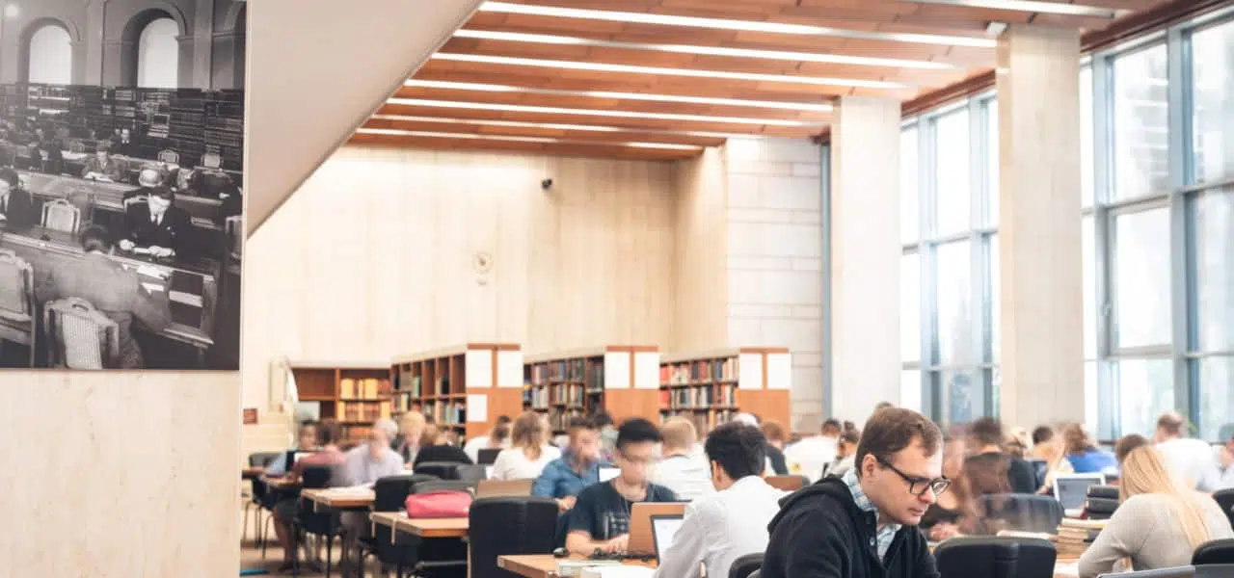
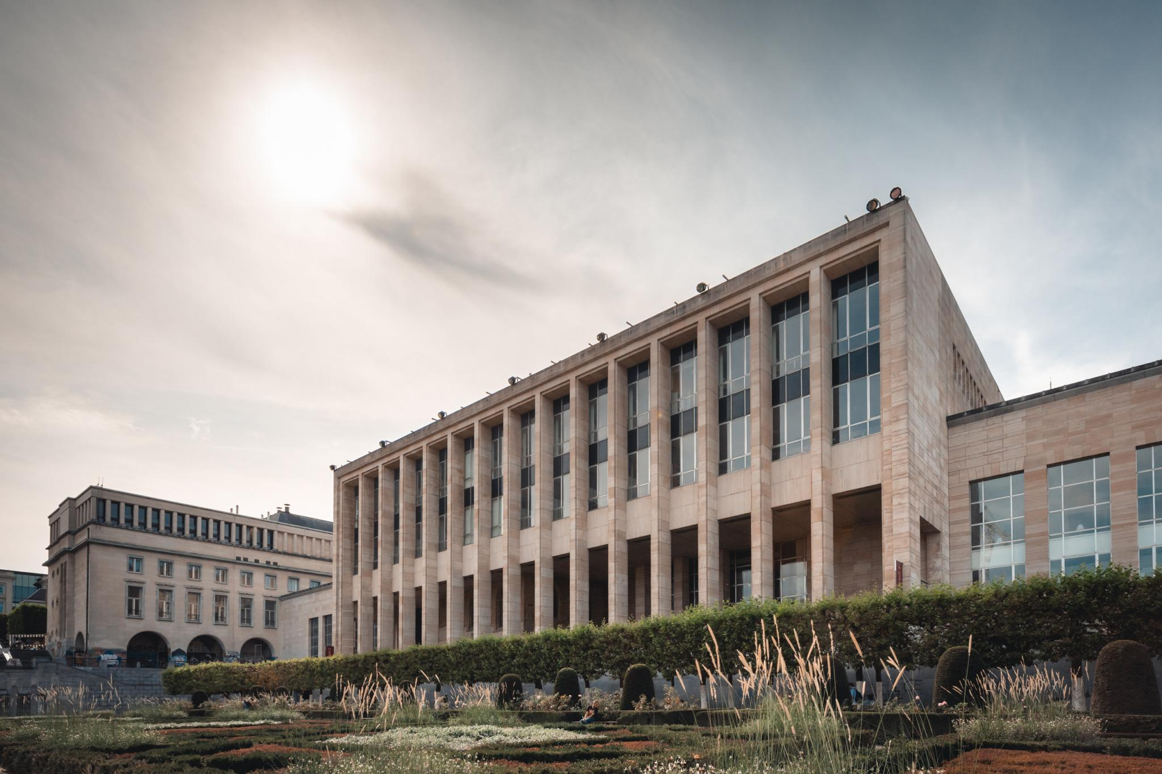
KBR is the national library of Belgium
We currently hold around 8 mio documents that can be consulted in our reading rooms
Via legal deposit we roughly receive 35,000 books each year
=> We have a lot of bibliographic and authority records (linked entities)
Opening up Belgian Cultural Heritage Reference Data with Wikibase

Slide 4

KBR is one of ten Federal Scientific Institutes (FSIs)
Belgian Science Policy Office
Open research data mandate
“As open as possible, as closed as necessary”
CC0 and CC BY recommended
for data created by BELSPO funded research
Royal Belgian Institute for Space Aeronomy (BIRA-IASB)
Royal Meteorological Institute of Belgium (KMI-IRM)
Royal Observatory of Belgium (KSB-ORB) and the Planetarium
Royal Belgian Institute of Natural Sciences (KBIN-IRSNB)
Royal Museum for Central Africa (KMMA-MRAC)
Royal Museums for Art and History (KMKG-MRAH)
Royal Museums of Fine Arts of Belgium (KMSKB-MRBAB)
Royal Institute for Cultural Heritage (KIK-IRPA)
Royal Library of Belgium (KBR)
State Archives (RA-AE)
Legal obligations to among other create inventories of the respective collections, share with the public and actively participate in (inter) national research

Slide 5






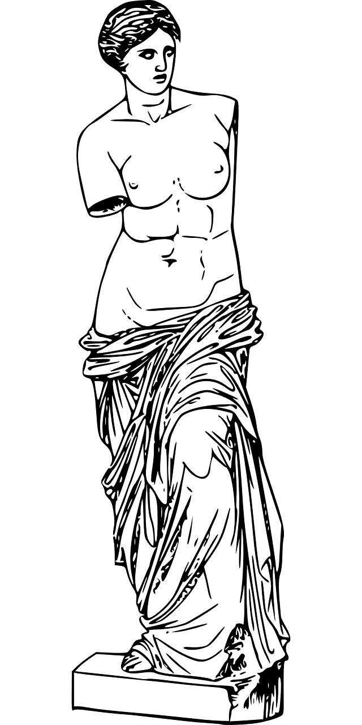






Duplicate data of shared entities leads to problems
Duplicate efforts to curate data about entities
+ efforts for data consumers to integrate and identify/fix inconsistencies
Varying quality and correctness of data

Slide 6
Decentral vs Central solution
Fully decentral
Current legacy systems not ready
Shifting data integration burden to users and data hubs
Not solving the issue of duplicate efforts and data
Keep in mind: not just dataset-metadata aggregation, but millions of records with duplicates
Fully central
A single-point of failure
One-size-fits-all schema pressure
Technical and social challenges by replacing existing system
Wikibase reference data system
Best of both worlds: loosely coupled FAIR data
Opening up Belgian Cultural Heritage Reference Data with Wikibase

Slide 7


Shared entity management - open source and FAIR
[1]
930,000
MetaBelgica
82,000
3,400
7,400
Loosely coupled, central deduplicated data: names, birth and death date/place, identifiers
Data integration on producer side (short-term: project until 2026-12, long-term: Wikibase)
Advantages of decentralized and central system + single trustworthy source for users
[1] Lieber, S., Lamas, E., Buelinckx, E., Angenon, E., & Van Oene, M. (2025). Deliverable 1.2.2 - Quality requirements and categories of Belgian entities. Zenodo. https://doi.org/10.5281/zenodo.14974410

Slide 8
Conclusions
Pragmatic and future-oriented
Wikibase is mature (TRL-9), data maintenance is user-friendly
and software widely used in similar contexts (Luxembourg, Germany, …)
Balancing control and collaboration
Local autonomy and data protection while providing
high quality FAIR reference data
Sustainable authority data management
Join forces to position Belgium’s cultural heritage on the global stage
Opening up Belgian Cultural Heritage Reference Data with Wikibase

Slide 9
Next steps
Data integration and enrichment
Apply tailored strategies depending on metadata quality categories
Data governance and public interface
Define clear roles, workflows and develop end-user front-end
Ease maintenance of loose coupling
Automatic or semi-automatic workflows to keep datasets aligned
Opening up Belgian Cultural Heritage Reference Data with Wikibase

Slide 10



Thanks!
https://w3id.org/metabelgica
https://zenodo.org/communities/metabelgica
https://fedihum.org/@metabelgica

