Slide 1
Thomas Francart
Sparna - https://www.sparna.fr
A model-driven approach for your knowledge graph project with SHACL Play!
... and how it is applied in the European Parliament Open Data Portal

Slide 2
SHACL as a specification language for knowledge graphs
SHACL is a W3C standard for specifying the expected structure of a knowledge graph
This specification of the graph structure is the foundation for many automated tasks in a knowledge graph project
A model-driven approach for your knowledge graph project with SHACL Play!

Slide 3
SHACL as the basis of model-driven approaches
Validate RDF data
Drive AI agents
Generate UML-like diagrams
Derive specification automatically from KG analysis
Publish a documentation
Specification of the KG structure
in SHACL
Edit specification in Excel files
Serialize specification in Excel files
Generate JSON-LD @context
Maintain data sources mapping rules
Generate API JSON(-LD) schema
Extract dataset from larger KG
Configure UI (edit or query) (e.g. Sparnatural)
A model-driven approach for your knowledge graph project with SHACL Play!

Slide 4
SHACL as the basis of model-driven approaches
Acquisition
In-project, internal usages
Dowstream usages for data dissemination
Validate RDF data
Drive AI agents
Generate UML-like diagrams
Derive specification automatically from KG analysis
Publish a documentation
Specification of the KG structure
in SHACL
Maintenance
Edit specification in Excel files
Serialize specification in Excel files
Generate JSON-LD @context
Maintain data sources mapping rules
Generate API JSON(-LD) schema
Extract dataset from larger KG
Configure UI (edit or query) (e.g. Sparnatural)
A model-driven approach for your knowledge graph project with SHACL Play!

Slide 5
SHACL Play !
SHACL Play! https://shacl-play.sparna.fr/
Free, open, online application to work with SHACL
  Also available as a Java command-line tool for scripting
  Github: https://github.com/sparna-git/shacl-play
Started in 2017 to generate human-readable data validation reports
Grew over time with many other features
  One of the most useful is the generation of a human-readable documentation from a SHACL specification
A model-driven approach for your knowledge graph project with SHACL Play!

Slide 6
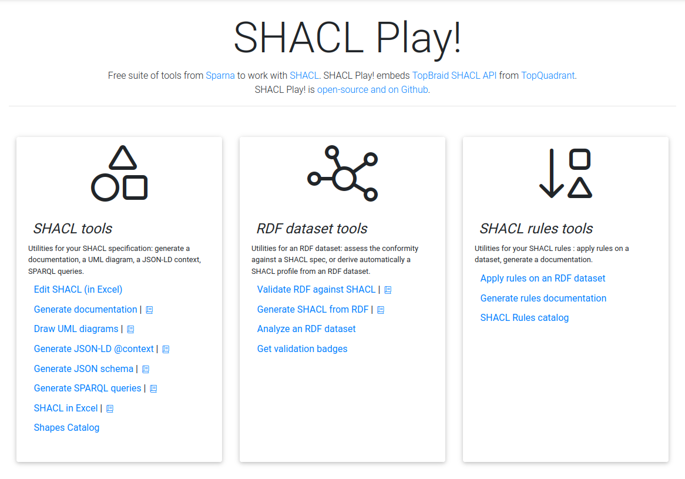
SHACL Play !
A model-driven approach for your knowledge graph project with SHACL Play!

Slide 7
A typical day with SHACL Play!
RDF dataset
1
2
Serialize the SHACL Profile (HTML / Excel)
Review SHACL
Detect inconsistencies in dataset (e.g. suspicious cardinalities)
3
Manually enhance / adjust the SHACL Profile (in Excel), and serialize back to RDF
=> produc final SHACL specification for the graph
Analyze the data to generate a SHACL profile automatically
Feedback loop with data producer to fix the data
  Validate data conformance against final SHACL Profile
  Downstream usages :
    Generate public HTML documentation
    and / or configure Sparnatural UI
    and / or AI Agents configuration
Feedback loop to data producer to fix the data (or periodic data validation)
4
5
Downstream usages
A model-driven approach for your knowledge graph project with SHACL Play!

Slide 8

Dataset analysis: from RDF to SHACL – demo

Slide 9
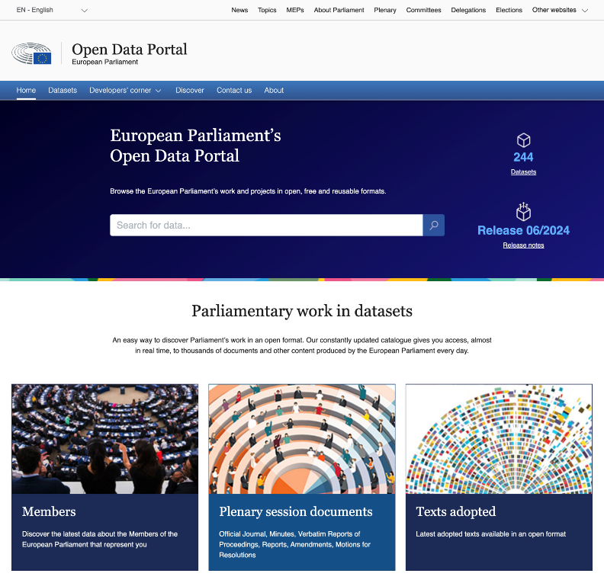
SHACL in the European Parliament Open Data Portal
https://data.europarl.europa.eu
Dataset Catalogue
  Features: DCAT dataset metadata, downloadable dumps (multilingual RDF, monolingual CSV, ...)
  Key users: non-IT users, researchers, data scientists, journalists
Near-real time RESTful APIs & Persistent URIs
  Features: data in multiple formats (RDF, json-ld, ...), Notification (ATOM feed) based on provenance
  Key users: semantic web specialists, web developers (non-RDF)
Based on knowledge graph technologies and standards
Human & machine-readable documentation
A model-driven approach for your knowledge graph project with SHACL Play!

Slide 10
Specification? Specifications!
OWL : web ontologies
Provide cross-domain interoperability at web scale
Example : Dublin Core, FOAF, VACRD, etc.
OWL : conceptual models / high-level ontologies
Provide strong conceptual foundations
Example : CIDOC-CRM, FRBR, RiC-O
From more generic to more specific
OWL : extensions to specific “business domain”
Provide interoperability for one knowledge domain
Example : ELI + ELI-DL
Use and combine classes and properties from multiple ontologies
OWL : extensions for one specific client
Provide specific and necessary extensions for one deployment
Example : EPVOC / EUVOC
SHACL : spécification de la conversion d’une source
SHACL : spécification de la structure du KG entier
SHACL : spécification de la structure d’un dataset extrait du KG
SHACL : specifications for the conversion of a datasource
SHACL : application profiles specifying the structure of the KG
SHACL : dataset definitions for a dataset family
Data flow, from data acquisition to data dissemination

Slide 11
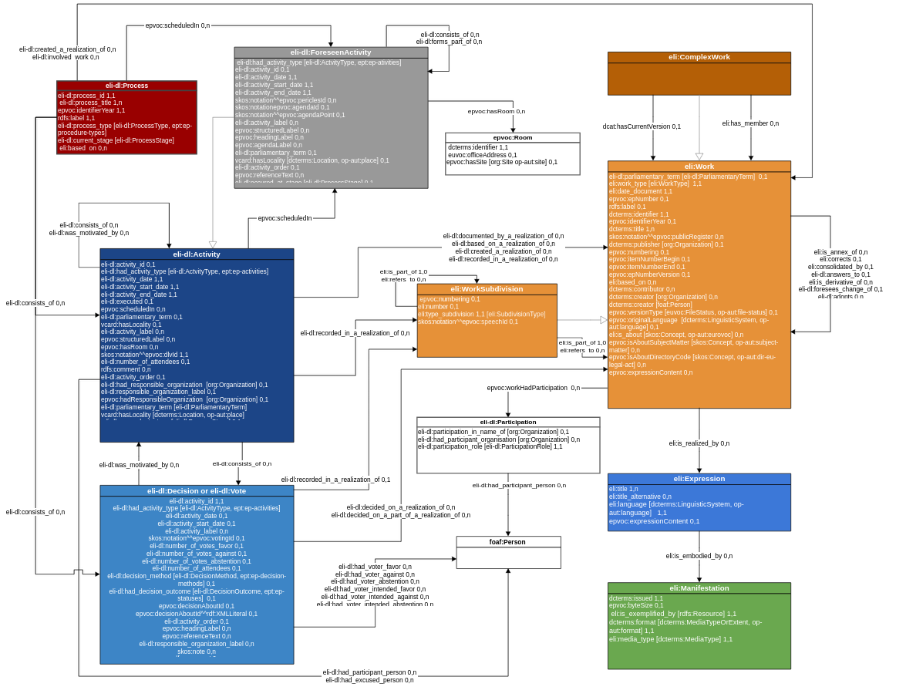
The ELI-EP 2.1.0 application profile
The modeling work starts with a UML diagram
Work (documents)
Activity (event)
(legislative) Process
Foreseen activities (agenda)
A mode-driven approach for your knowledge graph project with SHACL Play!

Slide 12
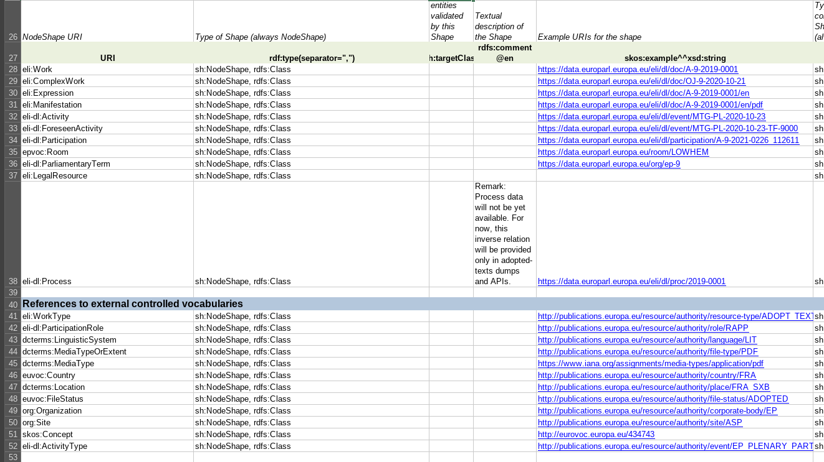
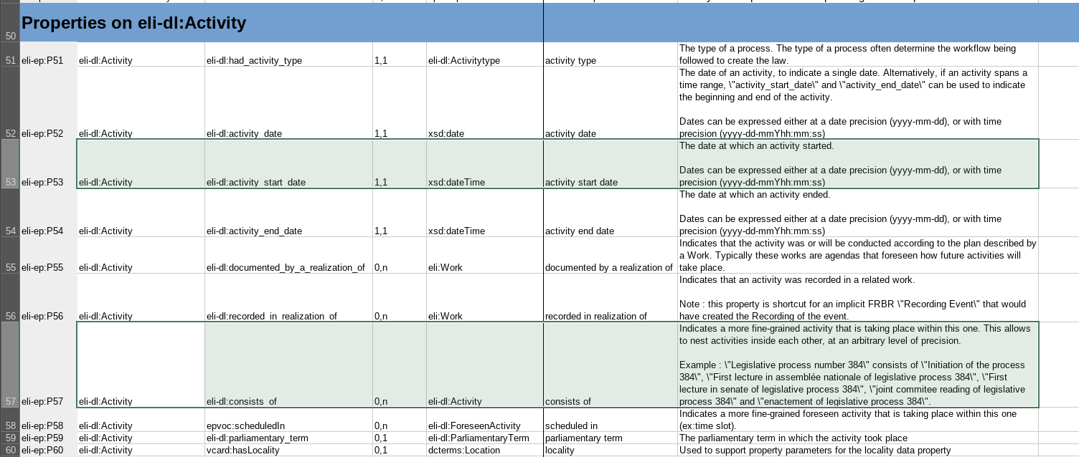
The SHACL specifications are encoded in Excel
Node Shapes
(Kind of entities inside the graph. Can be one shape = one class, bu usually much more precise)
Property Shapes
(Properties constraints on each entities, e.g. Cardinalities, expected datatype or value, etc.)
A mode-driven approach for your knowledge graph project with SHACL Play!

Slide 13
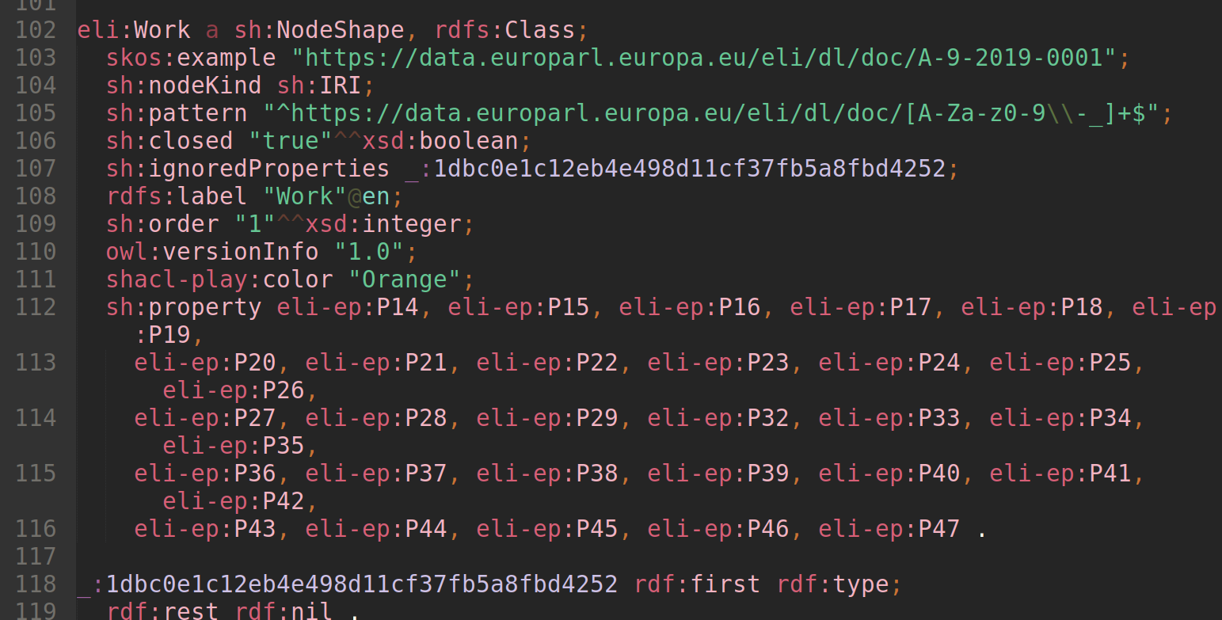
The Excel is converted into SHACL in RDF
xls2rdf converter
A model-driven approach for your knowledge graph project with SHACL Play!

Slide 14
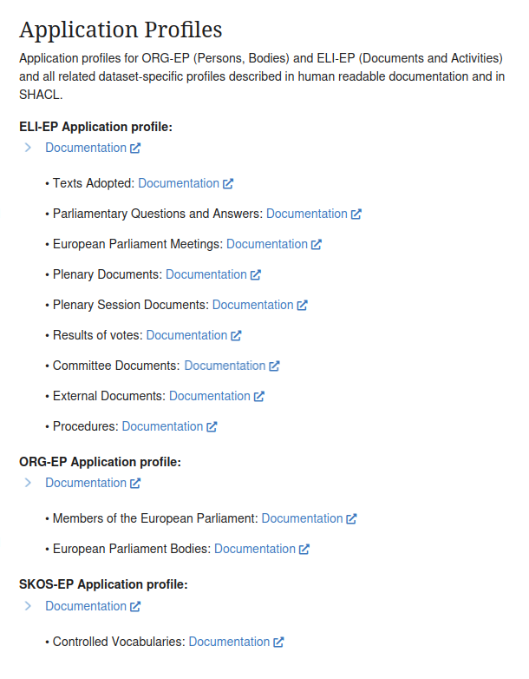
Data models documentation
All data models of EPODP documentations are generated with SHACL Play!
  Application profiles: ELI-EP, ORG-EP, SKOS-EP
  Dataset Definitions: Texts Adopted, Plenary documents, etc.
A model-driven approach for your knowledge graph project with SHACL Play!

Slide 15
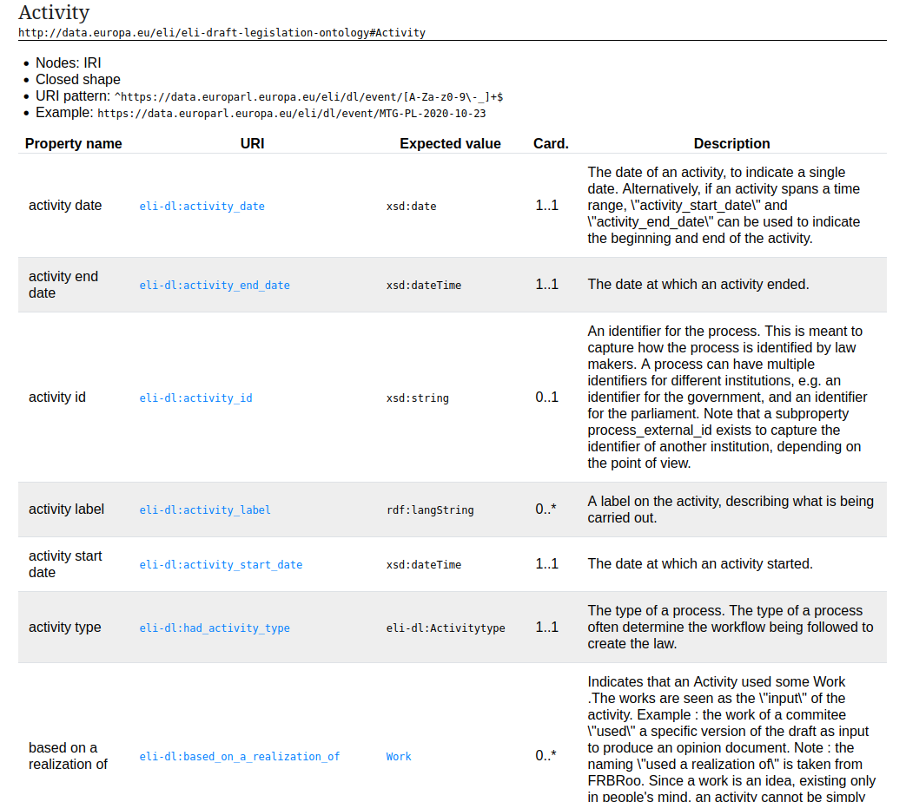
ELI-EP documentation generated by SHACL Play!
A model-driven approach for your knowledge graph project with SHACL Play!

Slide 16
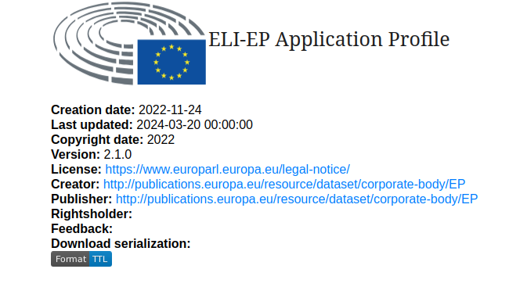
The SHACL specification itself is published in a reusable way
A model-driven approach for your knowledge graph project with SHACL Play!

Slide 17
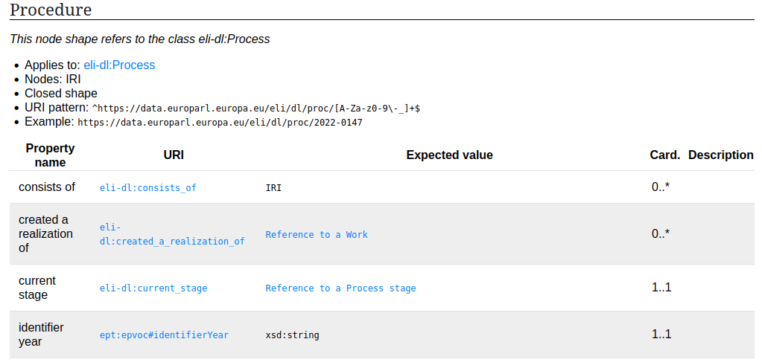
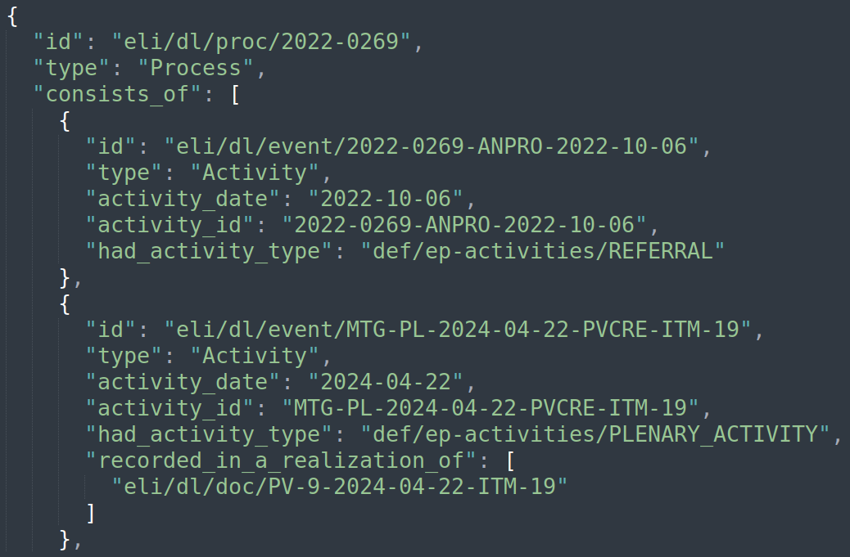
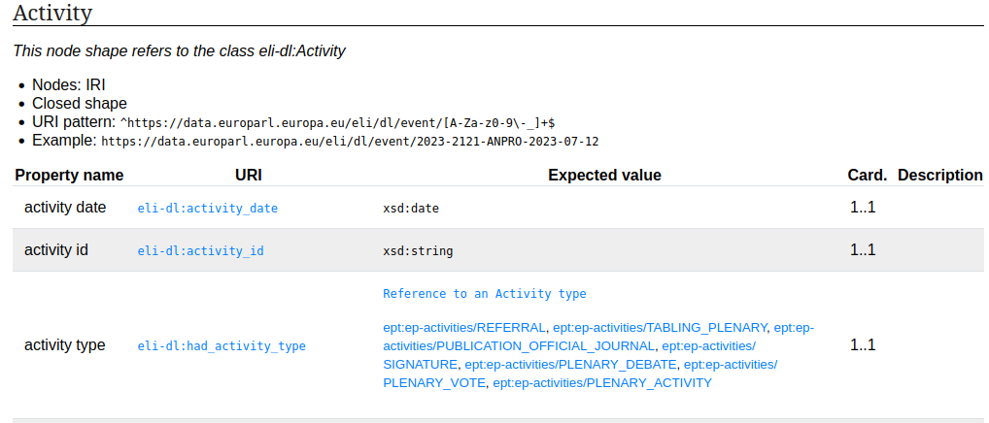
The specification drives the JSON schema of API output
  Automated JSON schema generation from the SHACL
A model-driven approach for your knowledge graph project with SHACL Play!

Slide 18
SHACL for AI Agent prompting: GraphRAG – leverages labels and descriptions in SHACL spec
Base instructions
  « You are an assistant that parses plain text queries and turn them into structured queries »
Additional instructions
  « The dataset structure is provided as a SHACL specification. In the SPARQL queries, use the classes referred to in sh:targetClass, and the properties mentionned in sh:path. When selecting a human-readable label to display, use *only* the properties flagged as dash:LabelRole in the dash:propertyRole annotation. »
SPARQL instructions
  « When you need to write a SPARQL query, use only the classes and properties provided in the schema and don't invent or guess any. Always try to return human-readable names or labels and not only the IRIs. »
Data model
  « The SHACL specification of the data model on which SPARQL queries are ran is the following:
  <here be the Turtle serialization of the SHACL spec> »
A model-driven approach for your knowledge graph project with SHACL Play!

Slide 19
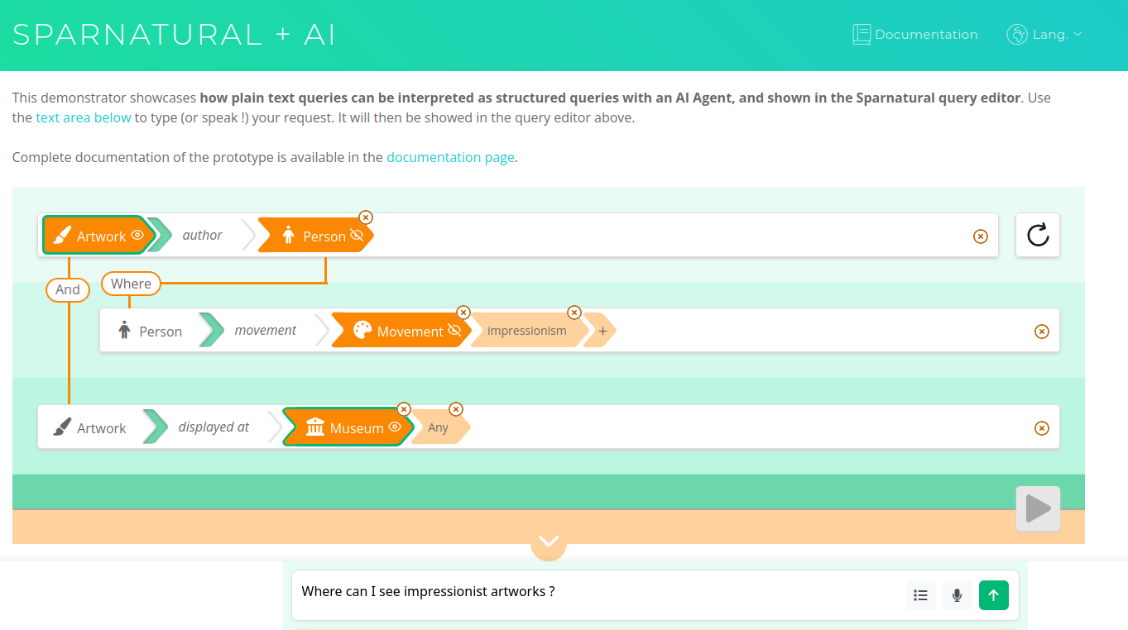
A prototype based on SHACL for plain-text to structured queries conversion
Query is visually displayed
URI values are fetched (« impressionism »)
AI Agent was prompted with the SHACL structure
« Where can I see impressionists artworks ? »
A mode-driven approach for your knowledge graph project with SHACL Play!

Slide 20
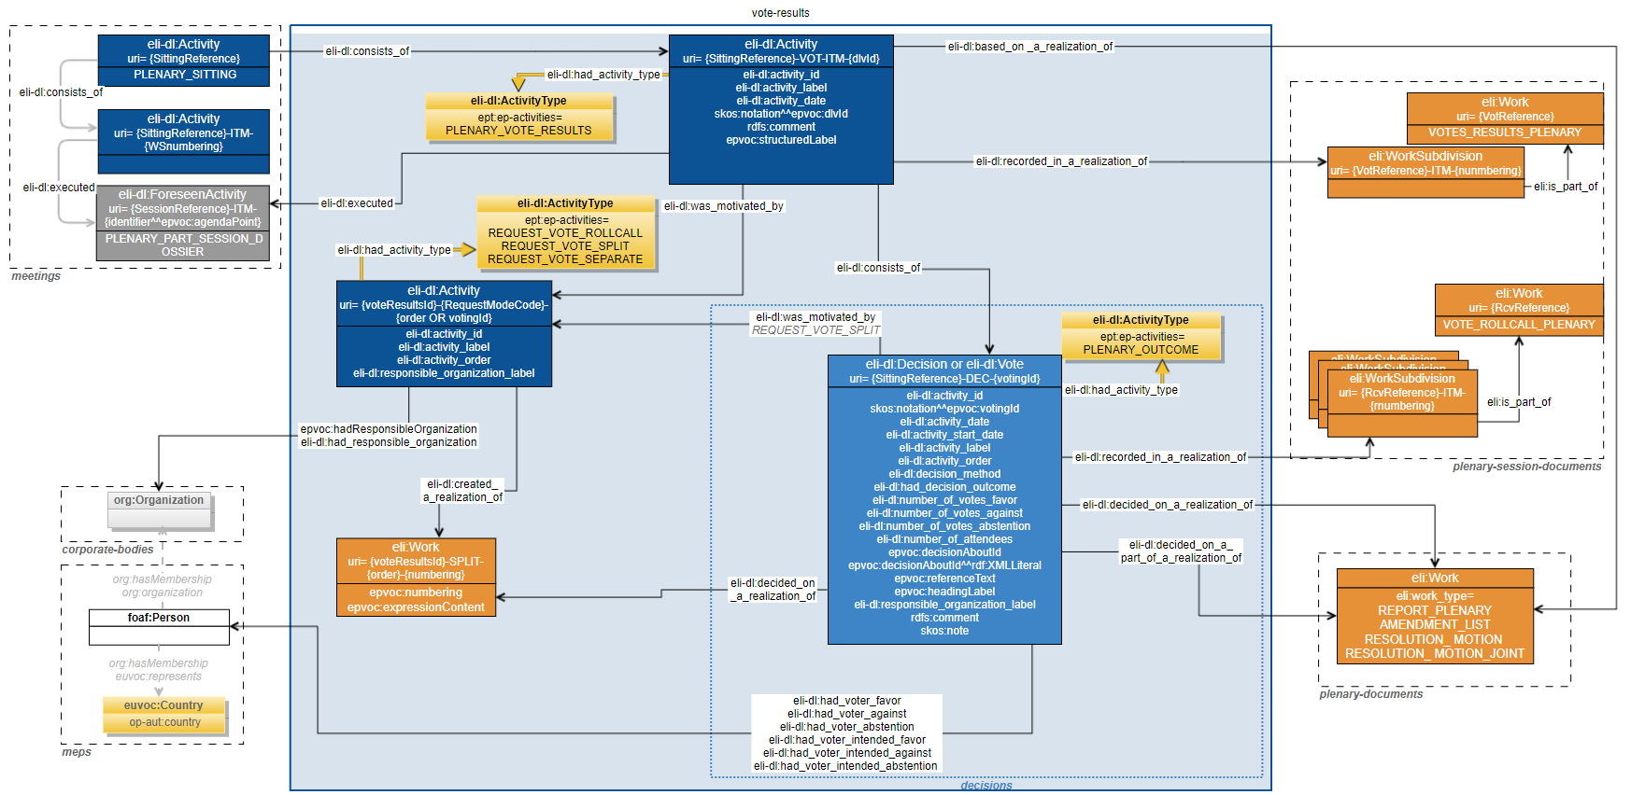
Multiply by number of named graphs
Data ingestion is split in different named graphs
Typically one graph per level in the FRBR hierarchy (Work, Expression, Manifestation)
Each named graph has its own SHACL specification
This results in more than 100 SHACL specifications to validate each named graphs structure individually
A model-driven approach for your knowledge graph project with SHACL Play!

Slide 21
Thank you !
SHACL Play! https://shacl-play.sparna.fr/play/

