Slide 1
Thora Hagen & Andreas Witt
Leibniz Institute for the German Language (IDS), Mannheim, Germany
DataGEMS: Unlocking Data through Semantic Linking
A Case Study of Historical Encyclopedias

Slide 2

Introduction: DataGEMS
EU-funded project to improve data accessibility by implementing a new LLM powered platform
Supports multi-disciplinary data of different formats, whether structured, unstructured, or streaming
Focus on automated semantic enrichment and cross-dataset linking, including reference vocabularies
Promotes data FAIRness and reusability
  For example: Could historical, qualitative records and real-time climate data predict migration patterns?
DataGEMS: Unlocking Data through Semantic Linking

Slide 3
Data Use Case: Language
Case study: Historical encyclopedias across languages and knowledge domains
Underutilized linguistic and cultural corpora
Reflect evolving world knowledge, attitudes, and semantic structures
Terms persist, but contexts shift over time
However:
  Lack of interoperability
  No standardised metadata
  How can we link such a broad, shifting spectrum of data?
DataGEMS: Unlocking Data through Semantic Linking

Slide 4
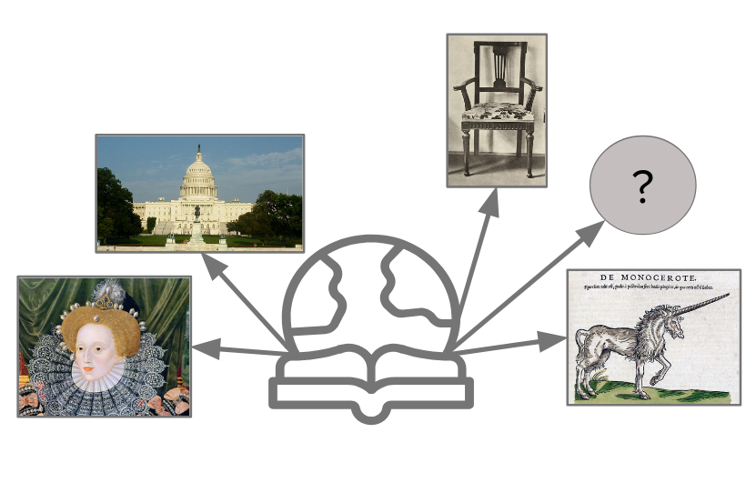
Encyclopedias
Corpus covers 1721–1911
Many “conversational” encyclopedias (like Brockhaus or Britannica) cover all aspects of everyday life.
Others are specialist encyclopedias on mythology, philosophy, the railway system…
DataGEMS: Unlocking Data through Semantic Linking

Slide 5
Preliminary Study: Links to Wikidata
A German portion of the encyclopedias was linked to Wikidata entries using semantic text similarity (LMs)
  Conceptual alignment possible
  Enables automatic topic classification and clustering
  With historical/multilingual corpora, we can then trace differences
Advantage: Vast taxonomy that is not limited to a specific domain, broad property spectrum
Disadvantage: Less standardised
DataGEMS: Unlocking Data through Semantic Linking

Slide 6
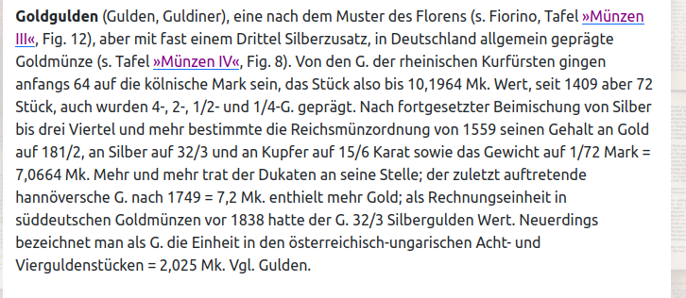
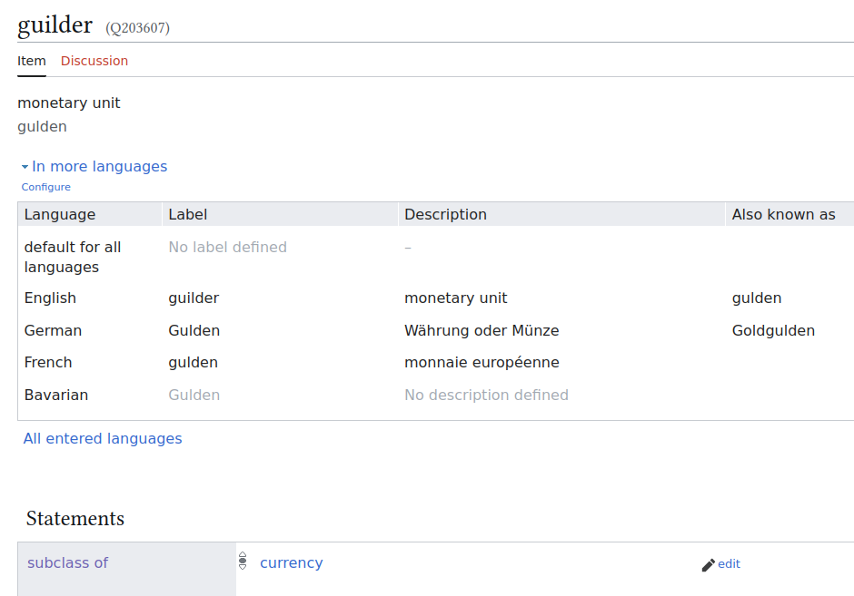
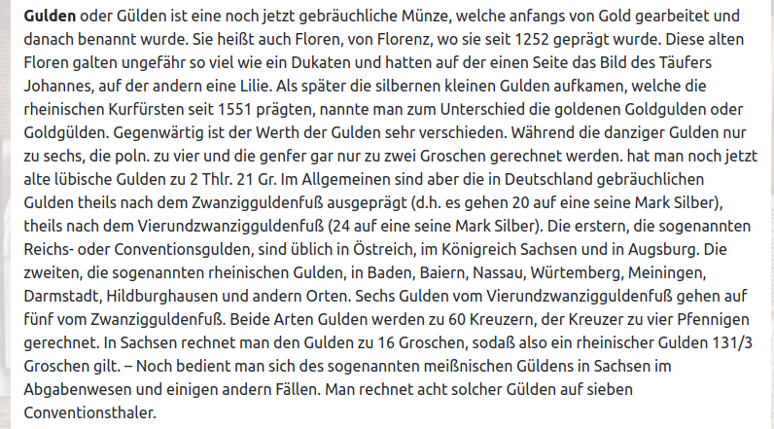
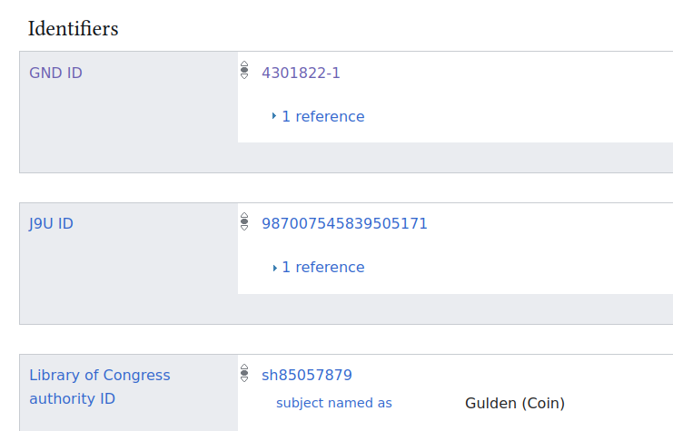
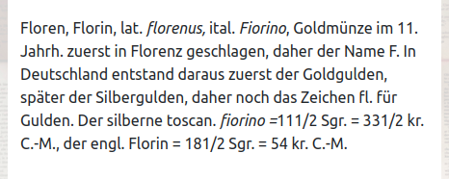
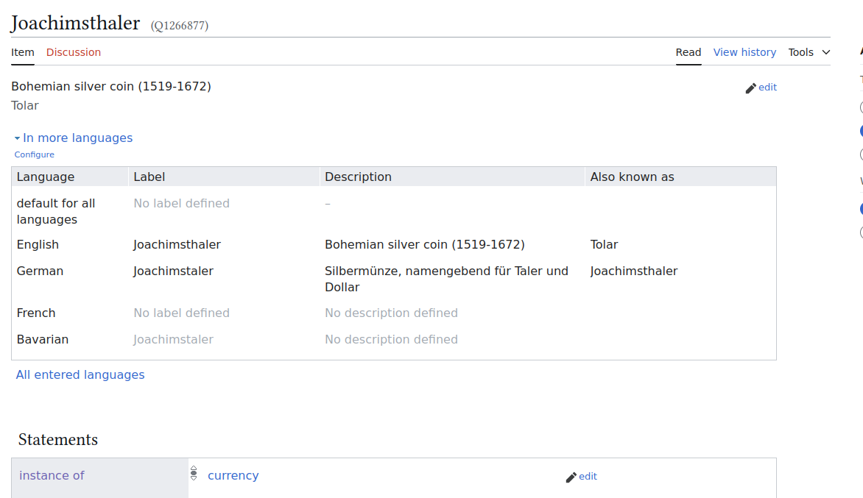
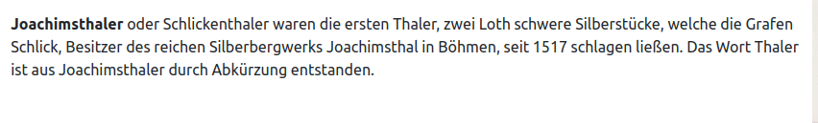
Preliminary Study: Links to Wikidata
Further information through properties
Alignment
Classification & grouping
DataGEMS: Unlocking Data through Semantic Linking

Slide 7
DataGEMS: Unlocking Data through Semantic Linking

Slide 8
DataGEMS: Unlocking Data through Semantic Linking

Slide 9
Conclusion
Concepts change over time or across disciplines, exhibiting different word senses
  e.g. revolution, computer
Referential data is as important for concepts as it is for named entities!
  Conceptual linking across datasets
  Enables more nuanced, context-sensitive content analysis of texts
  Historical challenges
  Better support for the humanities and cultural data!
DataGEMS: Unlocking Data through Semantic Linking

Slide 10
Thank you!
hagen@ids-mannheim.de
witt@ids-mannheim.de

