Slide 1
Reference data services for data spaces
Denis Dechandon, Anikó Gerencsér, Vassilis Tzouvaras
Publications Office of the European Union

Slide 2
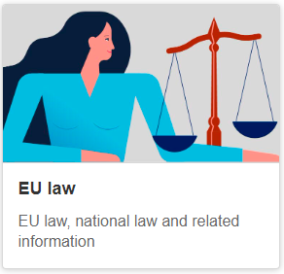
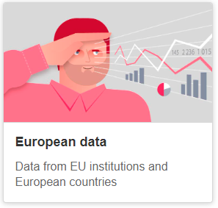

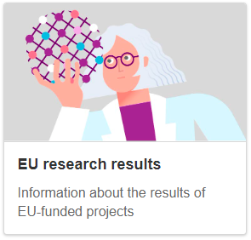
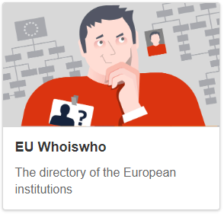
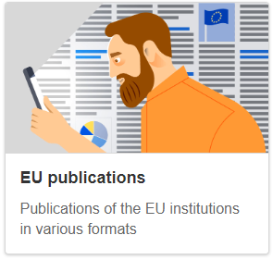

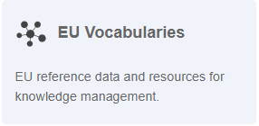
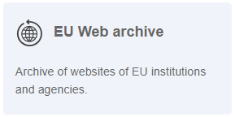
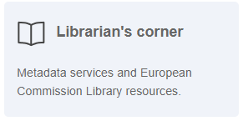

Who we are
The Publications Office of the European Union (OP)
The official publisher for all EU institutions, bodies and agencies
Multilingual expertise
Based in Luxembourg, working across all 24 official EU languages

Slide 3
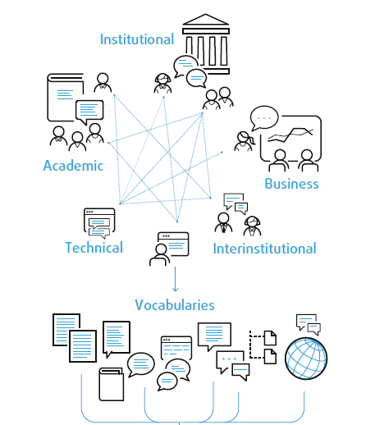
Our team
Reference Data and Style Guide Sector (OP.A.1.002)
We promote the standardisation of reference data, schemas, ontologies and linguistic resources across EU Institutions
We also provide support upon request and actively contribute to interinstitutional projects and initiatives
A diverse team of linguists, translators, terminologists, librarians and technical and semantic experts working together

Slide 4
What we do
Create, enrich and publish multilingual controlled vocabularies, available online on the EU Vocabularies website​
Provide services to all EU institutions and Data Spaces in
- Creation and updates of reference data​
- Maintenance and validation of data​
- Publication across various platforms​
- Promotion, training and ongoing support

Slide 5
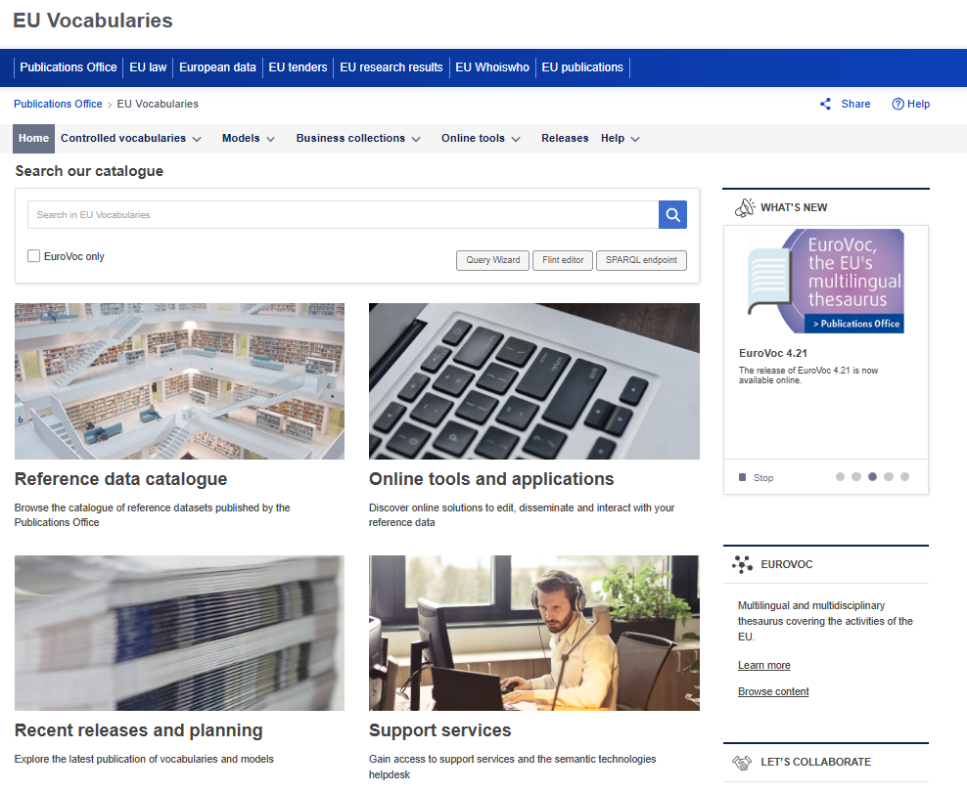
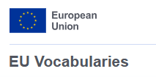
EU Vocabularies is...
Website
Gateway to reference data and the related tools and services
Reference data catalogue
~300 semantic assets, maintained by EU institutions
Set of services
Maintenance and publication of reference data
Support, training and helpdesk

Slide 6
Services offered to EU institutions
Creation and update of reference data
Create a new vocabulary
Update an existing vocabulary
Maintenance of reference data
Creation of the vocabulary in VocBench or TLT
Technical support, configurations, data upload
Publication
Cellar semantic repository
ShowVoc
Support in data modelling
EU Vocabularies website
Training and support
Use of the tools
Custom needs (SPARQL queries, custom forms etc.)
Persistent URIs
Customer service
for reference data-related questions

Slide 7
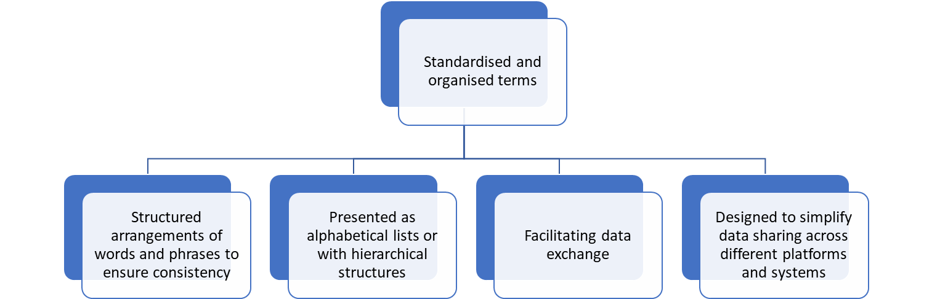
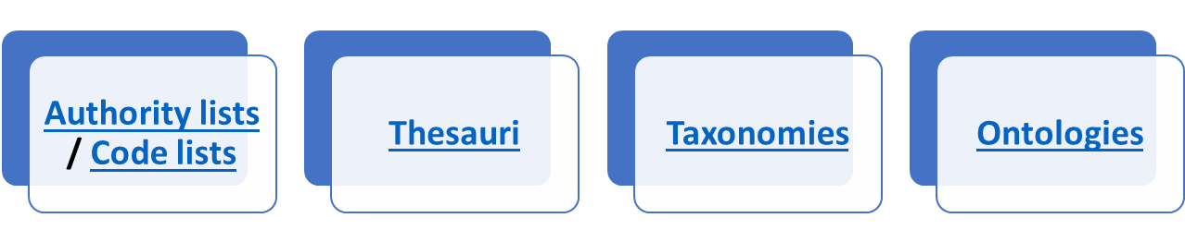
What are controlled vocabularies?

Slide 8
Authority tables – domains
General
Currency
Honorific
Legal
Event
Role
Procurement
Publication
Geographical
Countries and territories
Continent
Place
Language
Legal date
Subdivision
Contract nature
Main activity
Procurement procedure type
Product form
Publication theme
Target audience
Over 200 available authority tables available at: https://op.europa.eu/en/web/eu-vocabularies/authority-tables

Slide 9
Other semantic assets
Taxonomies
controlled vocabulary in which all the terms belong to a single hierarchical structure
Eurostat statistical classifications
European Learning Model taxonomies
EuroSciVoc
Cybersecrutiy Taxonomy
Thesauri
controlled vocabulary with concepts in a hierarchical structure and with related relationships to other terms
EuroVoc
Digital Europa Thesaurus
DE-BIAS Vocabulary
Ontologies
formal specification designed to group instances/concepts based on their common class and thus formalising a full or a subset of a domain
ELI ontology
ERA Vocabulary
AKN4EU schema
DE-BIAS ontology, eProcurement ontology
Application profiles
DCAT-AP: specifies how the DCAT standard is to be used in the context of European data portals
an application profile (AP) describes how a standard is to be applied in a particular domain or application
Mobility DCAT-AP
Health DCAT-AP

Slide 10
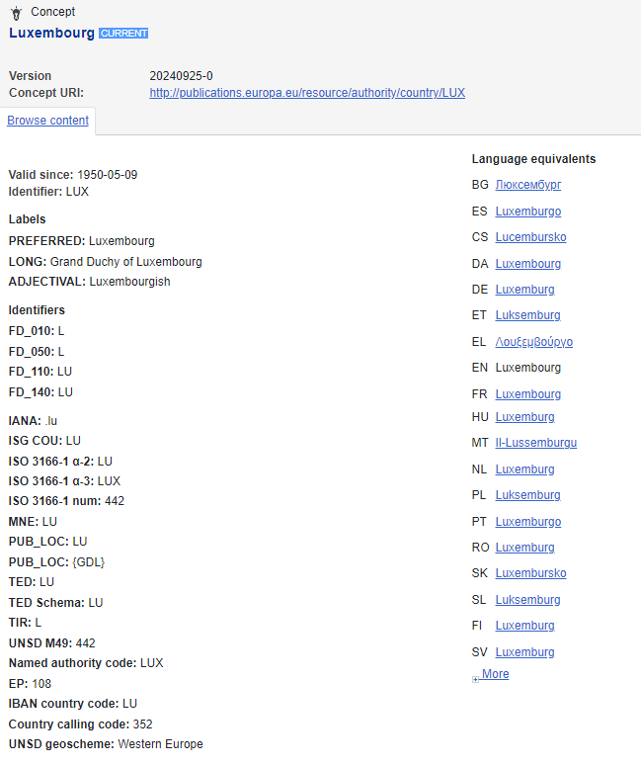
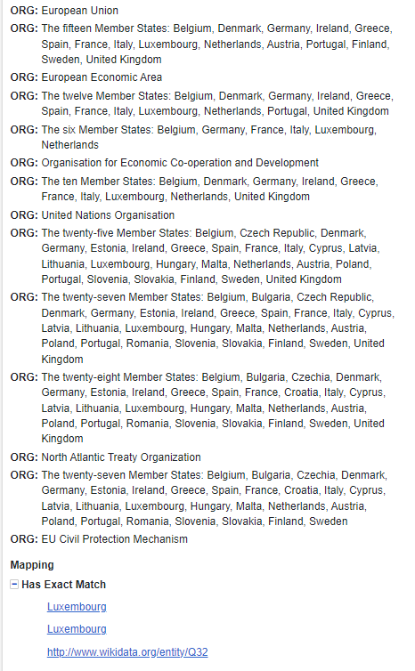
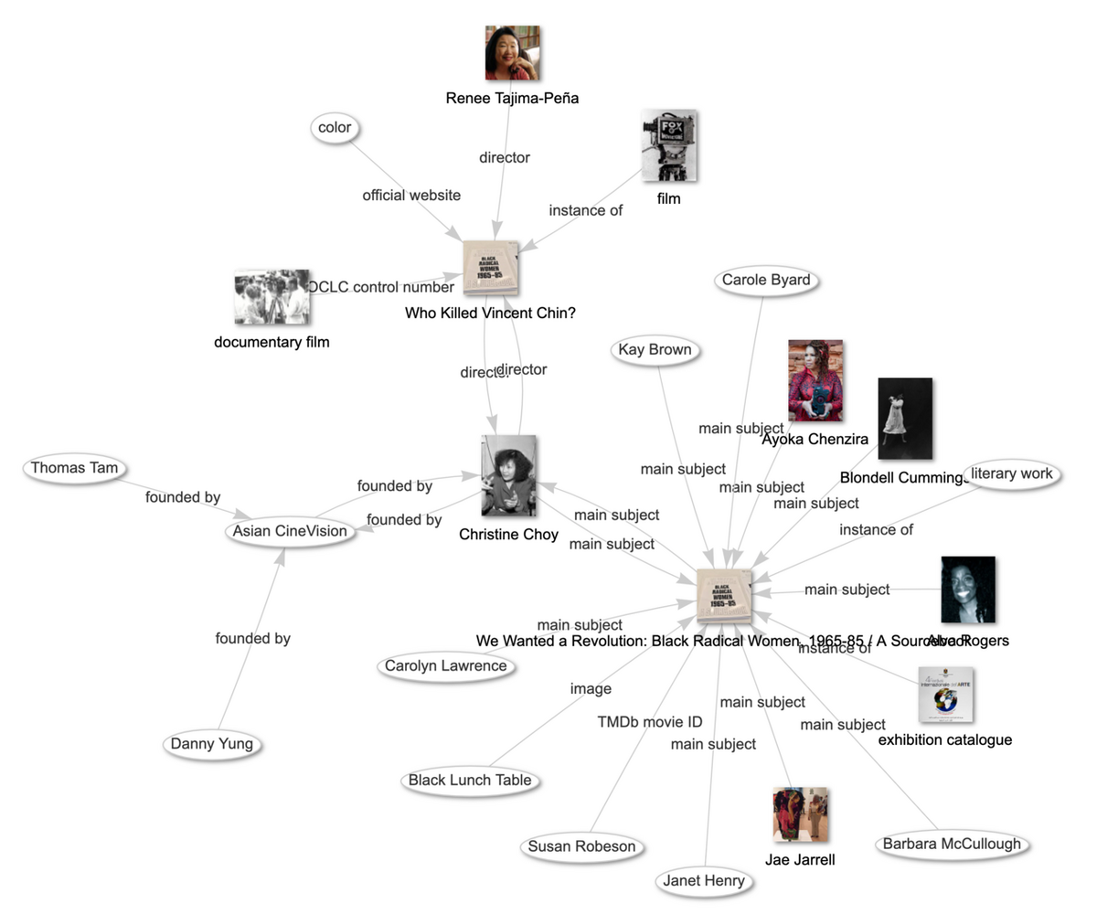
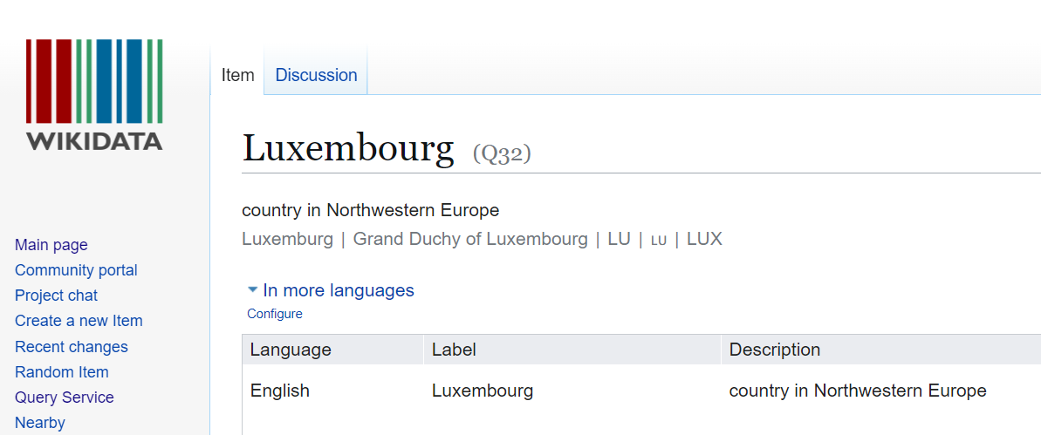
Internal and external mappings

Slide 11

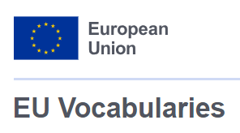

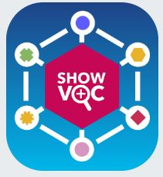

A variety of tools for:
Browsing
Accessing
Editing
Querying

Slide 12
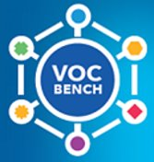
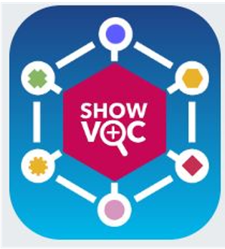
Maintenance and visualisation tools
Online editing tool of controlled vocabularies
Based on semantic technologies
Designed for large scale multilingual vocabularies
Collaborative features
Enhanced user management
Support of Linked Data functionalities
User-friendly browsing interface
Support of alignments
Enhanced visualization features
Global search
Dissemination of semantic datasets

Slide 13
Publication platforms: Cellar and EU Vocabularies
Semantic data repository
Features: API, SPARQL endpoint, machine-readable data
Access: http://publications.europa.eu/webapi/rdf/sparql
Reference data catalogue
Features: Browsing and searching, multiple display views, human-readable access
Access:
https://op.europa.eu/en/web/eu-vocabularies
Additionally: https://data.europa.eu/ - the central point of access to European open data from international, European Union, national, regional, local and geodata portals

Slide 14
Why
EU Vocabularies matters for Data Spaces
EU Vocabularies provides the essential semantic infrastructure necessary for data interoperability across European data spaces.
The controlled vocabularies standardise terms and meanings, facilitating smooth communication, integration, and reuse of reference data. Here is the specific value of reference data to selected data spaces:
    Legal
    Public Procurement
    Cultural Heritage
    Mobility
    Health
Live API look-ups
Ingestion pipelines and analytics tools resolve every concept in real time, fetching multilingual labels, hierarchies and definitions directly from the platform.

Slide 15
Legal Data Space
ELI & Euvoc Ontologies
The Legal Data Space relies on multiple ontologies (ELI Ontology, ELI Impact Ontology, ELI Draft Legislation Ontology, Euvoc Ontology) published on the EU Vocabularies platform and on data.europa.eu to model legislation and case-law metadata
Controlled reference data
Publication of AKN4EU schema on EU Vocabularies
Reuse of authoritative code-lists for places, corporate bodies, resource types, modification types and subdivisions ensure consistent classification across Member States.

Slide 16
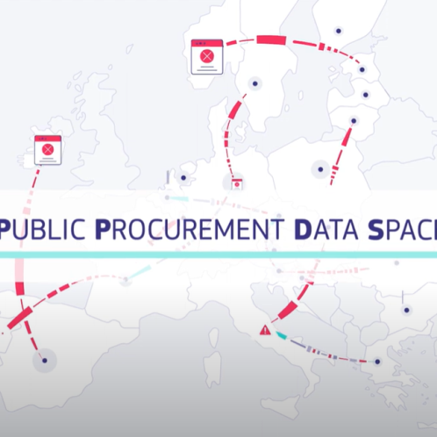
Public Procurement Data Space
eProcurement Ontology (ePO)
All PPDS data is mapped to the eProcurement Ontology URIs managed by the Publications Office, providing a shared model for procurement metadata
Rich controlled vocabularies
Over 60 code-lists (CPV, NUTS, ISO country/currency codes, notice types, etc.) are published on the EU Vocabularies platform and used in TED notices to ensure consistency across Member States.
Business collection page: https://op.europa.eu/en/web/eu-vocabularies/e-procurement

Slide 17
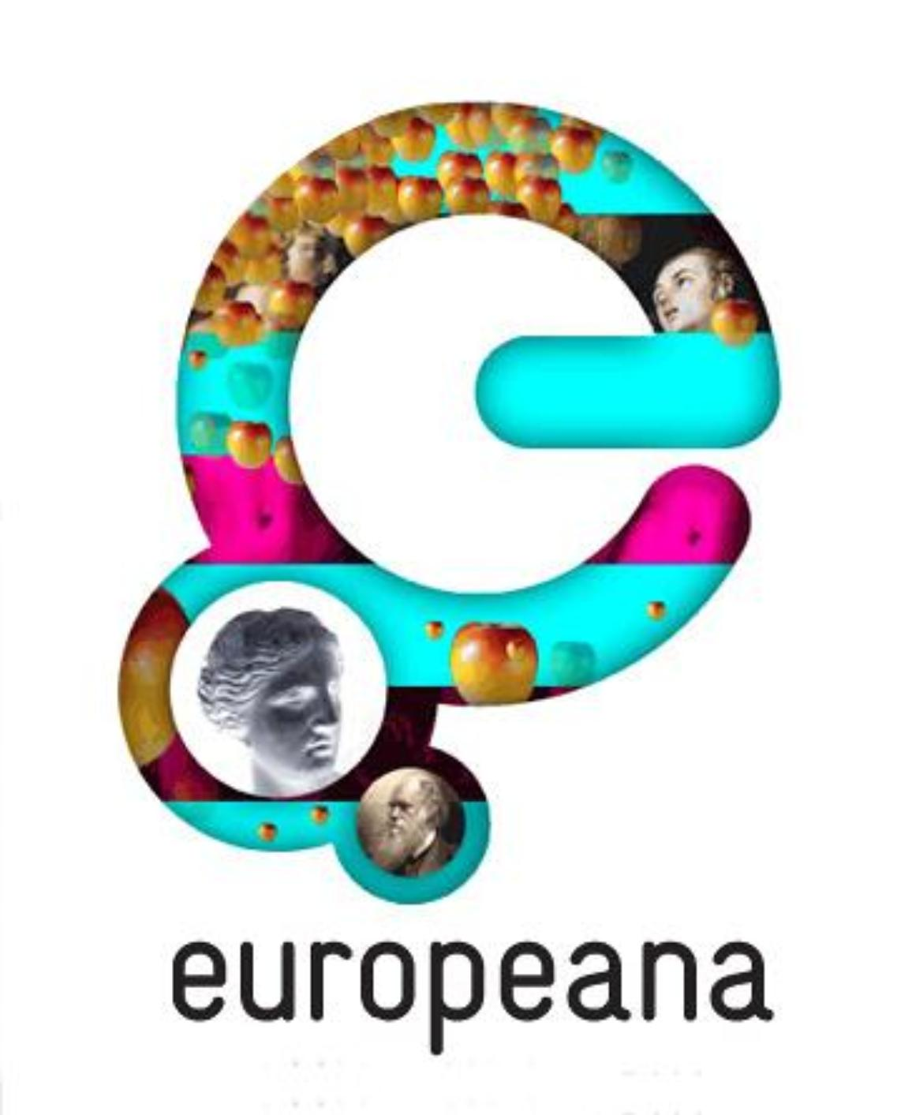
Cultural Heritage Data Space
DE-BIAS vocabulary on EU Vocabularies
The DE-BIAS Vocabulary and its companion Ontology are published as SKOS datasets on the platform, providing ~700 flagged terms (5 languages) with contextual notes and neutral alternatives.
Integrated bias check
During enrichment, the DE-BIAS tool calls those SKOS URIs to detect harmful/derogative descriptors, display explanations to curators, and suggest inclusive replacements—so collections become both interoperable and ethically described before they go live on the Europeana website.

Slide 18

Mobility Data Space
ERA Vocabulary: The Mobility Data Space leverages the ERA ontology - published on EU Vocabularies - to model transport entities (rail networks, infrastructure, services) https://op.europa.eu/en/web/eu-vocabularies/era
Mobility DCAT-AP: Datasets in the Mobility Data Space conform to a specialised DCAT-AP profile (Mobility DCAT-AP) hosted on data.europa.eu, ensuring consistent metadata structures across modes and jurisdictions
The Frequency Authority Table is used by the mobility DCAT-AP and has been adapted appropriately to meet the needs of the Data Space - so “hourly,” “every 15 min” and similar terms are linked to standardised URIs for unambiguous interpretation. Frequency - EU Vocabularies - Publications Office of the EU

Slide 19

Health Data Space
Health DCAT-AP
A specialized DCAT-AP profile adds new health-specific properties and controlled vocabularies (e.g., data permit categories, access-body registry, provenance, lineage). Published as SKOS datasets on data.europa.eu (Health DCAT-AP)
Health DCAT-AP
A specialised DCAT-AP profile adds new health-specific properties and controlled vocabularies (e.g., data permit categories, access-body registry, provenance, lineage). Published as SKOS datasets on data.europa.eu (Health DCAT-AP)
eHDSI Central Terminology System
Controlled vocabularies underpin the Central Terminology System (eHDSI) and the HealthData@EU platform, ensuring semantic consistency across medical records, prescriptions, and health datasets.

Slide 20
Ongoing collaboration with Data Spaces
Health
Reuse of existing vocabularies
Creation and maintenance in VocBench
Reuse of existing vocabularies
Visualisation in ShowVoc and page on EU Vocabularies
Legal
Reuse of existing vocabularies
Creation and maintenance in VocBench
Mobility
Cultural Heritage
DE-BIAS vocabulary: data modelling
Creation and maintenance in VocBench
Structuring of language data (AKN4EU)
Public Procurement
Reuse of existing vocabularies
Creation and maintenance in VocBench
Creation of controlled vocabularies (ERA)
Publication on EU Vocabularies
Publication on EU Vocabularies

Slide 21
The role of AI in enhancing the content of EU Vocabularies
AI significantly enriches and optimises the use, maintenance, and scalability of reference data, acting as a powerful enabler for semantic interoperability and effective data sharing across European Data Spaces. Key areas include:
Semantic tagging
Semantic alignment

Slide 22
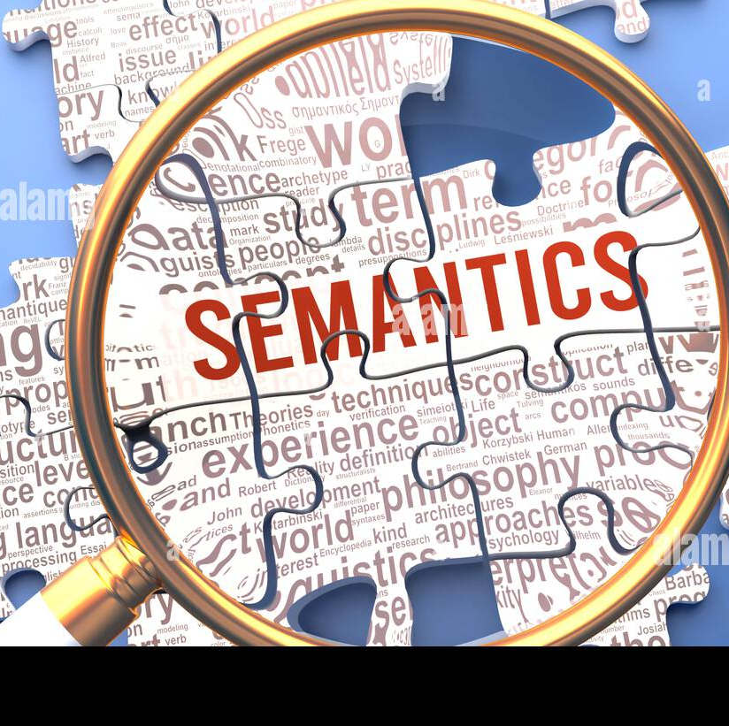
Semantic tagging
Semantic tagging facilitates automatic tagging of EU documents with authority tables (e.g., corporate bodies, places, resource types) from the EU Vocabularies platform
AI-powered approaches for semantic tagging include:
Entity recognition: Automatically detecting key concepts (organisations, places, objects) within text and linking them to vocabularies.
Context-aware disambiguation: Using deep learning models to choose the correct meaning when a word has multiple senses.
Multilingual tagging: AI models can perform tagging across different languages using translations provided on EU vocabularies.
Active learning: Systems improve over time by learning from corrections and human feedback.

Slide 23
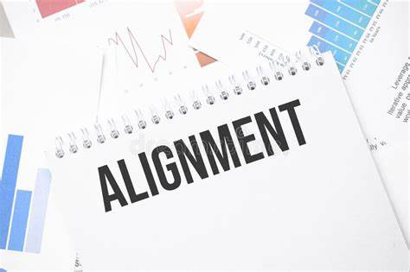
Semantic alignment
AI algorithms automate the alignment and harmonisation of multilingual controlled vocabularies.
They identify semantic equivalences across languages and domains, ensuring consistent terminology and interpretation.
It enables dynamic adjustments and semantic mappings between different data spaces, promoting cross-sectoral data exchanges
This is critical in multilingual data spaces where precision in translation and concept alignment is essential.
Real-world example:
Middleware platforms like Simpl will utilise AI-supported semantic mapping techniques to seamlessly connect sector-specific data vocabularies, enabling interoperability and consistent data transactions between sectors

Slide 24
Building high quality training datasets
For semantic tagging systems to perform reliably across multilingual, domain-specific European data spaces, they must be trained, validated, and benchmarked on high-quality, representative datasets
Selection of representative and diverse raw data
    Collect datasets covering all relevant domains, languages, formats, and types of information
Manual expert annotation (Human-in-the-Loop)
    Domain experts manually annotate data using
    EU Vocabularies
Benchmarking and evaluation
    Auto-tagging tools are tested against the golden dataset

Slide 25

Simpl and EU vocabularies
Simpl needs to ensure that different Data Spaces exchange data with shared meanings
  Controlled vocabularies provide common semantic definitions for key concepts (e.g., "organisation," "address," "legal act," "procurement notice," "corporate body")
  DCAT-AP variants (Health DCAT-AP, mobility DCAT-AP etc.) are used to standardise the metadata of datasets flowing through Simpl
Without EU Vocabularies
  Different Data Spaces might interpret the same term differently
  Data exchanges could fail due to semantic mismatches

Slide 26

Data Space Support Center and EU Vocabularies
Semantic interoperability: DSSC encourages data spaces to embed Authority Tables and EU ontologies in data models and metadata.
Blueprint evolution: EU Vocabularies aligns with updates to the DSSC’s evolving blueprint versions to remain future-proof.
Workshops & training: Joint participation in training events (like ENDORSE and webinars) to promote best practices for semantic assets.

Slide 27

data.europa.eu &
Registry of Semantic Models
Central access & governance
data.europa.eu serves as the official EU portal for open data, governed by the Publications Office, and underpins the Common European Data Spaces by providing the necessary infrastructure and governance frameworks to pool and share data within and across sectors in Europe.
Unified discovery portal
It offers a single entry point to discover and harvest datasets from supranational, national, regional and local public administrations—eliminating fragmentation and enabling data spaces to efficiently find and ingest the public data they need.
Semantic model registry
data.europa.eu will host a central registry of semantic models contributed by all Member States (ontologies, SKOS schemes, DCAT profiles), serving them via persistent URIs to ensure that every data space can access and reuse the same authoritative semantic frameworks.

Slide 28
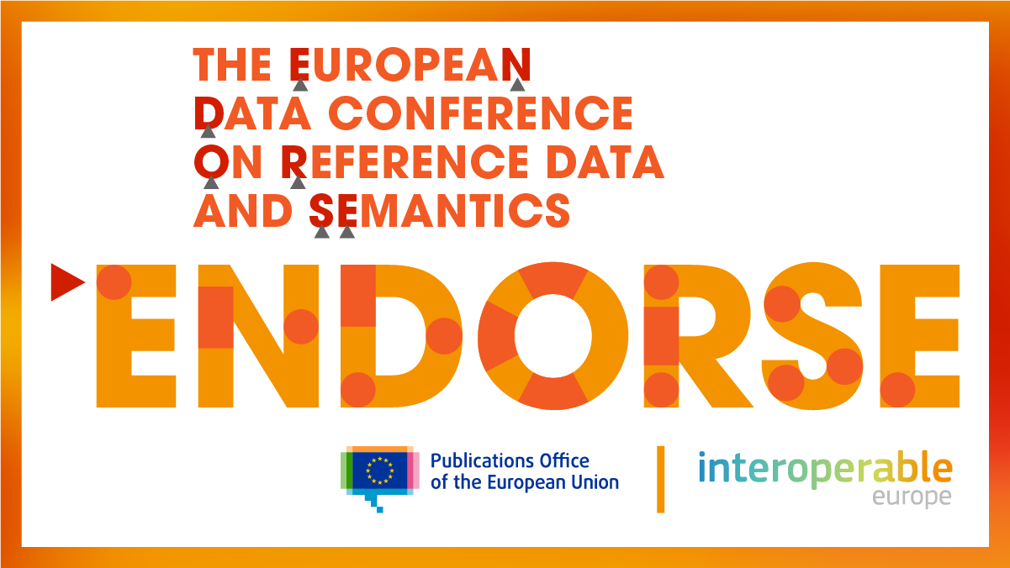
Common actions
OP and Interoperable Europe are collaborating in the organisation of the ENDORSE conference and a series of warm-up events
    Conference: 8-9 October 2025, Brussels
    https://op.europa.eu/en/web/endorse
    Warm-up events (Spring 2025): https://op.europa.eu/en/web/endorse/follow-up-events
Co-organisation of workshops and webinars in the field of interoperability and reference data
Support in Data Spaces

Slide 29
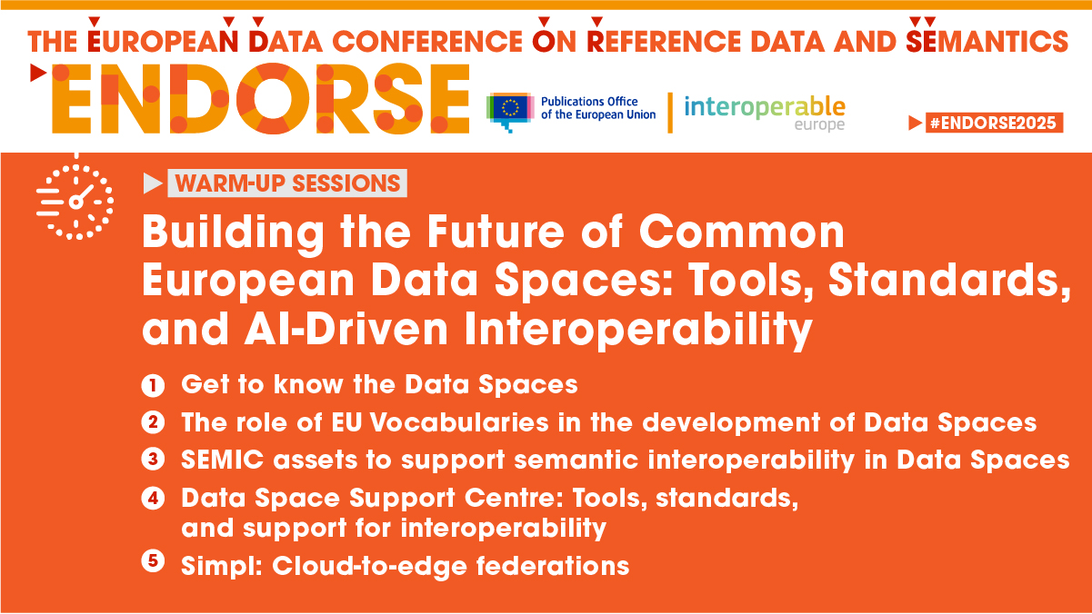

Slide 30

Contact us
Website: https://op.europa.eu/en/web/eu-vocabularies/home
Functional mailbox: OP-EU-VOCABULARIES@publications.europa.eu
OP-ENDORSE@publications.europa.eu
aniko.gerencser@publications.europa.eu
denis.dechandon@publications.europa.eu
vassilis.tzouvaras@ext.publications.europa.eu

