Slide 1
eForms Business ISSUES
6th eForms technical workshop – 26 September 2023
Karl Ferrand – Publications Office of the European Union

Slide 2

eForms business issues – autumn harvest
Status of eForms implementation
Publishing workflow and notice status
Links, dynamic rules, emails
Developer Portal, terms of service, Preview environment
SDK planning and releases
Looking ahead
Image by Agata from Pixabay

Slide 3
Status of eForms implementation
3940 eForms notices on TED* since November 2022 until today
  Majority from eSenders: Estonia (since May); Malta; Belgium, Finland and Switzerland (in September)
  Also via API from European Commission (JRC) and Monopolverwaltung (Austrian tobacco monopoly)
  42 notices via eNotices2 from Poland, Germany, Spain, Greece, France
Based on responses from today’s participants:
  average readiness: 6,7 out of 10
  34% live by mid-October, 43% just before or by 25 October, 23% plan for later
* TED expert search query: TD=[NOT (C or E or G or I or D or P or M or Q or O or R or 0 or 1 or 2 or 3 or 4 or 5 or 6 or 7 or 8 or 9 or B or S or Y or V or F or A or H or J or K)]
Add AND CY=[3-letter-country-code] to find eForms from a specific country

Slide 4
Reminder of eForms notice status and workflow
Archived
Deleted
Publishing
Published
eNotices2 web UI
Draft
Not Published
Submitted
Stopped
eNotices2 API
Validation Failed
End status for a given business ID (notice ID + version ID)

Slide 5
When is a valid notice not published?
Submitted status means notice is valid, i.e. no errors from CVS rules and ready to publish
Reasons for Not Published: not lawful or a technical error
Lawfulness rule warning:
  Buyer country not in lawful-country codelist and not using EU funds
  Also notices in English that contain the string “sale” (no plans to extend this soon)
  Human check by Publications Office team (within 5 calendar days)
In development: expose reason codes for Not Published in eNotices2 web and API

Slide 6
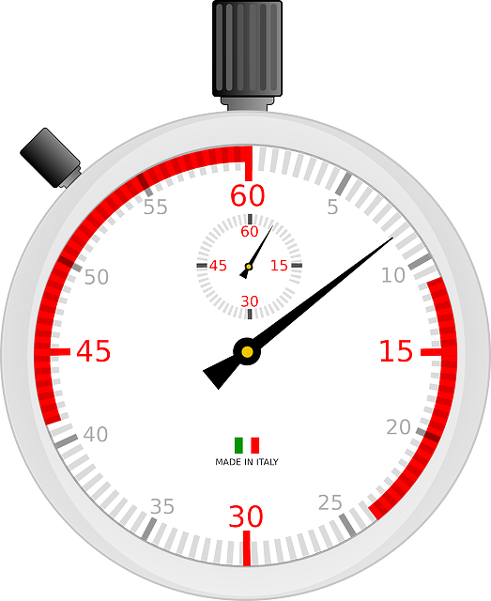
Publication dates – faster and slower
Image by Clker-Free-Vector-Images from Pixabay
Date of publication of eForms notices on TED: no longer 5 fixed calendar days
Option to set Preferred publication date (BT-738)
If empty, then we publish “As soon as possible”, i.e. in next available OJS issue
  notice can be on TED at 9:00 the next morning; maximum 2 working days
  less time to stop publication
If provided, then we publish on preferred date or next available OJS issue after this date
  check TED release calendar for working days
  preferred publication date can be up to 60 days in the future
On working day before expected publication date:
  daily export on working days between midday and midnight – notice enters OJS issue
  in “Publishing” status overnight (or over weekend or holidays)

Slide 7
Stop or Change or Cancel?
“Publishing” status visible next month in eNotices2 web and API
Buyer/API can Stop publication of notice while in Submitted status
Once in Published status (i.e. on TED), can Change notice or Continue procedure
Cancel lot or procedure via contract award notice with no winner
Change notice with “cancel” reason = the notice is null and void - possible but not recommended!
Buyer has these options to control their notices – no need to contact TED helpdesk

Slide 8

Linking notices
eForms are linked by procedure ID but for specific cases:
  Planning/PINs are not part of procedures: use BT-125
  Awards within a framework contract: use OPT-100
  Change notice: use BT-758
  Contract modification: use BT-1501
  Notices before eForms (and any other cases): use OPP-090
Use TED publication number ([1-8 digits]-[year]) or eForms UUID
Developer Docs FAQ includes this information
Image by OpenClipart-Vectors from Pixabay

Slide 9
Dynamic rules
Dynamic rules depend on information outside the notice and that may vary in time
Currently two rules (in stage 6 of Schematron rules):
  Dispatch date (BT-05) must be within 24 hours of reception by eNotices2 (since 1.7.0)
    Successor of eSentool’s check on NOTICE_DISPATCH_DATE within 12 hours
  Notice ID cannot be the same as a published notice ID (in CVS as from 1.9.0)
In future, using SDK2: checks on Change notice, Continue procedure and Contract modification
Fields that should not be changed (planned):
  BT-04 Procedure ID, BT-03 Form Type, BT-02 Notice Type, OPT-070 Notice Subtype, BT-105 Procedure Type, BT-23 Main Nature, BT-702 Notice language, BT-1501-(n)-Contract previous notice, BT-142 Winner chosen and the BT-195 Unpublished identifiers

Slide 10

Emails from eNotices2
In API submissions NoticeAuthorEmail should be the buyer’s email – eSenders must provide the true email address of the contracting authority in the metadata
The notice author email gets notifications for status changes:
  submission, validation failed, stopped, not published, published
eSender gets a copy sent to the email address used by EU Login for API key
Plans to improve content and translation of these email notifications
New feature soon: buyers get email notification when notice published with the same buyer name
  Be aware for testing by API (risk of getting lots of emails): use unique “main buyer” name for recurring buyer and randomised name for multiple buyers
Image by Boer Technology from Pixabay

Slide 11
Developer Portal profile and TED Apps terms of service
Incomplete profiles in Production will be deleted as from this Friday 29th
Why?
  need clean “official” accounts to know who is an active eSender
  remove testing accounts (risk of publication on TED)
  have an accurate eForms go-live dates
  prepare profiles for future opt-in eSender public catalogue (replacing list on SIMAP)
  explicit acceptance of terms of service and privacy statement
    eSender responsibilities for account, notice accuracy, personal data, capacity, support
No clean-up planned yet in Preview – to do after everyone is live to avoid developer disruption
Do not use eNotices2 web interface if you submit notices by API – front-end functions are not designed to handle eSender notices
Planned downtimes announced by email to Portal account and their associated emails

Slide 12

Preview environment
An integrated set of TED applications for validation, submission, viewing
There is no TED website so there is a mock “Published” status - but Submitted notices are valid
Preview is kept aligned with Production: software, SDK, system configuration
Be careful to test in the right environment (they look the same!)
Environment is provided “as is”, no guarantees; we welcome testing in moderation
Known issue: don’t put unpublished publication dates in the past
Image by Peggy und Marco Lachmann-Anke from Pixabay

Slide 13
Information and documentation
CSV files on Developer Docs available since SDK 1.7
    https://docs.ted.europa.eu/eforms/latest/reference/index.html#_downloads
Same content as SDK and web fields/rules/codelists - so also versioned
Import into Excel or your favourite tool
Table of correspondence of TED-XML forms and eForms available on SIMAP (3/8/3023)
    https://simap.ted.europa.eu/web/simap/eforms

Slide 14
SDK planning
Each SDK release is supported by default for 12 months; aim to announce deprecation with 6 months’ notice
SDK support means:
  Active: notices can be submitted in that version – controlled by the CVS active version range
  Patched: backport view-templates and labels/translations; exceptionally an SDK patch may change a rule but never to make it stricter
SDK version | Release date | End of support
1.3 | 3 November 2022 | January 2024
1.4 | 25 November 2022 | January 2024
1.5 | 16 December 2022 | January 2024
1.6 | 6 March 2023 | March 2024
1.7 | 11 May 2023 | May 2024
1.8 | 26 July 2023 | July 2024
1.9 | Early October 2023 | October 2024

Slide 15
SDK releases
SDK 1.8 highlights:
  Clearer structures, attributes, nodes, groups
  Reimplementation of many conditional mandatory/forbidden rules
  Rule and expression labels reviewed in English and translated into all languages
  More examples, improved view-templates, improved CSV files
SDK 1.9 includes: CVD fields in NTDs, improve nodes/NTDs, refined rules, update codelists
  See release candidate on SDK GitHub – in final testing
SDK 1.10 planned no earlier than December: more progressive improvements

Slide 16

Looking ahead
Public consultation on second eForms regulation amendment
  new fields for IPI, FSR, Energy Efficiency directive recast (by June 2024)
  addition of six voluntary forms E1-E6 (by November 2024)
  annex 2 will be the same as the extended annex (including CM/EM)
12 October: second eNotices2 webinar for web users (see video recording of last week’s webinar)
18 October: TED reusers workshop (see previous edition’s presentations and video)
12-13 December: annual eSenders seminar
Image by Jose R. Cabello from Pixabay

Slide 17
Thank you for your attention
Links​
​https://docs.ted.europa.eu​ - Developer guide, APIs, Preview, FAQ, every SDK version…​
​https://github.com/OP-TED/​ - Components and code for developers, SDK, discussions…​
​https://op.europa.eu/en/web/ted-eforms - OP eForms events
Any questions?​
Business: ted@publications.europa.eu ​
Technical: https://github.com/OP-TED/eForms-SDK/discussions/ ​

