Slide 1
CURRENT EFORMS IMPLEMENTATION
eSenders annual seminar – 13 December 2023
Karl Ferrand – Publications Office of the European Union

Slide 2

eForms business issues – Christmas edition
Status of eForms implementation
Status of SDK versions
Highlights SDK 1.9 and 1.10
Reading rules
Looking ahead
Image by Annick Vanblaere from Pixabay

Slide 3
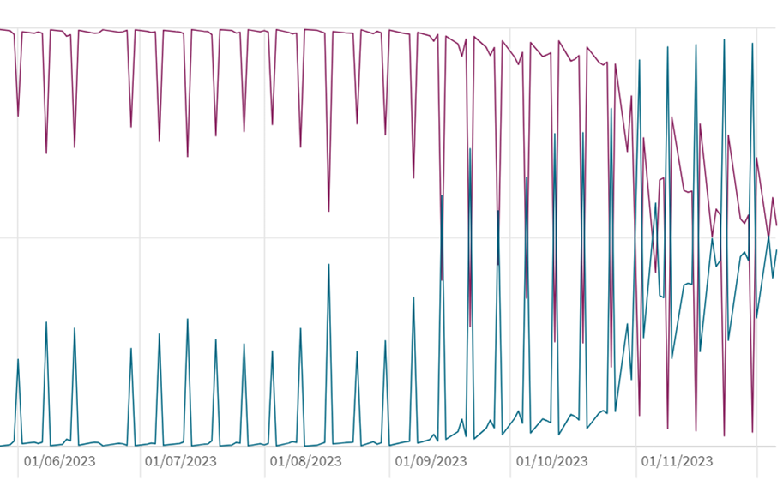
Status of eForms implementation
Over 48000 eForms notices published on TED since November 2022
In the past 7 days:
  49% eForms, 51% TED-XML
  eForms 12% via eNotices2, 88% from eSenders
  11 countries at >80% eForms: Belgium, Cyprus, Estonia, Finland, Germany, Hungary, Ireland, Latvia, Netherlands, Slovakia, Switzerland
  11 countries between 10% and 80%: Austria, Denmark, Iceland, Norway, Lithuania, Malta, Norway, Poland, Romania, Spain, Sweden, (EU institutions)
  8 countries below 10%: Bulgaria, Croatia, Czechia, France, Greece, Italy, Luxembourg, Slovenia
Range of cases: limited or partial transitions, multiple or no eSenders in country, imminent go-live, plans for January…

Slide 4
Status of SDK versions
Good uptake of newer versions but the party continues
Versions 1.3, 1.4, 1.5 no longer active on 31 January 2024
1.6 ends in March, 1.7 in May, 1.8 in July
More details and plans for active versions and CVS:
https://docs.ted.europa.eu/home/eforms/active-versions/index.html
General convention: SDK versions kept active in Production for 12 months after release
Active versions also get support and patches

Slide 5
SDK 1.9 October highlights
New attribute properties in fields.json and explicit fields for currencies and units to ease XML generation
Removed "change" form-type and "corr" notice-type -> Change notices must use the same form-type and notice-type as the original notices, possible since SDK 1.6
Added further conditional mandatory/forbidden rules
CVD fields added to notice type definitions (already available in schema and view-templates)
Dynamic rule to check that notice ID doesn’t match a published notice ID
Unpublished Access Date can be empty so field is never published
Preferred Publication Date can now be 0 days after Dispatch Date (and can be still up to 60 days after)
competition Change notice: cannot use “cancel” or “cancel-intent” after deadlines have passed (reminder: to cancel a lot or procedure, always publish a CAN with no winner)
Patches included some backported rules and the usual translations and view-templates
See more at https://github.com/OP-TED/eForms-SDK/releases/tag/1.9.0

Slide 6
SDK 1.10 December highlights
Added further conditional rules
Rules to check procedure type against notice subtype, based on codelists
Updated rules on accelerated procedure
Ensure identifiers are unique within the notice
If provided, use eSender dispatch date instead of Dispatch date to check notice submitted less than 1 day ago
Modified rules on duration fields, now also allowing empty estimated start date
Adjusted rules for opening event
Removed mandatory "Listed on a Regulated Market“ for winning organisations
Added systematic lawfulness warning for CEI notices (reserved for EU institutions)
Improved rules messages, including systematic mention of field name (not just the identifier)
See more at https://github.com/OP-TED/eForms-SDK/releases/tag/1.10.0

Slide 7
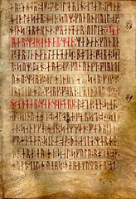
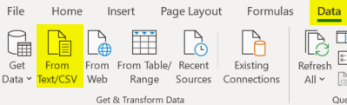
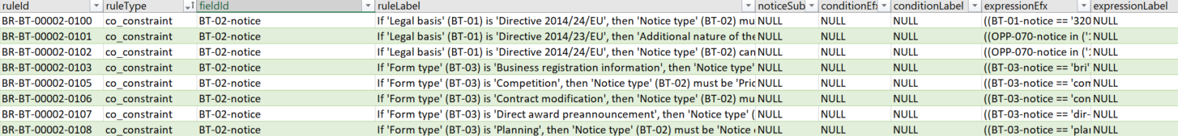
Reading runes rules
eForms rules are expressed and visible in different ways:
fields.json - see https://docs.ted.europa.eu/eforms/latest/fields/index.html
Schematron files - see https://docs.ted.europa.eu/eforms/latest/schematrons/index.html
Rule and expression labels - see https://docs.ted.europa.eu/eforms/latest/translations/index.html#asset-types
Metadata reference - see https://docs.ted.europa.eu/eforms/latest/reference/business-rules/index.html
Downloadable CSV files - see https://docs.ted.europa.eu/eforms/latest/reference/index.html#_downloads
Not so technical? Import the CSV files into Excel and start sorting, filtering, searching – let’s see some examples

Slide 8
Rules: codelists and patterns
Rule type value_check ensures the field contains a value from a codelist
  fieldId: BT-805-Lot
  codelistId: gpp-criteria
  ruleLabel: 'Green Procurement Criteria' (BT-805-Lot) must contain a value from codelist 'Green Public Procurement Criteria' (gpp-criteria)
  Also see codelists and their fields at https://docs.ted.europa.eu/eforms/latest/reference/code-lists/index.html
Rule type pattern_matching ensures the field value matches a specific format
  fieldId: BT-125(i)-Lot
  patternId: ProcedureVersionIDOrPublicationNumber
  ruleLabel: 'Identifier of the previous notice' (BT-125(i)-Lot) must match the following pattern: ProcedureVersionIDOrPublicationNumber
  Also see regex (!) at https://docs.ted.europa.eu/eforms/latest/reference/business-rules/index.html#_pattern_matching

Slide 9
Rules: co-constraints
Rule type co_constraint compares values between fields in the notice
  fieldId: BT-132(d)-Lot
    The field in the XML that triggers the rule (in Schematron stage 5)
  conditionEfx: (BT-132(d)-Lot is present) and (BT-131(d)-Lot is present)
    First check if a condition is filled: in this case, check the fields are filled; in many cases, there is no condition
  expressionEfx: BT-132(d)-Lot >= BT-131(d)-Lot
    Then evaluate the rule, also in EFX: in this case that one date is greater or equal to another date
  context: ND-PublicOpening
    Bear in mind the node in the XML where this rule applies
  ruleLabel: 'Opening date' (BT-132) must be later than 'Deadline for receipt of tenders' (BT-131)
    If you show these message directly to your users, now you know how to support them
  Also see at https://docs.ted.europa.eu/eforms/latest/reference/business-rules/index.html#_co_constraint

Slide 10
Rules: mandatory and forbidden
Rule types mandatory and forbidden are generated and apply per notice subtype
  fieldId: BT-132(d)-Lot
  noticeSubtype: 16
  conditionEfx: not(BT-105-Procedure == 'open')
    This is what makes a rule conditionally mandatory or conditionally forbidden
    If no condition, the field is always mandatory or forbidden for the subtype
  context: ND-LotTenderingProcess
  ruleLabel: 'Opening date' (BT-132(d)-Lot) is not allowed in notice type '16 – Contract notice – general directive, standard regime' under following condition: 'Type of procedure' (BT-105-Lot) is not 'Open’
  Also see at https://docs.ted.europa.eu/eforms/latest/reference/business-rules/index.html#_rules_applicable_to_specific_notice_sub_types

Slide 11
Rules: lawfulness
Rule type lawfulness are the only rules with warnings, requiring manual check by OP to publish or not
  fieldId: BT-514-Organization-Company
  conditionEfx: (OPT-200-Organization-Company in OPT-300-Procedure-Buyer) and OPP-070-notice in ('1','2','3','4','5','6','E1','E2’)
  expressionEfx: (BT-514-Organization-Company[OPT-200-Organization-Company in OPT-300-Procedure-Buyer] in (lawful-country))
  context: ND-Company
  ruleLabel: The buyer must be in a country for which the publication is expressly authorized
  Also see at https://docs.ted.europa.eu/eforms/latest/reference/business-rules/index.html#_lawfulness
  In the longer term, further non-Schematron rules may be developed, e.g. mix of languages, text analysis

Slide 12
Operational issues
CVS doesn’t have all rules yet, e.g. checking valid linked notices, Change notice, etc
Some notices will be rejected after CVS, i.e. Not Published – check your notice status
  Linking to a notice that hasn’t been published yet, especially Change notice
  Some cases of unpublished fields, with dates in the past
Data quality:
  Contract award notices need to carefully link tenderers, tenders, contract to define the winner
  Change notices or Continue procedure that are not consistent
  OP needs to implement rules but buyers are ultimately responsible
  eSenders are also responsible for business and technical capacity
  User interface can help to avoid poor notices
  OP will contact you via Developer Portal emails if needed
Image by melaniko from Pixabay

Slide 13

Looking ahead
Final switches to eForms – update your go-live dates in Developer Portal profile
eSentool: last submissions on 31 January, other functions available for further 3 months
Add Not Published reasons and Expected publication date
SDK 1.11 in Q1 2024
SDK 2.x, including rules for Change notice, Continue procedure and Contract modification
API v3
Implement 2023 amendment:
  By June: IPI and FSR fields, codelists, rules, NTDs, view-templates, translations
  By November: Six new E1-E6 forms
Continue support, documentation, 3 or 4 eSender workshops per year
New TED website https://gamma.tedv2.spikeseed.cloud/en/
Image by melaniko from Pixabay

Slide 14
Thank you for your attention
Links​
​https://docs.ted.europa.eu​ - Developer guide, APIs, Preview, FAQ, every SDK version…​
​https://github.com/OP-TED/​ - Components and code for developers, SDK, discussions…​
​https://op.europa.eu/en/web/ted-eforms - OP eForms events
Any questions?​
Business: ted@publications.europa.eu ​
Technical: https://github.com/OP-TED/eForms-SDK/discussions/ ​

