Slide 1
eFORMS business issues
eSender workshop – 20 June 2024
Karl Ferrand – Publications Office of the European Union

Slide 2

eForms business issues – summer sun?
SDK lifespan and upgrades
SDK 1.12 highlights
SDK 1.13 scope
Info for eSenders

Slide 3
Current SDK versions in use
66 311 eForms notices published on TED in past 30 days
50 eSenders and 13 000+ active eNotices2 users
Most eSenders on 1.7 and 1.8 upgrading to 1.10 in coming months (see 1.10.3 patch)
Almost all would like more time

Slide 4
SDK lifespans – more time for some
SDK Version | End of standard lifespan 12 months of patches | End of extended lifespan No longer accepted by CVS | New end of extended lifespan
1.6 | 06 March 2024 | 31 July 2024 | 30 September 2024
1.7 | 11 May 2024 | 30 September 2024 | 28 February 2025
1.8 | 26 July 2024 | 30 November 2024 | 28 February 2025
1.9 | 09 October 2024 | 28 February 2025
1.10 | 01 December 2024 | 28 February 2025
1.11 | 22 April 2025 | 22 April 2025
1.12 | June 2025 | June 2025
1.13 | October 2025 | October 2025
More details at https://docs.ted.europa.eu/eforms-common/active-versions/index.html (to be updated)
28 February 2025 is legal deadline in article 3b of eForms amendment 2023/2884 of 20 December 2023

Slide 5

SDK upgrade considerations
SDK 1.12 has XML for mandatory changes for exclusion/selection criteria
SDK 1.13 extends XML for optional fields (IPI, EED) and forms (E1-E6)
Start your work based on SDK 1.12, XML schema should comply with SDK 1.13
Add SDK 1.13 optional parts as needed, e.g. just IPI and EED if no need for voluntary forms
Additional time for SDKs 1.7 and 1.8 allow a possible upgrade directly to 1.13
SDK active versions are operational deadlines; eSenders/MS decide legal status
Check your data quality and add own rules if staying on an older SDK version (many CM/CF rules added between 1.8 and 1.11)
Image by Wolfgang Eckert from Pixabay

Slide 6

SDK 1.12 highlights
OP is testing SDK 1.12 Release Candidate - https://github.com/OP-TED/eForms-SDK/tree/1.12.0-rc.1
Main changes are business entities and everything for exclusion grounds/selection criteria and Foreign Subsidies Regulation on schema/nodes/fields (new and removed fields), codelists, rules, notice type defintions, view templates, translations
Codelists: removed redundant eforms- tailored codelists (same as parent); new susp-review Change reason code, added Ireland to postcode-country, adjustments for T01/T02
Rules: check legal basis vs subtype, e.g. only 2014/24/EU and Other for CN subtype 16
Notice type definitions: reordered subcontract and CVD fields
View templates: fixes including multilingual fields in Change and Modification sections
Labels and translations: December amendment descriptions, improved Estonian and Danish
  Member States/ministries: get in touch about translations (for SDK 1.13)
Image by günter from Pixabay

Slide 7

SDK 1.13 scope
The rest of the eForms December amendment
  see Excel at https://ec.europa.eu/docsroom/documents/58074
International Procurement Instrument (IPI): 5 fields, 3 codelists, in Result notices
Energy Efficiency Directive (EED): 6 fields, 3 codelists, in Competition and Result notices
E1 Pre-Market Consultation: mix of existing fields in PIN profile and PIN only
E2 voluntary Planning: very similar to PIN only (4)
E3 voluntary Competition: use existing fields and base on CN general form (16)
E4 voluntary Result: use existing fields and base on CAN general form (29)
E5 Contract Completion: similar to E4 with some added and removed fields plus
    New Review section: 16 fields, 4 codelists and also added to all Result notices (optional)
E6 Contract Modification for defence directive: use existing fields and base on general form (38)
Image by Ben Kerckx from Pixabay

Slide 8
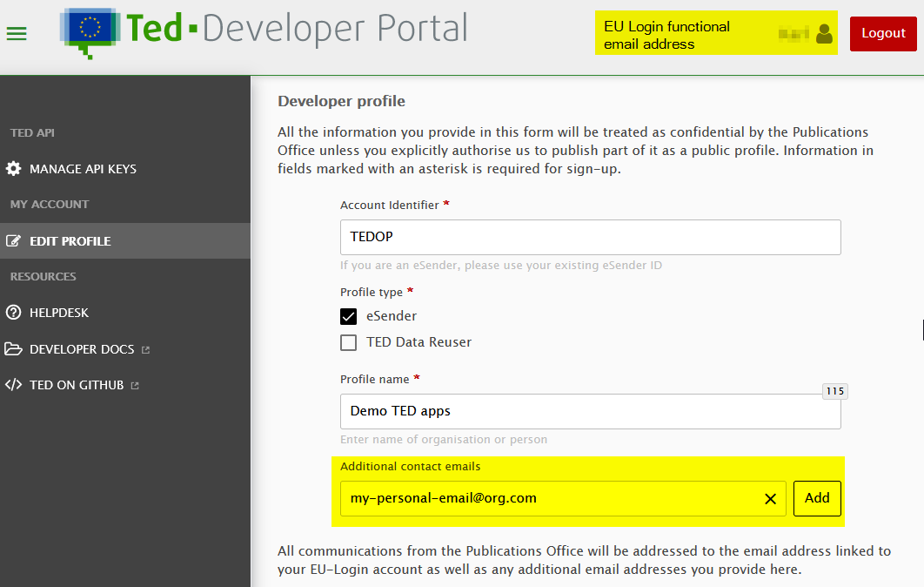
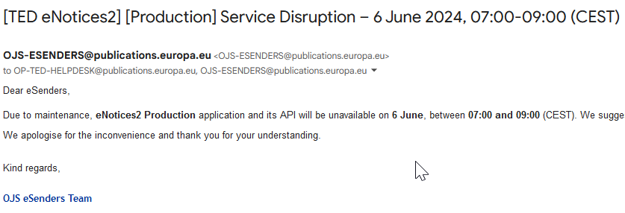
Info for eSenders
Developer Portal profiles: as many as you want in Preview, just one in Production (and one API key)
Use functional/shared email address EU Login for Production account
This email is now in copy of all notification emails sent to buyers
Provide a valid noticeAuthorEmail in API parameter (terms of service)
Add yourselves as additional emails to get (human) announcements, downtimes, specific messages from OP
eNotices2 web interface is not designed for eSenders, only for initial connection and to check notice status if really needed
Don’t touch any notices via web interface, don’t create workgroups, there’s no concept of “customer” in eNotices2
There will be a tidier/improved v3 of the APIs in a few months’ time but current APIs will run in parallel until everyone has moved

Slide 9
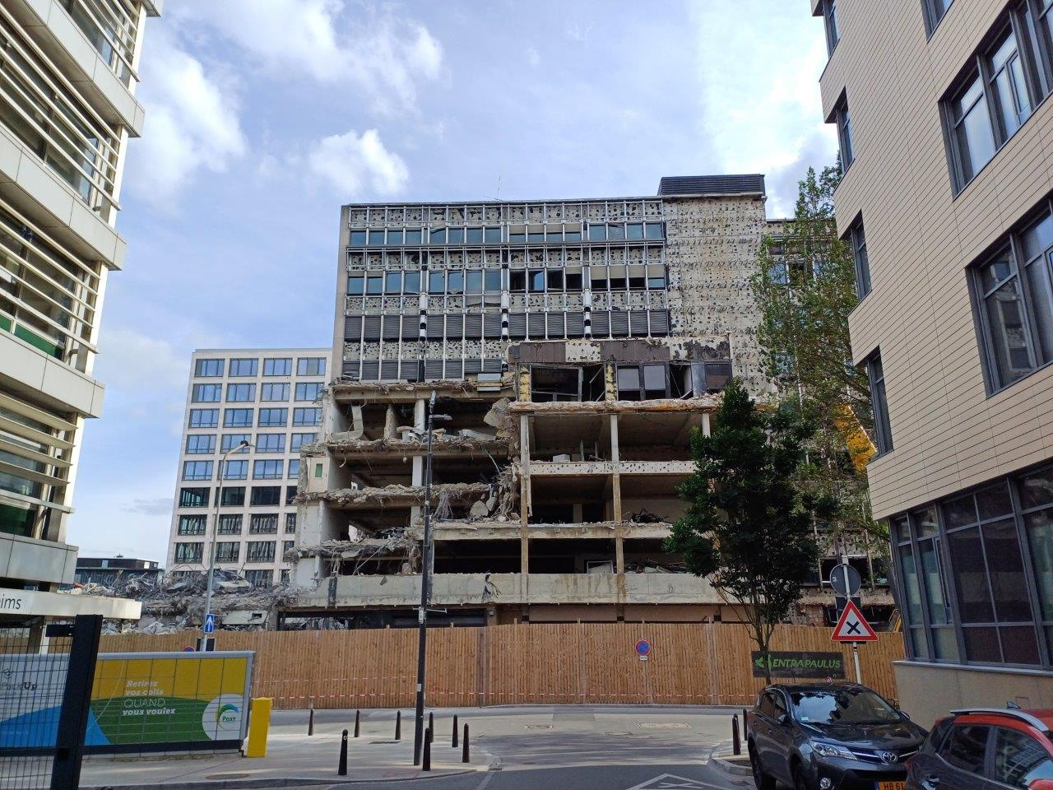
What’s next
DG GROW EXEP eForms workshops: 21 June for E1-E6 forms and 4 July for Review section
  Other issues and discussions at https://code.europa.eu/eproc/eforms/crs/-/issues
2 more eSender workshops in September and December
  https://op.europa.eu/en/web/ted-eforms
  December hybrid meeting in Luxembourg? Combine with ESPD, eProcurement ontology, TED reusers?
eSentool closed on 30 April, eNotices and back-office TED Monitor 2012 closing in July, end of an era…

Slide 10
THANK YOU FOR YOUR ATTENTION
Links​
​https://docs.ted.europa.eu​ - Developer guide, APIs, Preview, FAQ, every SDK version…​
​https://github.com/OP-TED/​ - Components and code for developers, SDK, discussions…​
​https://op.europa.eu/en/web/ted-eforms - OP eSender workshops
Any questions?​
Business: ted@publications.europa.eu ​
Technical: https://github.com/OP-TED/eForms-SDK/discussions/ ​

