Slide 1
eForms SDK – Business Entities
Ioannis Rousochatzakis, Publications Office, 20/06/2024

Slide 2
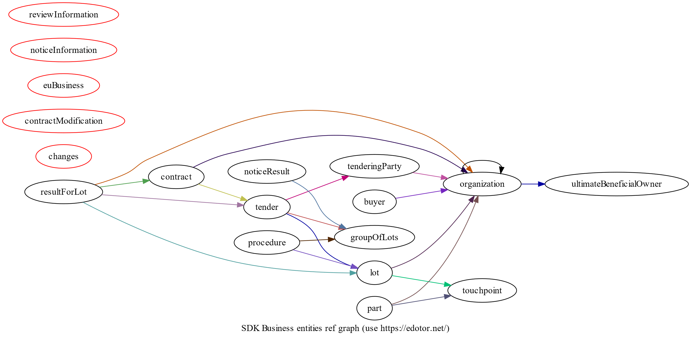
Business Entities
New in SDK 1.12
Group fields into business concepts
Allow applications to implement features that were not previously practical to implement
Provide a better basis for linking eForms to the eProcurement Ontology
Introduced now so that eSenders have enough time to adopt before SDK 2 is released

Slide 3
Business Entities
They come as a new section in fields.json.
Every field “belongs” to one Business Entity.
Identifiers (id fields) identify Business Entities.
Cross-references (id-ref fields) reference Business Entities.
Business Entities can repeat (of course)
  When they do, they are linked with the Node which they “repeat with”.
Business Entities provide information on
  How to generate and reference instance identifiers for them
  How to reference them in Change Notices

Slide 4
Business Entities are different from Nodes
Nodes
Business Entities
How fields combine to form business concepts
Where fields are placed in the XML
Physical model
Logical model

Slide 5
Hierarchical structures in the SDK
Physical Model
Nodes
Logical model
Business Entities
Visual Model
Display Groups
Fields
Fields
Fields
XML Generation
Cross-referencing
Forms

Slide 6
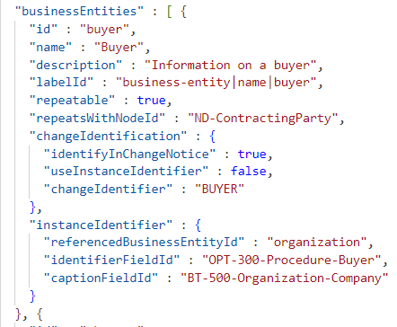
Business Entities
Linked to a Node when repeating
Provide information for instance identification
Provide information on how to identify them in change notices
Every Field belongs to one Business Entity

Slide 7
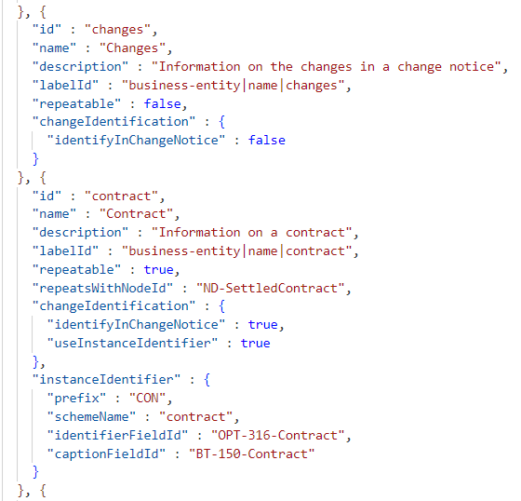
Business Entities
Linked to a Node when repeating
Provide information for instance identification
Provide information on how to identify them in change notices
Every Field belongs to one Business Entity

Slide 8
Business Entities in SDK 1.12

Slide 9
Use cases
Generating identifiers
  Replaces the current solution and overcomes its limitations
Cross-referencing
  Linking id-ref fields with identifiers that were not possible in previous versions of the SDK
Change notices
  Simplify/automate filling-in of change section

Slide 10
Change notices
Context:
  Your application tries to generate a form for filling-in a change notice
Your application wants to:
  Make it easier for the user to fill-in the CHANGE section by automatically recording each modification in the CHANGE section
Your application needs to:
  Infer the section of the notice that changed from the field that was modified

Slide 11
Change notices before Business Entities
Not possible
Any solution would have to be hardcoded and maintained manually

Slide 12
Change notices with Business Entities
Every field “belongs” to the Business Entity provided the “businessEntityId” property
  Example: "businessEntityId" : "noticeResult“
Business Entities provide a “changeIdentification” property
  Example: "changeIdentification" : {
  "identifyInChangeNotice" : true,
  "useInstanceIdentifier" : false,
  "changeIdentifier" : "RESULT“
  }
Using this information, the application can automatically record each change in the CHANGE section so that the user only needs to review it and provide the reason codes and descriptions to complete the change notice.

Slide 13
Generating identifiers
Context:
  Your application tries to generate the UI for filling-in a notice
Your application wants to:
  render a button that allows the user to create new instances of repeatable display-groups
Your application needs to:
  Know if it needs to generate an instance identifier for the new repeatable group
  Know the format of the identifier that should be generated
  Know which field the new identifier should be stored in

Slide 14
Generating identifiers before Business Entities
Repeatable display-groups point to a corresponding Node with the “nodeId” property
The Node provides an “identifierFieldId” and a “captionFieldId”
The “id” field provides an “idScheme” that indicates the format of the identifier

Slide 15
Generating identifiers with Business Entities
Repeatable display-groups provide a “businessEntityId” property
  Example: "businessEntityId" : "groupOfLots"
The business entity provides “instanceIdentifier” property
  Example: "instanceIdentifier" : {
  "prefix" : "GLO",
  "schemeName" : "LotsGroup",
  "identifierFieldId" : "BT-137-LotsGroup",
  "captionFieldId" : "BT-21-LotsGroup“
  }

Slide 16
Improvements in identifier generation
Overcomes the limitations of the previous solution.
Slightly simpler, more future proof.
The “idScheme” and “SchemeName” properties of “id” fields become redundant and will be removed in SDK 2.

Slide 17
Cross-referencing
Context:
  Your application tries to generate the UI for filling-in a notice
  Encounters a field of type “id-ref” and tries to render it in the UI
Your application wants to:
  Restrict the values that the user can enter to values that will be accepted during validation
The application needs to:
  Know which fields can be referenced
  Know which fields contain the corresponding user-friendly captions
  Collect the identifiers and their captions in a combo-box

Slide 18
Cross-referencing before Business Entities
“id-ref” fields provide the “idSchemes” property
  Example: “idSchemes”: [“GLO”, “LOT”]
“id” fields provide the “idScheme” property
  Example: "idScheme" : “LOT"
The application can find the matching “id” fields and collect their values

Slide 19
Cross-referencing with Business Entities
“id-ref” fields provide the “referencedBusinessEntityIds” property
  Example: "referencedBusinessEntityIds" : [ "groupOfLots", "lot" ]
The application can find the matching Business Entities
Business Entities provide “instanceIdentifier” property
  Example: "instanceIdentifier" : {
  "prefix" : "GLO",
  "schemeName" : "LotsGroup",
  "identifierFieldId" : "BT-137-LotsGroup",
  "captionFieldId" : "BT-21-LotsGroup“
  }

Slide 20
Improvements in cross-referencing
“id-ref” fields can now be linked with any identifier
  Example: Section identifiers in change notices can now be linked with identifiers like “PROCEDURE”, “BUYER”, “RESULT”
The properties that were used become redundant and will be removed in SDK 2
  “idScheme” property of “id” fields
  “idSchemes” property of “id-ref” fields

Slide 21
Business Entities – future evolution
Planned for 2025
  Alignment with the eProcurement Ontology classes
  Composition - “has …” relationships
  Inheritance – “is …” relationships
Possible (but not yet planned)
  Alignment with Business Groups
  (future updates to the regulation)
  To be used by EFX 3 to simplify expressions

Slide 22
Thank you

