Slide 1
eFORMS business issues
eSender workshop – 26 September 2024
Karl Ferrand – Publications Office of the European Union

Slide 2

eForms business issues – autumn rain?
Image by Yiannis Kamatsos from Pixabay
SDK lifespan and upgrades
Getting to SDK 1.12 and SDK 1.13
What’s next

Slide 3
SDK lifespans and deadlines
SDK Version | End of standard lifespan 12 months of patches | End of extended lifespan No longer accepted by CVS | Latest patch 2 September
1.6 | 06 March 2024 | 30 September 2024 | 1.6.5
1.7 | 11 May 2024 | 28 February 2025 | 1.7.5
1.8 | 26 July 2024 | 28 February 2025 | 1.8.4
1.9 | 09 October 2024 | 28 February 2025 | 1.9.4
1.10 | 01 December 2024 | 28 February 2025 | 1.10.4
1.11 | 22 April 2025 | 22 April 2025 | 1.11.1
1.12 | 18 July 2025 | 18 July 2025
1.13 | October 2025 | October 2025
More details at https://docs.ted.europa.eu/eforms-common/active-versions/index.html
28 February 2025 is legal deadline in article 3b of eForms amendment 2023/2884 of 20 December 2023 but…

Slide 4
SDK versions used by the 50 direct eSenders
More than half on extended lifespan SDKs
Reported upgrade paths:
    1.7 -> 1.11/1.12
    1.8 -> 1.11/1.13
    1.9 -> 1.12/1.13
    1.10 -> 1.12/1.13
    1.11 -> 1.12/1.13
More time?
    April, June, late 2025…

Slide 5

SDK upgrade to 1.12 or to 1.13?
SDK 1.12 XML schema has mandatory changes for exclusion/selection criteria
SDK 1.13 has no changes to the schema for mandatory fields
Notices in SDK 1.12 schema should be ok in SDK 1.13 schema
But SDK 1.13 has rule changes including:
  NUTS 2024 (Brexit, Kosovo, DE, IT, LV, NL, PT, FI, NO) and codelists
  BT-131 Deadline Receipt Tenders allowed for subtype 8 and forbidden for subtype 9
  Check valid procedure types for each subtype
  Forbid namespace prefixes on the root element of notices
  etc…
Image by Tommy Staziker from Pixabay

Slide 6
SDK 1.12 and 1.13 optional additions
Implementation depends on your client/national/technical needs
Business entities (1.12)
Foreign Subsidies Regulation (FSR) (1.12)
International Procurement Instrument (IPI) in Result notices
Energy Efficiency Directive (EED) in Competition and Result notices
E1 Pre-Market Consultation: new consultation form type and pmc notice-type
E2 voluntary Planning, E3 voluntary Competition, E4 voluntary Result
E5 Contract Completion: new completion form type and compl notice-type plus
    New Review section, also added to all Result notices
E6 Contract Modification for defence directive
Image by günter from Pixabay

Slide 7
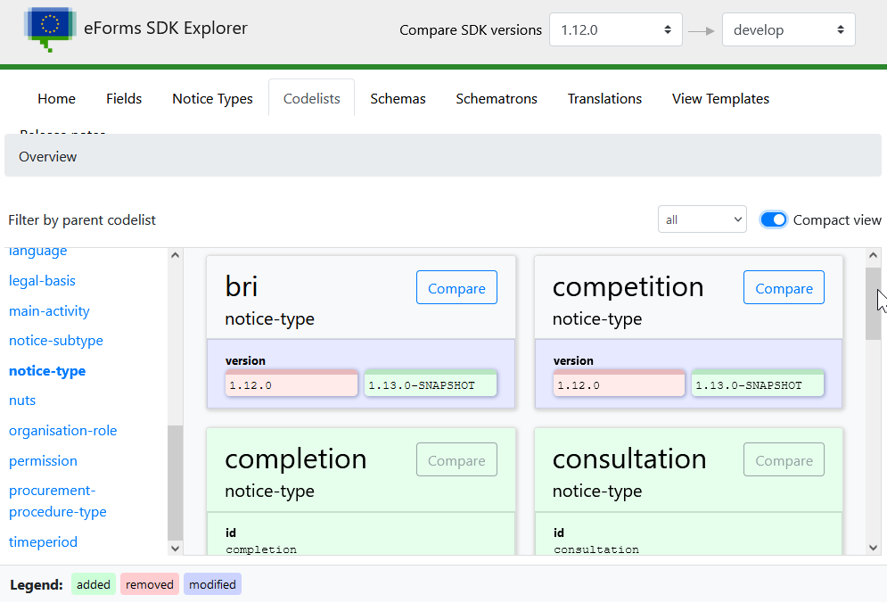
SDK 1.13 planning
Ongoing commits in GitHub develop branch
SDK Explorer compares against develop
Bulk of changes committed (e.g. schema and codelists are stable) but still working on rules, view-templates, NTDs, labels
SDK 1.13 Release Candidate by mid-October
Target: SDK 1.13 released by end of October
Deployed and activated in Preview
Activated in Production later on
Let us know if you need more time to upgrade…

Slide 8
Why so many SDK versions?
Three SDK releases in 2024, down from five releases in 2023 -> more mature?
Upgrades are hard -> new extended lifespans more than 12 months
SDKs need maintenance: business and technical improvements, issues you raise, EFX2, unpublished
SDK tailoring: national/legal, operational, implement rules before next SDK
Sectoral regulation: eForms for reporting and data (FSR, IPI, EED, CVD) and more to come…
More policy governance to come but see already DG GROW’s GitLab issues, guides, EXEP workshops
3rd eForms amendment not planned for before mid-2025
New European Commission -> revision of EU procurement directives!
EXPP meeting today: evaluation of directives, sectoral files, Draghi report, strategic procurement
Try to simplify but design for change…

Slide 9
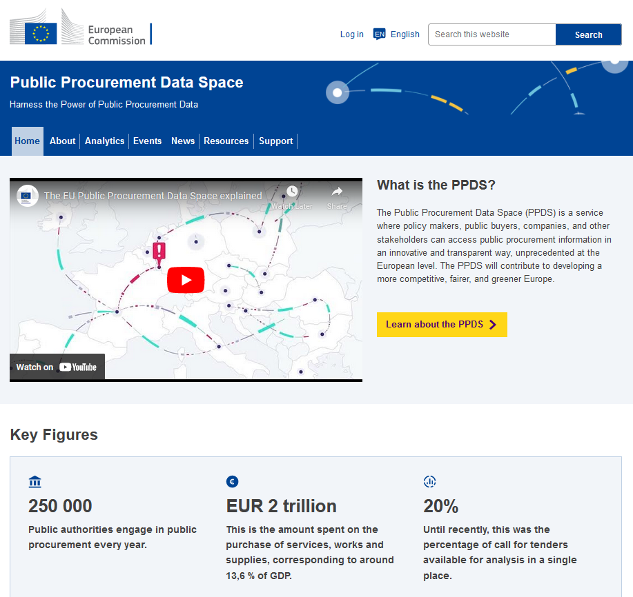
What’s on
PPDS launched on 24 September:
  https://www.public-procurement-data-space.europa.eu/en
“TED-together” on 3rd and 4th December
  Joint meeting of eSender, TED reuser, eProcurement ontology and ESPD communities
  Hybrid in Luxembourg and online
  Presentation from an eSender?
eNotices2 web usability study in Q4

Slide 10
THANK YOU FOR YOUR ATTENTION
Links​
​https://docs.ted.europa.eu​ - Developer guide, APIs, Preview, FAQ, every SDK version…​
​https://github.com/OP-TED/​ - Components and code for developers, SDK, discussions…​
​https://op.europa.eu/en/web/ted-eforms - OP eSender workshops
Any questions?​
Business: ted@publications.europa.eu ​
Technical: https://github.com/OP-TED/eForms-SDK/discussions/ ​

