Slide 1
EFORMS SDK
eSender workshop – 28 March 2025​
Ioannis Rousochatzakis – Publications Office of the European Union

Slide 2
Agenda
SDK 2 progress & timeline
Addressing some recent questions
Tailoring the eForms SDK
Working together

Slide 3
SDK-2

Slide 4
SDK-2 is EFX-2
We want to keep SDK-2 fully compatible with SDK-1
Except EFX…
  Rules in fields.json will be in EFX-2
  View Templates will be in EFX-2
Other changes that SDK 2 may include:
  Full set of Business Entities
  Field aliases
  (Maintaining existing field names but also adding friendlier names standardised by the eProcurement Ontology)

Slide 5
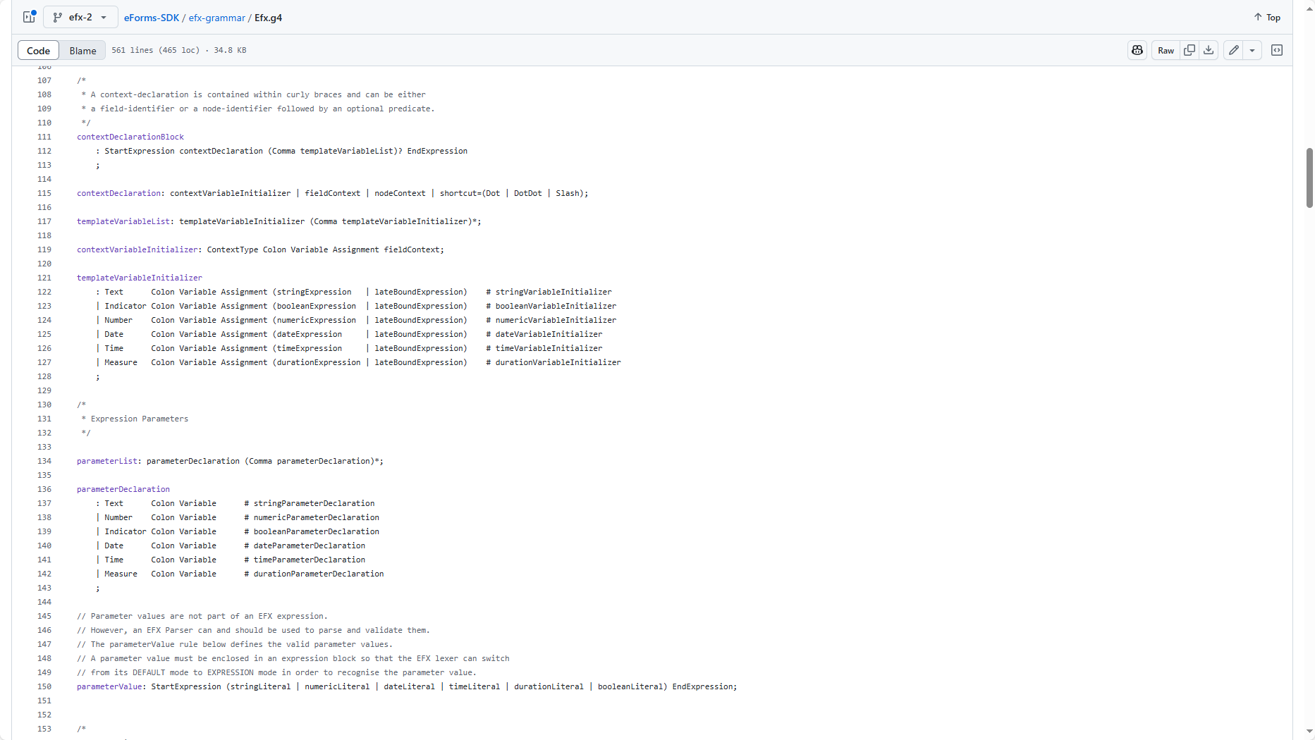
EFX-2 Features
More expressive, easier to read, easier to write
Improved type-safety
Data type improvements (Measures and DateTime)
Unpublished fields
Syntax simplifications
Template variables & improved scoping
Template functions
Expanded set of available functions
Preprocessor
Better control of the performance of the compiled output
Data retrieval through API calls for Dynamic Rules
(and better documentation)

Slide 6
EFX-2 Today
Creating the View Templates in EFX-2
Work on the grammar ongoing
Work on dynamic rules to resume after view templates
Still on schedule as discussed in TED-together 2024
We will update you on availability in the next Workshop

Slide 7
RECENT QUESTIONS

Slide 8
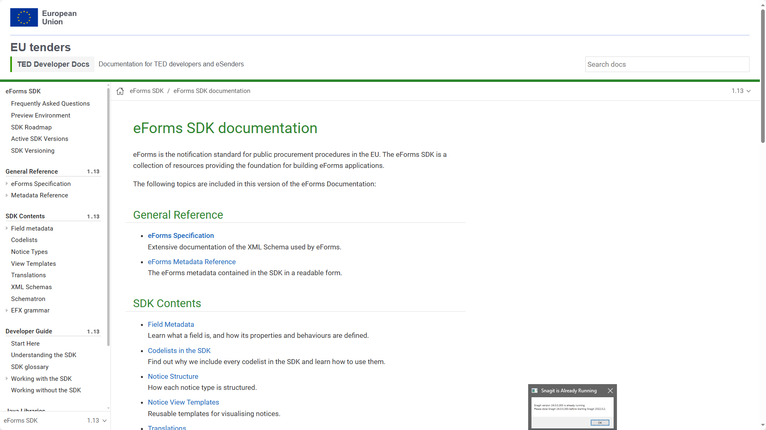
Business Entities Docs?
We need to wait for ePO alignment
Business Entities link eForms with the eProcurement Ontology
Standardise terminology
  Field names
  Search fields (Search API)
Establish links between Entities
  Identifiers
This work will have an impact on EFX 2

Slide 9
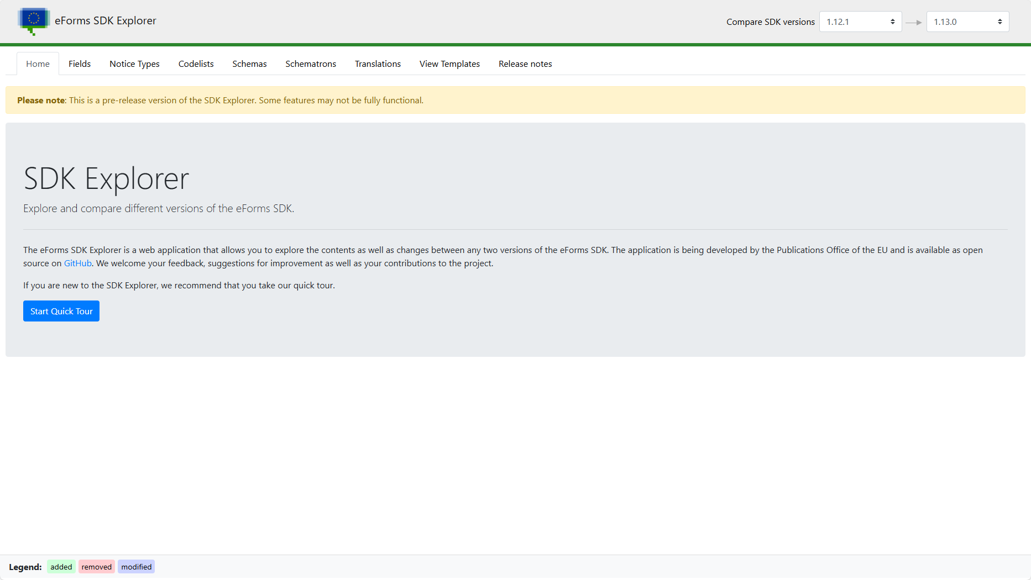
Migration Guide?
SDK Explorer – compares any two versions of the SDK
Comprehensive comparison – friendlier than Git diffs
Migration guide, change summary?
  Same information different format
  Can you contribute?
    Implementation
    Design ideas

Slide 10
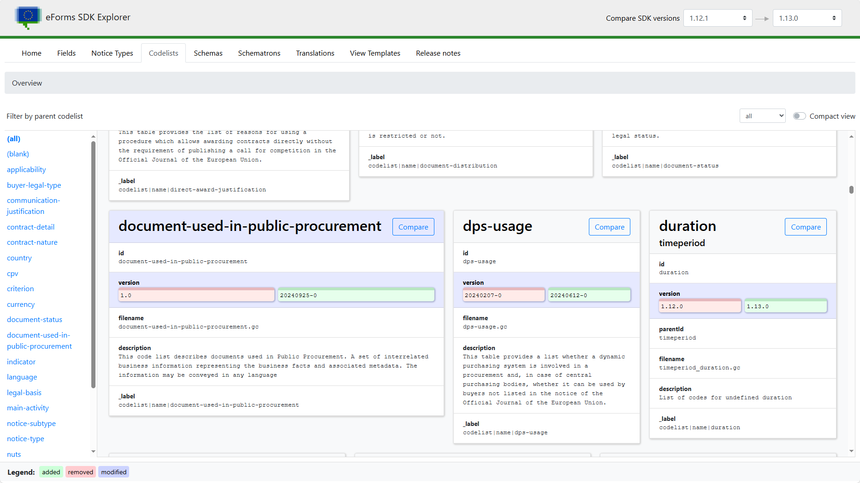
By the way…
Unchanged content
Changed content
Changed Metadata
Metadata

Slide 11
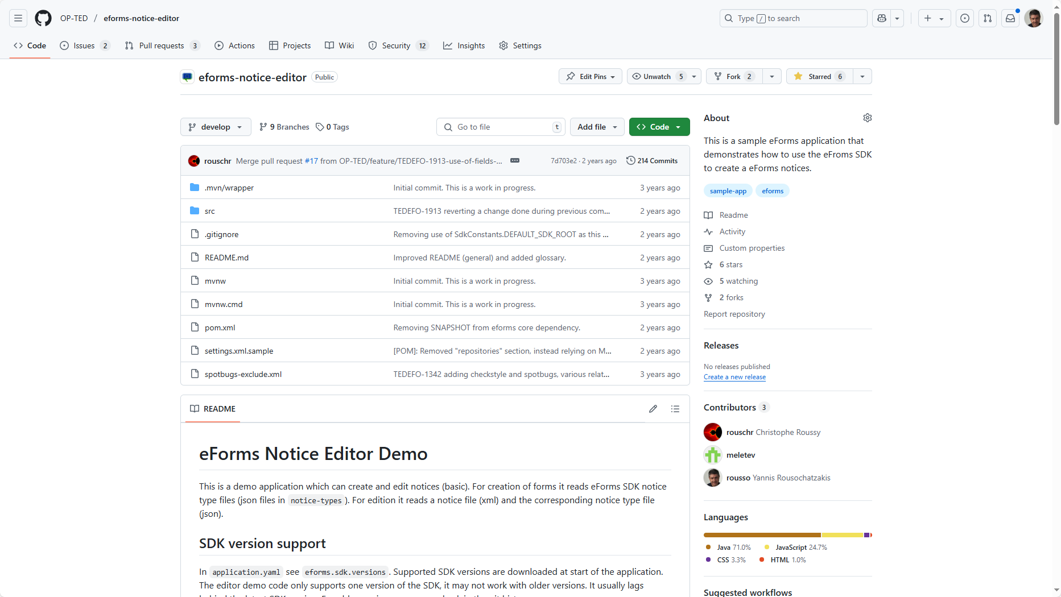
Reference implementation?
eForms Notice Editor - sample application
  Java backend, JavaScript frontend
Considering resources & timing for completion
Can you contribute?
Developer Guide
Currently the main source of information for implementers
We are interested in your feedback and contribution

Slide 12
Why EFX? Any better alternatives for view templates?
EFX
Domain-specific ✔️
Platform-independent ✔️
We have full control over it ✔️
Downside
We need to make our own compilers 🤨
Alternatives
General-purpose – No eForms semantics ❌
(no fields.json)
Platform-specific ❌
  Freemarker, Thymeleaf (Java)
  Handlebars/Mustache (JavaScript/Node, …)
XSLT
  Widely available ✔️
  Too complicated if done right ❌
  (XSLT using fields.json)
  Hard to maintain without fields.json ❌
  (manually updating XPaths)

Slide 13
Tailoring

Slide 14
Tailoring
We need to:
  Clarify the actual needs
  Identify what can be done without introducing a new major version of the SDK.
  Identify the improvements that must go to a major version and plan for it.
Issues to address:
  How to override existing entries (in fields.json, notice-types, codelists, view-templates etc.)
  Inserting additional entries (fields etc.)
  Suppressing/removing unwanted entries (fields etc.)
Is SDK 2 an opportunity?
We need to start a discussion

Slide 15
Tailoring
eForms SDK
Tailoring Filter
Tailored SDK
We need to start a discussion
Meet regularly
Goal is to arrive to a specification that can be implemented in the SDK to facilitate tailoring.
General idea
The eSender maintains a Tailoring Filter that takes as input a version of the SDK and transforms it to a tailored version.

Slide 16
Possible Timeline
2025
2026
2027
Release SDK-2
(focus on EFX)
Phase out SDK-1
Release SDK-3
(focus on tailoring)

Slide 17
contributing

Slide 18
Topics where we can work together
EFX-2 – Testing and feedback
Tailoring – Technical working group – Specification – Planning
SDK Explorer – Adding a migration guide feature
eForms Core Library – Code improvements
EFX Toolkit – Porting to other platforms

Slide 19


Working together
ⓘ Start presenting to display the poll results on this slide.

Slide 20

Thank you
© European Union 2025
Unless otherwise noted the reuse of this presentation is authorised under the CC BY 4.0 license. For any use or reproduction of elements that are not owned by the EU, permission may need to be sought directly from the respective right holders

