Slide 1
eFORMS business issues
eSender workshop – 26 June 2025
Karl Ferrand – Publications Office of the European Union

Slide 2
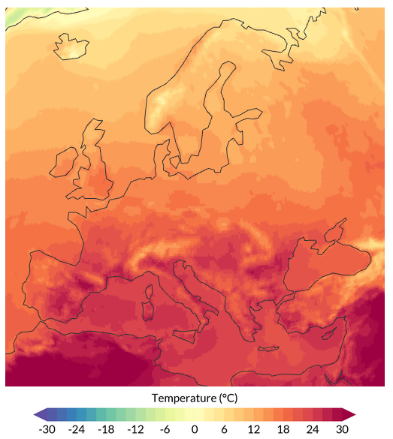
eForms business issues – hot spring?
SDK versions and upgrades
SDK 1.13.2 patch
SDK 1.14 scope
3rd eForms amendment and beyond
eSender housekeeping
What’s next
Surface air temperature ● 24 Jun 2025
Daily average ● Data ERA5
Credit: C3S/ECMWF

Slide 3
SDK versions and upgrades
Newest
SDK 1.14
1.7, 1.8, 1.9 ended April/May
3 requests to extend 1.10 and 1.11 - to be decided by EC in July
Biggest challenges:
  analysing and understanding SDK changes, especially rules
  lacking support for functional/business users
Other challenges:
  new types of metadata
  time to implement/test/validate/integrate
  changing notices in a previous SDK version
  lawfulness warnings
  selection criteria
  tailoring into UI
  need more examples
target: RC1 by late September
SDK 1.13
until March 2027 (at least): 27 eSenders
SDK 1.12
until June 2026: 18 eSenders
SDK 1.11
ending 31 July 2025: 1 eSender
SDK 1.10
ending 31 July 2025: 6 eSenders
Oldest

Slide 4

SDK 1.13.2 patch
Image by Mohamed Hassan from Pixabay
Because some things cannot wait for SDK 1.14… aim to release by end of July
International Procurement Instrument (IPI) measure adopted last week for Chinese medical devices – see guide at https://code.europa.eu/eproc/eforms/docs/-/blob/main/guides/gde_002_ipi.md
  add “true” to ipi-scope codelist for BT-684
  remove “empty” and add “32025R1197” to ipi-measure codelist for BT-685
  add rule that the IPI measure can only be used for lots that use a limited range of CPV codes
Correct view-templates to display BT-806 Exclusion Grounds Source and BT-821 Selection Criteria Source
SAFE (Security Action for Europe) and EDIP (European Defence Industry Programme) regulations:
  remove “voluntary” from label of subtype E6 (recommended contract modification for defence directive 2009/81)
  add 2009/81 as allowed legal basis for notice subtype 38 (alternative short-term option for contract modification)

Slide 5
A bigger SDK 1.13.2 patch?
Until SDK 1.12: BT-720 (Tender value) was mandatory for subtypes 38 and 39 (= eForms annex)
Intended for SDK 1.13: add condition so that BT-720 only mandatory if not a framework agreement
But: these manual Schematron rules (in stage 4m) were accidentally omitted - so BT-720 now always optional
We have 3 options:
  Patch now with SDK 1.13.2
  Fix in SDK 1.14 and backport to 1.13.3 after September
  Only fix in SDK 1.14 and do nothing for SDK 1.13
So far: 2% of contract modifications with SDK 1.13 already have empty tender value (mostly from eNotices2…)
Is it ok to break our general principle that SDK patches don’t tighten rules?

Slide 6
SDK 1.14 scope
In SDK 1.14 scope, following decisions from Member States/EXEP in eForms workshop on 25 June 2025:
Enforce consistent NUTS code and country (Issue 132)
Improve tendering statistics (Issue 127) (see Guide)
Make BT-113 (Framework Maximum Participants Number) optional (Issue 124)
Remove BT-634 (Procurement Relaunch) from competition notices (Issue 94)
Remove “Group of public authorities" from codelist "Buyer Legal Type" (BT-11) (Issue 3)
Limit amounts to 2 decimals (Issue 130)
Not in SDK 1.14 -> to be revisited/reviewed for later SDK/3rd amendment
Enforce positive monetary amounts (Issue 130) -> decide which BTs it would apply to
Make eSender role mandatory (Issue 131) -> combine with broader discussion on roles

Slide 7
More SDK 1.14 scope
Housekeeping and incremental improvements:
Check that certain numbers are integers
Limit certain numbers to 4 digits (<10000)
Make BT-33 (Lots max allowed) optional for all subtypes
Rule to indicate lead buyer
Adjust whitespace checks for leading and trailing spaces
Add CVD fields to subtypes T01 and T02
Add procurement documens to subtype T01
Enforce winner chosen in BT-142 for subtype T02
Remove old EU financial regulation
Maintenance of view-templates, notice type definitions, codelists, translations
etc…
Publish a draft SDK 1.14 release note on GitHub by end of July

Slide 8
3rd eForms amendment – candidates for spring cleaning
Move fields from lot to procedure - issue 122
Allow NUTS2 for place of performance - issue 83
Include forms T01 and T02 (passenger transport regulation 1370/2007) - issue 126
Use COFOG codelist for activity and merge BT-10 & BT-610 - issue 4
Remove or review Group of lots - issue 133
Unlimited contracts and framework contracts – issue 134
Clarify and review roles of organisations – issue 90
Improve descriptions – issue 128
Revise EED fields – issue 123
etc…
Rework “unpublished” (non-public) fields
Revisit versioning of notices
Clarify and control direct awards
Remove touchpoints (TPO) and parts (PAR)
Clarify and improve framework agreements (FA) and dynamic purchasing systems (DPS)
Better registration numbers for organisations
Move BT-634 (Relaunch Procurement) to LotResult and remove from procedure level
Remove pointless BTs and put OPP/OPT fields in eForms annex
Implement amendment to defence directive 2009/81, e.g. add DPS (depends on Defence Readiness omnibus)
The target has moved: amendment adoption in March 2026 -> implementation in SDK 2.1

Slide 9
Proposal for new EU public procurement framework
Strengthening the strategic role of public procurement through qualitative requirements, and European preference criteria for strategic sectors
The EU added value of procurement for our citizens, through the security of supply for strategic technologies, products and services.
The simplification of mechanisms, having in mind especially startups, innovators and local and regional authorities.
The consolidation and clarification of the interaction between public procurement provisions across different pieces of legislation.

Slide 10
eSender housekeeping
1 July: notices in Preview that are in workflow error or lawfulness will be moved to status Not Published
29 July: OJS sync time will move to 4:00 CEST (instead of 8:30)
Lawfulness warnings: rules changed in SDK 1.13
  Reminder: these are warnings for manual checks and don’t block submissions
  See more background at https://github.com/OP-TED/eForms-SDK/discussions/1166

Slide 11
What’s up next
TED usability study now at https://ec.europa.eu/eusurvey/runner/TED-Usability-Survey-2025
  Just 3 to 5 minutes to complete survey – but include your email as we need eSender volunteers for:
    live 1-to-1 activities such as website testing and card sorting (this and next week)
    focus groups (planned for after the summer)
eForms workshop on 24 July and also in August - work on 3rd amendment issues
eSender workshop on 25 September
TED-together on 26-27 November in Luxembourg
  Call for speakers (your presentations are rated higher than OP/EC ones…)

Slide 12

THANK YOU FOR YOUR ATTENTION
Links​
​https://docs.ted.europa.eu​ - Developer guide, APIs, Preview, FAQ, every SDK version…​
​https://github.com/OP-TED/​ - Components and code for developers, SDK, discussions…​
​https://op.europa.eu/en/web/ted-eforms - OP eSender workshops
Any questions?​
Business TED helpdesk: https://ted.europa.eu/en/contact
Technical: https://github.com/OP-TED/eForms-SDK/discussions/ ​
© European Union 2025​
Unless otherwise noted the reuse of this presentation is authorised under the CC BY 4.0 license. For any use or reproduction of elements that are not owned by the EU, permission may need to be sought directly from the respective right holders

