Slide 1
EFORMS SDK
eSender workshop – 26 June 2025​
Ioannis Rousochatzakis – Publications Office of the European Union

Slide 2
SDK-2

Slide 3
SDK-2 is EFX-2
We want to keep SDK-2 fully compatible with SDK-1
Except EFX…
  Rules in fields.json will be in EFX-2
  View Templates will be in EFX-2
Other changes that SDK 2 include:
  Full set of Business Entities
  Field aliases
  (Maintaining existing field names but also adding friendlier names standardised by the eProcurement Ontology)
  Possibly additional file formats

Slide 4
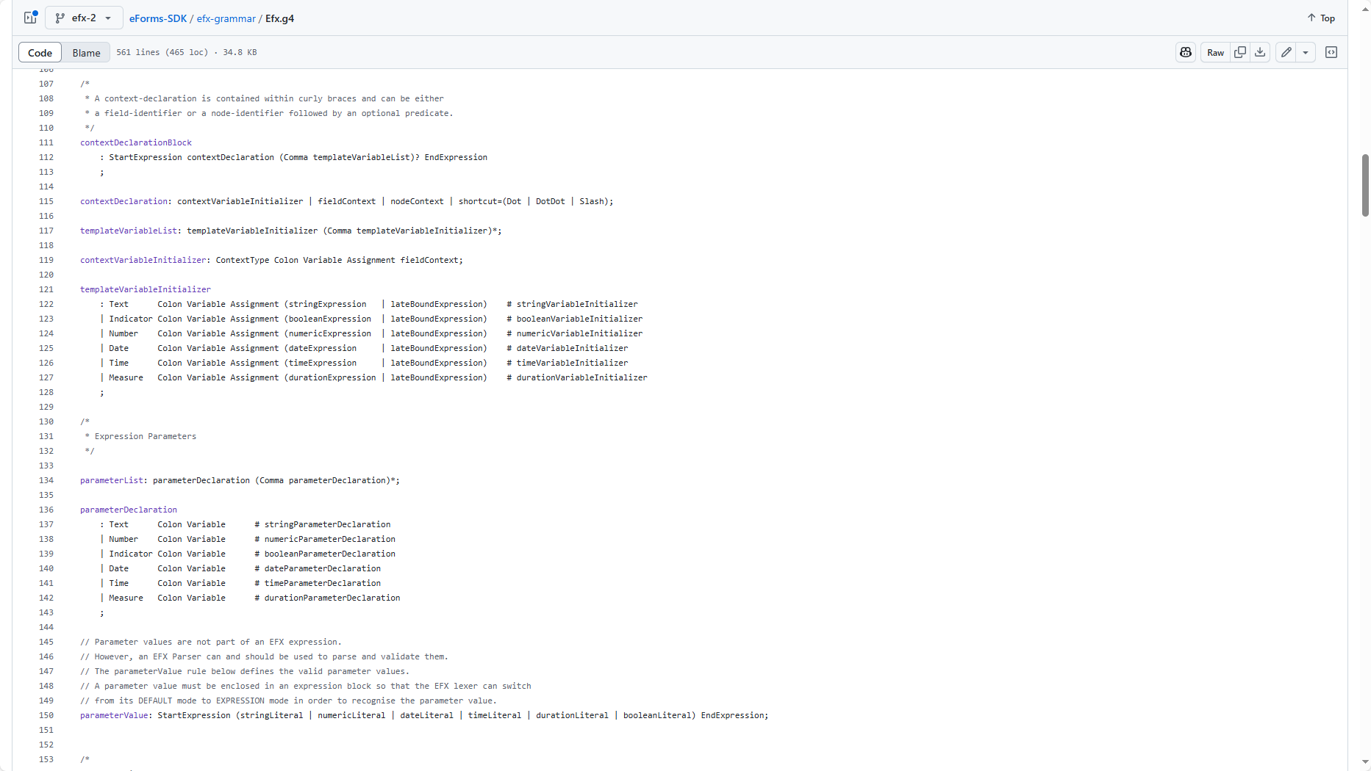
EFX-2 Features
More expressive, easier to read, easier to write
Improved type-safety
Data type improvements (Measures and DateTime)
Unpublished fields
Syntax simplifications
Global & local variable scoping
Reusable templates & functions
New EFX Rules syntax
Expanded set of available functions
Preprocessor
Better performance of the compiled output
Data retrieval through API calls for Dynamic Rules
(and better documentation)

Slide 5
EFX-2 Today
Work on EFX Template grammar close to completion.
Starting next month:
  Work on EFX Rule grammar
  Work on dynamic rules
  EFX Expression grammar improvements
  Recreating the View Templates in EFX-2
We are about a month behind in schedule
SDK 2.0.0-alpha.2 in July
We aim to release in Fall 2025

Slide 6
Pending work
Special sub-sections in EFX Templates
  Summary, Navigation, Main sections
Automatic/easy rendering of unpublished data
EFX-1 to EFX-2 translator
ID to Alias two-way translator
New EFX Rules syntax
Dynamic Rule APIs
Finalise Aliases

Slide 7
visualisations

Slide 8
EFX-2 Performance
EFX-2 is still work in progress, but,
  Will perform much better
We do not have metrics yet, but,
  We will measure/tune/verify performance improvements before releasing SDK-2
EFX-2 features that improve XSLT performance:
  Introduction of global and local variables = avoid repeated evaluation of XPath expressions
  Introduction of dictionaries (xsl:key equivalent) = fast lookups
  Introduction of callable templates and functions = smaller, faster XSLT
In parallel: Ongoing analysis and improvement of TED Viewer performance

Slide 9
Sdk 2 - Backward compatibility

Slide 10
Backwards compatibility vs progress
We want all eSenders to adopt SDK-2 asap
Nevertheless, we also want to:
  Simplify
  Harmonise
  Progress
Therefore
We will maintain backward compatibility with SDK-1
  We will not change fields.json or other file formats.
  We will not remove obsolete metadata.
  (at least not without confirming it with eSenders first)
  We will not enforce use of “Business Entities”, etc…
But we are evaluating some additions that we consider important

Slide 11
Unanswered questions
Several decisions yet to be made:
  Are we going to also include additional formats?
  How?
  Should we wait for SDK-3 to design for tailoring?
Any decision will be made in consultation with eSenders
Consultation through GitHub

Slide 12
Feature/improvement requests?
Now is the time!
Please send through GitHub Discussions

Slide 13



Please download and install the Slido app on all computers you use
Backward compatibility
ⓘ Start presenting to display the poll results on this slide.

Slide 14
Evolutions

Slide 15
Evolutions
SDK-2 is about:
  Improving EFX
  Preparing for SDK-3
Improving EFX
Improve “domain specificity”
More expressive, powerful syntax
Express all rules fully in EFX
Allow for dynamic rules
Preparing for SDK-3
Test our adaptability to major changes
Introduce new features without breaking compatibility
Extend the time to prepare for SDK-3

Slide 16
Evolutions
SDK-3 will be about
  simplification,
  harmonisation,
  modernisation
Simplification means “remove unnecessary constructs and concepts”, like:
  break apart fields.json
  remove obsolete relationships
Harmonisation means “solve similar problems in similar ways”, like:
  Unify file formats
  Enable smother upgrades/migrations
  Tailoring
Modernisation means “enable modern applications”, like:
  Make the SDK LLM friendly

Slide 17
Please download and install the Slido app on all computers you use
SDK Evolution
ⓘ Start presenting to display the poll results on this slide.

Slide 18

sdk-2 GitHub discussions
Please use the GitHub discussions to suggest improvements and provide feedback
© European Union 2025
Unless otherwise noted the reuse of this presentation is authorised under the CC BY 4.0 license. For any use or reproduction of elements that are not owned by the EU, permission may need to be sought directly from the respective right holders

Slide 19
Questions?
© European Union 2025
Unless otherwise noted the reuse of this presentation is authorised under the CC BY 4.0 license. For any use or reproduction of elements that are not owned by the EU, permission may need to be sought directly from the respective right holders

Slide 20
Please download and install the Slido app on all computers you use
EFX usage
ⓘ Start presenting to display the poll results on this slide.

