Slide 1
eFORMS business issues
eSender workshop – 25 September 2025
Karl Ferrand – Publications Office of the European Union

Slide 2

eForms business issues – season of mist and mellow fruitfulness
SDK version overview
SDK 1.14 scope and status
SDK 1.15 and SDK 2.0
SDK 2.1 and 3rd eForms amendment
What’s next
Image by Monfocus from Pixabay

Slide 3
SDK versions and upgrades
Newest
SDK 1.15 + SDK 2.0
SDK 1.12 is legal but is missing:
  International Procurement Instrument (IPI)
  Energy Efficiency Directive (EED)
  Voluntary forms E1-E6
  Recommend upgrade to SDK 1.13 or 1.14
SDK 1.13, SDK 1.14, SDK 1.15/2.0 lifespans
  Will allow time to upgrade to SDK 2.1
  Recommend upgrade to SDK 2.0 (=1.15) in 2026
  Also good to keep up with SDK 1.14
SDK 2.1 is next legally binding release
  - Implements 3rd eForms amendment
  Available end of 2026 at best, upgrades in 2027
  Note: SDK 1.13.2 patch released on 30 July
Target: spring 2026
SDK 1.14
RC1 in October 2025
SDK 1.13
until March 2027 (at least!): 38 eSenders
SDK 1.12
until June 2026: 17 eSenders
SDK 1.11 and SDK 1.10
ended 31 August 2025 (1 bonus month)
Oldest

Slide 4
SDK 1.14 scope – maintenance release, no schema changes
Enforce consistent NUTS code and country
Improve tendering statistics (see Guide)
Make BT-113 (Framework Maximum Participants Number) and BT-33 (Lots max allowed) optional
Remove BT-634 (Procurement Relaunch) from competition notices
Remove “Group of public authorities" from codelist "Buyer Legal Type" (BT-11)
Number controls: limit amounts to 2 decimals, check integers are integers, limit range to 0-10000
Make BT-720 (Tender value) mandatory (again) for subtypes 38 and 39 + backport to 1.13.3
IPI like in 1.13.2 plus control CPV code is medical devices
Rules for lead buyer and tenderer group leader
Improve controls for deadlines and dispatch dates
Update context for some rules
Change document-used codelist for ESPD Request
Correct references to BT-142 for DAP and Contract Modification
Add Natural Person Indicator to Contract Modifications
Adjust whitespace checks for leading and trailing spaces
T01/T02: add CVD fields and procurement documents, enfoce BT-142 (Winner chosen)
Remove old EU financial regulation
Add Bosnia and Georgia as lawful-countries
Maintenance of view-templates, notice type definitions, codelists, translations (including FR/BE MS feedback)
Release candidate not ready by late September, now aiming for late October

Slide 5

SDK 1.15 (new!) and SDK 2.0
Work still needed for 3rd eForms amendment and for SDK 2.0 so…
New SDK 1.15 planned for spring 2026
Tentative scope: changes that don’t require eForms amendment, for example:
  Rules for direct awards per notice subtype (legal basis)
  Reworked/improved/simpler approach for non-public (unpublished) fields
  Other maintenance and incremental changes
SDK 2.0 RC planned for Q1 2026
  Same scope: only EFX2 for rules and view-templates
  Align business rules with SDK 1.15 (instead of 1.14 as previously announced)
  Don’t use EFX? Then upgrade to 2.0 = upgrade to 1.15 (except for some dynamic rules)
Image by Sandra Kapella from Pixabay

Slide 6
3rd eForms amendment – (same) candidates for midlife cleaning
Move fields from lot to procedure - issue 122
Allow NUTS2 for place of performance - issue 83
Include forms T01 and T02 (passenger transport regulation 1370/2007) - issue 126
Use COFOG codelist for activity and merge BT-10 & BT-610 - issue 4
Remove or review Group of lots - issue 133
Unlimited contracts and framework contracts – issue 134
Clarify and review roles of organisations – issue 90
Improve descriptions – issue 128
Revise EED fields – issue 123
etc…
Rework “unpublished” (non-public) fields -> 1.15?
Revisit versioning of notices
Clarify and control direct awards -> 1.15?
Remove touchpoints (TPO) and parts (PAR)
Clarify and improve framework agreements (FA) and dynamic purchasing systems (DPS)
Better registration numbers for organisations
Move BT-634 (Relaunch Procurement) to LotResult and remove from procedure level
Remove pointless BTs and put OPP/OPT fields in eForms annex
Implement amendment to defence directive 2009/81, e.g. add DPS (depends on Defence Readiness omnibus)
The target has moved again: amendment adoption possibly in second half of 2026 -> implementation in SDK 2.1

Slide 7
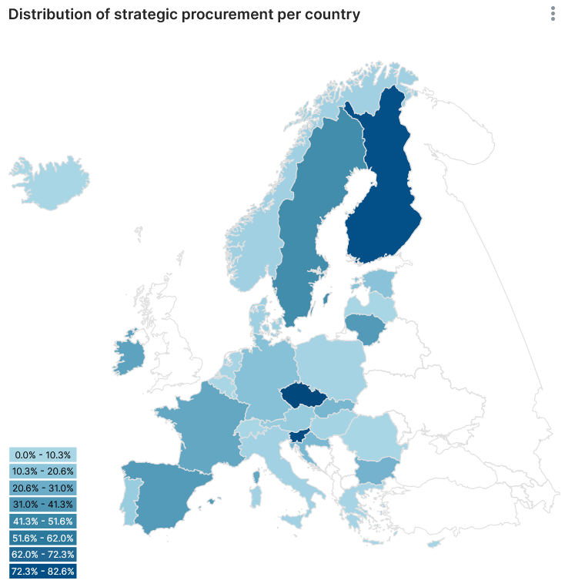
What’s up next
TED-together on 27-28 November in Luxembourg (and online)
  Registration open: https://op.europa.eu/en/web/ted-together
  Volunteers to present eSender experience?
Revision of the EU procurement directives
  European Commission working on evaluation report for Q3 2025
  Impact assessment and legislative proposal in 2026
Connect to PPDS and benchmark your data (quality)
  Example: https://api.public-procurement-data-space.europa.eu/superset/dashboard/strategicprocurement/

Slide 8

THANK YOU FOR YOUR ATTENTION
Links​
​https://docs.ted.europa.eu​ - Developer guide, APIs, Preview, FAQ, every SDK version…​
​https://github.com/OP-TED/​ - Components and code for developers, SDK, discussions…​
​https://op.europa.eu/en/web/ted-eforms - OP eSender workshops
Any questions?​
Business TED helpdesk: https://ted.europa.eu/en/contact
Technical: https://github.com/OP-TED/eForms-SDK/discussions/ ​
© European Union 2025​
Unless otherwise noted the reuse of this presentation is authorised under the CC BY 4.0 license. For any use or reproduction of elements that are not owned by the EU, permission may need to be sought directly from the respective right holders

