Slide 1
Retrieving notices from
TED portal
Workshop on eForms for reusers of TED data
14 December 2023
Carmelo Greco – TED and EU public procurement
Publications Office of the EU

Slide 2
Agenda
Download xml notices in bulk from the TED portal.
Download the release calendar.
Download notices in any format using direct links.
Search API.
Fair usage policy.
Demo.

Slide 3
Download xml notices in bulk. (1/6)
The user can download xml notices in bulk from the TED portal.
    daily package: file containing all the notices in xml format for each day.
    monthly packages: file containing all the notices in xml format for each month.
The FTP server is not available in the new TED portal.
The daily and monthly packages can be downloaded using HTTPS.
  The user can download the packages using the user interface or using a direct link.
  No need to sign in to download the daily or monthly packages.

Slide 4
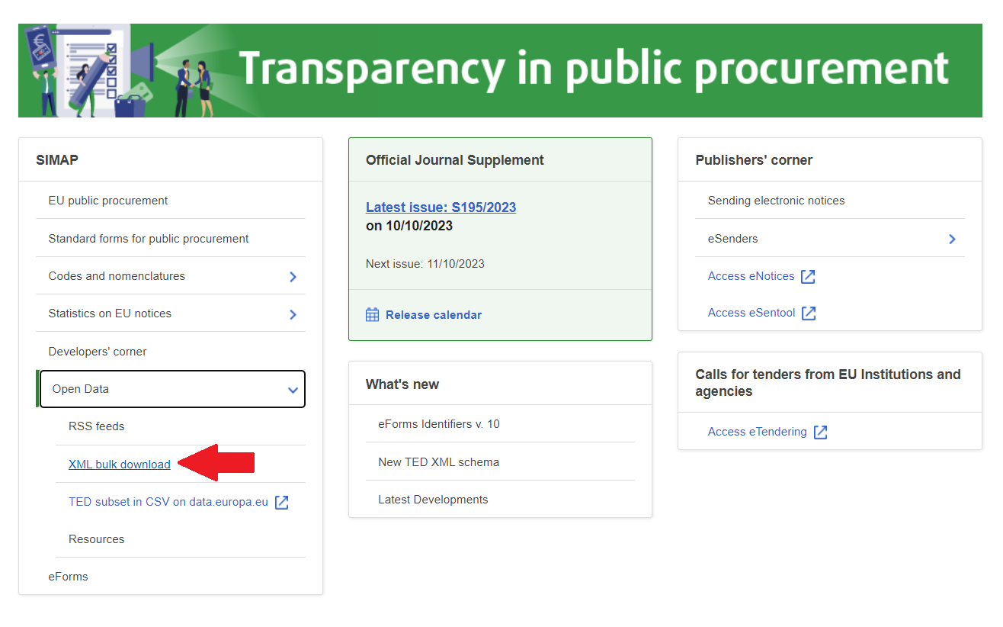
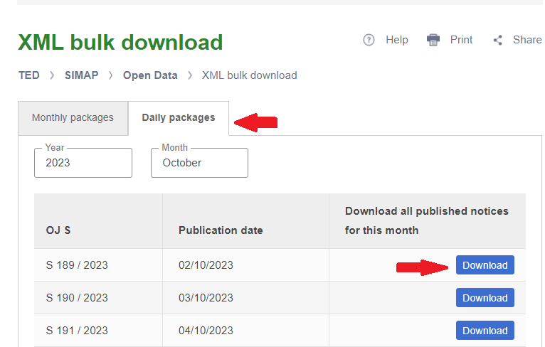
Download XML notices in bulk. (2/6)
Download package via user interface
  From the Home page:
    expand ‘Open Data’ from the menu SIMAP
    click ‘XML bulk download’ to access the ‘XML bulk download’ page
  From ‘XML bulk download’ page:
    select the tab ‘Daily packages’ or ‘Monthly packages’
    select the year and the month
    navigate to the page to select the package
    click Download button to download the package

Slide 5
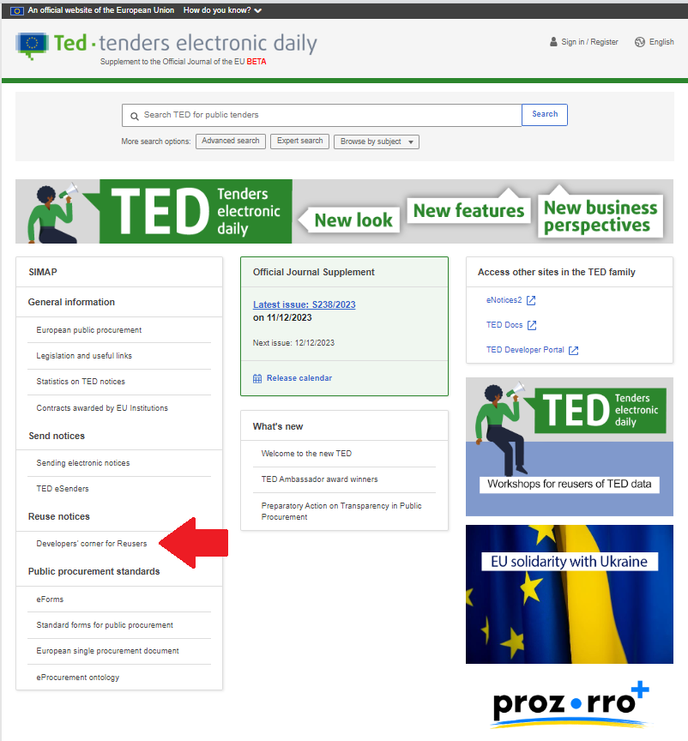
Download XML notices in bulk. (3/6)
Download package via user interface
  Note:
  When the new TED portal will go-live, the link of the page XML bulk download will be in the page Developers’ corner

Slide 6
Download XML notices in bulk. (4/6)
Download packages using a direct link
  URL format for daily packages:
    https://{ted-url}/packages/notice/daily/{yyyynnnnn}
    where {yyyynnnnn} is the OJ S number
    Example - Download the daily package of the OJ S 1 / 2023
      https://gamma.tedv2.spikeseed.cloud/packages/daily/202300001
  URL format for monthly packages:
    https://{ted-url}/packages/notice/monthly/{yyyy-n}
    where {yyyy-n} is the year and the month
    Example - Download the monthly package of January 2023
      https://gamma.tedv2.spikeseed.cloud/packages/monthly/2023-1

Slide 7
Download XML notices in bulk. (5/6)
  File format of a daily package:
    {yyyymmdd}_{yyyynnn}.tar.gz
      Where {yyyymmdd} is the OJ S publication date and {yyyynnn} is the OJ S number
      Example: daily package of the OJ S 1 / 2023
        20230102_2023001.tar.gz
  File format of a monthly packages:
    {yyyy}_{mm}.tar.gz
      Where {yyyy} is the year and {mm} is the month
      Example: monthly package of January 2023
        2023_01.tar.gz

Slide 8
Download XML notices in bulk. (6/6)
The XML packages contain XML files numbered in two ways:
  for eForms notices the XML files have 8 digits followed by the year (e.g. 00654321_2022.xml)
  for TED schema notices the XML files have 6 digits followed by the year (e.g. 123456_2022.xml)

Slide 9
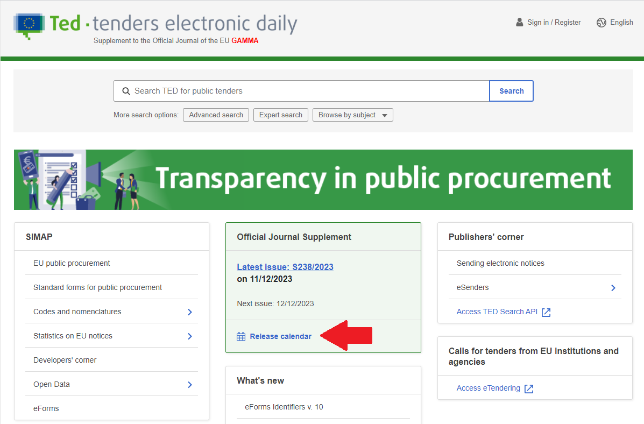
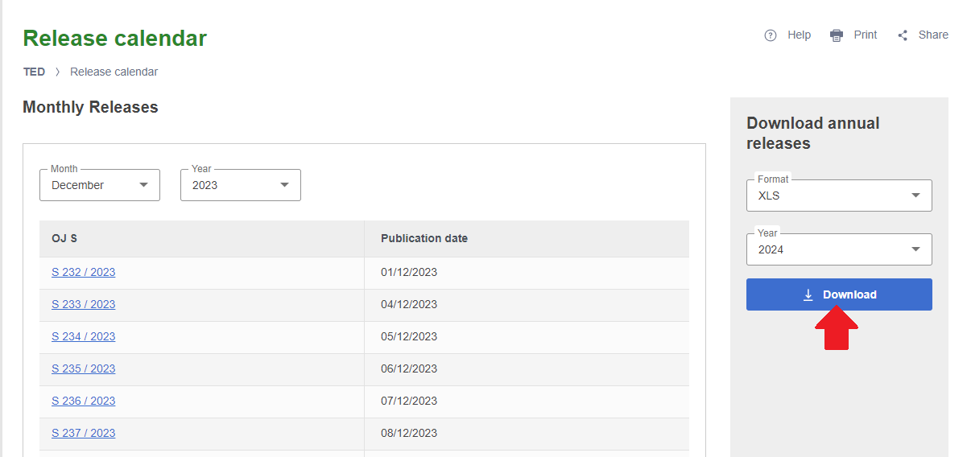
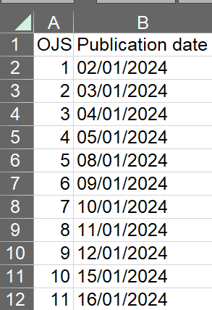
Download the release calendar. (1/2)
The user can download the list of annual releases from the TED portal.
Download the release calendar via user interface
  From the Home page, click ‘Release calendar’ from the menu ‘Official Journal Supplement’
  From ‘Release calendar’ page, select the option ‘Download annual release’ to download the ‘Release calendar’ of a specific year in a specific format.
  Click Download button to download the file.

Slide 10
Download the release calendar. (2/2)
Download the release calendar using a direct link
  Format: https://{ted-url}/{lang}/release-calendar/-/download/file/{format}/{year}
    where:
      {lang} is the language
      {format} can be : XLS, PDF, CSV
      {year} is the year
  Example: https://gamma.tedv2.spikeseed.cloud/en/release-calendar/-/download/file/XLS/2024

Slide 11
Download notices in any format using direct links (1/4)
A user can download a notice using direct link in the formats listed below and in any EU official languages:
      HTML
      HTML download
      Signed PDF
      Non-signed PDF
      XML
  The format HTML download is a new feature compared to the current TED website.
    Thanks to this , there is no need for an API on the TED portal to render a notice.
    There will be only one API that can be used to render the eForms notices in PDF or HTML
      Swagger UI link : https://viewer.ted.europa.eu/swagger-ui/index.html
      For more information read on https://docs.ted.europa.eu/api/index.html

Slide 12
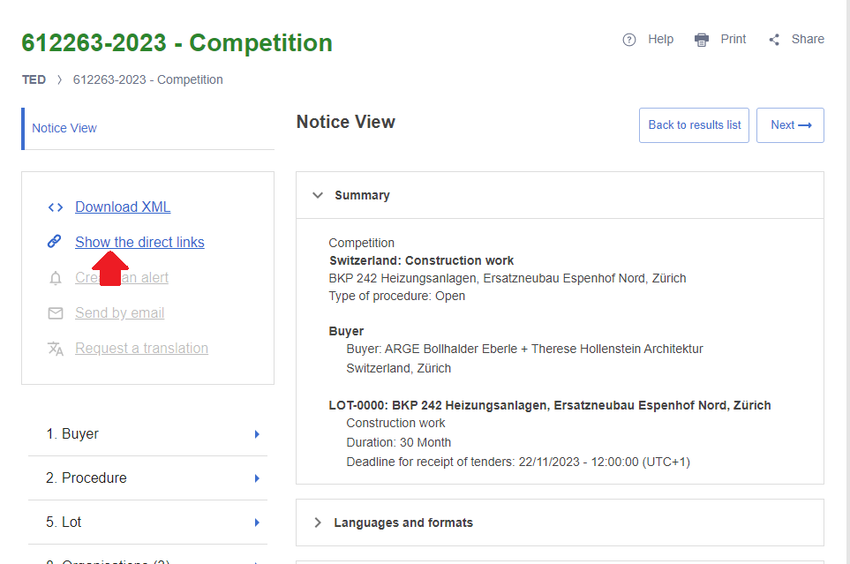
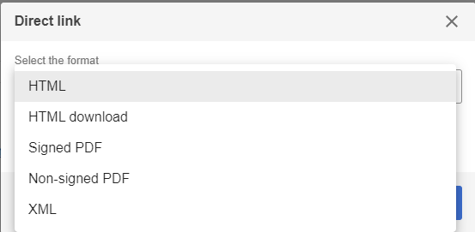
Download notices in any format using direct links (2/4)
A user can download a notice in xml, HTML or PDF format and in any EU official languages using direct link
  From any notice view page:
    click ‘Show the direct link’
    A pop-up window lists the available formats of the direct links:
      HTML
      HTML download
      Signed PDF
      Non-signed PDF
      XML

Slide 13
Download notices in any format using direct links (3/4)
Format of the URLs of the direct link:
  https://{ted-url}/{lang}/notice/{publication-number}/{format}
  where:
    {lang} is the language
    {publication-number} is the publication number
    {format} can be :
      html: to display the HTML download file
      pdf: to download the notice as PDF
      pdfs: to download the notice as signed PDF
      xml: to download the notice as XML.
Direct link of the notice view page: https://{ted-url}/{lang}/notice/-/detail/{publication-number}
Backward compatibility with the current TED:
  Example :
    https://gamma.tedv2.spikeseed.cloud/udl?uri=TED:NOTICE:735065-2022:TEXT:EN:HTML
    https://gamma.tedv2.spikeseed.cloud/en/notice/-/detail/735065-2022

Slide 14
Download notices in any format using direct links (4/4)
Example of direct link - Notice 564613-2023
HTML:
  EN: https://gamma.tedv2.spikeseed.cloud/en/notice/-/detail/564613-2023
  FR: https://gamma.tedv2.spikeseed.cloud/fr/notice/-/detail/564613-2023
HTML download:
  EN: https://gamma.tedv2.spikeseed.cloud/en/notice/564613-2023/html
  FR: https://gamma.tedv2.spikeseed.cloud/fr/notice/564613-2023/html
Non-signed PDF
  EN: https://gamma.tedv2.spikeseed.cloud/en/notice/564613-2023/pdf
  FR: https://gamma.tedv2.spikeseed.cloud/fr/notice/564613-2023/pdf
Signed PDF
  https://gamma.tedv2.spikeseed.cloud/en/notice/564613-2023/pdfs

Slide 15
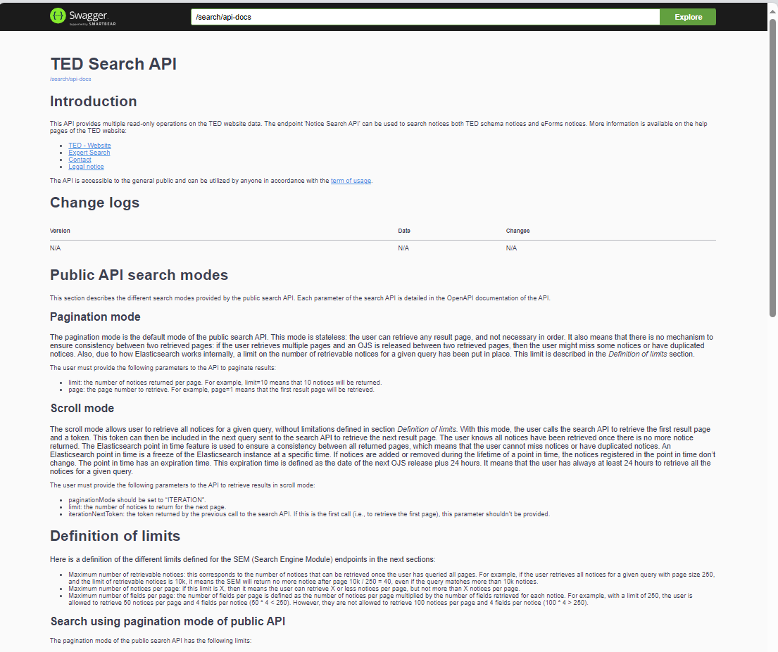
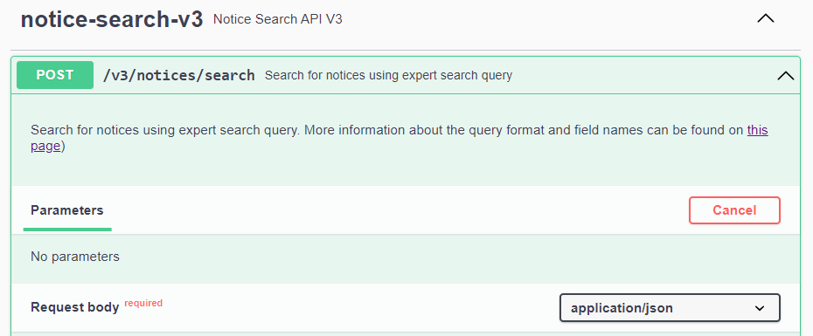
Search API (1/7)
Swagger UI - https://api.gamma.tedv2.spikeseed.cloud/swagger-ui/index.html
Request URL - https://api.gamma.tedv2.spikeseed.cloud/v3/notices/search

Slide 16
Search API (2/7)
The new search API is non-backward compatible
Two search modes:
  Pagination mode: allows to retrieve up to 15000 notices for a given query, using pagination.
  Iteration (scroll mode): allows to retrieve more notices
Response file:
    Contains the total number of notices that match the search, and a list of results.
    Each result contains the fields indicated in the request.
    Each item contains the list of URLs for the various formats and languages in which the corresponding notice is available.

Slide 17
Search API (3/7)
Search mode – Pagination
  Allows to retrieve up to 15000 notices for a given query, using pagination.
  Limits:
    Maximum number of retrievable notices: 15k.
    Maximum number of notices per page: 250.
    Maximum number of fields per page: 10k.
    In case a limit is reached, the search API will return an error to the user

Slide 18
Search API (4/7)
Search mode – Iteration (scroll mode)
  Allows to retrieve all notices for a given query, without limitations. With this mode, the user calls the search API to retrieve the first result page and a token. This token can then be included in the next query sent to the search API to retrieve the next result page.
  Limits:
    Maximum number of notices per page: 250.
    Maximum number of fields per page: 10k.
    In case a limit is reached, the search API will return an error to the user. There is no limit on the number of retrievable notices

Slide 19
Search API (5/7)
Request body of the notice search endpoint
  query: Expert search query to filter and sort notices
  fields: Fields to return for each notice
  page: Result page number, used to paginate results
  limit: Maximum number of returned notices, used to paginate results.
  scope: Search scope
  checkQuerySyntax: To check the syntax of the query.
  paginationMode: PAGE_NUMBER or ITERATION
  iterationNextToken: token returned by the previous call to the search endpoint to retrieve the next result page.

Slide 20
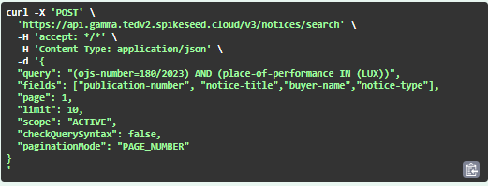
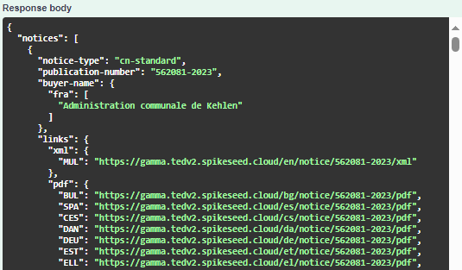
SEARCH API – Demo (6/7)
Search mode: pagination
Example - Find notices of the OJ S 18/2023 where the place of performance is Luxembourg; the result must contain the publication-number, the notice-title, the buyer-name and the form-type .
{
"query": "(ojs-number=180/2023) AND (place-of-performance IN (LUX))",
"fields": ["publication-number", "notice-title","buyer-name","notice-type"],
"page": 1,
"limit": 10,
"scope": "ACTIVE",
"checkQuerySyntax": false,
"paginationMode": "PAGE_NUMBER"
}

Slide 21
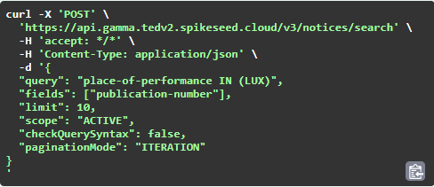
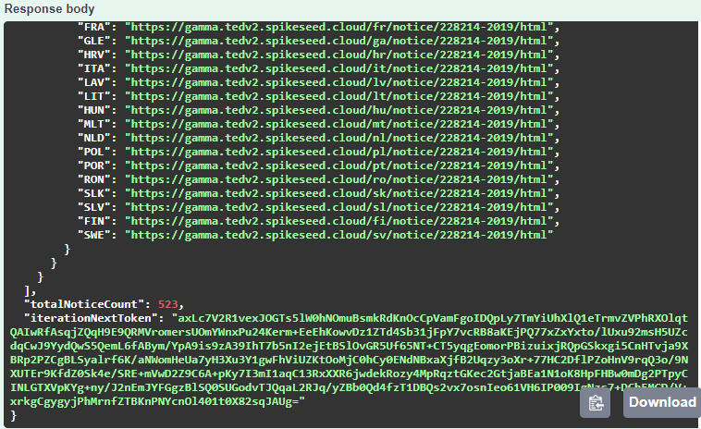
SEARCH API – Demo (7/7)
Search mode: iteration
Example - Find notices where the place of performance is Luxembourg; the result must contain the publication-number.
{
"query": "place-of-performance IN (LUX)",
"fields": ["publication-number"],
"limit": 10,
"scope": "ACTIVE",
"checkQuerySyntax": false,
"paginationMode": "ITERATION"
}

Slide 22
Fair usage policy (1/2)
To enable as many users as possible to access our services we defined HTTPS usage thresholds in the new TED portal.
As you can see in the table below, we have slightly increased the HTTPS usage thresholds in the new TED portal.
Operation | Current TED portal | New TED portal
Visualize or download notices from a single IP | 500 visualizations or downloads in less than 6 minutes | 600 visualizations or downloads in less than 6 minutes
HTTP Requests | 666 requests in the last minute | 700 requests in the last minute
Download daily or monthly Packages via FTP Service | 3 concurrent connections | Not applicable
Download daily or monthly Packages HTTPS Service | 3 concurrent downloads | 3 concurrent downloads

Slide 23
Fair usage policy (2/2)
In the current TED portal, data consumed by technical users* comes from 90% of the webpage (search result page, notice visualization) and 10% of the API (search and notice visualization)
* A technical user is a “bot” designed to automatically extract data from websites
The architecture of the new TED portal has been designed differently compared to the current TED portal:
  The Web pages are fully powered by a CMS enabling a better and tailored user experience. This CMS is efficient within a specific range of loads.
  A dedicated public API to search notices and direct link to download their contents is efficient and scalable.
On this basis, the Publications Office strongly recommends that technical users must use the public API to benefit from performance and scalability and to leave CMS resources available to "human users".

Slide 24

THANK YOU

